Slide 1
What’s Up with Engineering and Editing of Plants and Foods…
and Some Other Thoughts
Peggy G. Lemaux
University of California, Berkeley
http:/ucbiotech.org
http://pmb.berkeley.edu/lemaux
https://clear-project.org

Slide 2

What will be covered?
1. Background on genes, genomes, genetic engineering, genome editing
2. What GE crops are commercialized? In the pipeline?
3. What is the regulatory structure for GE crops?
4. What are some food safety issues with GE foods?
5. What are some environmental issues with GE crops?
6. Some food for thought…
Notes:
To be covered
overview of the development in biotechnology in agriculture including the latest technologies,
applications and implications to the future of food,
historical background
domestic policy, and if possible, global policy and its challenges.

Slide 3
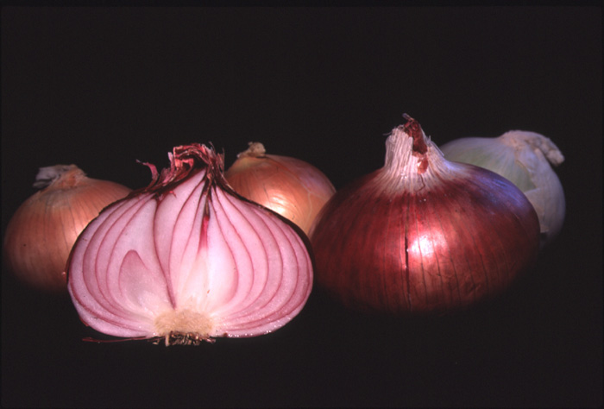
Tour d'Onion
Or, what makes an onion and onion?

Slide 4
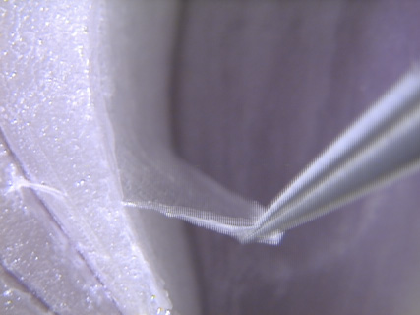

Slide 5
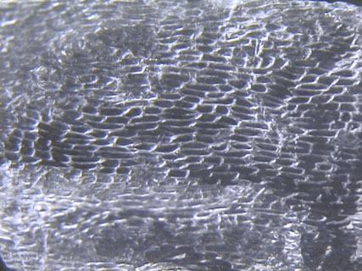
CELLS

Slide 6
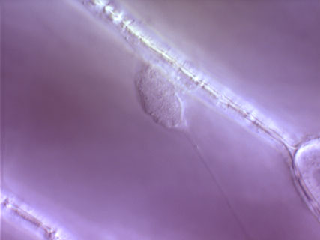
Cell Wall
Nucleus

Slide 7
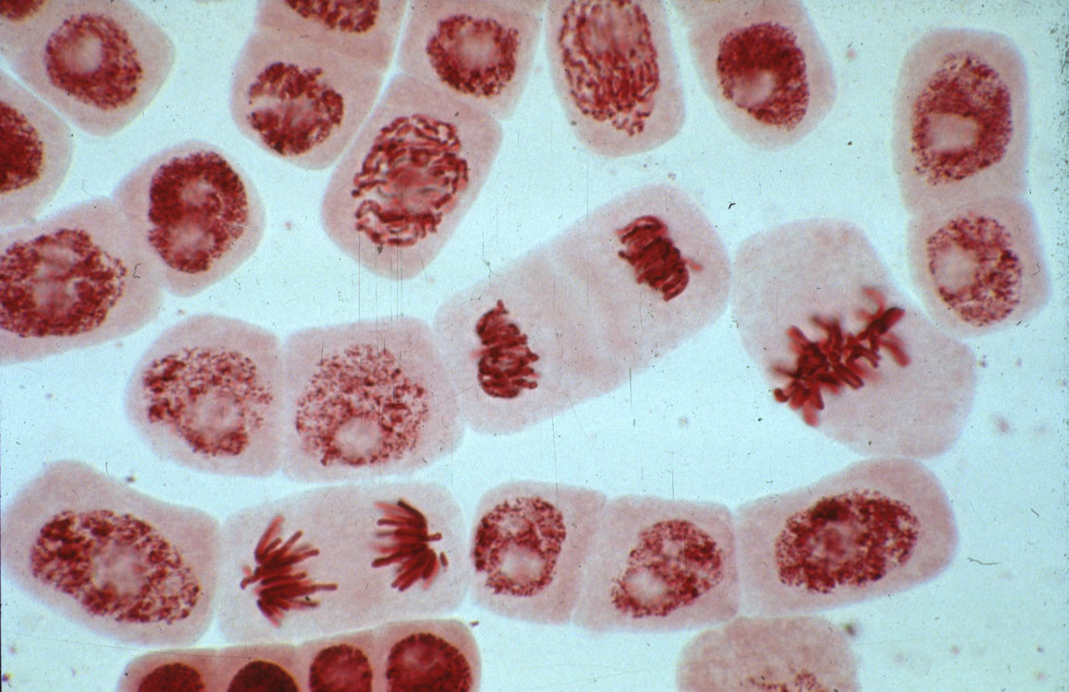
Dividing cell
Chromosomes

Slide 8
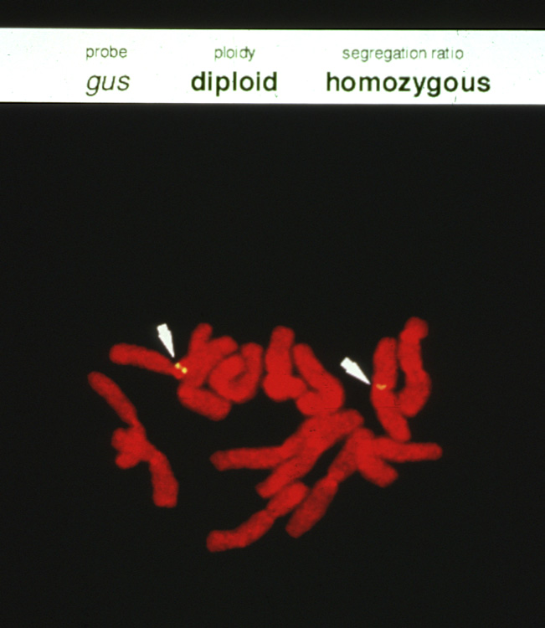
Chromosome
Genes

Slide 9
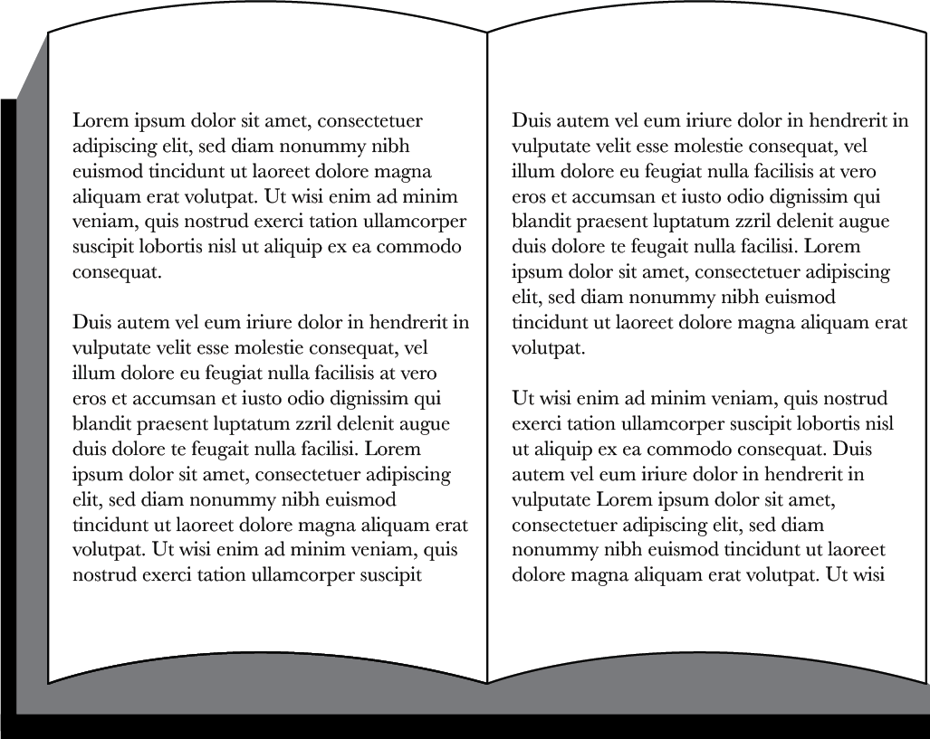
Genetic information in cell is responsible for traits
Chemical units in DNA represented by alphabetic letters
...CTGACCTAATGCCGTA...
...CTGAACTAATGCCTTA...
Genome
1700 books
1000 pages each
1700 books
(or 1.7 million pages)
Sometimes mistakes happen when copying information in books (genomes) → creating changes, called mutations

Slide 10
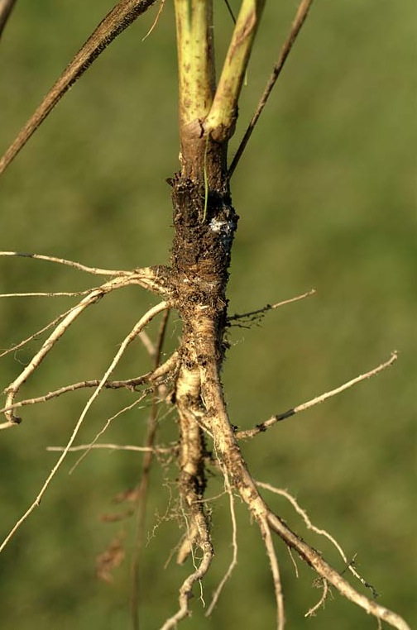
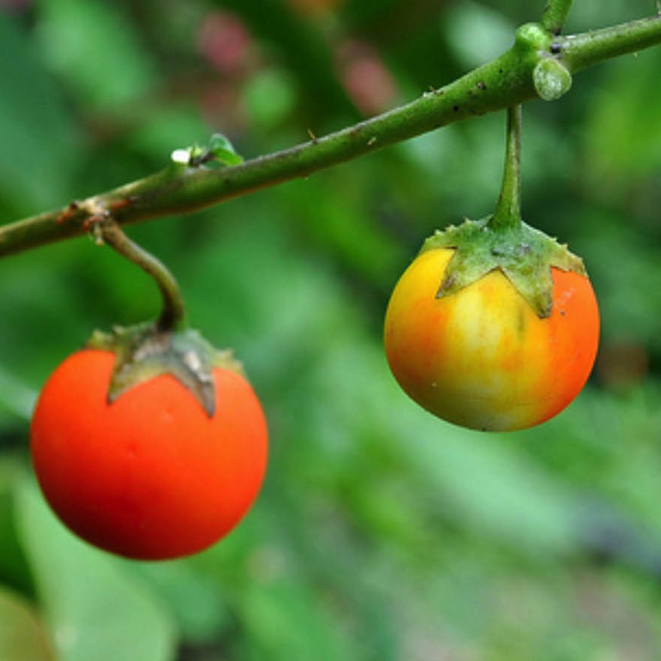
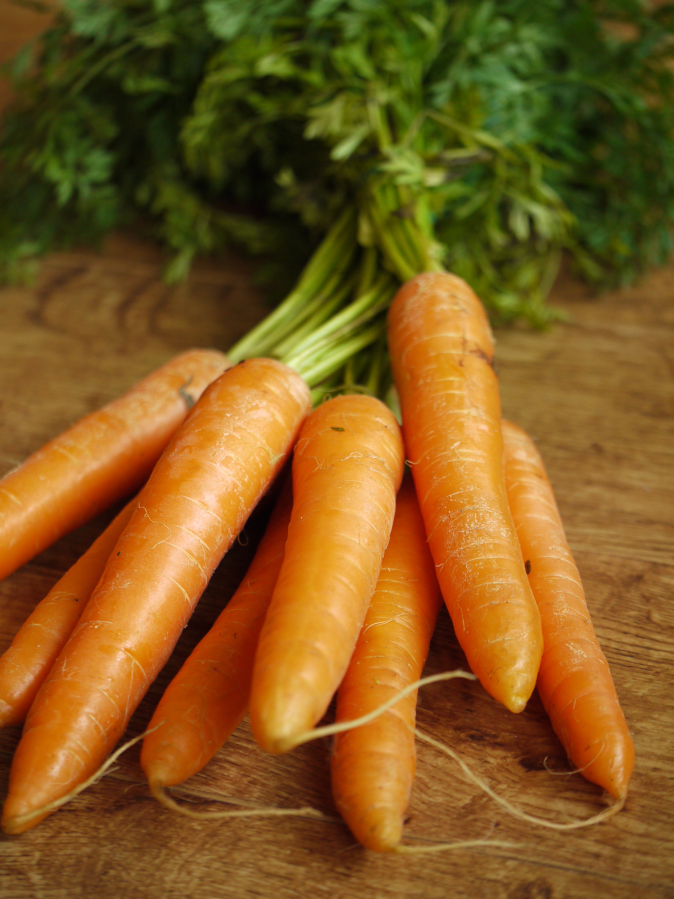
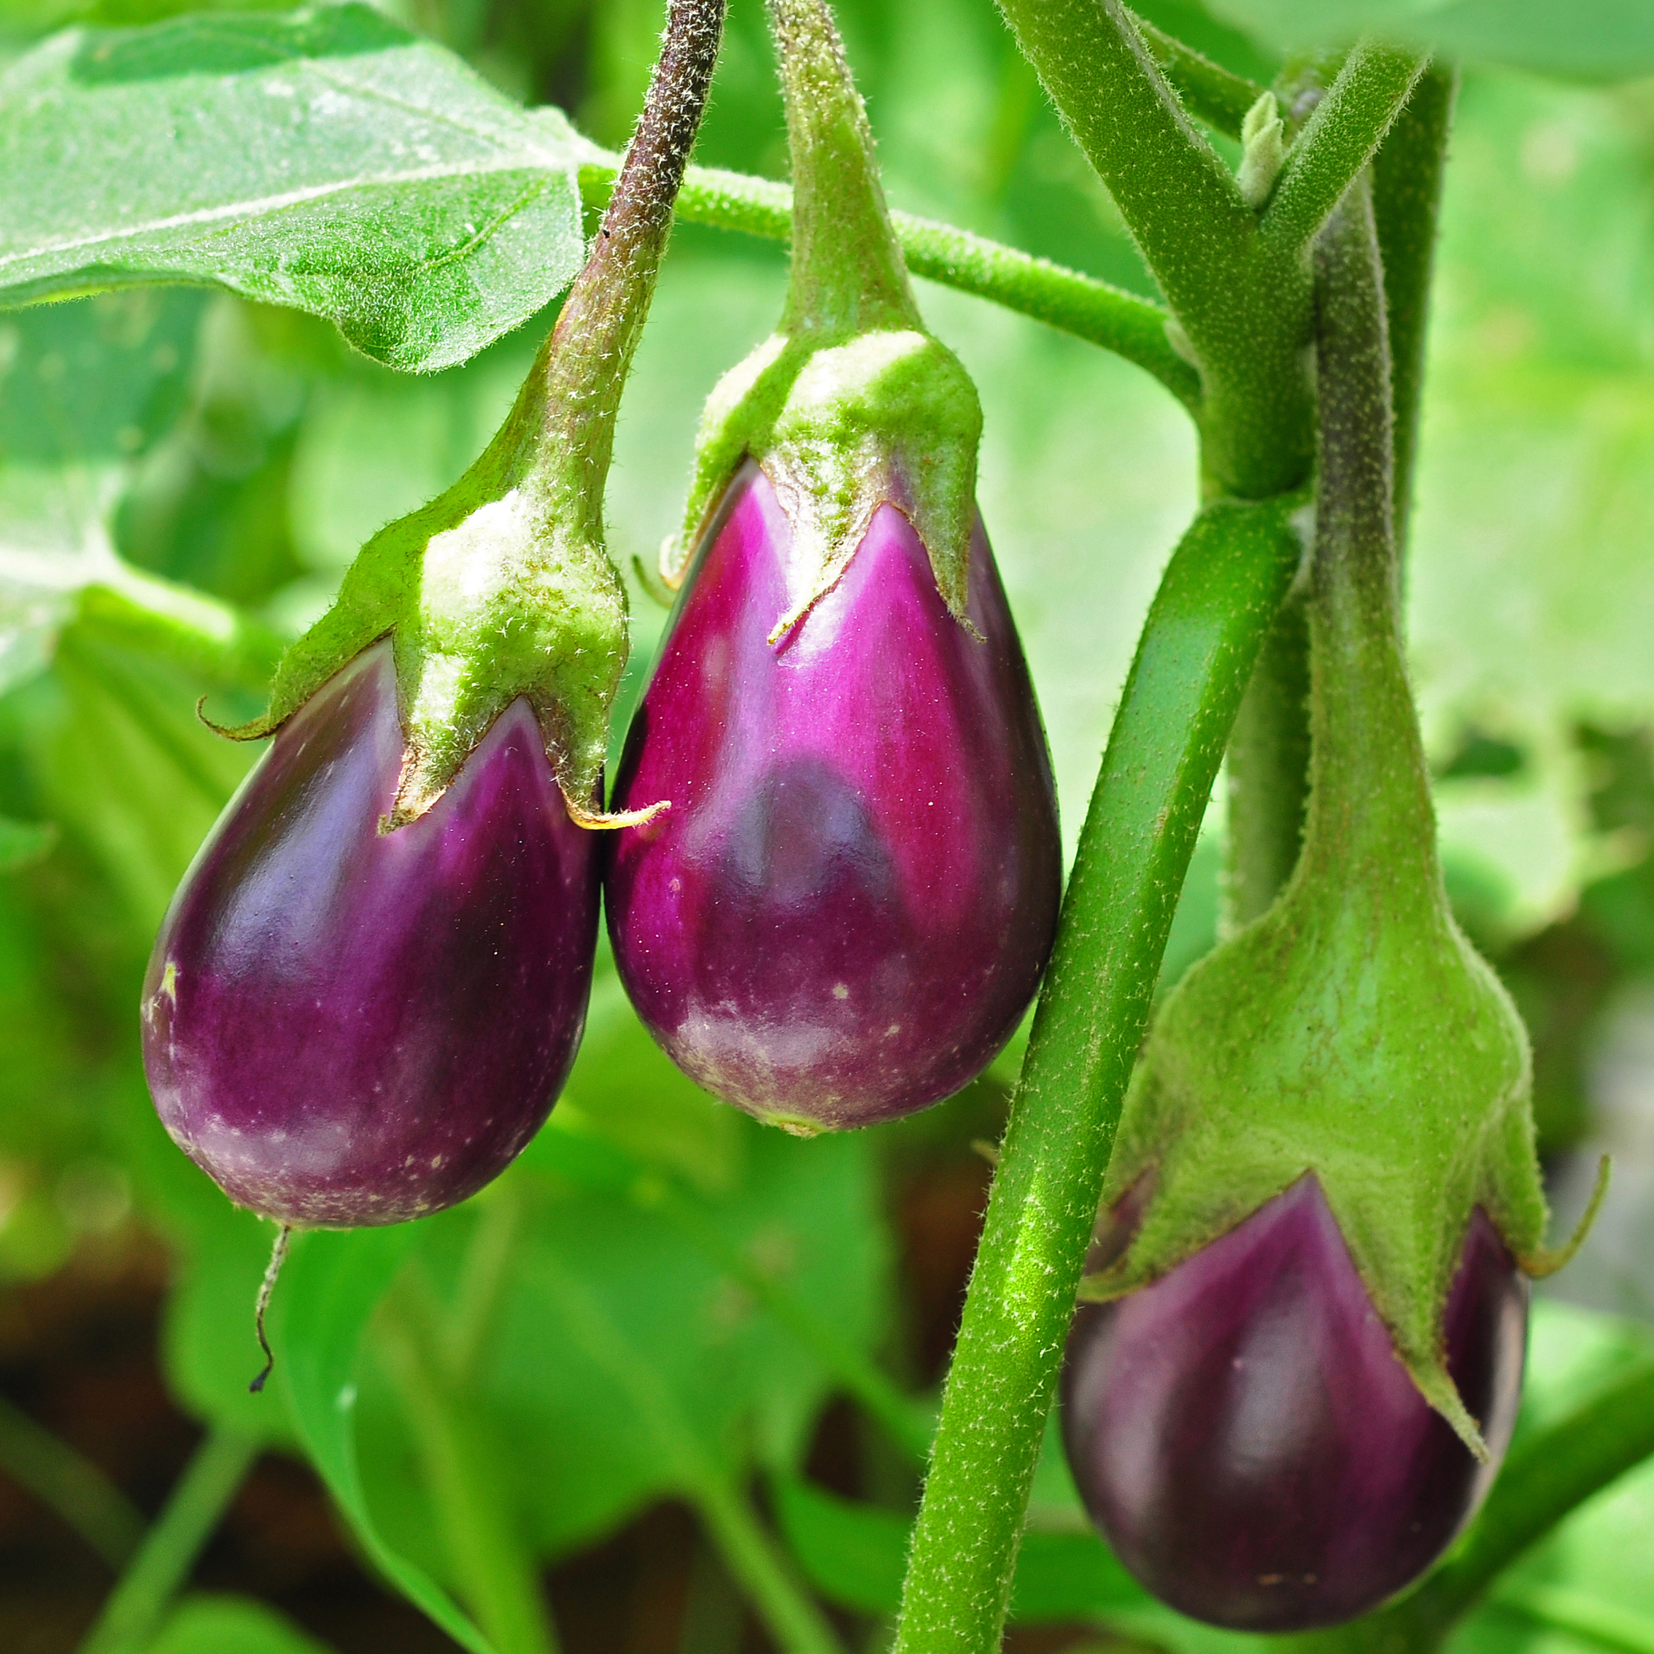
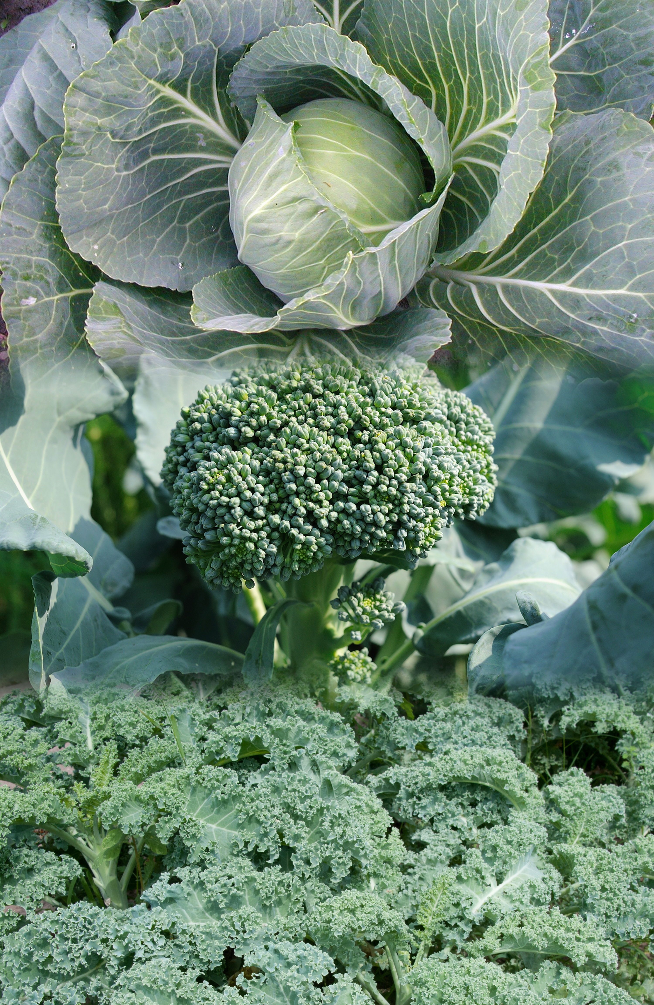
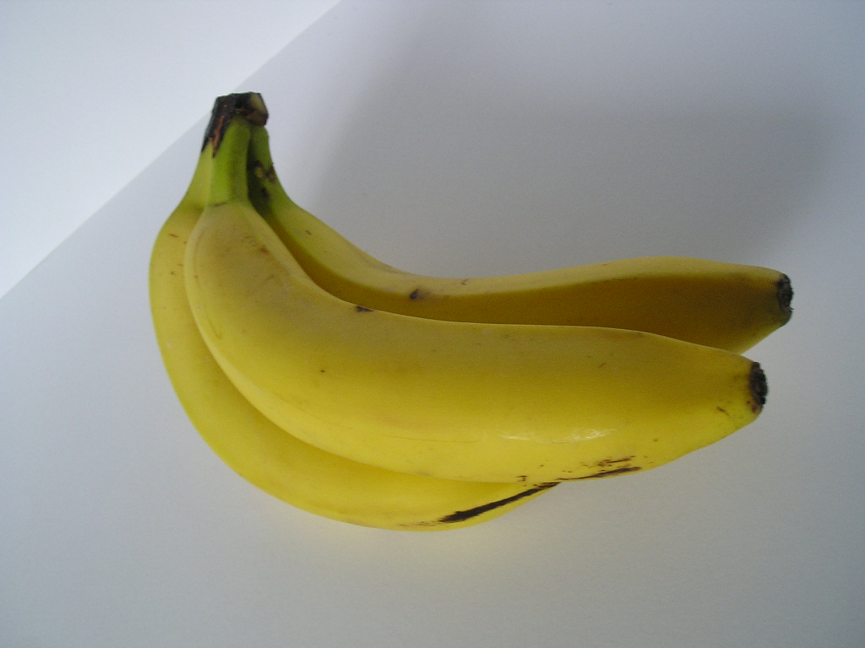
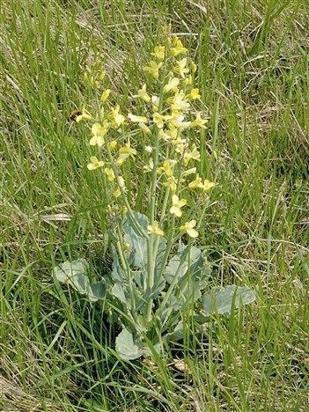
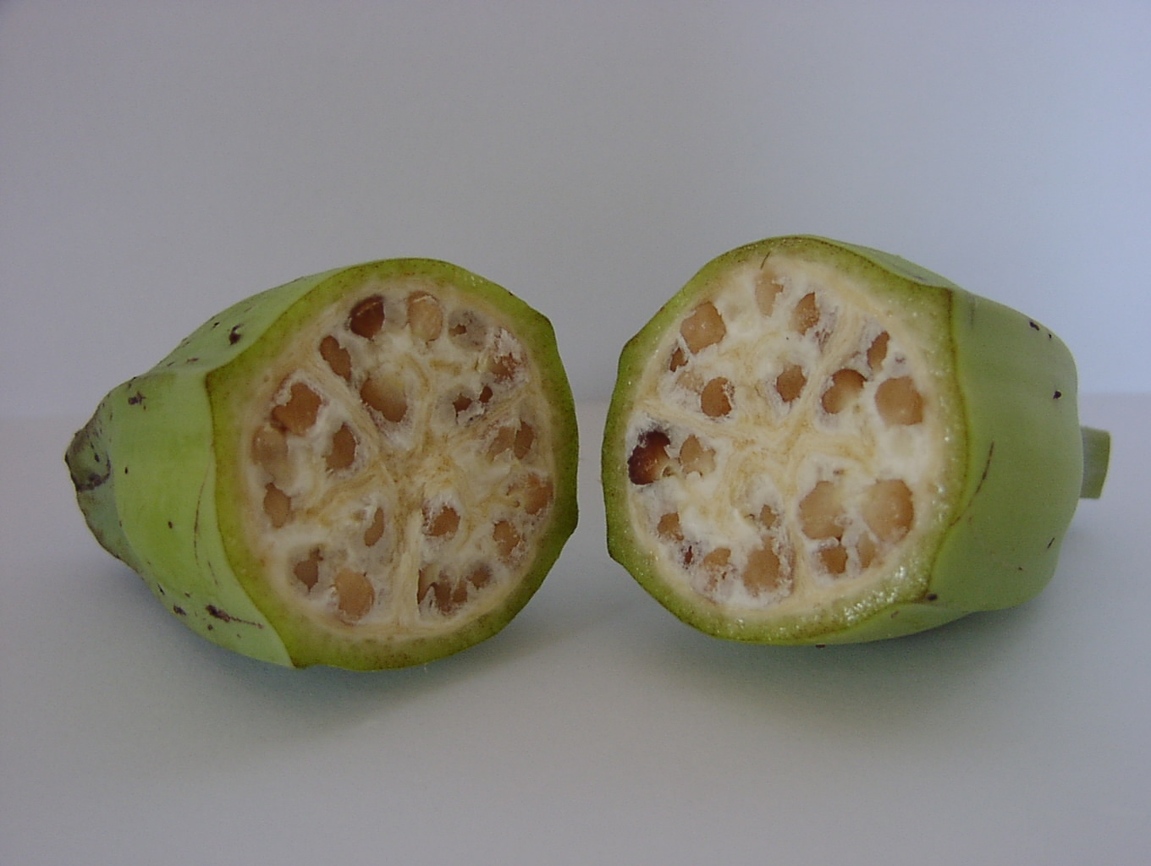
Mutations Have Gotten These Plants from Looking Like This…
To Looking Like They Are Now
Eggplant
Carrot
Banana
Broccoli, Kale, Cabbage

Slide 11
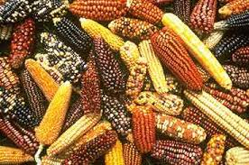
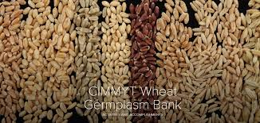
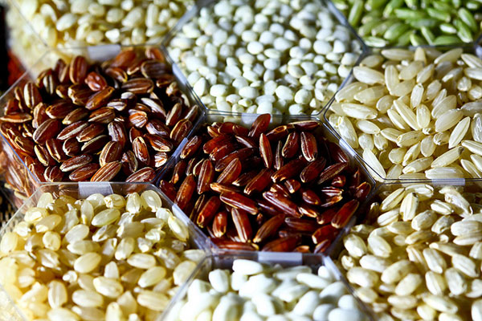
Since 1950’s intentional mutation breeding has created >3200 crops – e.g., 600 maize, rice, wheat varieties. Although modified genetically, they are not under regulations for genetically engineered (GMO) varieties.
Van Eenennaam 11/29/2016
Photo by Stephen Ausmus, USDA
Notes:
The methods used in mutation breeding have been in use since the 1950s and are excluded from GMO legislation, because such mutations also occur without human intervention but with a much lower frequency. The occurrence of mutations is considered to be a natural process, commonly used by breeders to exploit natural variation, that is simply boosted by the applied technique. Up to now, more than 3200 officially released cultivars are known to have been obtained by mutation breeding, among them more than 600 cultivated lines of wheat, rice and maize

Slide 12
Modern Example
Japanese Farmer Creates Mongee Banana With Softer, Digestible Skin
2/22/2018 A-peeling? Japanese farmers invent edible banana skin | World news | The Guardian
Notes:
2/22/2018 A-peeling? Japanese farmers invent edible banana skin | World news | The Guardian

Slide 13
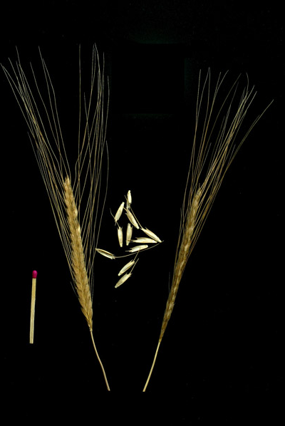
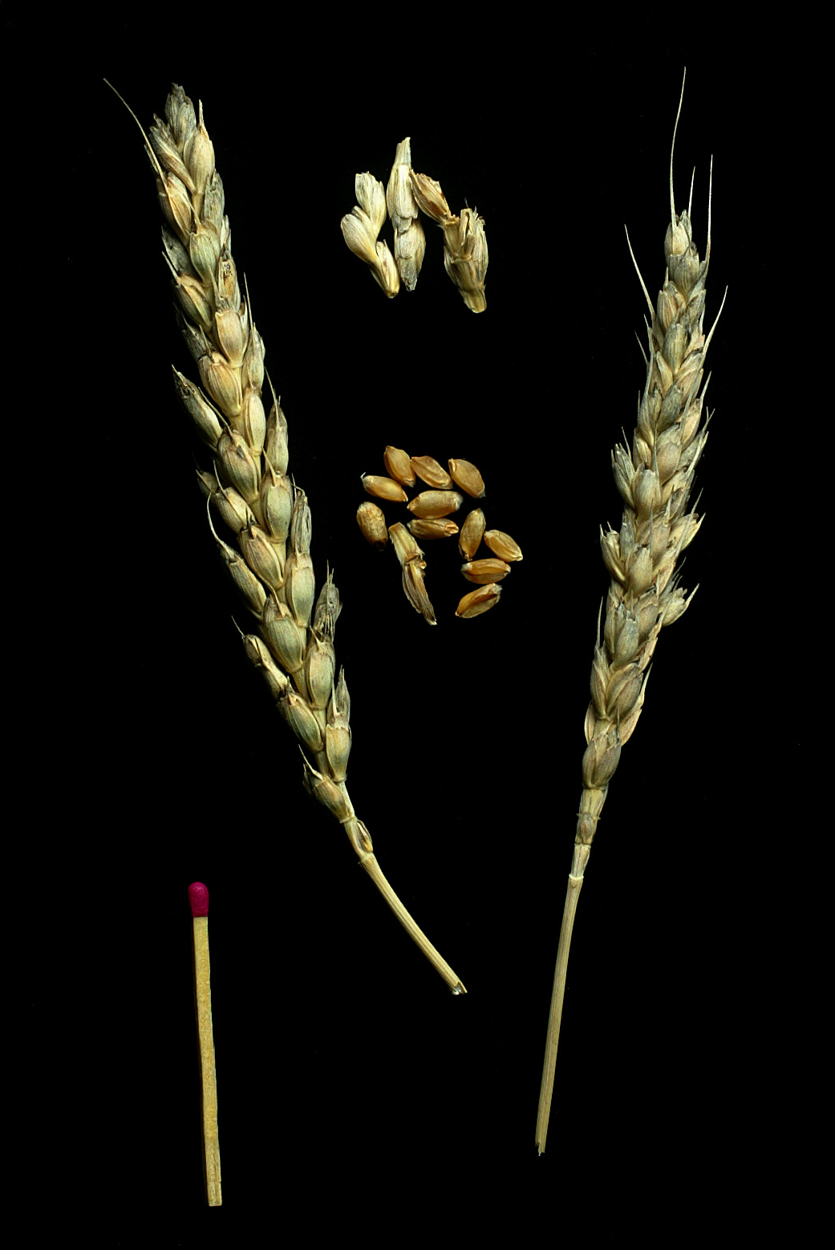
But genomes have also been modified by classical breeding to create new plant varieties?
Triticum monococcum Ancient variety
Triticum aestivum
Modern bread variety

Slide 14


Hybridization or Cross-breeding of Wheat
x
Random retention of information from each parent
1700 books
(or 1.7 million pages)
1700 books
(or 1.7 million pages)
1700 books
(or 1.7 million pages)
Genetic modification by hybridization is not GE or GMO

Slide 15
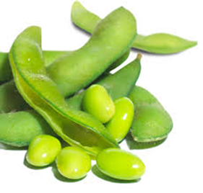
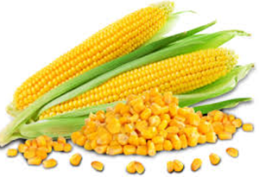
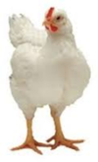
Breeding efforts were critical to increases in crop production…
Product | 2014 US acreage | US Acreage needed at 1950’s rate | Additional Resources needed
Soybeans | 82,591,000 acres | 180,971,889 acres | ~98 million acres (= size CA)
Corn | 83,136,000 acres | 372,134,346 acres | ~289 million acres (= 3X size CA)
Broiler Chickens | 8,544,100,000 head | 16,679,545,455 head | ~8 billion head requiring 81.5 billion lbs feed
Van Eenennaam 11/29/2016
Notes:
FCR = feed conversion ratio

Slide 16
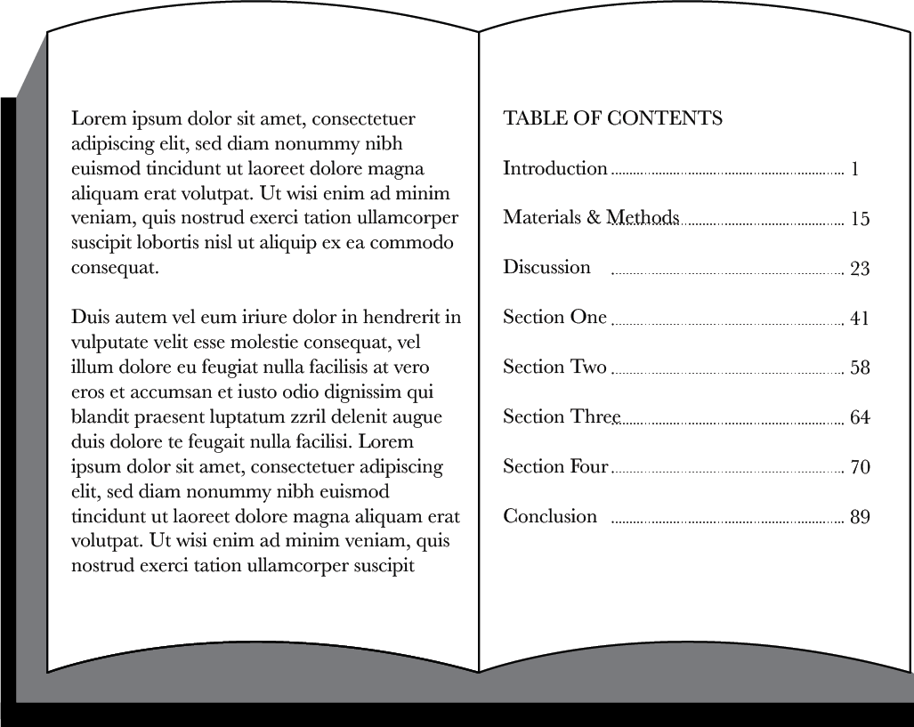
New Breeding Method
Uses table of contents of genes for marker assisted selection
...CTGACCTAATGCCGTA...
Disease tolerance
1700 books
(or 1.7 million pages)
Genetic modification that is not GE or GMO

Slide 17
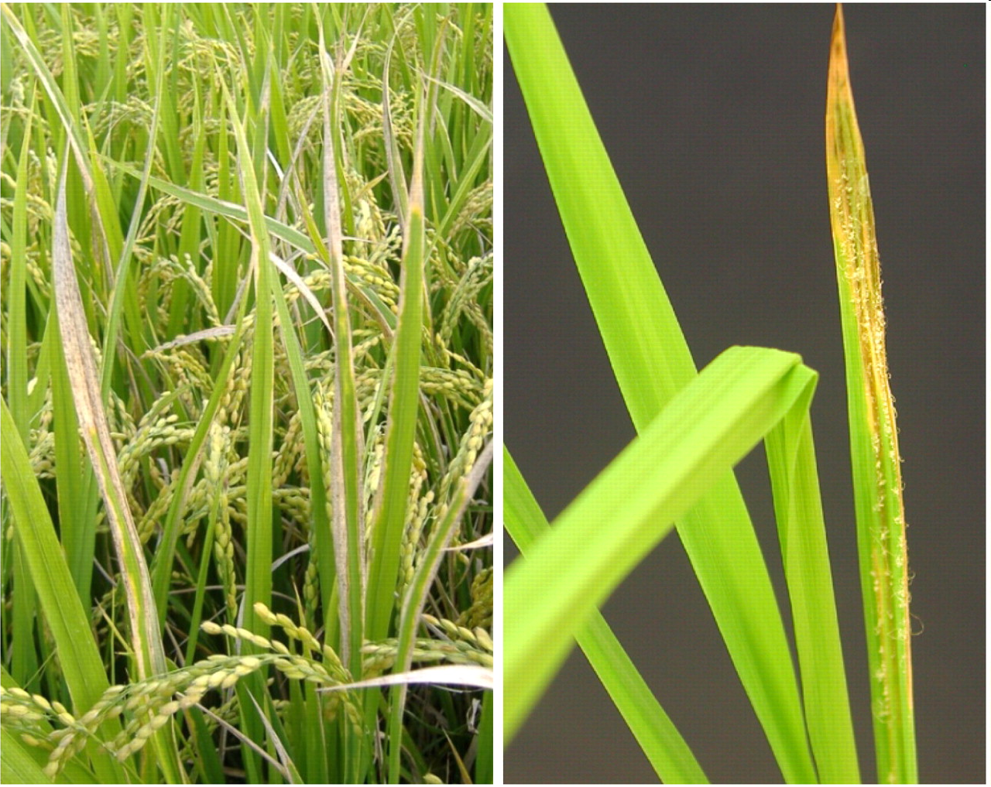
Can’t we just do all modifications this way?
Marker-assisted selection used to protect rice against bacterial blight and blast disease
Protection limited to diversity in crop and compatible relatives

Slide 18
Also modify genomes with genetic engineering → GMOs
What Kinds of GE Crops and Foods Are in the Commercial Market?
+
Inserts gene(s) randomly in genome
One-half page equivalent to a gene
1700 books
(or 1.7 million pages)
1700 books
(or 1.7 million pages)
Genetic modification by genetic engineering is GE or GMO

Slide 19
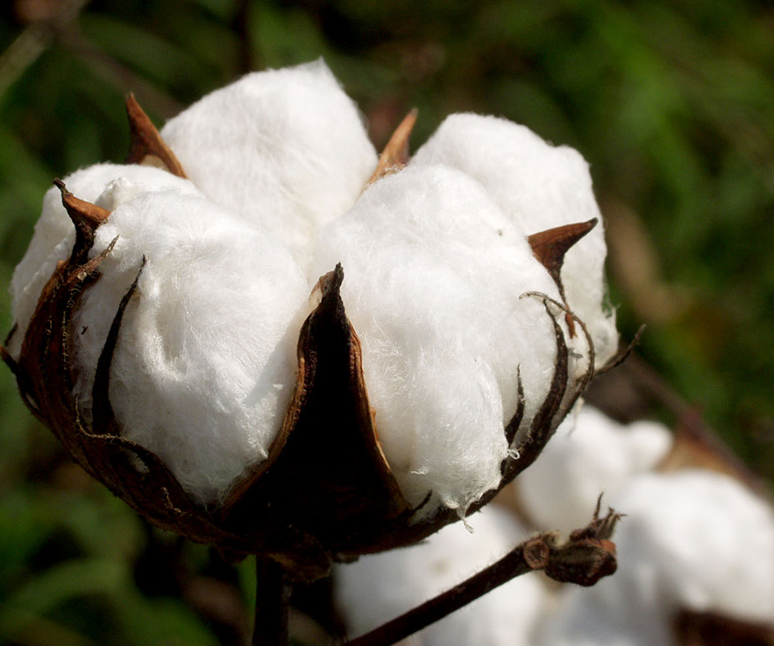
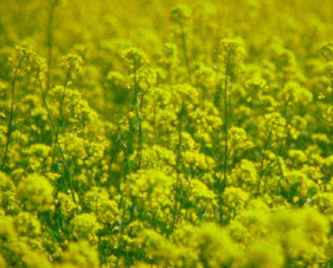
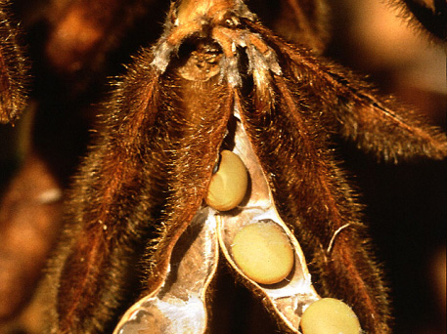
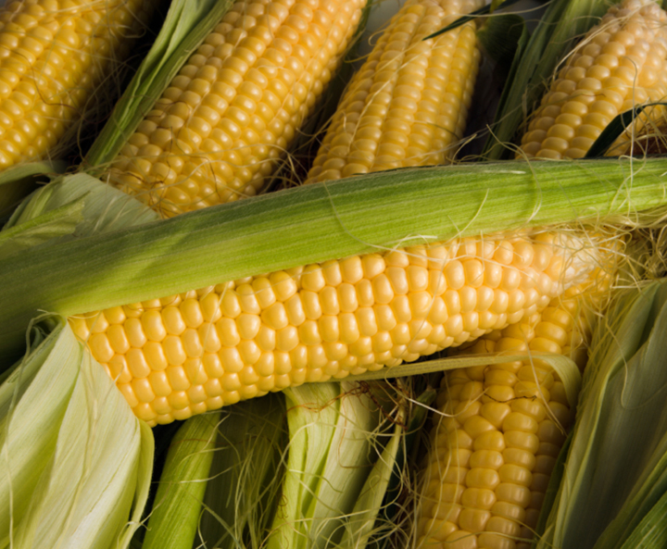
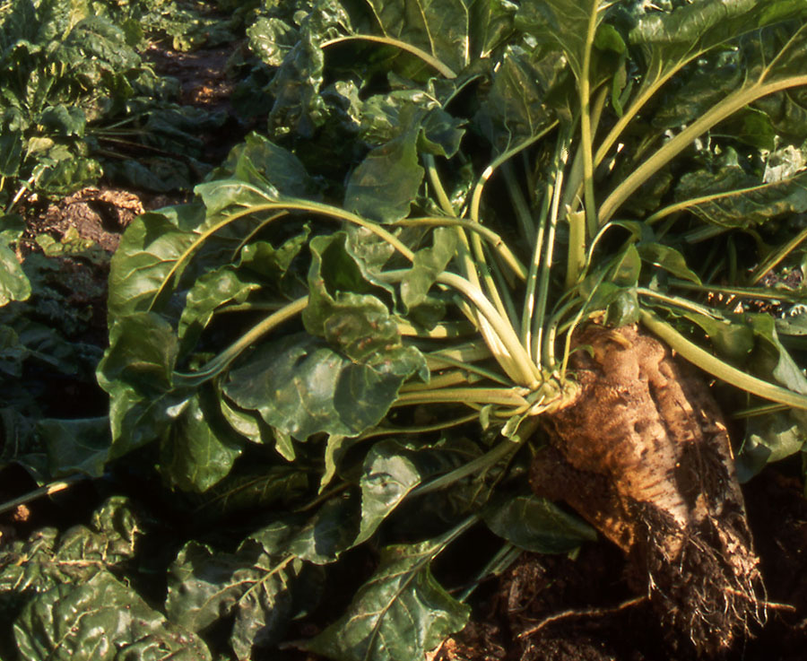
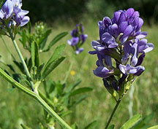
Number of different commercially available, large acreage GE (GMO) crops is limited
GE Cotton
98% of 2019 acreage
(Insect Resistant: 3% Herbicide tolerant: 6% Stacked gene: 89%
GE Canola
100% of 2018 acreage
GE Soybean
94% of 2019 acreage
(Herbicide resistant: 94%)
Source: USDA-ERS, 2019
Source: ISAAA, 2018
Source: USDA-ERS, 2019
GE Corn
92% of 2019 acreage
(Insect Resistant: 3% Herbicide resistant: 9% Stacked gene: 80%)
GE Sugarbeet
100% of 2018 acreage
GE Alfalfa
15% of 2018 acreage
Source: ISAAA, 2018
Source: USDA-ERS, 2019
Source: ISAAA, 2018
Notes:
August 20, 2014

Slide 20
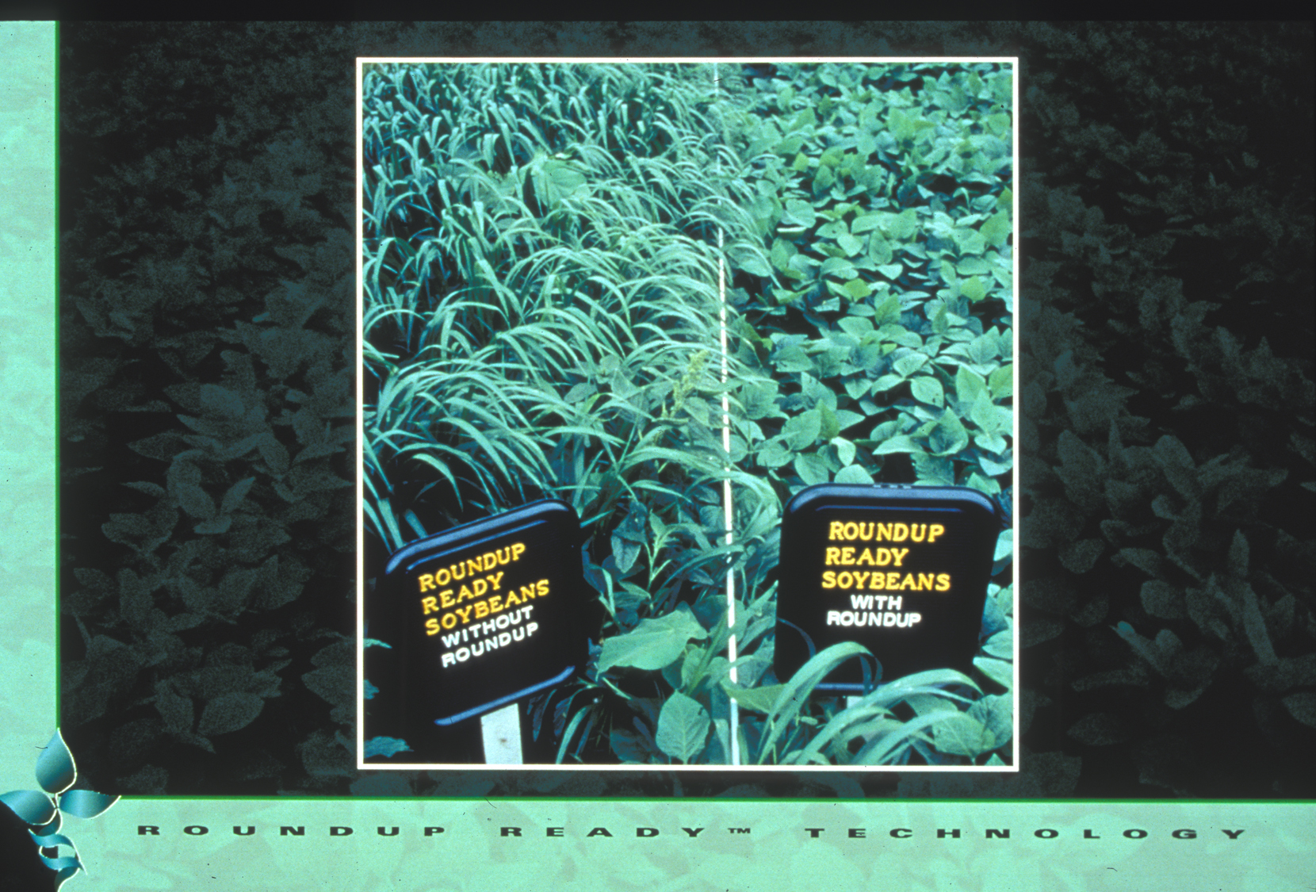
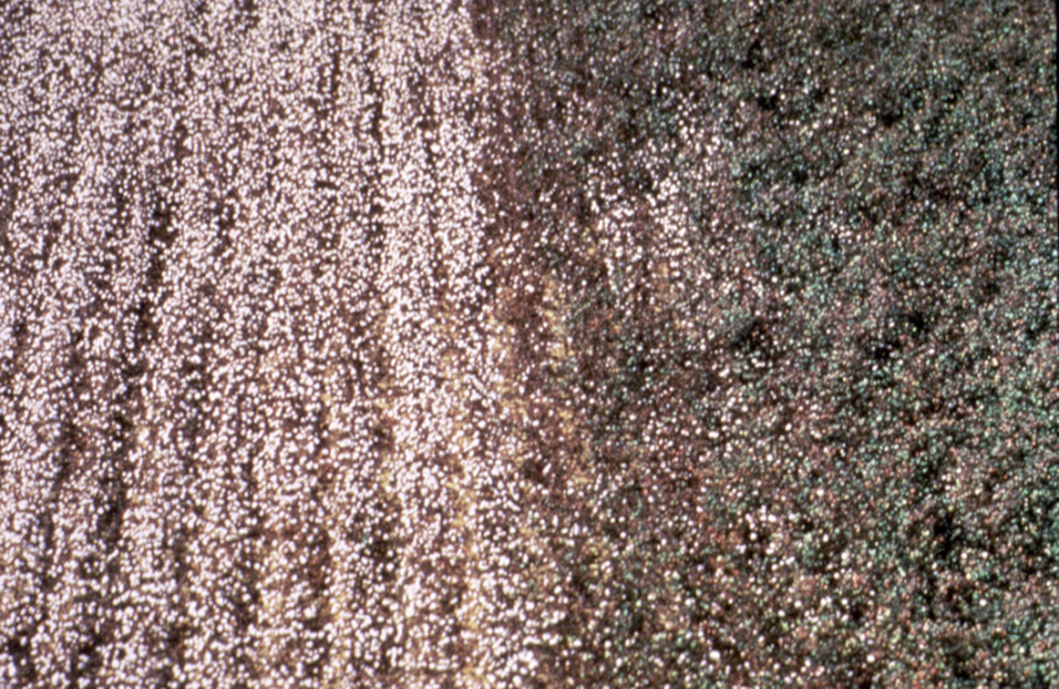
Roundup Ready Soybean™
Number of different traits available in large acreage GE crops is also limited
Herbicide-tolerant - engineered with gene to tolerate herbicide application
Insect-tolerant Bt crops - engineered for resistance using gene from naturally occurring bacterium
Crops with stacked traits - Bt and HT - are available

Slide 21
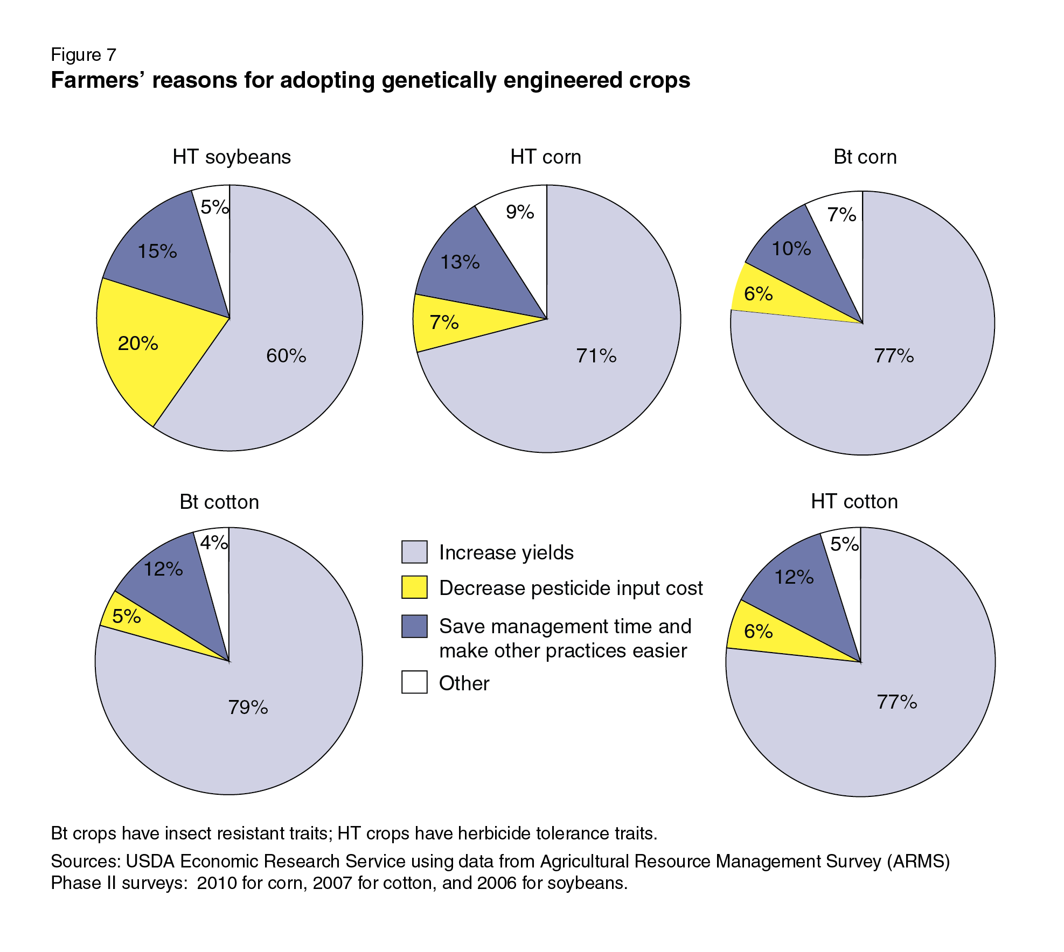
Why do U.S. growers use GE crops?
Reasons vary from crop-to-crop but primary reason is improved yields
SOURCE: Fernandez-Cornejo, J., Wechsler, S., Livingston, M. and Mitchell, L. 2014. Genetically Engineered Crops in the United States. USDA Economic Research Service Report No. 162, February 2014.
Notes:
March 25, 2014

Slide 22
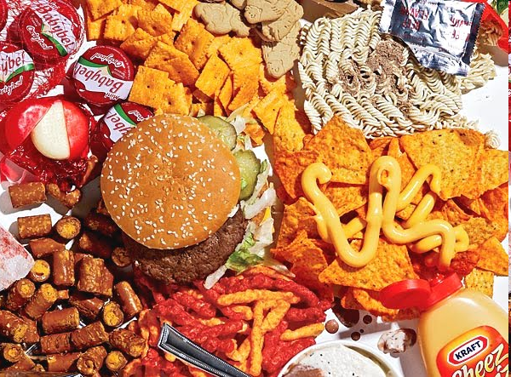
Corn oil
Canola oil
Soy lecithin
Soy protein
Corn starch
Cottonseed oil
These types of large-acreage GE crops lead to estimates that 60-80% of processed foods in U.S. have GE ingredients – often only a minor ingredient
SOURCE: https://factsaboutgmos.org/disclosure-statement

Slide 23
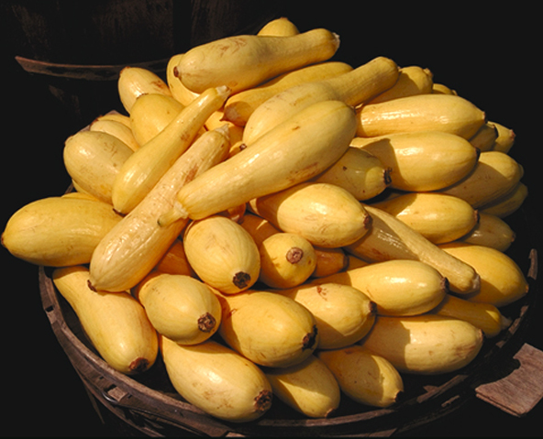
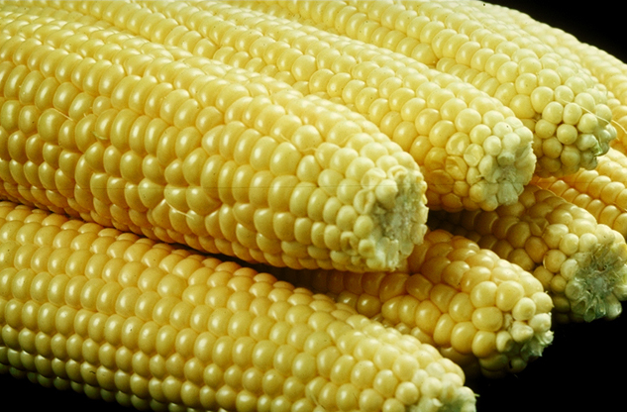
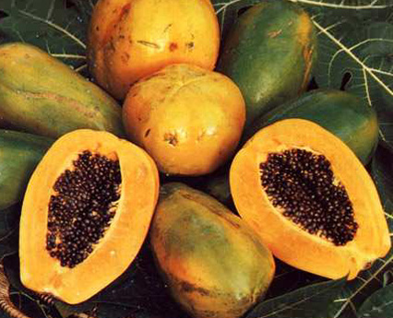
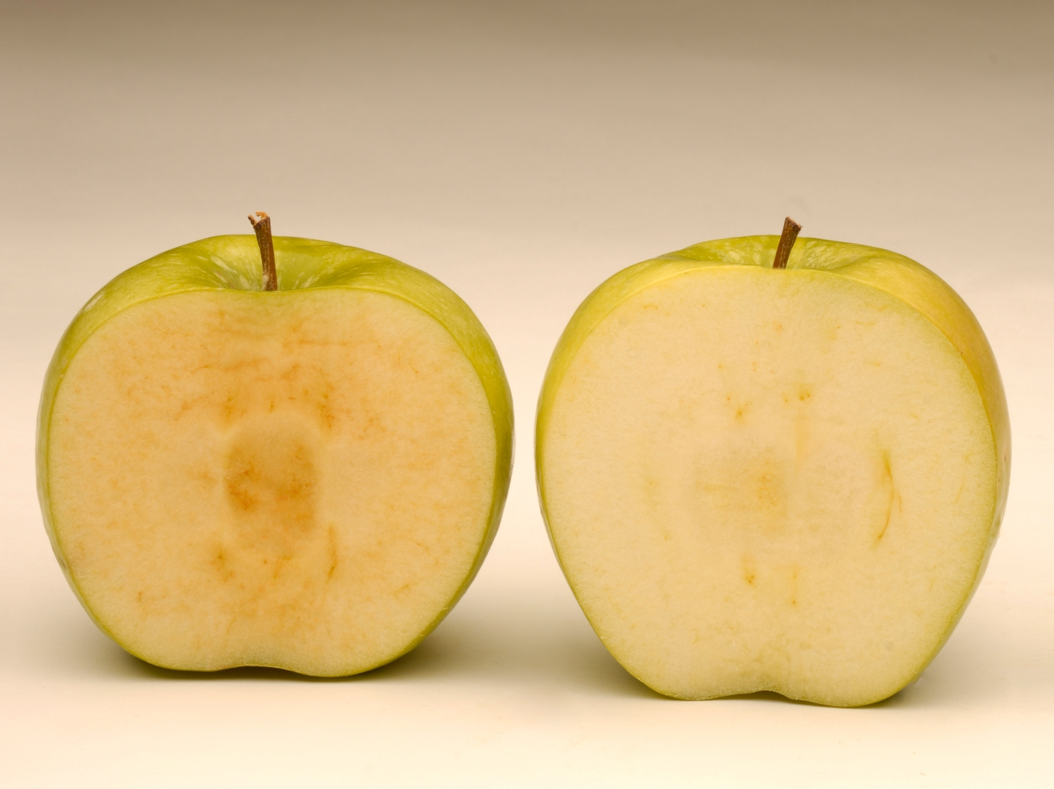
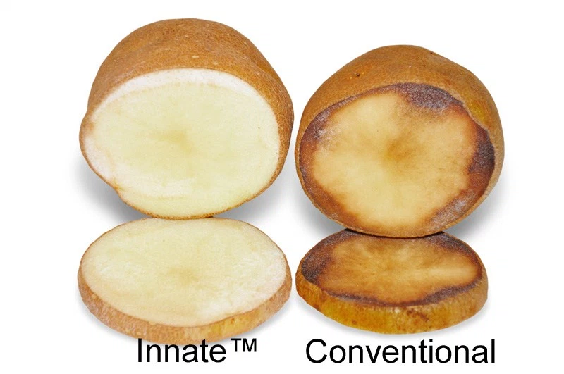
There are only a few whole, genetically engineered foods in the U.S market
GE Squash
~2,471 acres in 2018
GE Sweet Corn
33% of 2017 acreage
GE Papaya
77% of 2018 acreage
from Hawaii
Source: ISAAA, 2018
Source: ISAAA, 2017
Source: ISAAA, 2018
Two more are just being introduced
Arctic Apple™
593 acres in 2018
Innate™ Potato
Generation 1: ,1977 acres in 2018
Generation 2: 2,224 acres in 2018
Source: ISAAA, 2018
Source: ISAAA, 2018

Slide 24
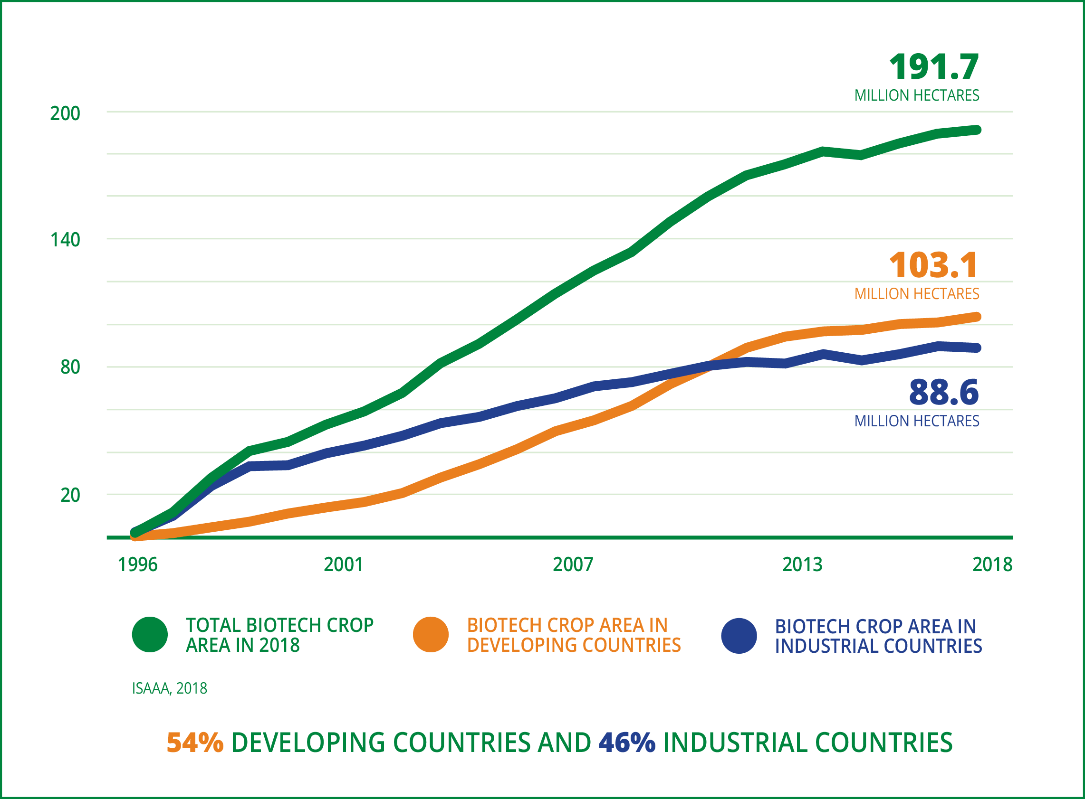

Despite limited U.S. crop and trait types, worldwide acreage is increasing in developing and developed countries
In 2018, 17M farmers in 26 countries planted 474M acres 191.7M hectares) ~4X size of CA

Slide 25
WHAT’S IN THE
PIPELINE?
Notes:
To be covered
overview of the development in biotechnology in agriculture including the latest technologies,
applications and implications to the future of food,
historical background
domestic policy, and if possible, global policy and its challenges.

Slide 26
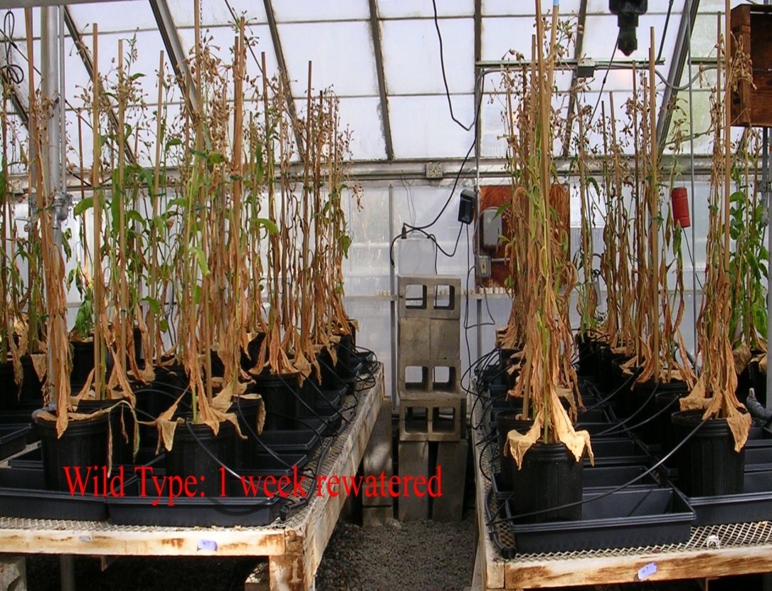
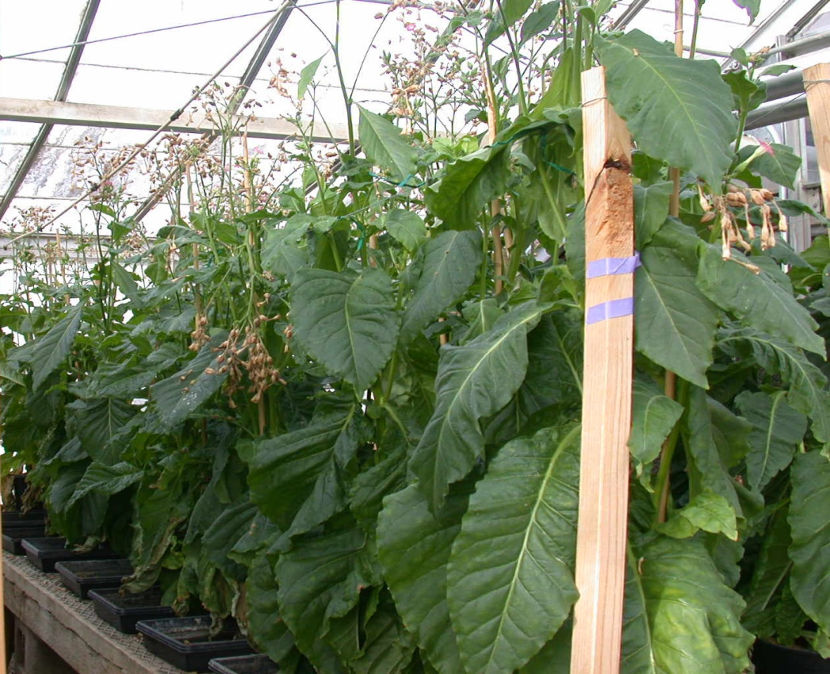
Salinity and Drought Tolerance - UC Davis
Wild type AtNHX1
200 mM NaCl (~1/2 sea water)
Wild type IPT gene
15 days drought, 7 days re-watered
Salt-tolerance
Drought-tolerance
Hanana M. 2011. Environ Rev 19: 121-140; Anjuman A et al. 2013 Mol. Biotechnol 54: 379-392

Slide 27
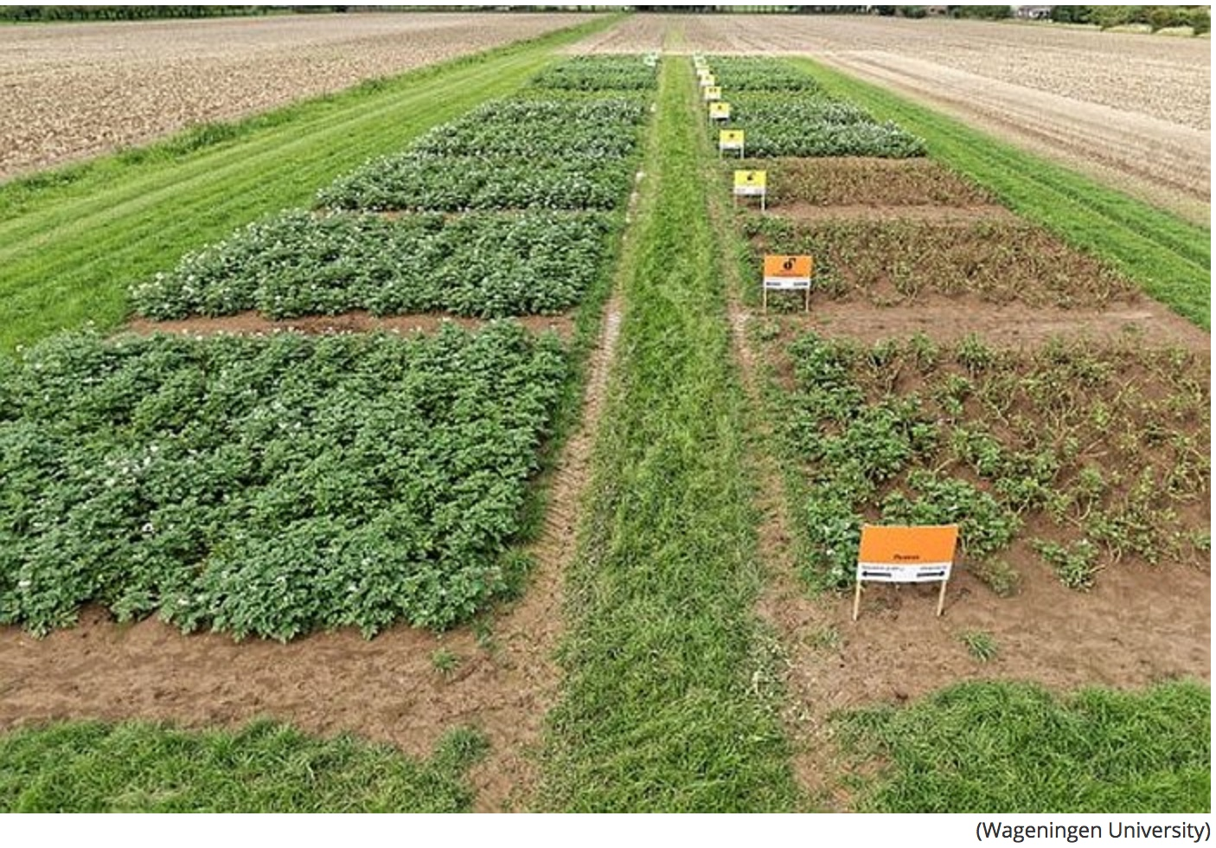
GE potato + pest management controls potato blight - reducing chemical fungicide use by up to 90%:
Kessel, GJT. 2018. Development and validation of IPM strategies for the cultivation of cisgenically modified late blight resistant potato. Eur J Agron. 96:146.

Slide 28
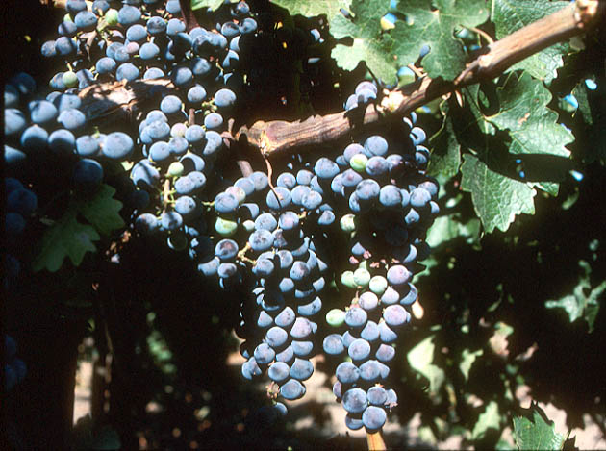
Field Trials in California with Grape Root Stocks Engineered for Resistance to Fanleaf Virus
SOURCE: http://www.democratandchronicle.com/apps/pbcs.dll/article?AID=/20080806/BUSINESS/808060336/1001

Slide 29
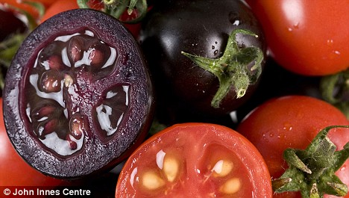
High anthocyanin purple GE tomatoes. Diets with 10% purple tomatoes increased lifespan of cancer-prone mice
Butelli et al. 2008. https://www.jic.ac.uk/staff/cathie-martin/purple-tomatoes.html
Notes:
Purple fruit contains same level of anthocyanins as half basket of blueberries. Large orange tomatoes (~100g) have same amount of beneficial compound as 27 bottles of red wine (resveratrol). Yellow-fruited variety contains genistins, in amount equal to 150 g of tofu. Fourth variety has quercetin and kaempferol, health-promoting compounds found in capers, radishes, onions and watercress. Offer protection against inflammation, cancer and cardiovascular disease. http://news.jic.ac.uk/2014/03/bbsrc-most-promising-innovator/ Produce 100 fold higher levels of anthocyanins than conventional blue tomatoes

Slide 30
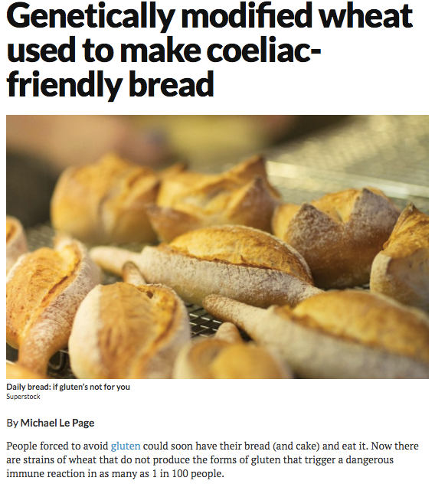
New genome editing technology used to turn off expression of genes responsible for traits
“Knocked out” 35 of the 45 gliadin genes involved in coeliac;
efforts now use genome editing (CRISPR)
Sanchez-Leon S. et al., 2017. Plant Biotechnology Journal September 18, 2017 DOI: 10.1111/pbi.12837
Notes:
New Scientist Sept. 26, 2017
Francisco Barro: Cordoba Spain
Using CRISPR to knock out 35 of 45 gliadin genes
Biotechnology Journal DOI: 10.1111/pbi.12837
https://www.newscientist.com/article/2148596-genetically-modified-wheat-used-to-make-coeliac-friendly-bread/#.Wc7Dv_mnOMk.email

Slide 31
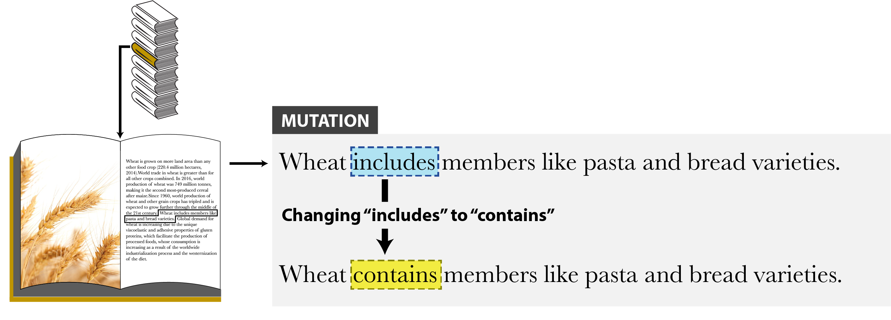
What New Genetic Method?
Genome Editing - Mutation
Genome editing a.k.a. New Breeding Technology (NBT)
Find target text, inserts gene edit at specific location in genome
This type of genome editing is not GE or GMO for USDA regulation – no pathogen introduction

Slide 32
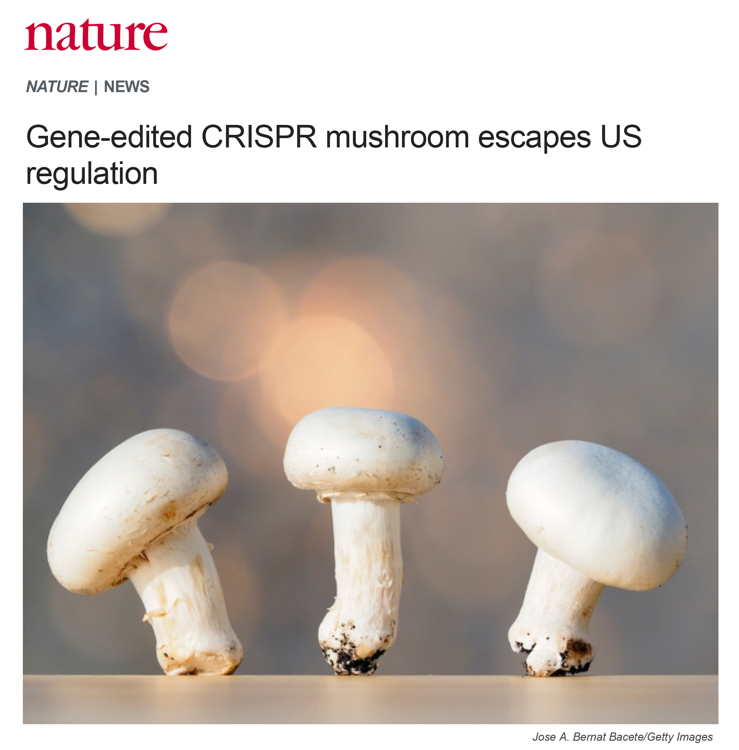
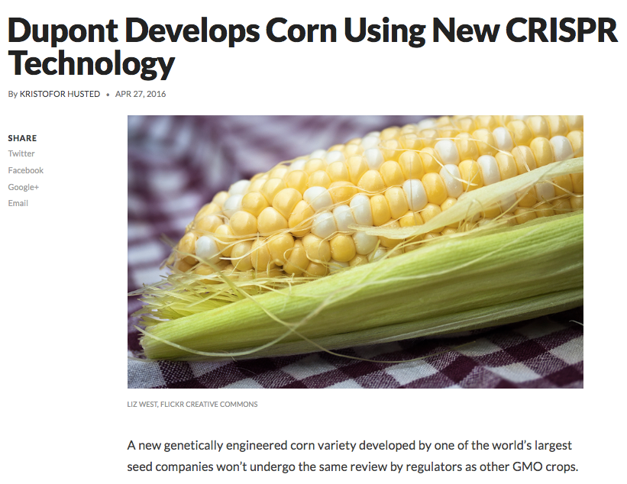


EXAMPLES of edited products
University
Company
Company
Company
In 2016/2017, USDA said they can’t regulate these edited crops because no DNA from plant pests or pathogens is introduced

Slide 33

Another Type of Genome Editing - Modification
Inserts edits specifically in genome
INSERTION
DELETION
This type of genome editing may or may not be GE or GMO for federal regulation

Slide 34



Use editing to exploit genetic diversity in wild plants
de novo domestication of wild Solanum pimpinellifolium
Edited wild tomato variety, S. pimpinellifolium, was edited to get 3X fruit size, 10X fruit number and 500% increase in lycopene.
Zsogon A et al. 2018. De novo domestication of wild tomato using genome. Nature Biotech 36:1211-1216

Slide 35

Why Are GE (GMO) Crops and Foods So Controversial?

Slide 36

Look what greeted residents in Tule Lake in late 80’s during first field test of GE “ice minus bacterium” – men in moon suits spraying the organism on local fields.
Then they went to another place in CA – and were not welcome there either!

Slide 37


But large-scale pushback started in the late 90’s in Europe. Factors that fueled and continue to fuel controversy there:
Food safety scares
Involuntary nature of change
Cultural differences
Economic incentives
1999
Lord Melchett participating in GM protest
And there are issues in the U.S. too
2014
GM maize protest in Germany

Slide 38
What are some issues with GE crops & foods?
Regulatory oversight
Lack of peer-reviewed food safety tests
Consumer attitudes and labeling
Environmental issues
Some additional food for thought…
Notes:
To be covered
overview of the development in biotechnology in agriculture including the latest technologies,
applications and implications to the future of food,
historical background
domestic policy, and if possible, global policy and its challenges.

Slide 39
What are some issues with GE crops & foods?
Regulatory oversight
Lack of peer-reviewed food safety tests
Consumer attitudes and labeling
Environmental issues
Some additional food for thought…
Notes:
To be covered
overview of the development in biotechnology in agriculture including the latest technologies,
applications and implications to the future of food,
historical background
domestic policy, and if possible, global policy and its challenges.

Slide 40
U.S. Regulatory Agencies
USDA
FDA
EPA
Field testing
Permits
Notifications
Determination of
non-regulated status
Food safety
Feed safety
Pesticidal plants
tolerance exemption
registrations
Herbicide registration
Plant pest?
Danger to people?
Risk to environment?

Slide 41
Are they as safe as conventional foods?
Regulation based
substantial equivalence
Which means modified food has essentially all characteristics of nonmodified food except for introduced trait
Product of introduced genetic information tested for safety separately
How is substantial equivalence tested?
SOURCE: Safety of Genetically Engineered Foods: Aproaches to Assessing Unintended Health Effects 2004. Natl Acad Press

Slide 42

Substantial

Slide 43

Regulation based on 1986 regulatory system, creates problems:
New products emerge with no rules to govern them
Old products not in market because no pathway to commercialize
New products created to step around regulatory system
On July 2, 2015, Obama White House Initiative announced plan to modernize biotech regulation, but no progress until…

Slide 44

Executive Order on Agricultural Biotechnology June 11, 2019
Agencies to regulate end products, not processes used to make them. So, genetically edited pest resistant product not treated differently from one made with traditional breeding.
Biotech products to be regulated proportional to risks.
Perhaps applies only to gene edited products, not transgenic products or GMOs - still regulated on a case-by-case review.
SOURCE:Berezow A. “Trump’s Executive Orders Move Biotech, Healthcare in right Direction”. ACSH Weekend Highlights. July 5, 2019.

Slide 45
What are some issues with GE crops & foods?
Regulatory oversight
Lack of peer-reviewed food safety tests
Labeling
Environmental issues
Some additional food for thought…
Notes:
To be covered
overview of the development in biotechnology in agriculture including the latest technologies,
applications and implications to the future of food,
historical background
domestic policy, and if possible, global policy and its challenges.

Slide 46


Occasional widely publicized studies cast doubt on safety of GE foods - one in Sept. 2012 by French researcher
Later reviewed by European Food Safety Authority and found to have no merit
Claim that Monsanto’s RR corn causes tumors in rats
But did you ever hear that?
What about other published studies?

Slide 47




2014 study
9B food-producing animals in U.S
95% consumed feed with GE ingredients
Analysis of public data from 1983 to 1996,
before GE crops, vs. 1996 to 2011
Conclusions:
No unfavorable or perturbed trends in livestock health and productivity.
No differences in nutritional profile of animal products from GE-fed animals.
SOURCE: “Prevalence and impacts of genetically engineered feedstuffs on livestock populations”
A. L. Van Eenennaam and A. E. Young, J. Animal Science September 2014
Notes:
October 21, 2014

Slide 48
What are some issues with GE crops & foods?
Regulatory oversight
Lack of peer-reviewed food safety tests
Labeling
Environmental issues
Some additional food for thought…
Notes:
To be covered
overview of the development in biotechnology in agriculture including the latest technologies,
applications and implications to the future of food,
historical background
domestic policy, and if possible, global policy and its challenges.

Slide 49

What about labeling for GE foods?
July 8, 2016: Senate passes bill for mandatory national system for GM disclosures on food products; Obama signed on July 29. Nullified Vermont’s labeling law
Proposed symbols for foods with GE ingredient – must use bioengineered, not genetically modified
Law requires USDA to decide what ingredients in food are from GE organisms; labels to be added using words, pictures or a scannable bar code for smartphones. Mandatory in 2020.
http://deltafarmpress.com/soybeans/senate-passes-roberts-stabenow-gmo-labeling-bill-preempts-vermonts

Slide 50

Impossible Burger contains engineered soy and bears the new label

Slide 51
What are some issues with GE crops & foods?
Regulatory oversight
Lack of peer-reviewed food safety tests
Labeling
Environmental issues
Some additional food for thought…
Notes:
To be covered
overview of the development in biotechnology in agriculture including the latest technologies,
applications and implications to the future of food,
historical background
domestic policy, and if possible, global policy and its challenges.

Slide 52
Insect Resistance
B.t. cotton and corn engineered for insect resistance with gene(s) from naturally occurring bacterium.
Development of herbicide-tolerant weeds or resistant insects
To date minimal insect resistance has occurred

Slide 53

What about Herbicide Tolerance?
Environmental impact of herbicide use, measured by Environmental Impact Quotient, fell by 17.1%
But is there a consequence?
SOURCE: Brookes, G. 2012. Genetically Engineered Crops: Environmental Impacts 1996-2009. ISB Report, January 2012, pp. 1-5
Brookes, G. and Barfoot, P. 2011. Global impact of biotech crops: Environmental effects 1996-2009. GM Crops 2: 34-49
Notes:
March 8, 2012

Slide 54

“When any single herbicide mechanism of action is used repeatedly without alternative management tactics, selection pressure becomes intense for plants tolerant or resistant to that herbicide.”
SOURCE: Council for Agricultural Science and Technology (CAST). 2012. Herbicide-resistant Weeds Threaten Soil Conservation Gains: Finding a Balance for Soil and Farm Sustainability. Issue Paper 49. CAST, Ames, Iowa. http://bit.ly/w0AXOq
Notes:
February 27, 2012

Slide 55

“We’ve reached a critical tipping point in our ability to control agricultural weeds with herbicides currently on the market.” And no new classes have been developed in 30 yrs!
Davis AS, Frisvold GB. "Are herbicides a once in a century method of weed control?” 2017. Pest Management Science. DOI: 10.1002/ps4643

Slide 56

Glyphosate-resistant weeds due to mutation, gene flow, weed shift – exacerbated when same herbicide is used repeatedly
Didn’t we already learn this?
Notes:
40 WEED Species found resistant to glyphosate by 2018

Slide 57

And there are/were ways to avoid this
Example: “Sugar beet engineered for resistance to three herbicides gives growers more options”
SOURCE: “Breeders working on new GM sugar beet variety”, Capital Press, December 18, 2015
http://www.capitalpress.com/Idaho/20151218/breeders-working-on-new-gm-sugar-beet-variety
Notes:
January 19, 2016

Slide 58
What are some issues with GE crops & foods?
Regulatory oversight
Lack of peer-reviewed food safety tests
Labeling
Environmental issues
Some additional food for thought…
Notes:
To be covered
overview of the development in biotechnology in agriculture including the latest technologies,
applications and implications to the future of food,
historical background
domestic policy, and if possible, global policy and its challenges.

Slide 59


Consider This…
Nigeria: little over twice the size of California
75% more arable land than U.S.
But 5 times less land per capita than in U.S.
In 2050, expected to be third most populous country in the world overtaking the U.S.
Source: United Nations http://www.un.org/apps/news/story.asp?NewsID=51526#.WRC5wFPytp8
Notes:
http://www.un.org/apps/news/story.asp?NewsID=51526#.WRC5wFPytp8

Slide 60

And this…
If food waste were a country, it would rank behind only the US and China for greenhouse gas emissions.
And…production of wasted food uses 28% of the world’s agricultural area.
XiaoZhi Lim | January 27, 2017 | Genetic Literacy Project

Slide 61

And this…
Loss of diversity
In the past 250 years, 571 plant species have gone extinct; four times more than the number of plant extinctions on record
SOURCE: Akst, J. The Scientist June 11, 2019

Slide 62

And this…
Impact of Climate Change
Camp and Woolsey Fires

Slide 63


Climate Change?
And this…

Slide 64

Lastly this
Big mergers “could change food supplies and costs worldwide”
U.S.: Dow Chemical bought Dupont-Pioneer
Germany: Bayer bought Monsanto
China: ChemChina buys Syngenta
This $170B in consolidations will profoundly affect future global agriculture
And frankly this scares me!
SOURCE: “China’s $43 billion bid for food security”, Fortune Magazine, 5/1/17
http://fortune.com/2017/04/21/chemchina-syngenta-acquisition-deal/
Source” Colvin, G. “China’s $43Billion Bid for Food Security” Fortune May 2017: 79-86.
Notes:
May 8, 2017

Slide 65

Where to get more information on issues and copies of my talks?
THANKS!
http://ucbiotech.org
Notes:
65
February 16, 2012

