Slide 1
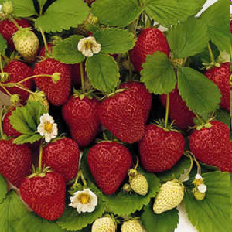
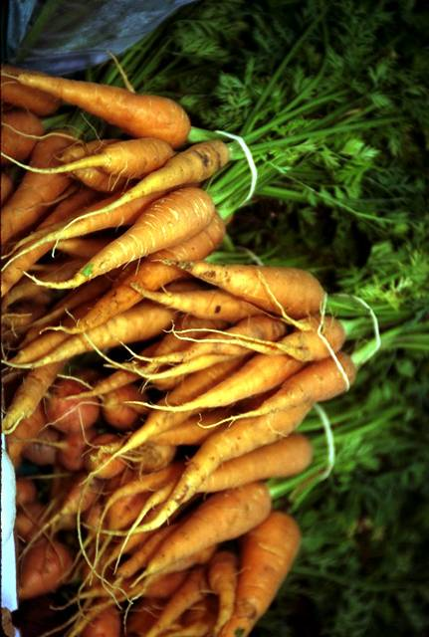
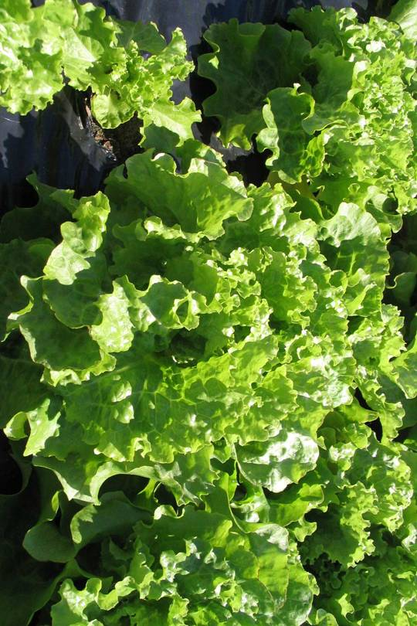
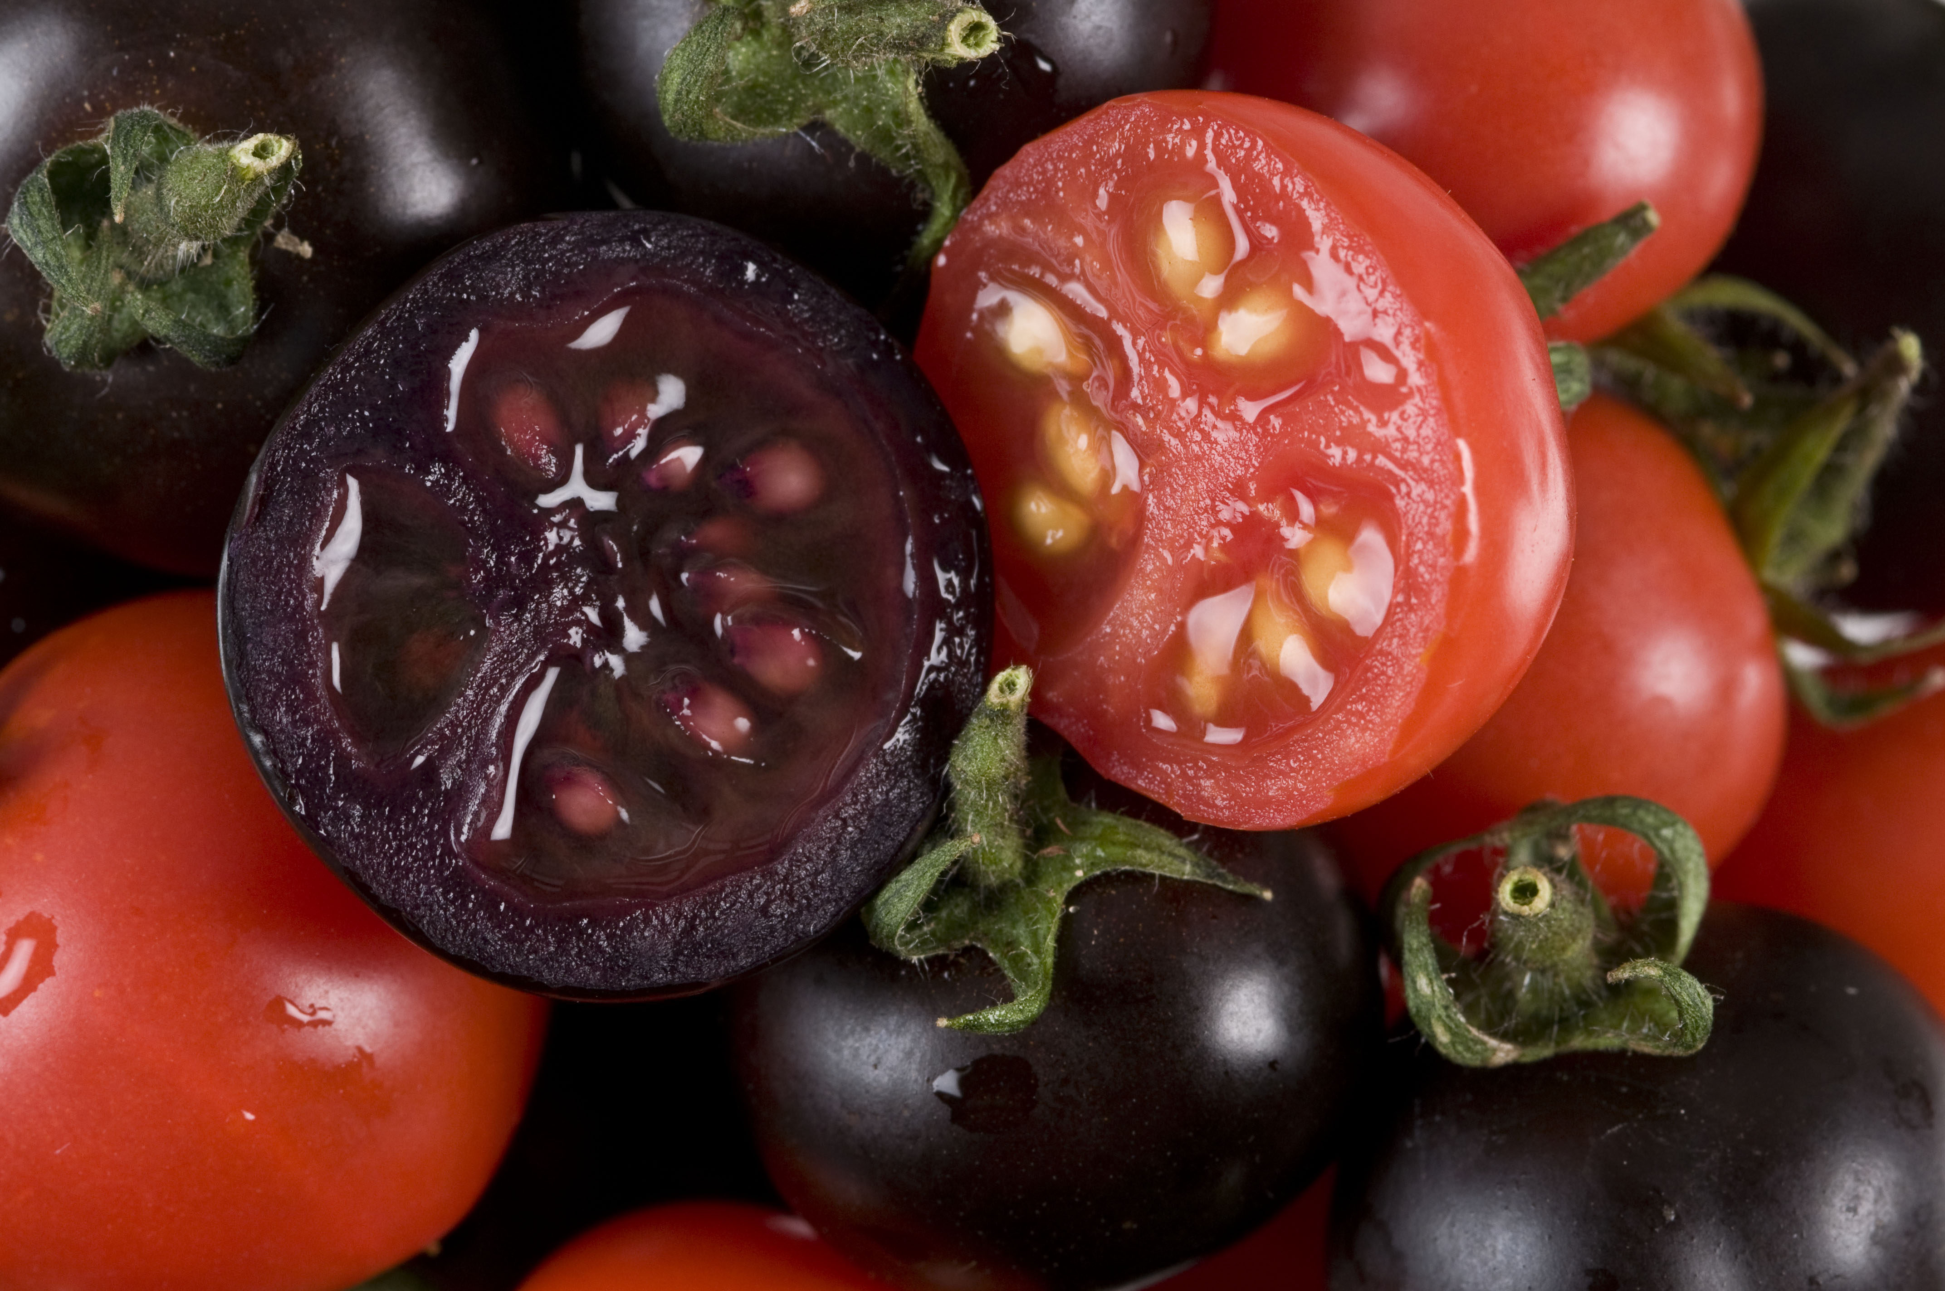
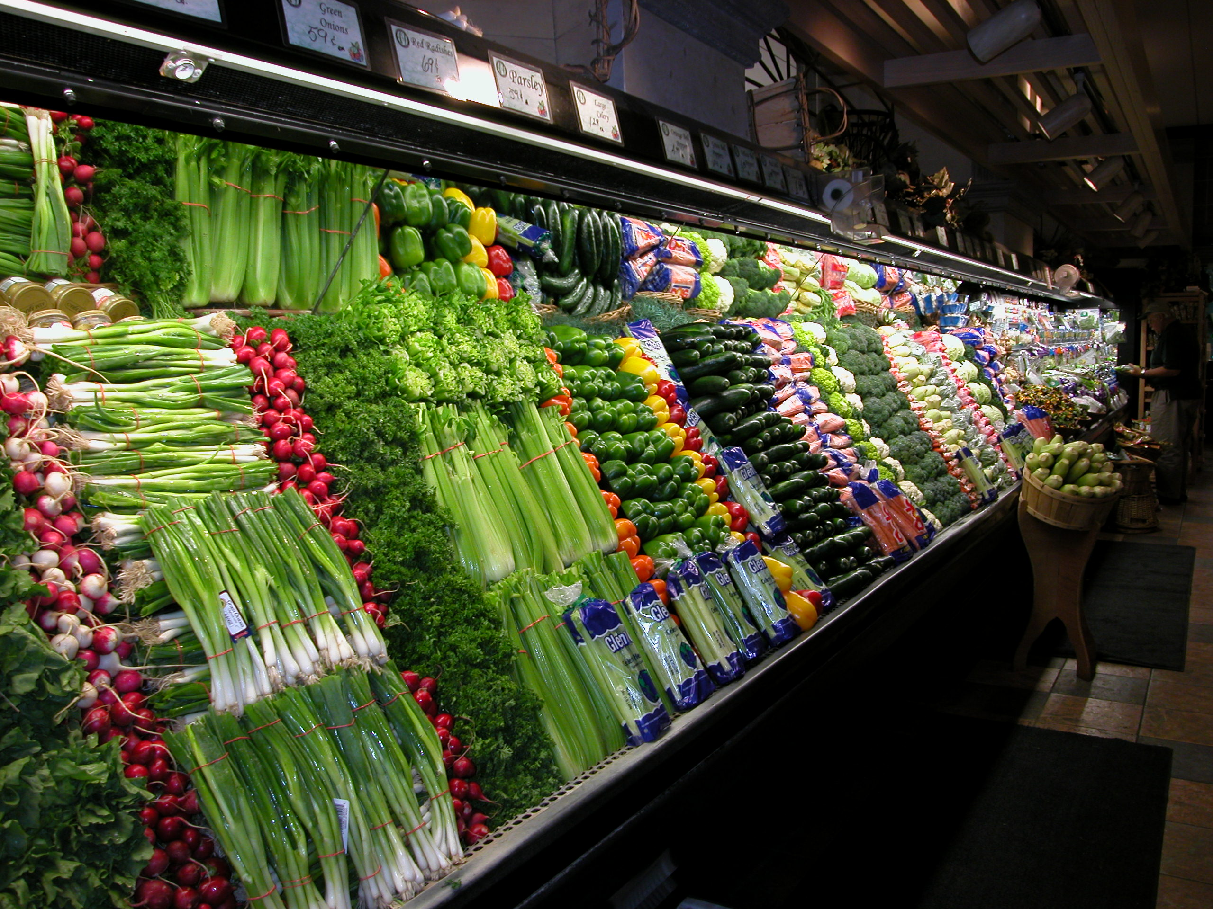
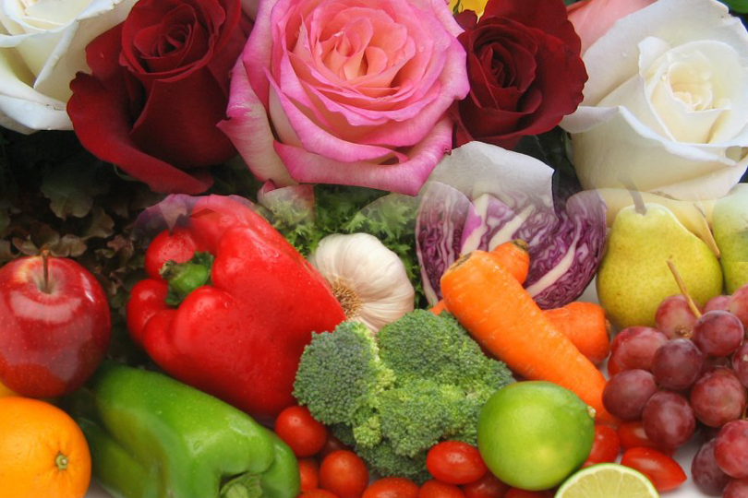

Current Status of GMO’s
Peggy G. Lemaux, Ph.D.
University of California, Berkeley
http:/ucbiotech.org
http://pmb.berkeley.edu/lemaux
Peggy G. Lemaux
University of California, Berkeley
http:/ucbiotech.org
http://pmb.berkeley.edu/lemaux

Slide 2
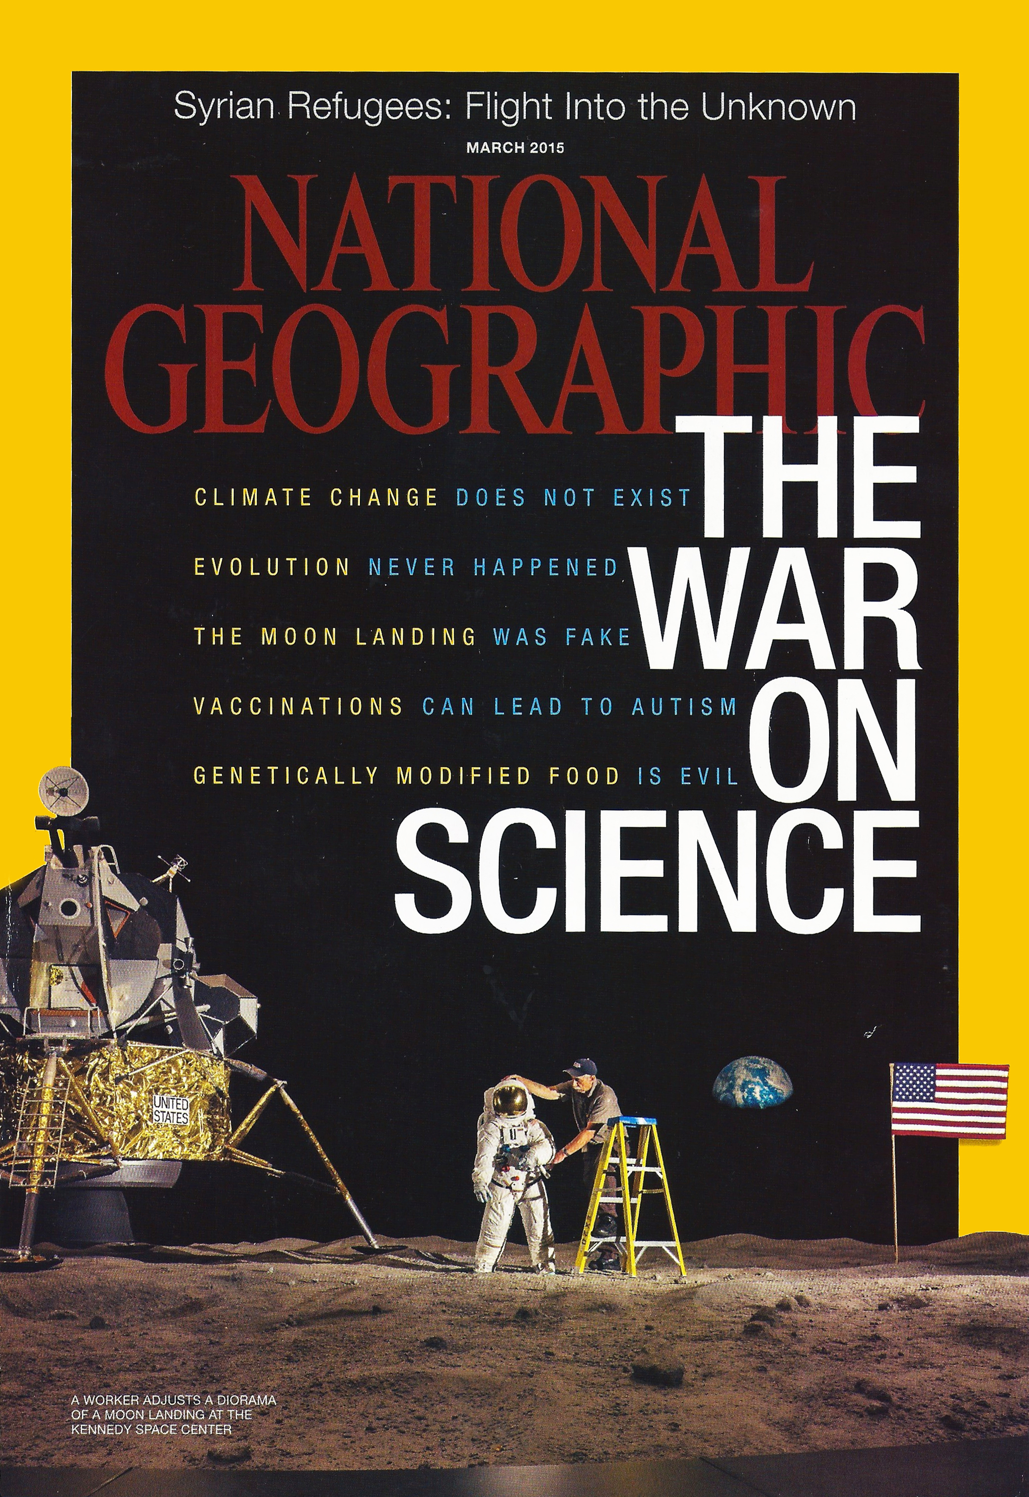
There seems to be doubt about many contemporary science issues
Consider the March 2015 National Geographic article highlighting public concerns about:
Climate Change
Evolution
Moon Landing
Vaccination
Genetically Modified Foods, GMO’s
Notes:
March 8, 2015

Slide 3
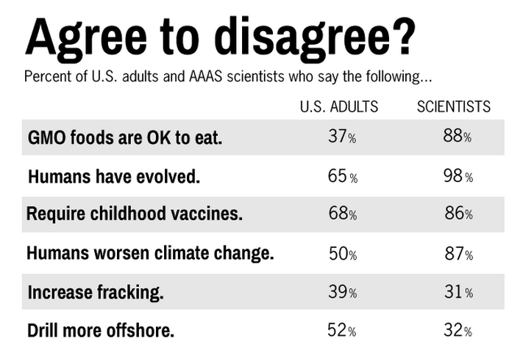
But, views of the public and scientists often disagree on these issues
SOURCE: Pew Research Center, January 29, 2015, “Public and Scientists’ Views on Science and Society”
http://www.pewinternet.org/2015/01/29/public-and-scientists-views-on-science-and-society/
Notes:
February 2, 2015

Slide 4


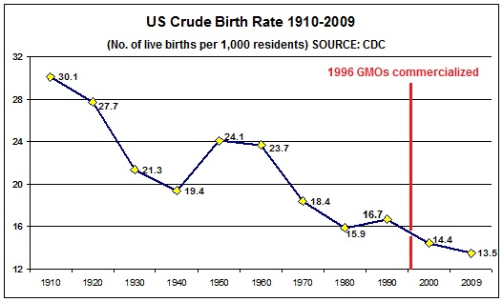
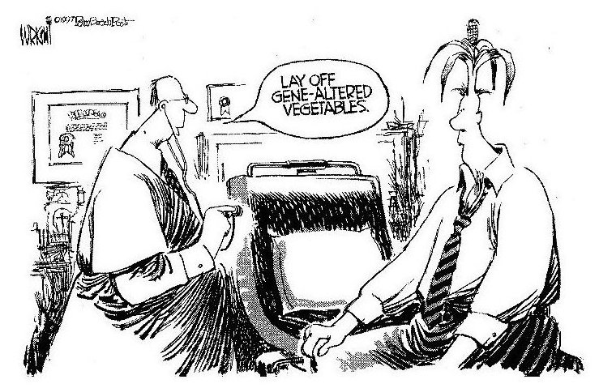
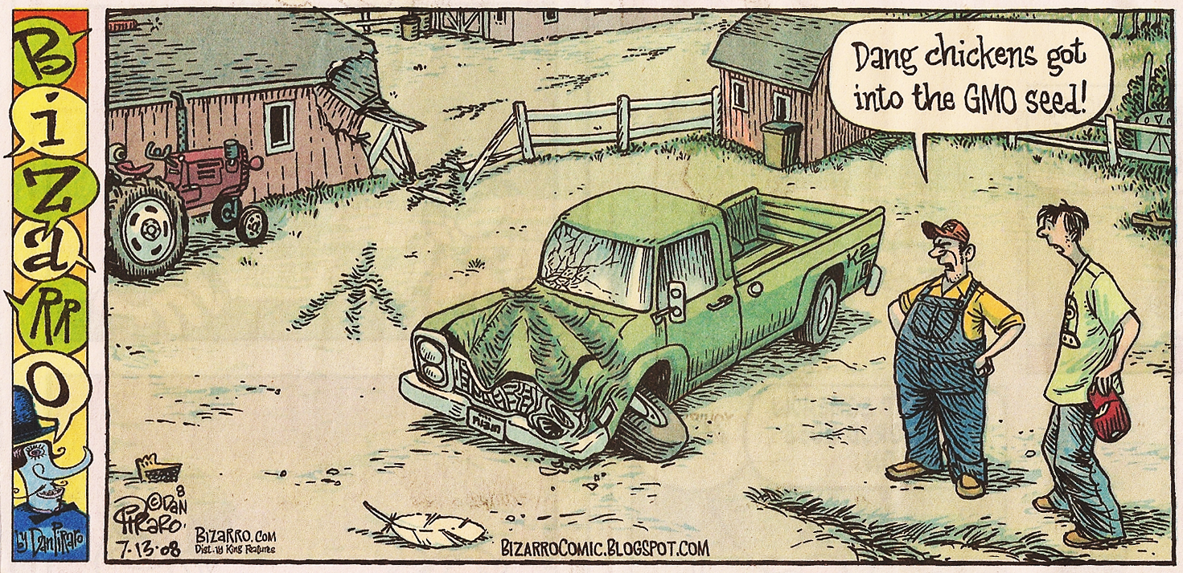
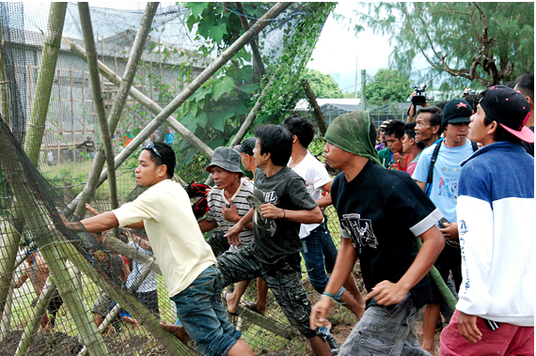
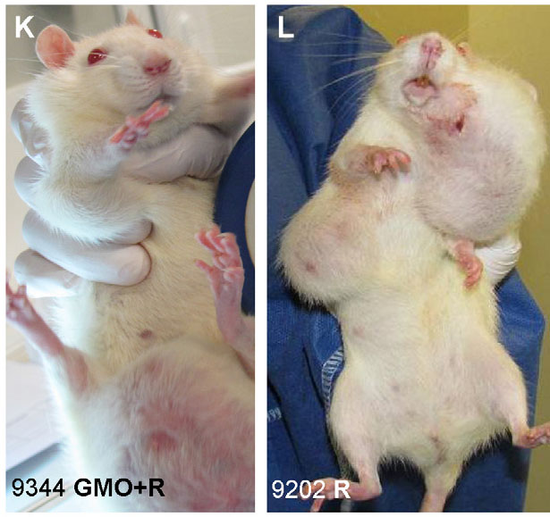
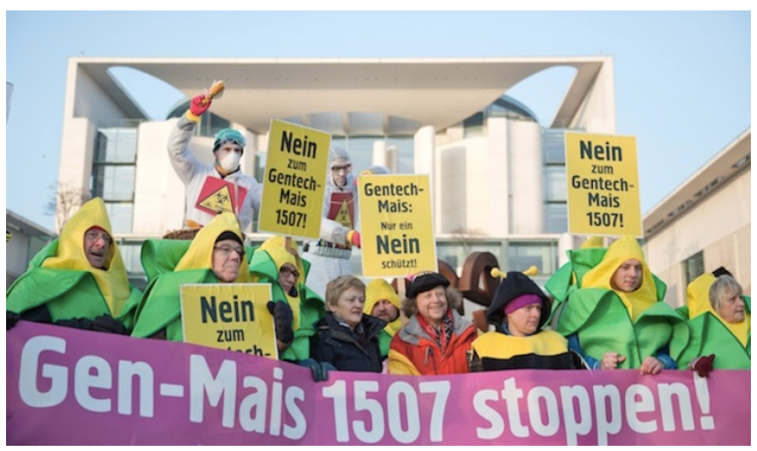
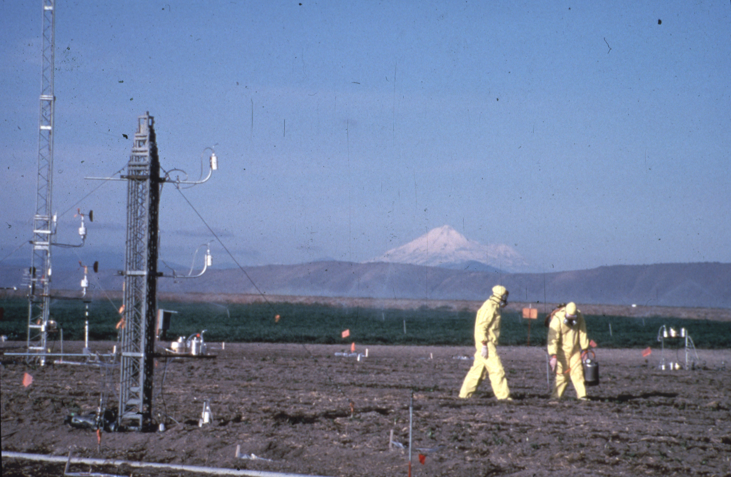
My focus today will be primarily on genetically engineered
(GE, GMO) crops and foods and some of the issues.

Slide 5
What Will I Cover?
What is genetic modification, genetic engineering (GE), biotechnology, GMO?
What GMO (genetically engineered, GE) crops
are commercial? What’s in the pipeline?
How are GE crops and foods regulated? Problems?
What are some food safety and environmental
issues?
Peggy G. Lemaux
University of California, Berkeley
http:/ucbiotech.org
http://pmb.berkeley.edu/lemaux

Slide 6
What is genetic modification, genetic engineering (GE), biotechnology, GMOs?

Slide 7
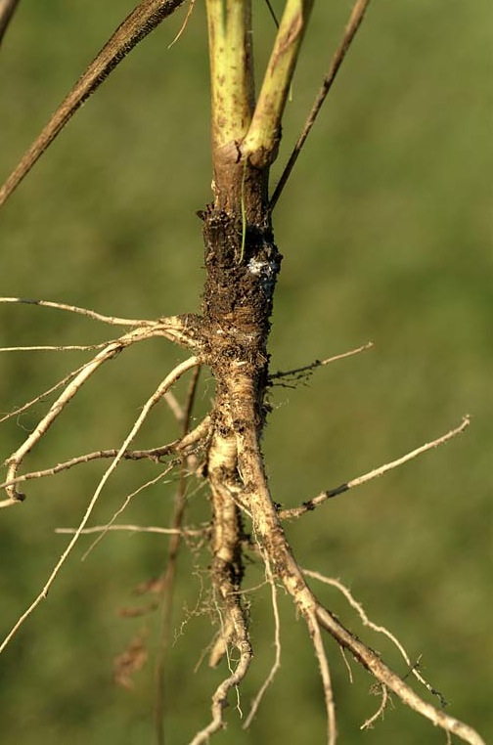
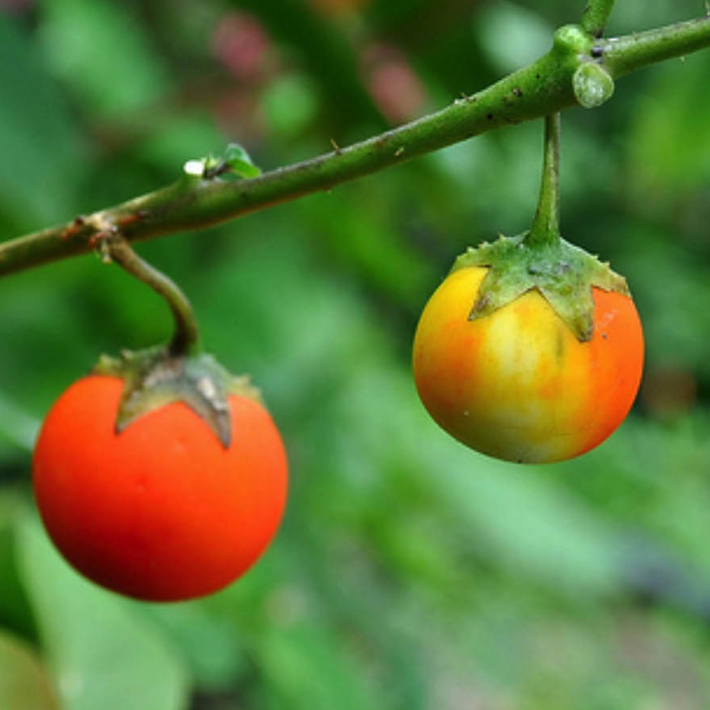
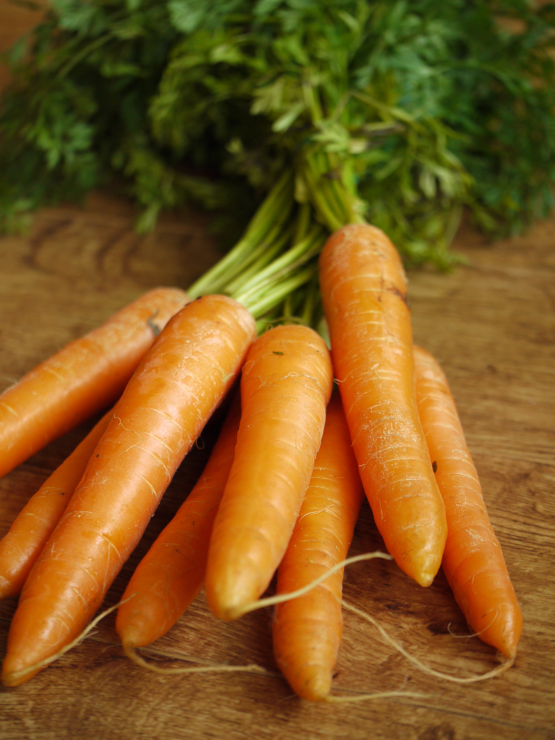
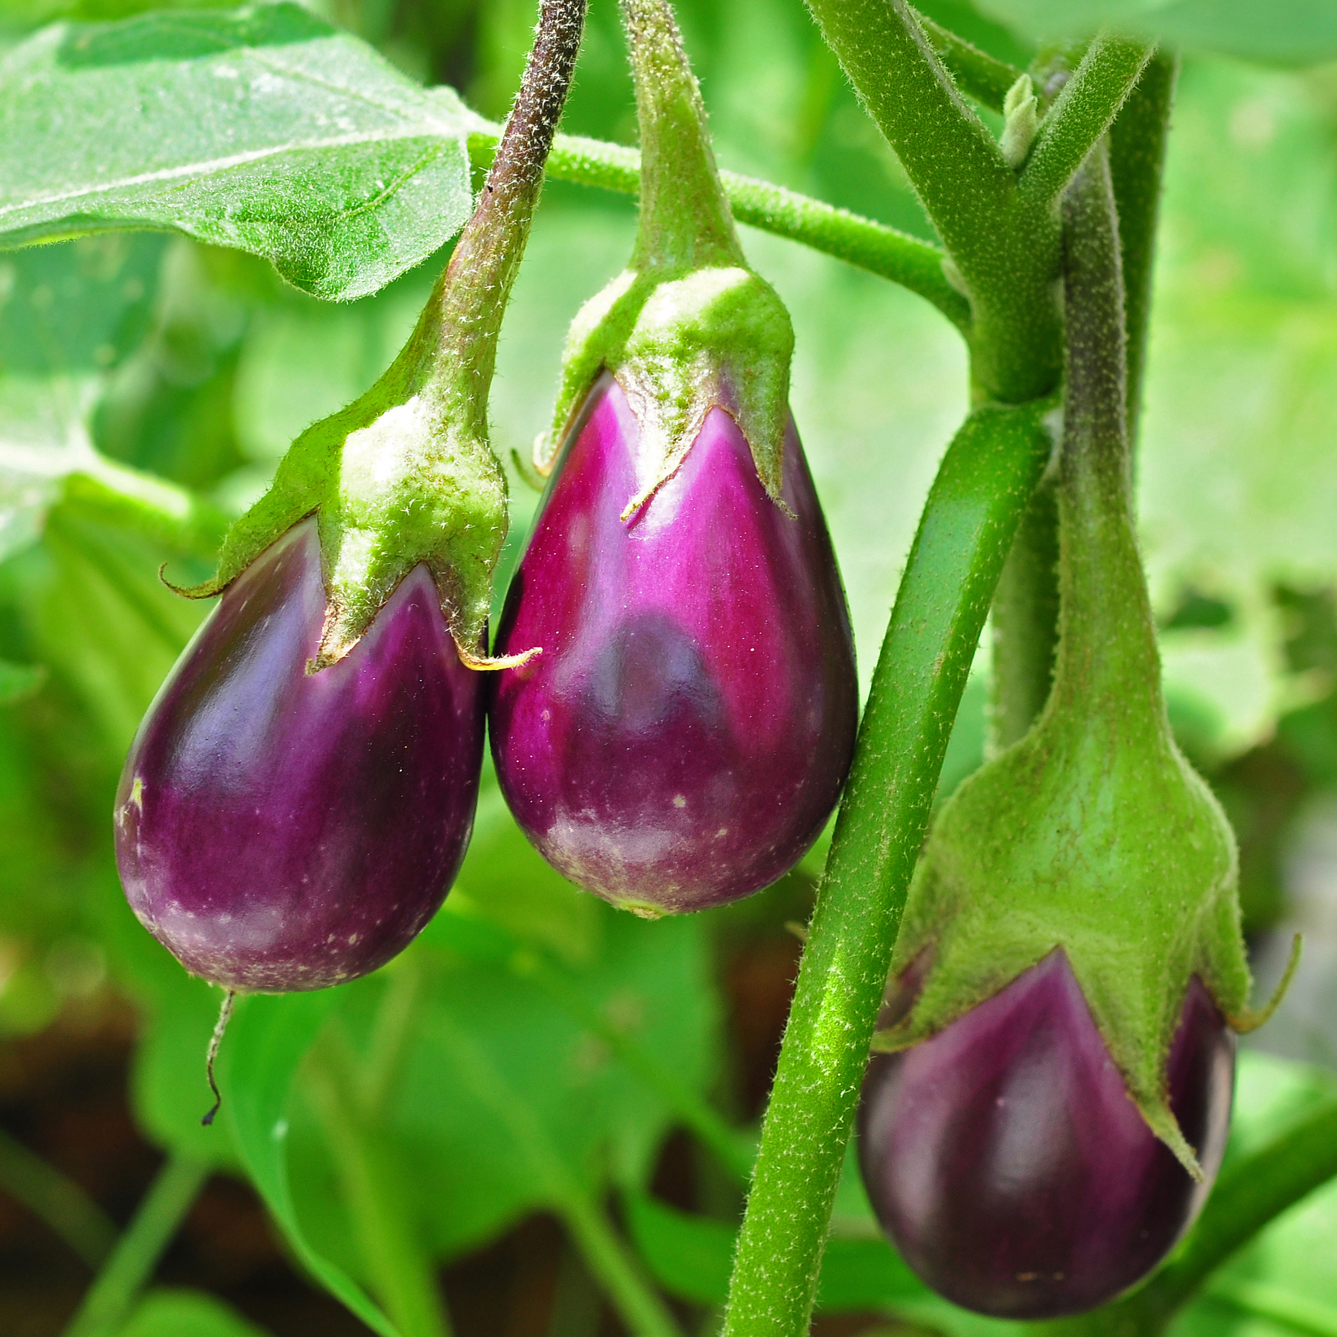
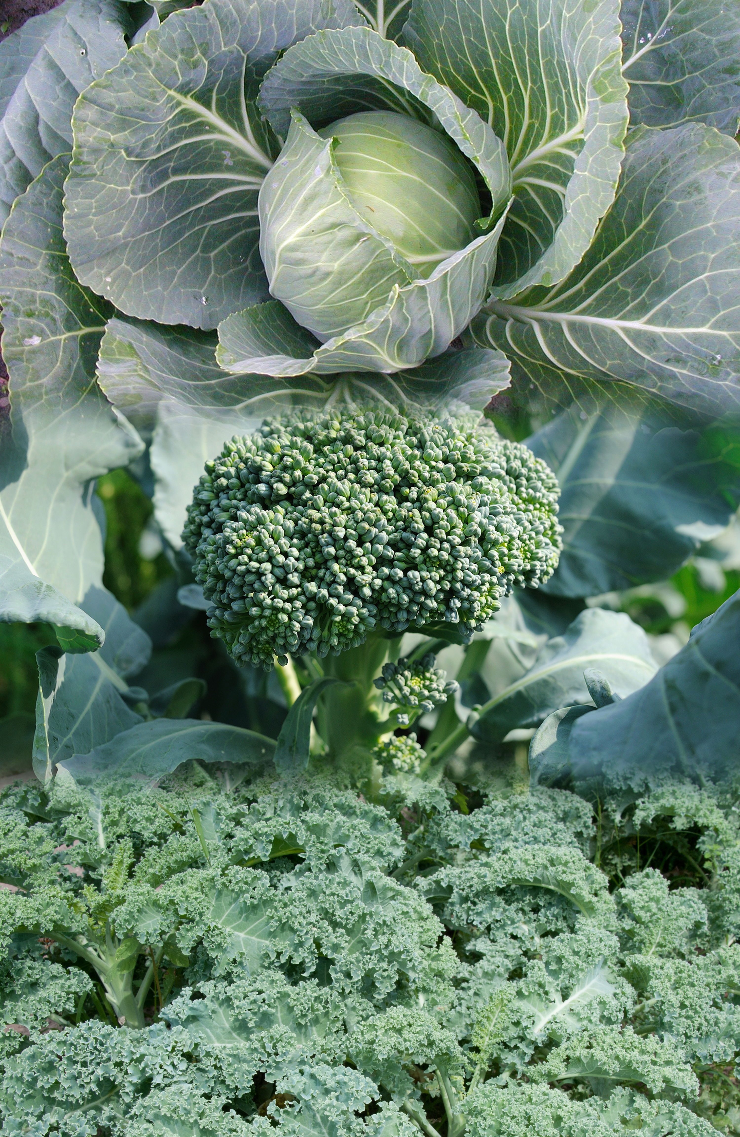
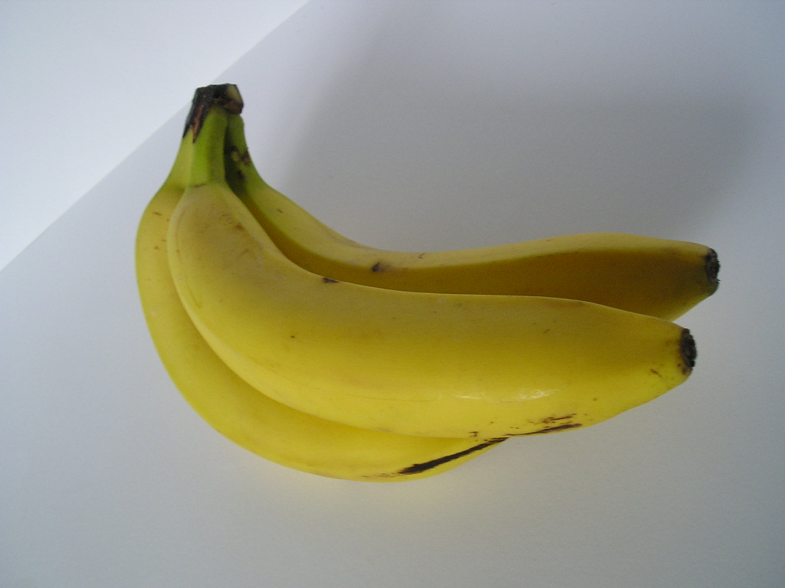
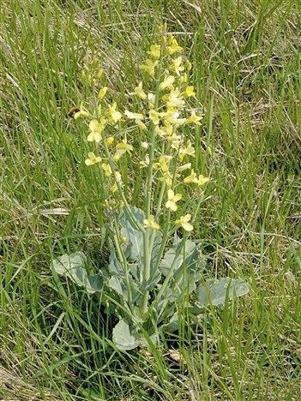
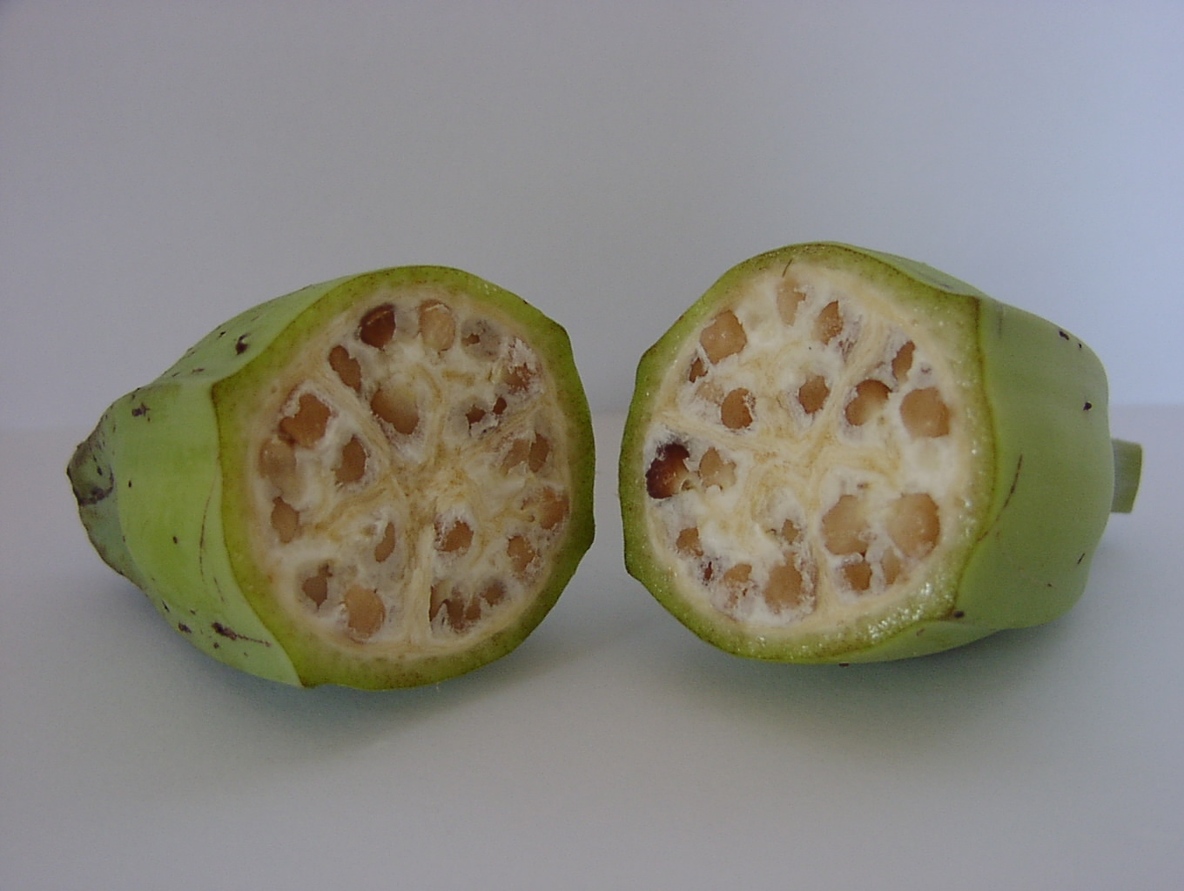
Have Foods Been Modified to Look Differently Today than Years Before?
YES!
Eggplant
Carrot
WHY?
Banana
Historically modifications happened via spontaneous mutations, crossing, and selection
Broccoli, Kale, Cabbage

Slide 8
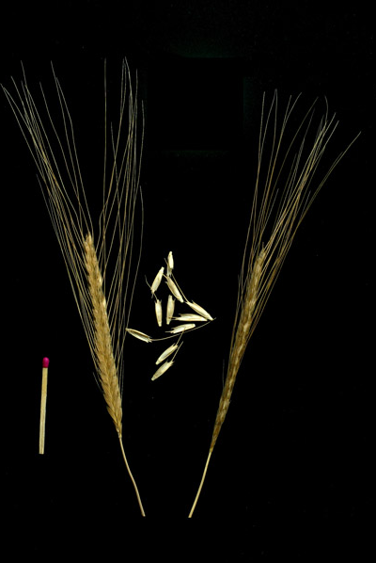
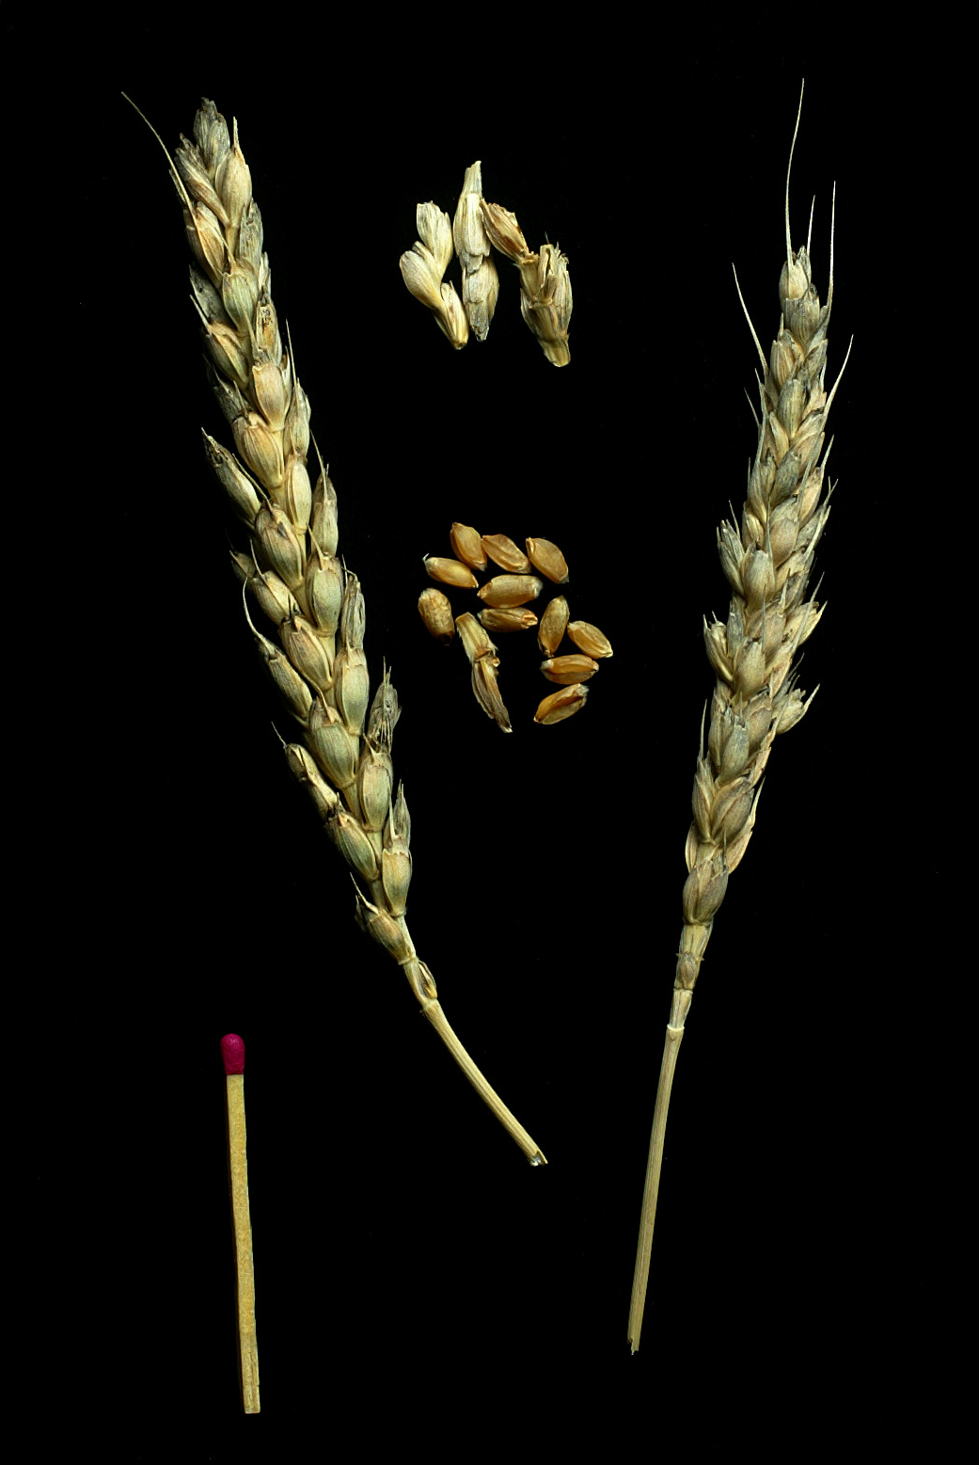
In recent times humans have intentionally modified plants using classical breeding?
What happens genetically during classical breeding of two plants
Triticum monococcum Ancient variety
Triticum aestivum
Modern bread variety

Slide 9
Genetic Information in Cells of Wheat Plant
Genetic information is made of chemical units – represent each unit with alphabetic letter
...CTGACCTAATGCCGTA...
1700 books
1000 pages each
1700 books
(or 1.7 million pages)

Slide 10
What happens during classical breeding?
Random retention of ~50% of the information from each parent
x
What is the outcome of the cross?
1700 books
(or 1.7 million pages)
1700 books
(or 1.7 million pages)
1700 books
(or 1.7 million pages)
Genetic modification that is not GE or GMO

Slide 11
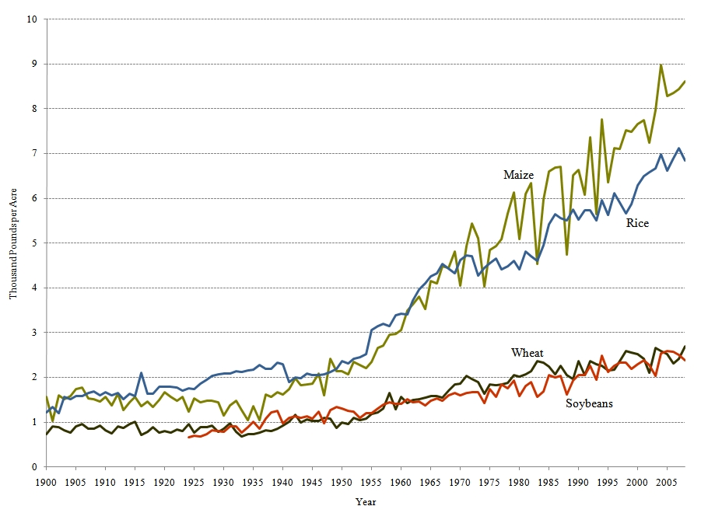
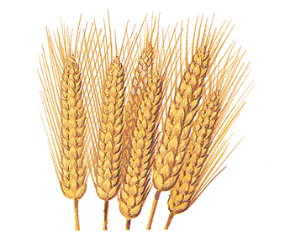
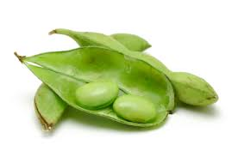
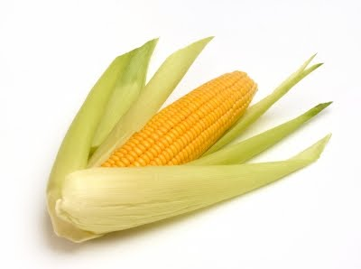
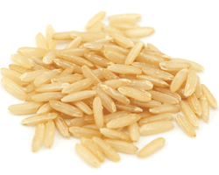
Yield increase by year
http://www.choicesmagazine.org/magazine/print.php?article=95

Slide 12
There are new ways to do breeding…
Uses table of contents of genes (genomics) for
marker assisted selection
...CTGACCTAATGCCGTA...
Increases speed of breeding process
Genetic modification that is not GE or GMO
1700 books
(or 1.7 million pages)

Slide 13
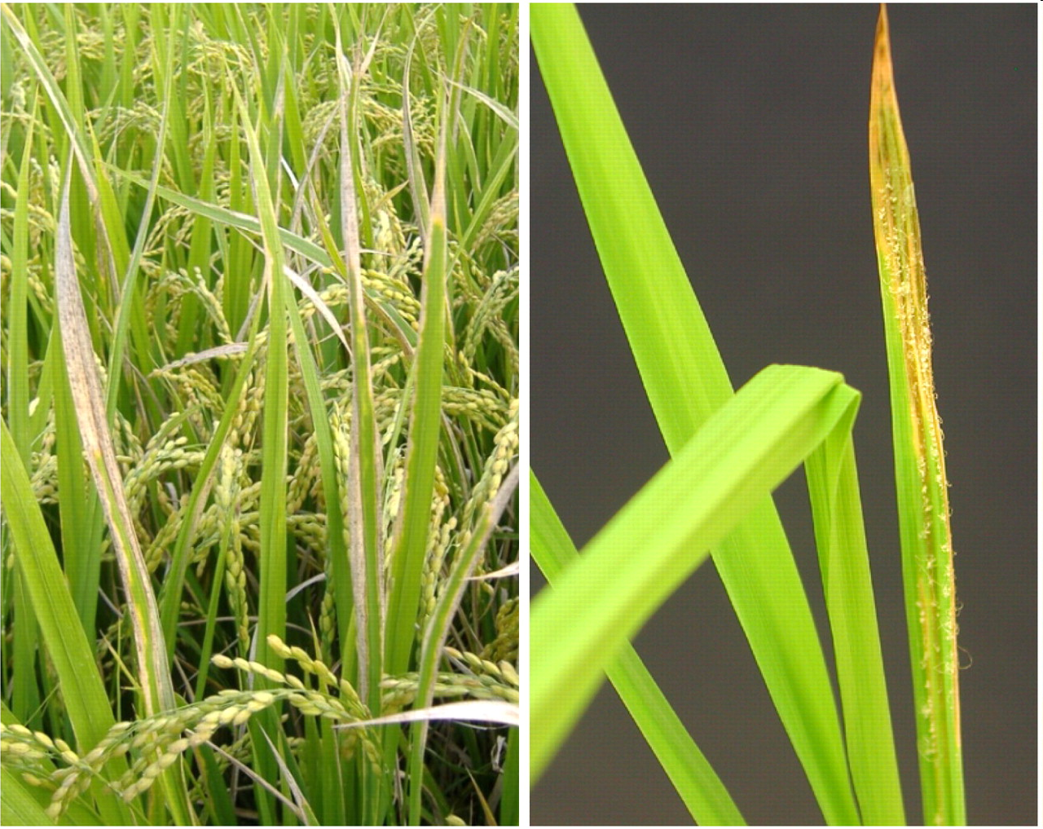
Can’t We Just Do All Modification This Way?
Marker-assisted selection was used to protect rice against bacterial blight and blast disease
Limited to diversity in crop and compatible relatives

Slide 14
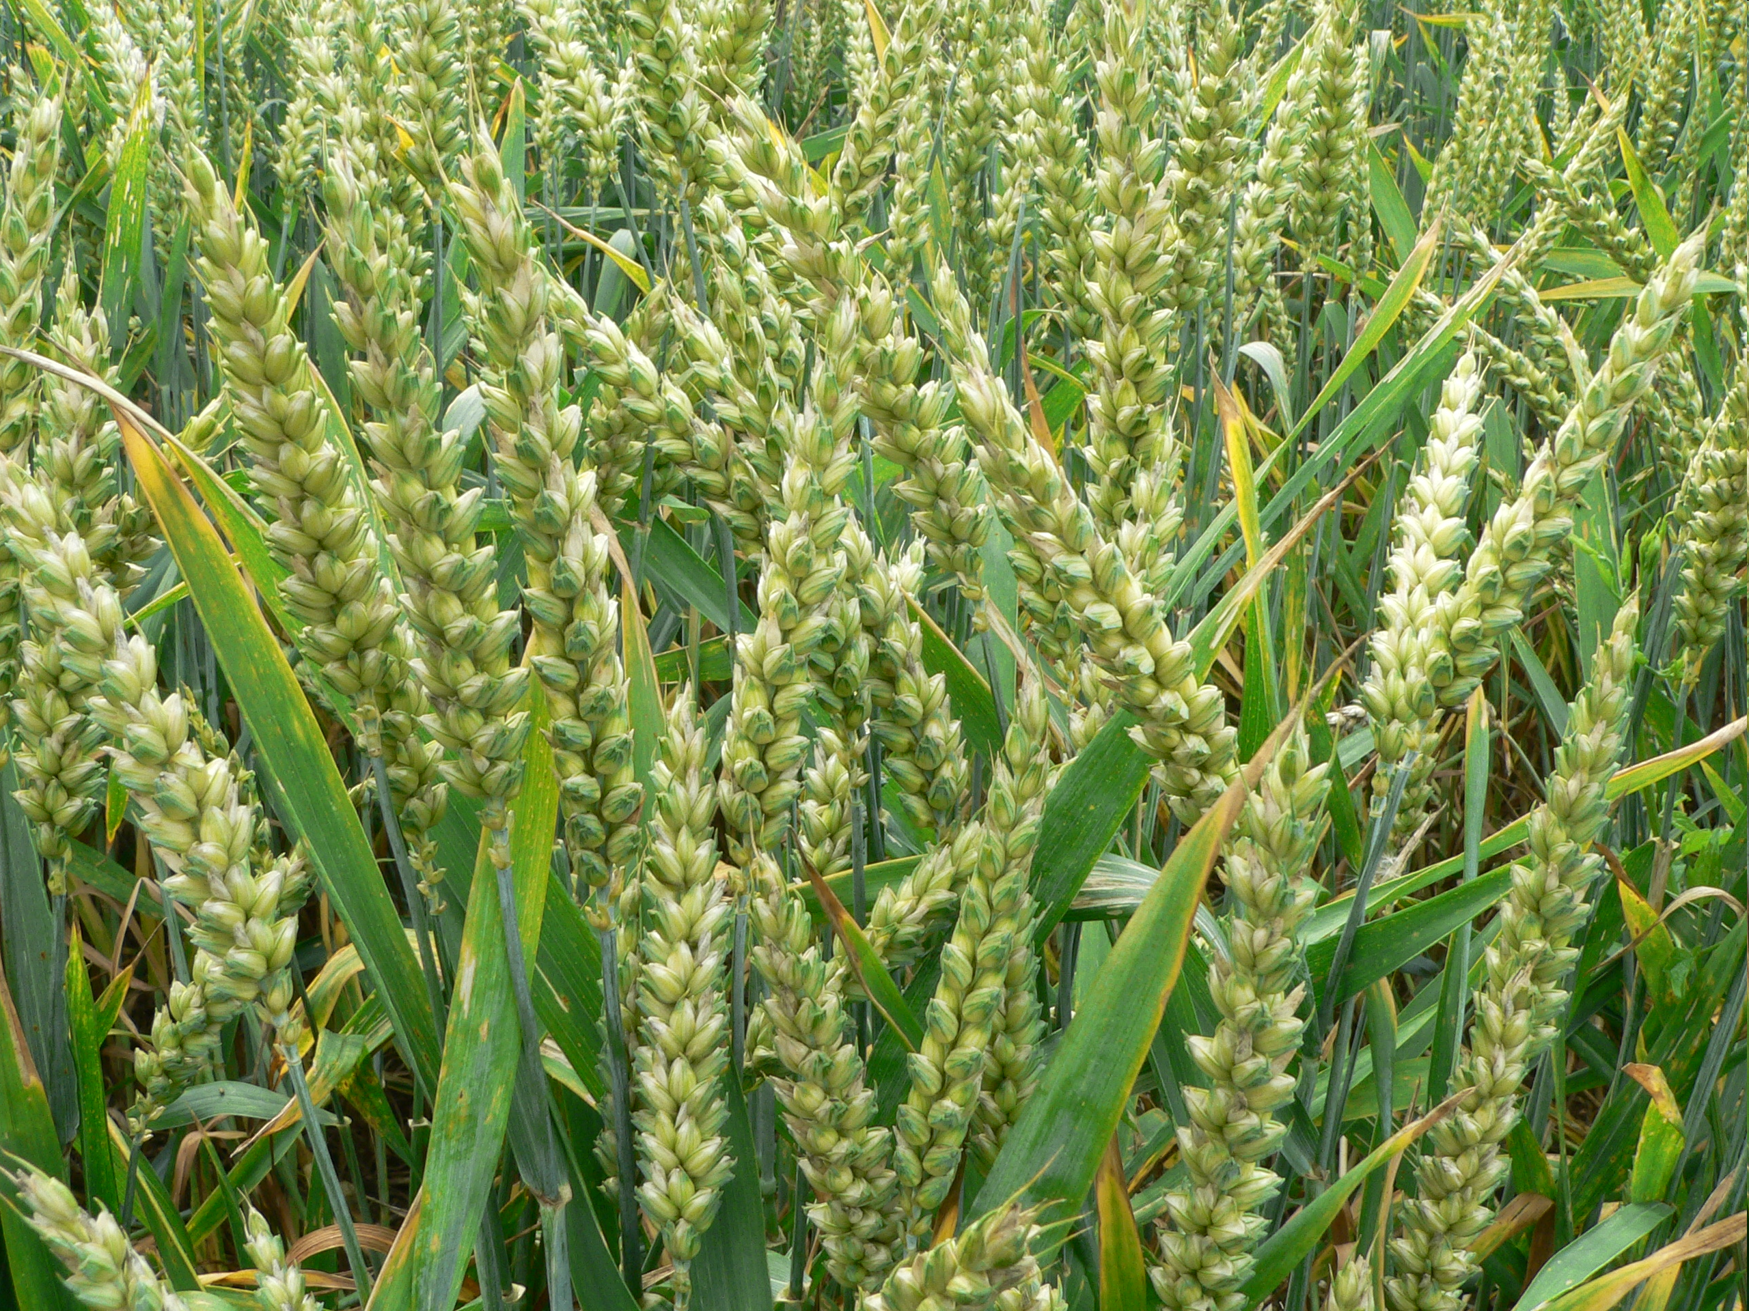
What other ways can the modern tools of genetics be used to create new varieties?

Slide 15
Genetic Engineering
Inserts randomly in genome
+
Inserted gene(s)
One-half page equivalent to a gene
1700 books
(or 1.7 million pages)
1700 books
(or 1.7 million pages)
Genetic modification that is GE and GMO

Slide 16
What Kinds of GE Crops and Foods Are in the Commercial Market?

Slide 17
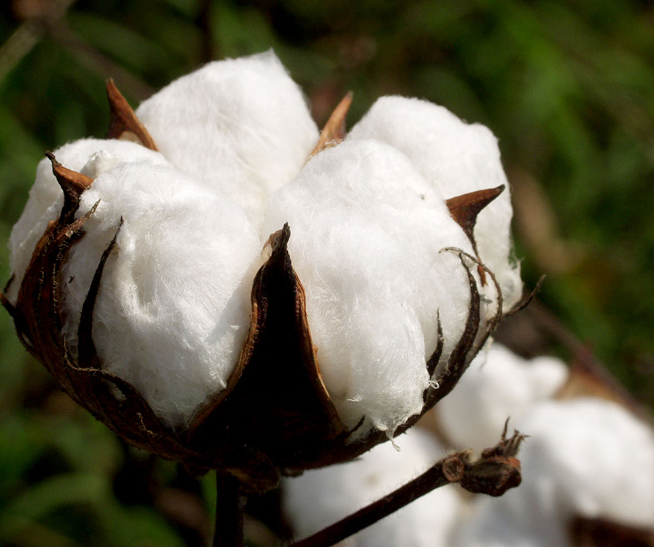
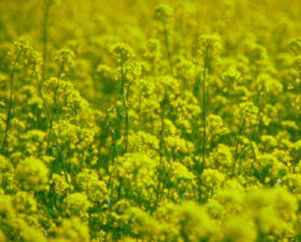
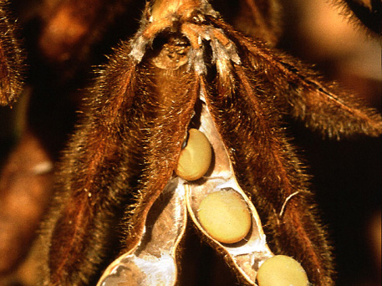
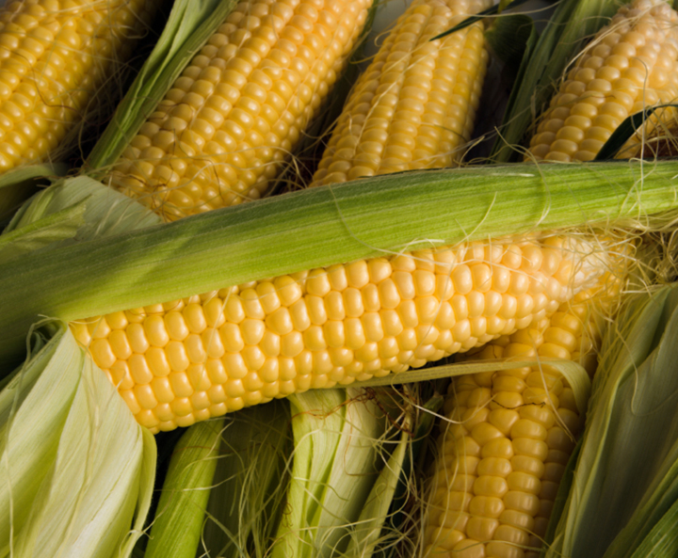
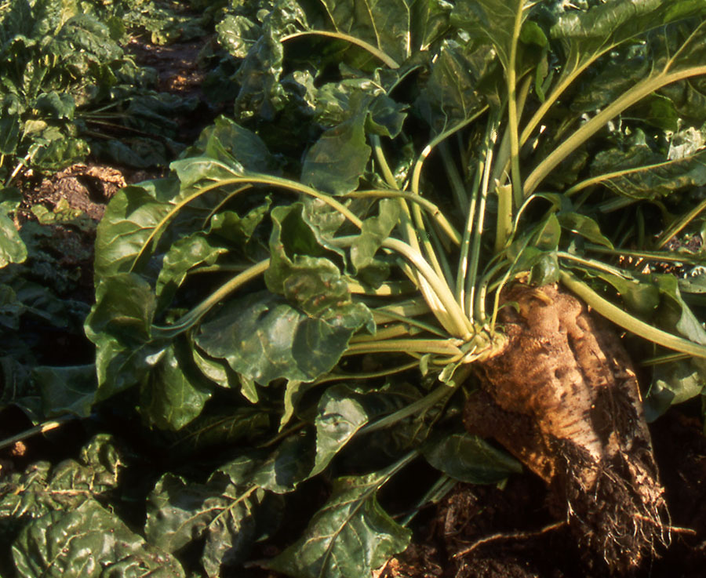
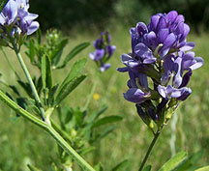
Number of commercial large acreage GE crops in U.S. is limited
GE Cotton
96% of 2014 acreage
(Insect Resistant: 5% Herbicide tolerant: 12% Stacked gene: 79%
GE Canola
93% of 2013 acreage
GE Soybean
94% of 2014 acreage
(Herbicide resistant: 94%)
Source: USDA-ERS, 2014
Source: ISAAA, 2011
Source: USDA-ERS, 2012
GE Corn
93% of 2014 acreage
(Insect Resistant: 4% Herbicide resistant: 13% Stacked gene: 76%)
GE Sugarbeet
98% of 2013 acreage
GE Alfalfa
25% of 2014 acreage
Source: USDA-ERS, 2014
Source: ISAAA, 2011
Source: Dan Putnam, UC ANR, 2014
Notes:
August 20, 2014

Slide 18
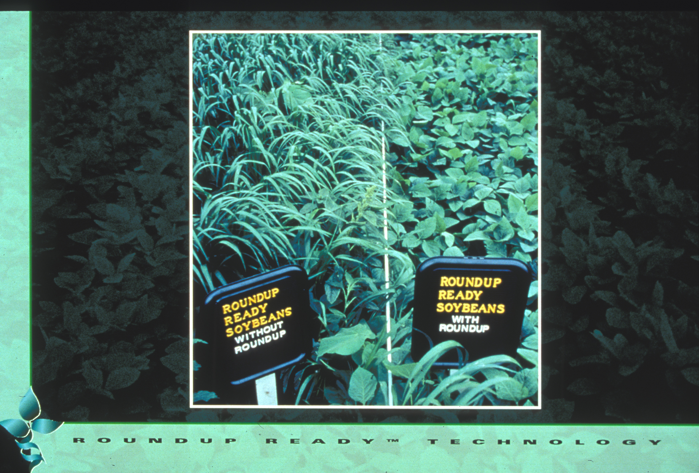
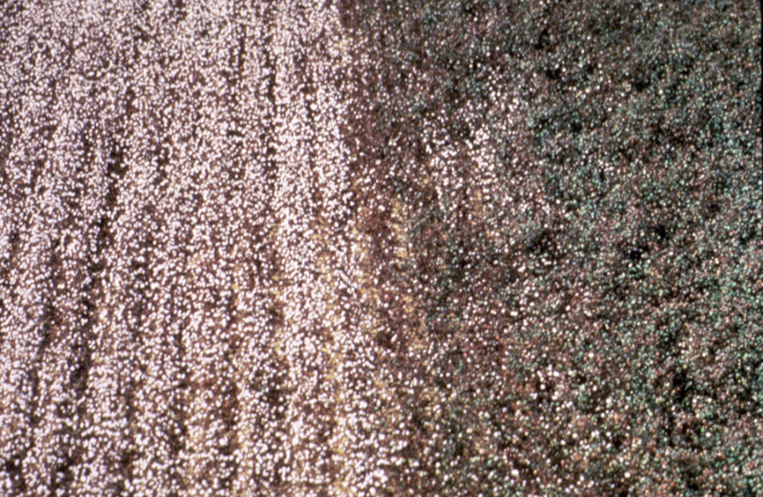
Roundup Ready Soybean™
Number of different traits available in large acreage GE crops is also limited
Herbicide-tolerant - engineered with gene to tolerate herbicide application
Insect-tolerant Bt crops - engineered for resistance using gene from naturally occurring bacterium
Crops with stacked traits - both Bt and HT - are available

Slide 19
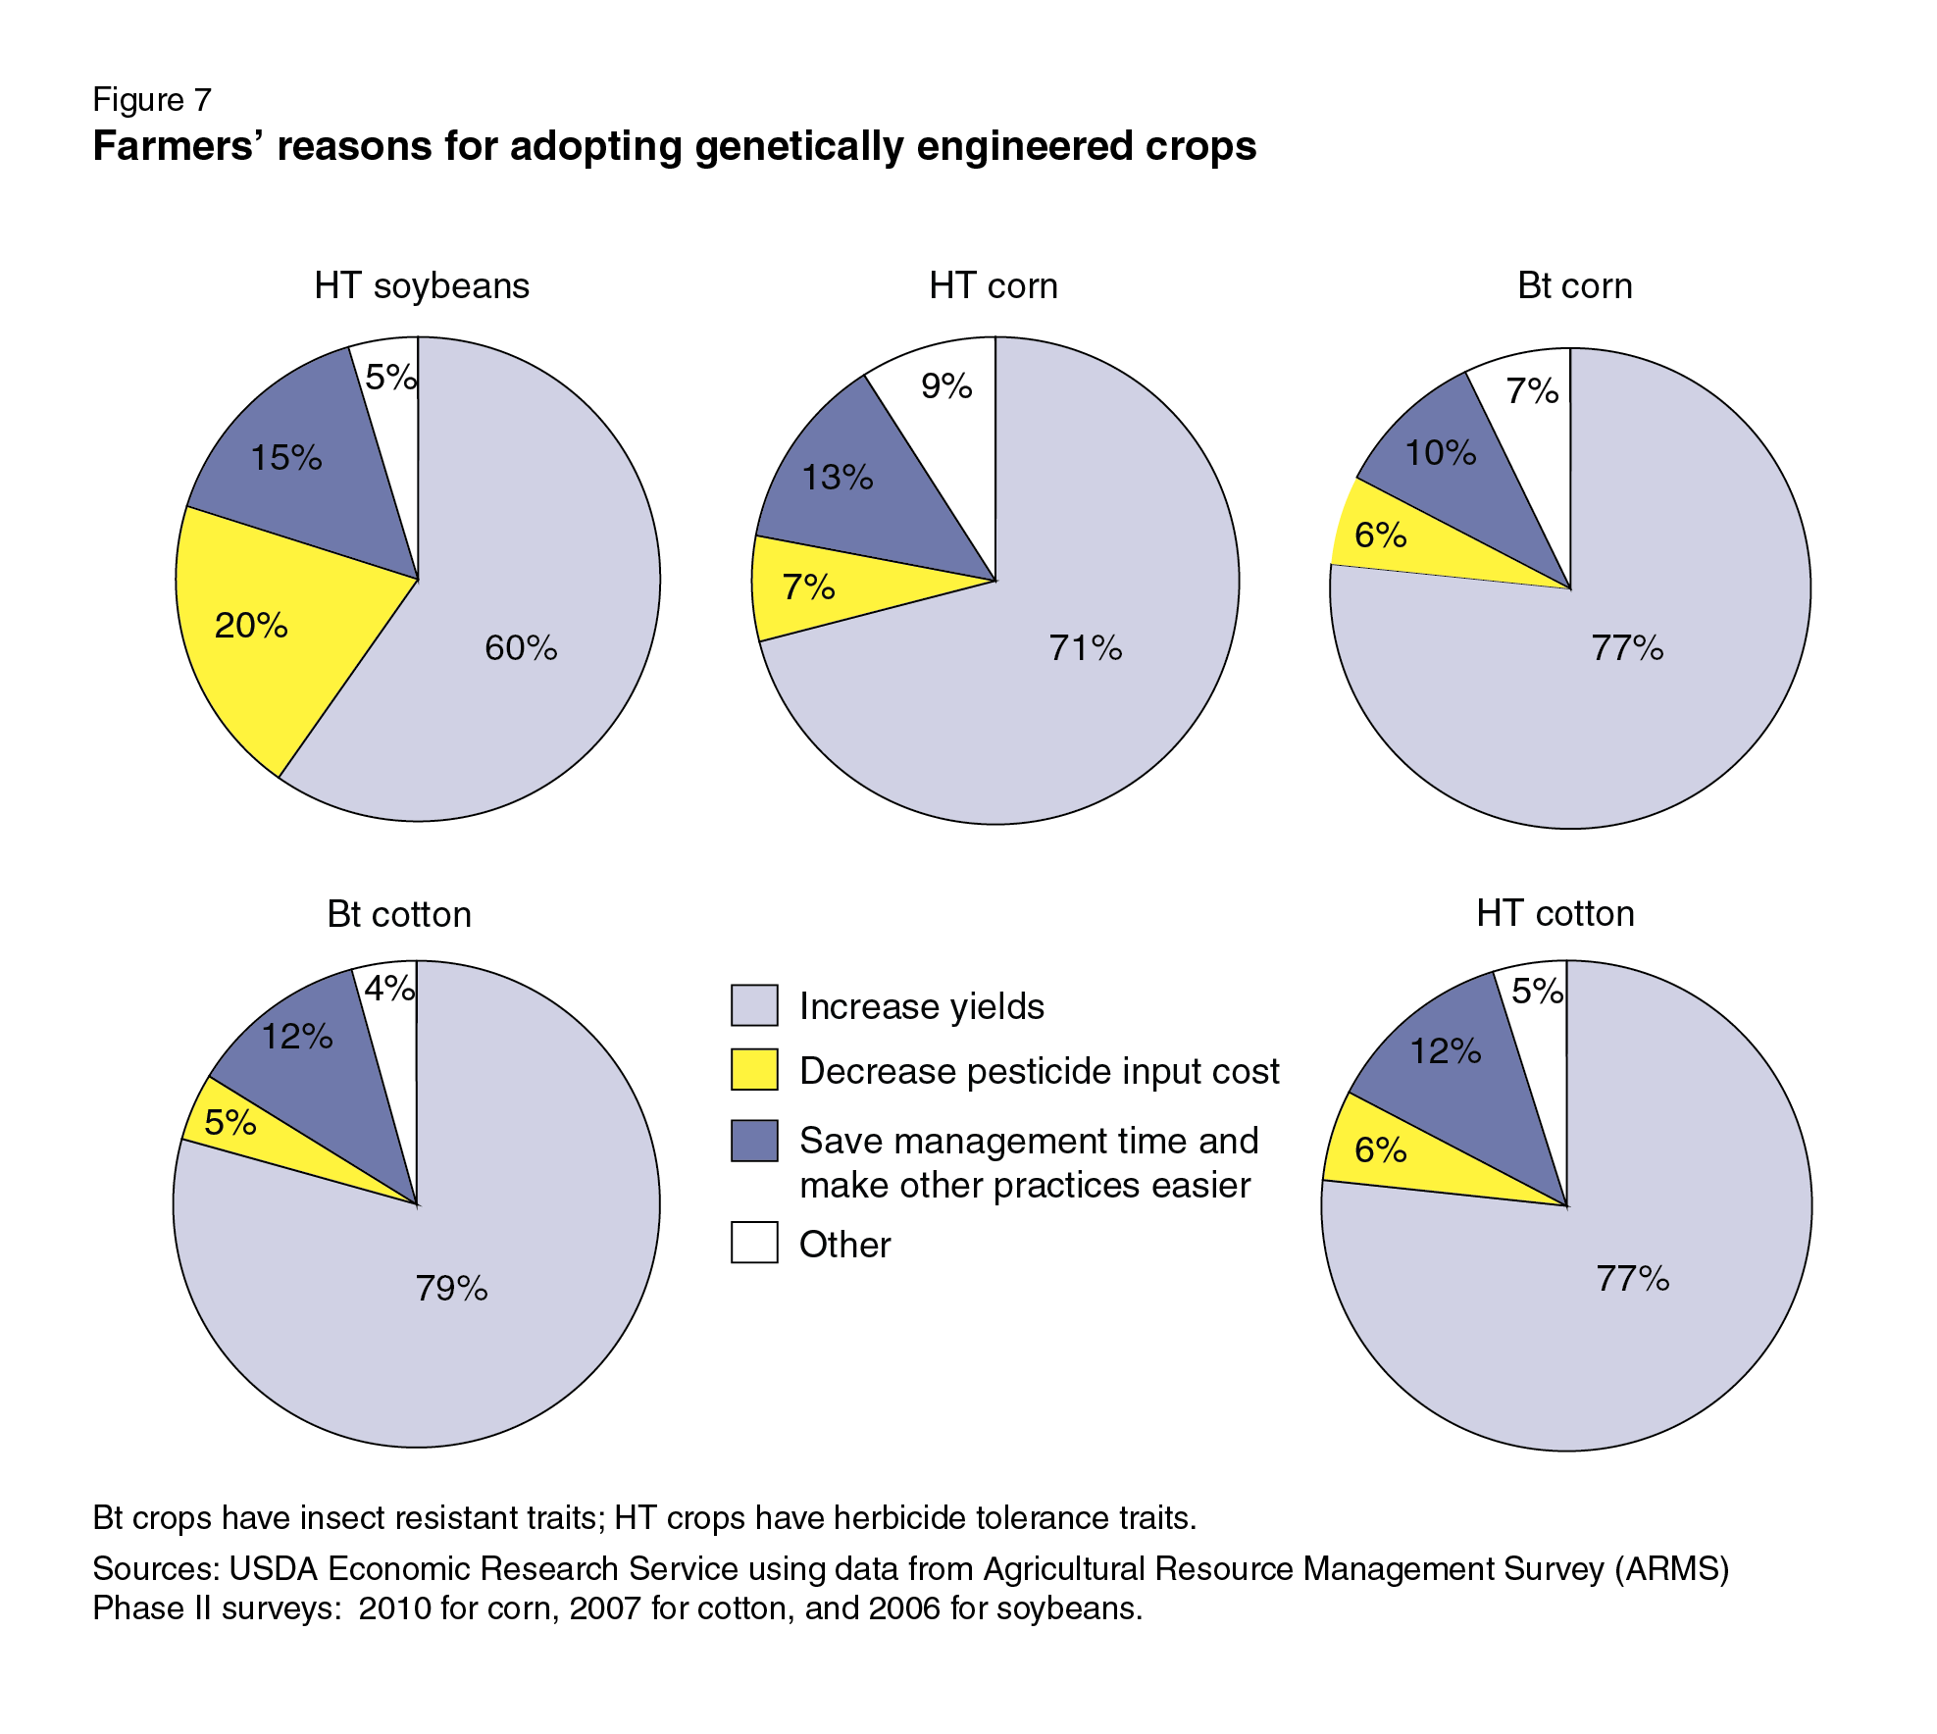
Why do U.S. growers use GE crops?
Reasons vary from crop-to-crop but primary reason is improved yields
SOURCE: Fernandez-Cornejo, J., Wechsler, S., Livingston, M. and Mitchell, L. 2014. Genetically Engineered Crops in the United States. USDA Economic Research Service Report No. 162, February 2014.
Notes:
March 25, 2014

Slide 20
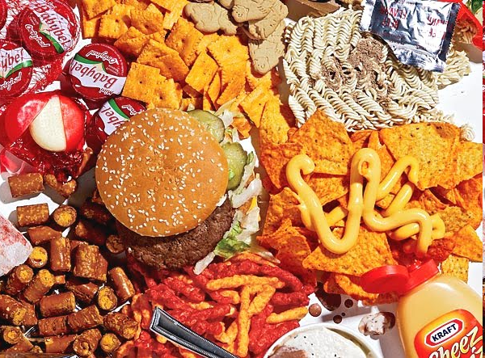
Corn oil
Canola oil
Soy lecithin
Soy protein
Corn starch
Cottonseed oil
These types of large-acreage GE crops lead to estimates that 60-80% of processed foods in U.S. have GE ingredients
SOURCE: https://factsaboutgmos.org/disclosure-statement

Slide 21
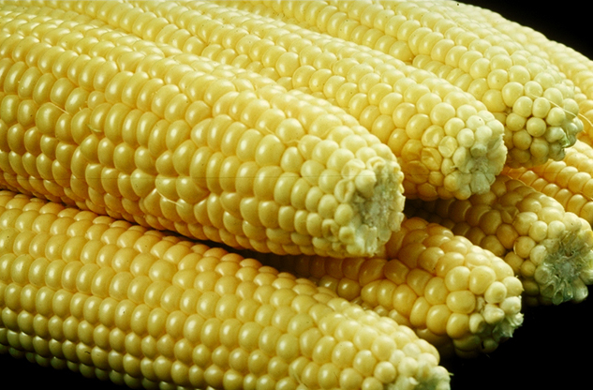
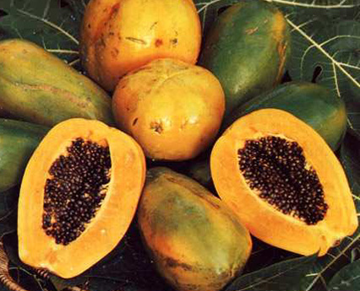
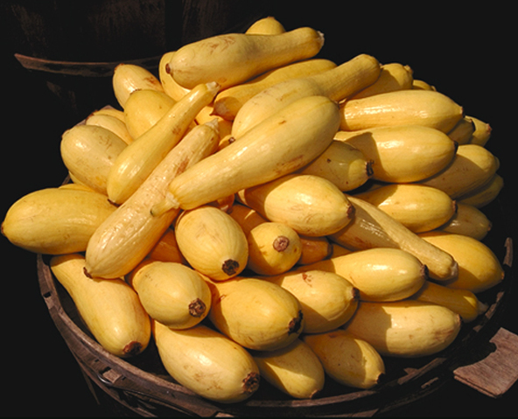
Only a few whole, GE foods are in the commercial U.S market
GE Sweet Corn
GE Papaya
GE Squash

Slide 22
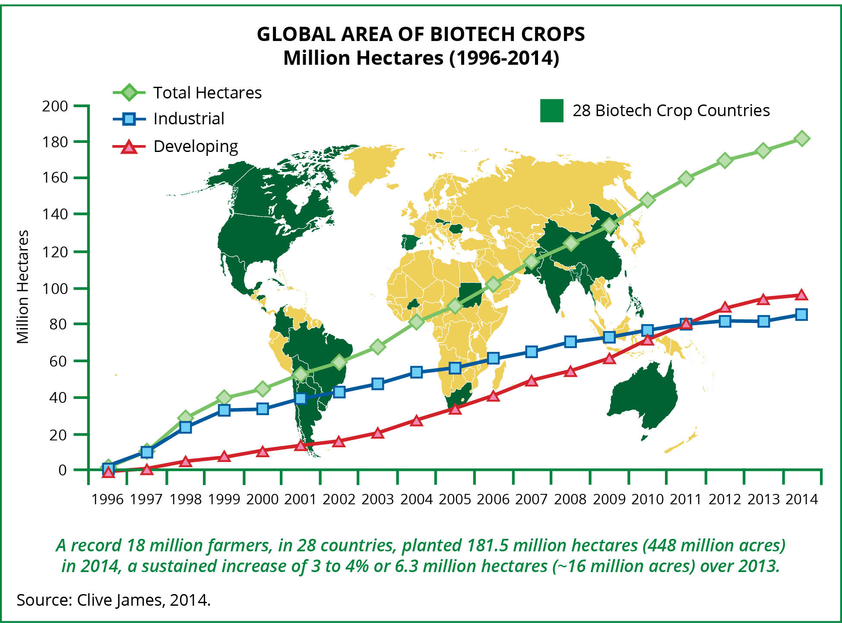
Despite limited crop and trait types, worldwide acreage is increasing in 20 developing, 8 developed countries
2014: 18 million farmers in 28 countries planted
448M acres (>4X size of California)
>90% small acreage farmers in developing countries
Clive James 2014 http://www.isaaa.org/resources/publications/briefs/46/executivesummary/
Notes:
A record 18 million farmers in 28 countries planted 175.3 million hectares (million acres) in 2013, a sustained increase of 3% or 5 million hectares (million acres) over 2012.
Ind = 81.2, Dev = 94.1, total = 175.3

Slide 23
What Kinds of GE Crops and Foods Are in the Pipeline?

Slide 24
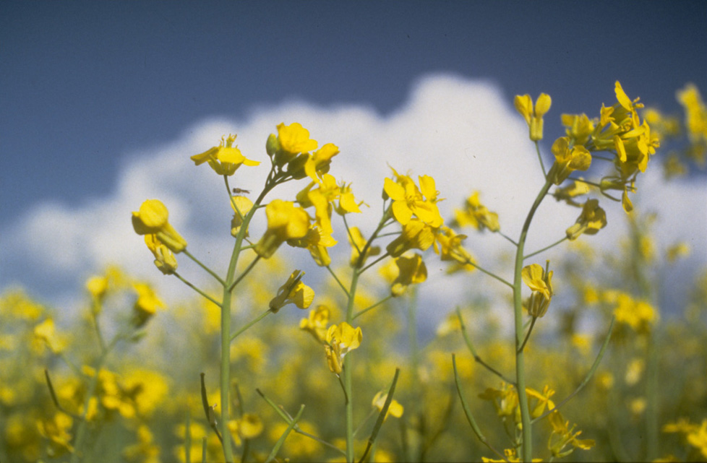
Arcadia Biosciences in Davis developed GE canola that uses 50% less nitrogen fertilizer
SOURCE: http://archives.foodsafety.ksu.edu/agnet/2007/4-2007/agnet_april_10.htm#story0

Slide 25
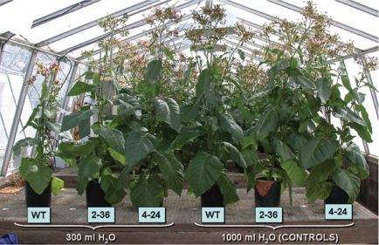
UC Davis researcher engineers drought tolerance: vigorous growth after prolonged drought
Drought
Normal water
Con
GE
GE
Con
GE
GE
SOURCE: Rivero, R.M., Kojima, M., Gepstein, A., Sakakibara, H., Mittler, R., Gepstein, S. and Blumwald, E. 2007. Delayed leaf senescence induces extreme drought tolerance in a flowering plant. Proceedings of the National Academy of Sciences USA 104: 19631-19636.

Slide 26
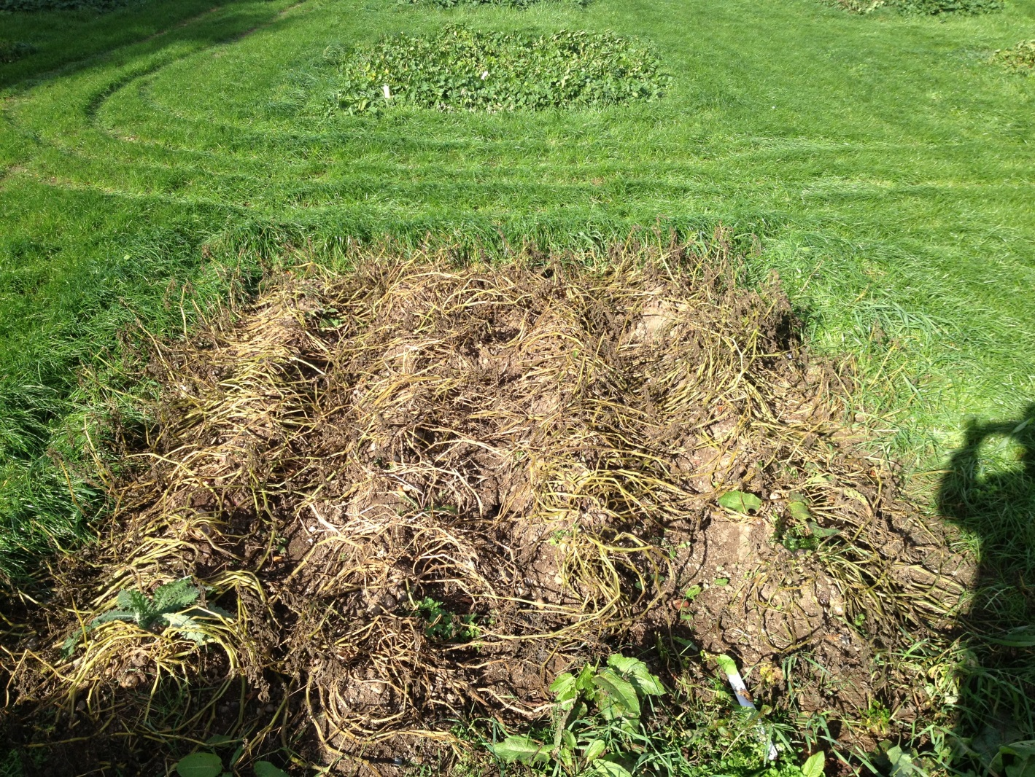



2013 GE potato field study – Ireland
Desiree potato variety, highly susceptible to late blight, engineered with gene from wild potato variety
GE Desiree
Non-GE Desiree

Slide 27
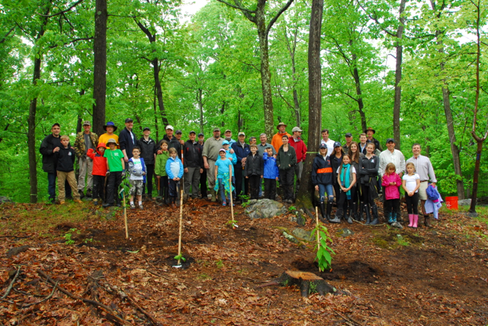

Chestnuts engineered with a wheat gene prevents cankers from forming; replanted with $104K raised through crowd funding campaign
http://www.newscientist.com/article/dn25644-american-chestnut
Notes:
American chestnut used to be major

Slide 28

High anthocyanin purple GE tomatoes protect against cardiovascular disease and certain cancers. Diets with 10% purple tomatoes increase lifespan of cancer-prone mice
Notes:
Purple fruit contains same level of anthocyanins as half basket of blueberries. Large orange tomatoes (~100g) have same amount of beneficial compound as 27 bottles of red wine (resveratrol). Yellow-fruited variety contains genistins, in amount equal to 150 g of tofu. Fourth variety has quercetin and kaempferol, health-promoting compounds found in capers, radishes, onions and watercress. Offer protection against inflammation, cancer and cardiovascular disease. http://news.jic.ac.uk/2014/03/bbsrc-most-promising-innovator/

Slide 29


Advanced genome-editing techniques used to create wheat resistant to powdery mildew
SOURCE: “Chinese Researchers Stop Wheat Disease with Gene Editing”, MIT Technology Review, July 21, 2014
http://www.technologyreview.com/news/529181/chinese-researchers-stop-wheat-disease-with-gene-editing/
Notes:
September 10, 2014

Slide 30
What is Genome Editing?
It is this one sentence which will be modified
It is that new sentence which will be modified
Inserts specifically in genome
+
Insert gene edits
Find target text, cut out, paste in new modified text
1700 books
(or 1.7 million pages)
1700 books
(or 1.7 million pages)
Genome editing may or may not be GE or GMO

Slide 31
How are GE crops and foods regulated in the U.S.?

Slide 32
U.S. Regulatory Agencies
USDA
FDA
EPA
Field testing
Permits
Notifications
Determination of
non-regulated status
Food safety
Feed safety
Pesticidal plants
tolerance exemption
registrations
Herbicide registration
Plant pest?
Danger to people?
Risk to environment?

Slide 33
USDA APHIS Determines Nonregulated Status 111 granted: 8-2-2014
When sufficient data is collected, crops are deregulated and no longer require APHIS review for release or movement in U.S.
Alfalfa - HT – removed, reinstated
Apple - PQ
Corn - HT, IR, AP
Cotton - HT, IR
Soybean - HT, PQ
Potato - IR, VR
Tomato - PQ
Squash - VR
Canola – HT
Papaya - VR
Plum - VR
Potato - PQ
Rice - HT
Rapeseed - HT, AP, PQ
Sugar beet - HT - removed, reinstated
Flax - HT
Chicory - AP
Tobacco – PQ
Rose - PQ
But then the courts weighed in on regulation
Large-scale production
Not on market
(http://www.aphis.usda.gov/brs/not_reg.html)

Slide 34

Although deregulated, U.S. Circuit Court directed APHIS to demand full environmental impact statement, preventing growers from planting GE sugar beets and GE alfalfa until statement was complete
SOURCE: “Appeals court rules biobeet challenge moot”, Capital Press, December 19, 2012
http://www.capitalpress.com/newest/mp-biotech-sidebar-121712
Notes:
January 15, 2013; environmental assessment

Slide 35


There are Other Regulatory Issues with GE Crops and Foods
Regulation of GE products unchanged since 1986 causing increased problems.
New products emerge with no rules to govern them
No clear path for commercialization of some old products
New products created to step around regulation
GE turfgrass: created without using a plant pest or plant pest part – sidestepping USDA regulation

Slide 36

Crops, being created using ‘genome editing’, were never imagined when regulations were created.
These new methods may avoid regulatory rules and costs ($10-20M per event) and may provide opportunities for smaller companies and university researchers to engineer less common crops
Notes:
USDA determined that Calyxt’s potatoes and soybeans, engineered for longer storage and healthier oil using a CRISPR alternative called TALENs, fall outside its
authority for GM plants.

Slide 37

Why Are GE (GMO) Crops and Foods So Controversial?

Slide 38

Look what greeted residents in California in late 80’s during first field test of GE organism, “ice minus bacterium” – men in moon suits spraying the organism on local fields.

Slide 39

Then large-scale pushback started in the late 90’s in Europe: Factors that fueled and continue to fuel controversy there
Food safety scares
Involuntary nature of change
Cultural differences
Economic incentives
1999
Lord Melchett participating in GM protest
And there are issues in the U.S. too
2014
GM maize protest in Germany

Slide 40
What are some food safety issues?
Lack of peer-reviewed food safety tests
Labeling
Creation of allergens or activation of toxins
Pharma crops contaminating food supply
Gene flow from food to intestinal bacteria increasing antibiotic resistance

Slide 41

On occasion widely publicized studies cast doubt on safety of GE foods, e.g., one by French researcher in Sept. 2012
Featured on Dr. Oz Show
Claim that Monsanto’s RR corn causes tumors in rats
Later reviewed by European Food Safety Authority: study had no merit – but that was not as widely publicized

Slide 42





But are GM foods safe?
2012 French review of published results showed GE foods are:
nutritionally equivalent to non GE foods
can be safely consumed in food and feed.
Based on 12 long-term (>90d to 2yr) and 12 multigenerational (2 to 5 generations) feeding trials of GE feed in animals
potato
rice
maize
soy
triticale
SOURCE: Snell C, Bernheim A, Berge J-P, Kuntz M, Pascal G, Paris A, Ricroch AE. 2012. Assessment of the health impact of GM plant diets in long-term and multigenerational animal feeding trials: A literature review. Food and Chemical Toxicology 50: 1134-1148.
Notes:
June 4, 2012

Slide 43

A second larger scale analysis in 2014, using public sources from 1983 to 2011, tracking over 100 billion animals raised on GE feed, concluded:
“no unfavorable or perturbed trends in livestock health and productivity”.
SOURCE: Van Eenennaam, A.L. and Young, A.E. 2014. Prevalence and impacts of genetically engineered feedstuffs on livestock populations. Journal of Animal Science, published online on September 2, 2014, doi:10.2527/jas.2014-8124.
http://www.journalofanimalscience.org/content/early/2014/08/27/jas.2014-8124
Notes:
September 24, 2014

Slide 44

What about labeling?

Slide 45
“Do you support or oppose the following government policies?”
Does the public want labels indicating they are GE? Anything else?
Support Oppose
A tax on sugared sodas 39% 61%
A ban on the sale of marijuana 47% 53%
A ban on the sale of food products made with transfat 56% 44%
A ban on the sale of raw, unpasteurized milk 59% 41%
Calorie limits for school lunches 64% 36%
Mandatory calorie labels on restaurant menus 69% 30%
Mandatory labels on foods containing DNA 80% 20%
Mandatory labels on foods produced with genetic engineering 82% 18%
Mandatory country of origin labels for meat 87% 13%
SOURCE: “80% Of Americans Support Mandatory Labels On Foods Containing DNA. DNA!”, iO9, 1/18/15. hom/80-of-americans-support-mandatory-labels-on-foods-cont-1680277802
Food Demand Survey, Oklahoma State University, January 16, 2015ttp://agecon.okstate.edu/faculty/publications/4975.pdf)
Notes:
January 22, 2015

Slide 46

Food labeling activity—2013
There is potential for a patchwork of local labeling laws because some states passed and others are considering such laws for products with GE ingredients – making it difficult for commerce.
SOURCE: “GE Labeling Resurrected in California, Petition For Ballot Measure Circulating in Colorado”, March 25, 2014, Food Safety News.
http://www.foodsafetynews.com/2014/03/gm-labeling-resurrected-in-california-petition-circulating-for-initiative-in-colorado/#.UznX9q1dVLM
Notes:
March 31, 2014

Slide 47

Non-legislative labeling efforts have arisen, like the popular Non-GMO Project label
SOURCE: “GMO Labeling: These Numbers Will Astound You”, The Motley Fool, 2/7/15
http://www.fool.com/server/printarticle.aspx?file=/investing/general/2015/02/07/gmo-labeling-these-numbers-will-astound-you.aspx
SOURCE: Costanigro, M. and Lusk, J.I. 2014. The signaling effect of mandatory labels on genetically engineered food. Food Policy 49: 259-267
Notes:
February 23, 2015

Slide 48

USDA now offers voluntary, for-a-fee verification of food companies’ claims that products contain no GMO’s - part of their audit program that verifies “grass-fed, antibiotic-free and humanely raised”
SOURCE: “U.S. action on GMOs stops far short of mandatory labels”, San Francisco Chronicle, 5/14/15.
http://www.sfgate.com/science/article/U-S-plan-to-vouch-for-GMO-free-foods-disappoints-6264407.php
Notes:
May 18, 2015

Slide 49


Also there is HR1599:
Requires safety reviews of GE foods before sale
Prevents states from having their own labeling laws
FDA can’t require labeling for GE foods only because they’re engineered
Passed in House; awaiting Senate consideration
So, labeling issue has not yet been resolved.
SOURCE: “Food industry seeks voluntary GMO labeling”, Washington Post, February 6, 2014.
http://www.washingtonpost.com/politics/federal_government/food-companies-propose-voluntary-gmo-labels/2014/02/06/78d2487c-8f4e-11e3-878e-d76656564a01_story.html
Notes:
February 11, 2014

Slide 50
What are environmental and economic issues?
Loss of efficacy of engineered trait?
Property rights (gene patents)?
Transfer of engineered genes to non-GMO/organic crops?
Spread of pharmaceutical genes into crops?
Loss of genetic diversity?

Slide 51
Insect Resistance
B.t. cotton and corn engineered for insect resistance with gene(s) from naturally occurring bacterium.
Development of resistant insects of herbicide-tolerant weeds
To date minimal insect resistance has occurred

Slide 52


B.t. originally thought to be detrimental to Monarch butterfly larvae but extensive research established minimal harm. But issue resurfaces due to Roundup’s impact on milkweed – an exclusive feedstock for butterfly larvae
SOURCE: “Groups seek glyphosate limits to protect butterflies”, Capital Press, September 3, 2014
http://www.capitalpress.com/Nation_World/Nation/20140903/groups-seek-glyphosate-limits-to-protect-butterflies
Notes:
September 15, 2014

Slide 53

Herbicide Tolerance
Environmental impact associated with herbicide and insecticide use, as measured by the Environmental Impact Quotient, fell by 17.1%
But was there a consequence?
SOURCE: Brookes, G. 2012. Genetically Engineered Crops: Environmental Impacts 1996-2009. ISB Report, January 2012, pp. 1-5
Brookes, G. and Barfoot, P. 2011. Global impact of biotech crops: Environmental effects 1996-2009. GM Crops 2: 34-49
Notes:
March 8, 2012

Slide 54

Glyphosate- Resistant Weeds – USA December 13, 2010 – adapted from: www.weedscience.org
Occurrence of glyphosate-resistant weeds - due to mutation, gene flow, weed shift – was exacerbated when same herbicide is used repeatedly
Ambrosia artemisiifolia Common Ragweed
Amaranthus tuberculatus (syn. rudis) Tall Waterhemp
Ambrosia trifida Giant Ragweed
Lolium multiflorum Italian Ryegrass
Poa annua Annual Bluegrass
Kochia scoparia Kochia
Lolium rigidum Rigid Ryegrass
Conyza canadensis Horseweed
Didn’t we already learn this?
Conyza bonariensis Hairy Fleabane
Eleusine indica Goosegrass
Sorghum halepense Johnsongrass
Amaranthus palmeri Palmer Amaranth
K. Neil Harker
AAFC - Lacombe, AB
Notes:
April 26, 2011
The arrows on the slide are colored as follows:
- Black = species biotype resistant to glyphosate
- Yellow = species biotype resistant to glyphosate + one more herbicide mode of action
- Red = species biotype resistant to glyphosate + two more herbicide modes of action
- Green = First confirmed species biotype resistant to glyphosate in Canada
Keep in mind that the map is only “up-to-date” for December 13, 2010.
54

Slide 55

Where to get more information on the issues?
http://ucbiotech.org
Notes:
55
February 16, 2012

