Slide 1
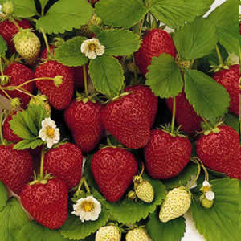
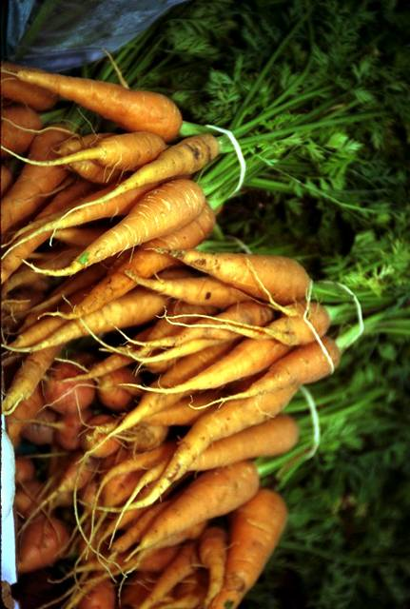
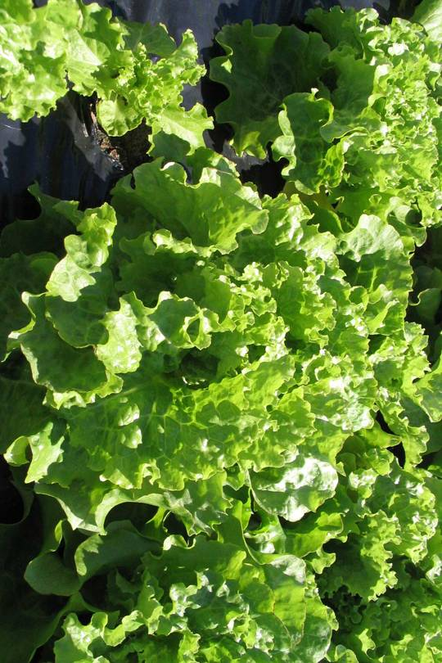
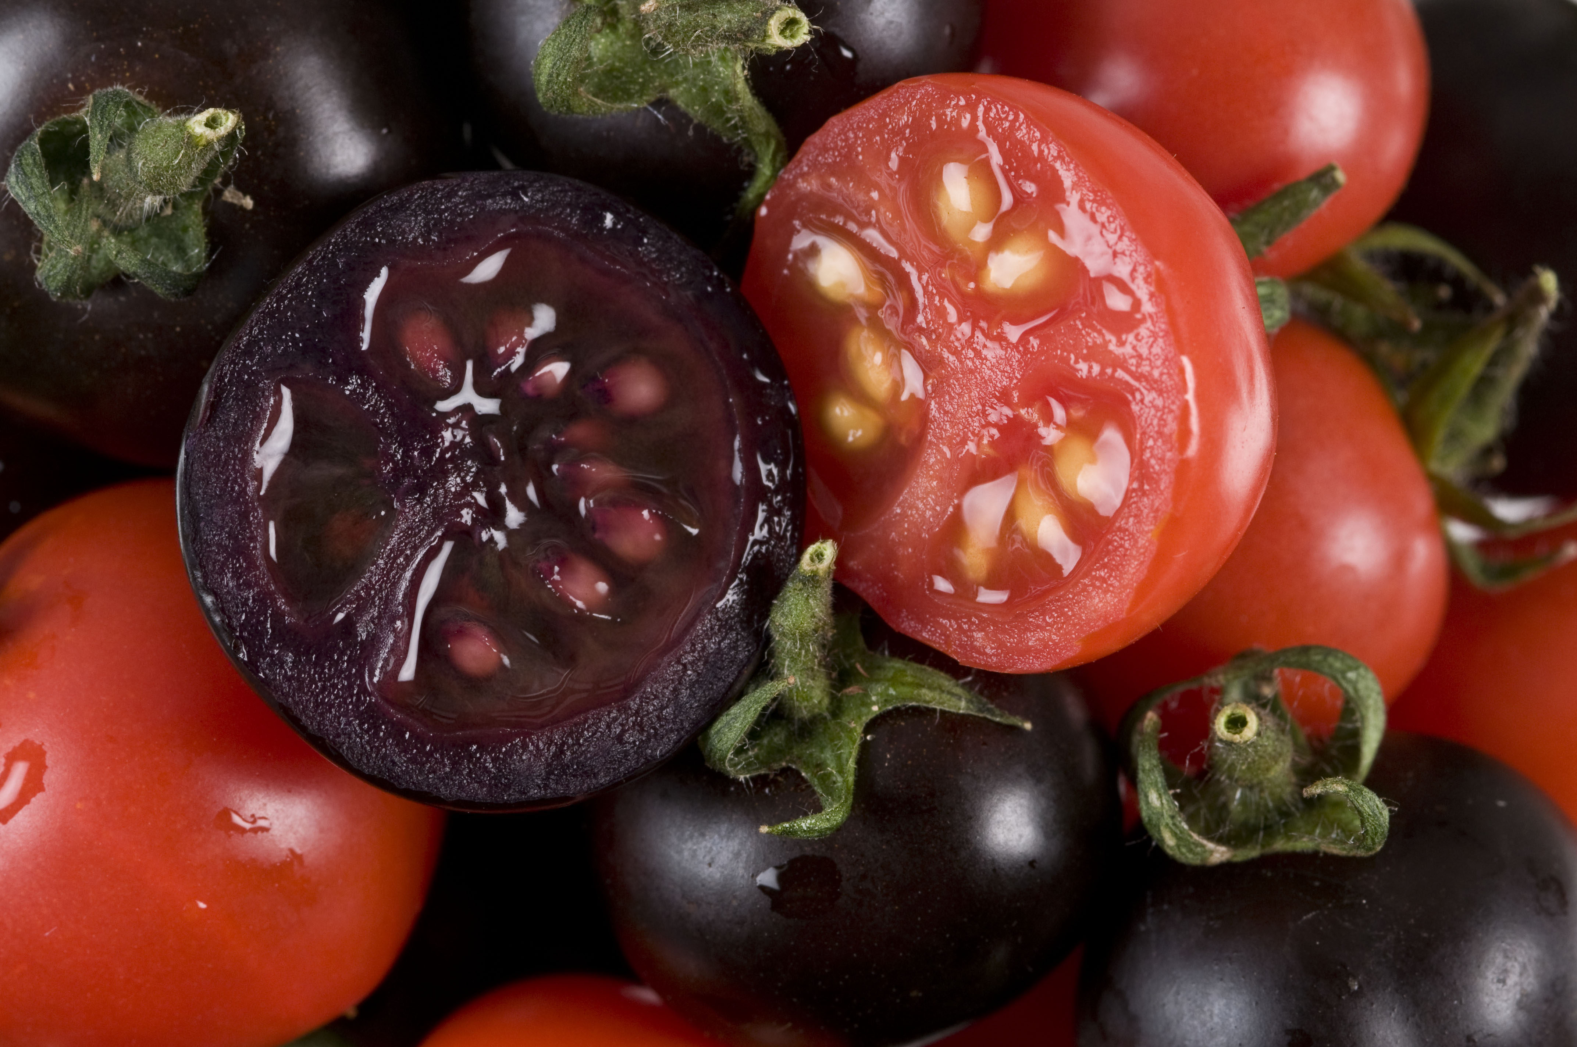
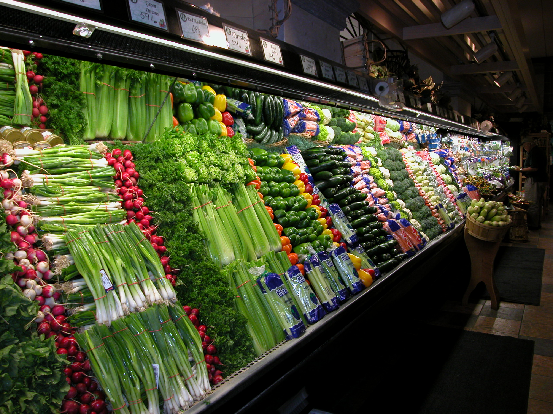
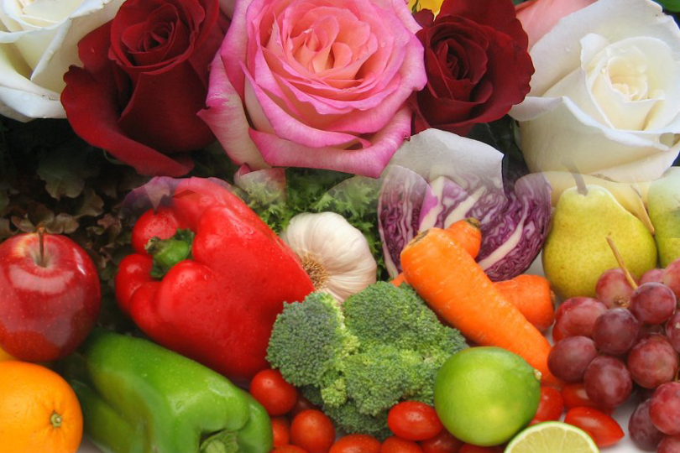

Genetically Engineered Foods
What Do I Need to Know?
Peggy G. Lemaux, Ph.D.
lemauxpg@berkeley.edu
University of California, Berkeley
http:/ucbiotech.org
http://pmb.berkeley.edu/lemaux

Slide 2
What will we talk about?
1. What about genes, genetics, genetic engineering?
2. What are GMO’s? What GMO’s are in our food?
3. What’s in the pipeline?
4. How does the U.S. regulate them?
5. Are they safe to eat? What about labelng?

Slide 3
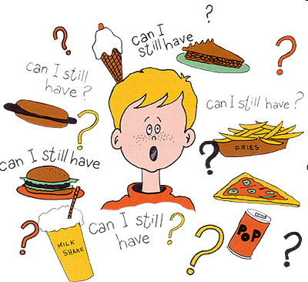
Consumers depend on dietitians and nutritionists as two of the most believable information resources on genetics as it relates to their diet and nutrition.
So, what do we know about the genetics of foods?
Intl Food Information Council,
2009 Functional Foods/Foods For Health Consumer Trending Survey

Slide 4
Background on genes, genetics, genetic engineering

Slide 5
All living things contain DNA – including the foods we eat
First we’ll start with some basics on genetics…

Slide 6
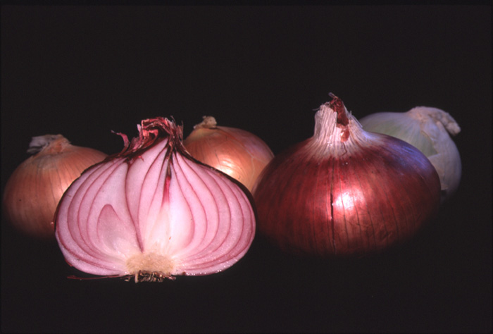
Tour d'Onion
Or what makes an onion, an onion?

Slide 7
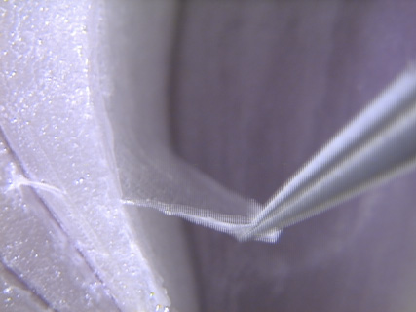
Tissue peel

Slide 8
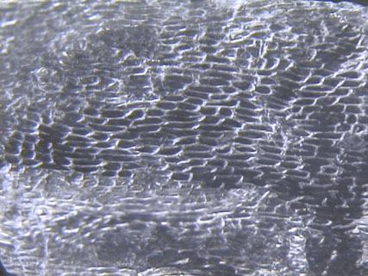
Cells

Slide 9
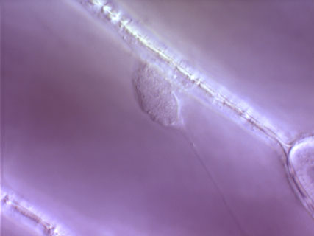
Cell Wall
Nucleus

Slide 10
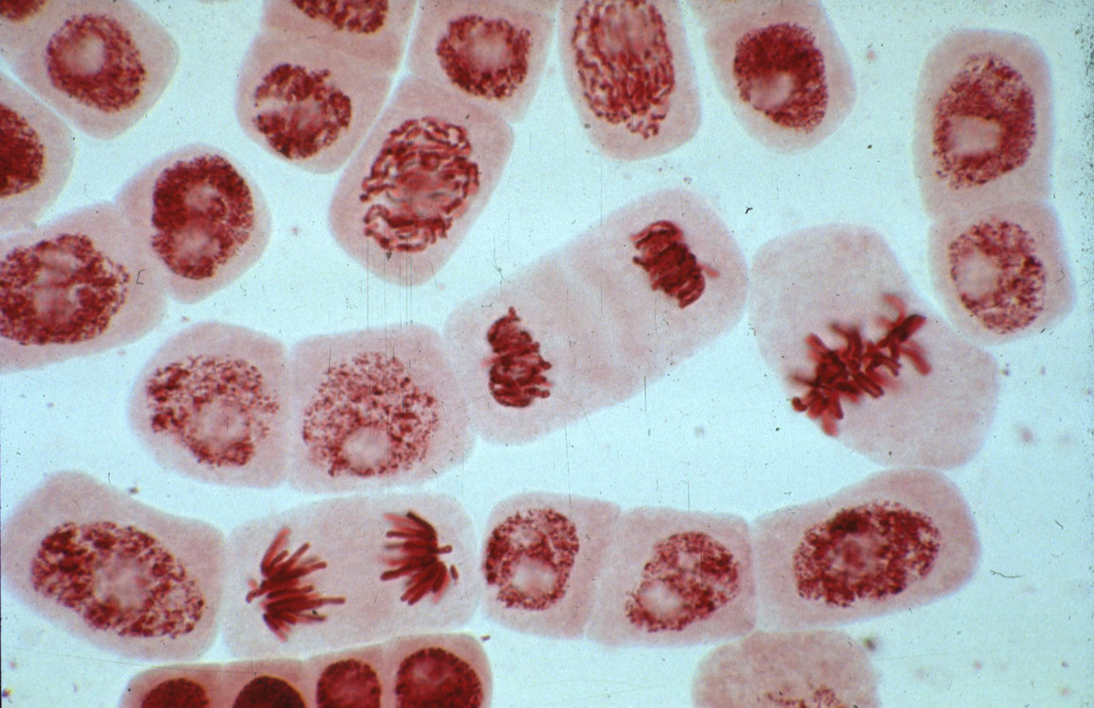
Dividing cell
Chromosomes
Stretched out, the DNA in each cell would be ~ 5 feet long

Slide 11
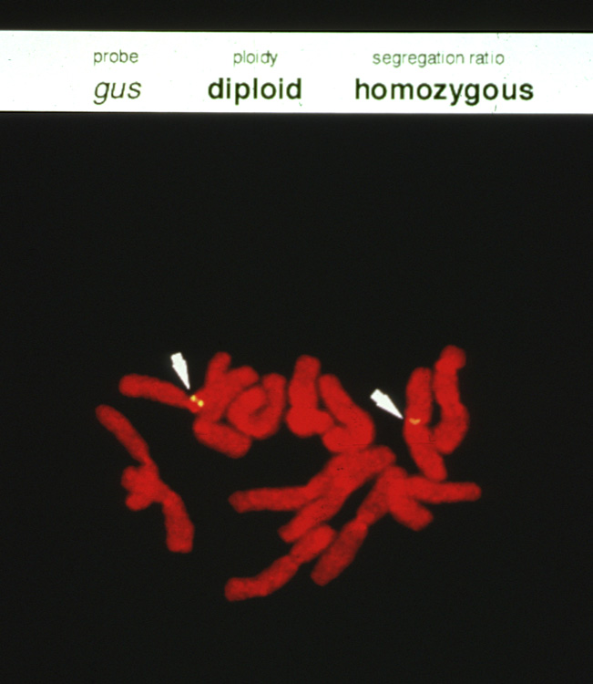
Chromosome
Genes

Slide 12
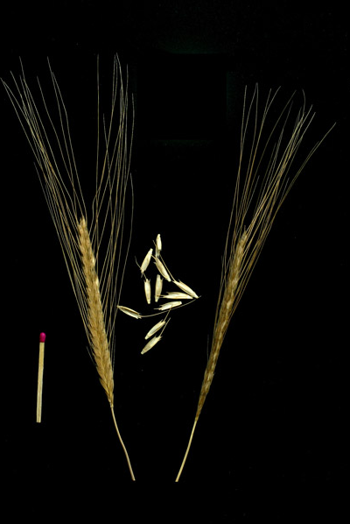
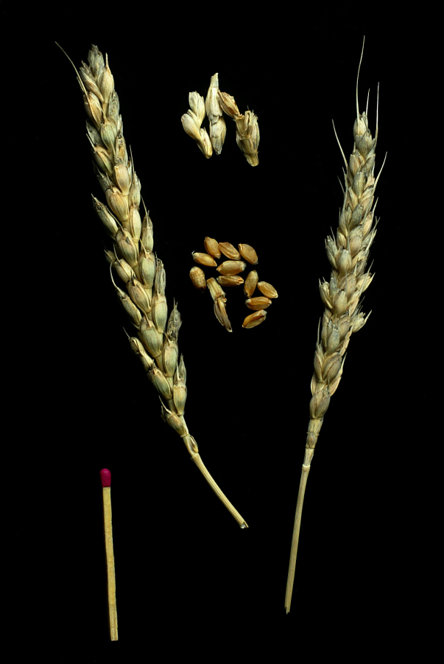
How can you use genetics to create a new wheat crop – with better nutritional qualities –
using an ancient wheat variety?
What happens to the genetic information from the two parents?
X
Triticum monococcum
Ancient variety
Triticum aestivum
Modern bread variety

Slide 13
Information in the wheat genome
Chemical units represented by alphabetic letters
...CTGACCTAATGCCGTA...
1700 books
1000 pages each
1700 books
(or 1.7 million pages)

Slide 14
Hybridization or breeding of wheat
x
Random retention of ~50% of the information from each parent
1700 books
(or 1.7 million pages)
1700 books
(or 1.7 million pages)
1700 books
(or 1.7 million pages)
Genetic modification that is not GE or GMO

Slide 15
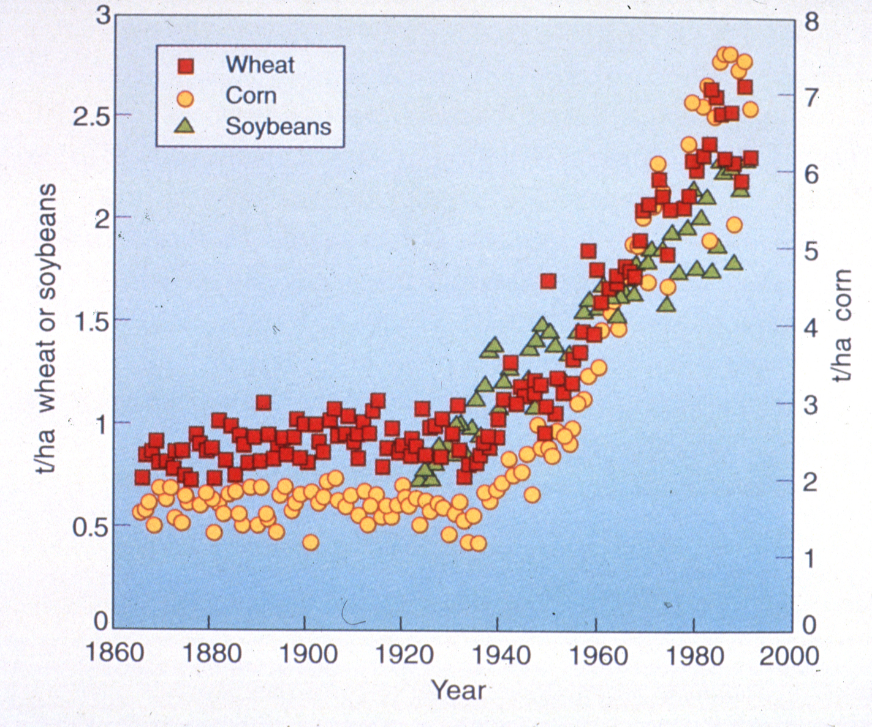
Yield Increase by year in U.S.

Slide 16
Table of contents for wheat information
...CTGACCTAATGCCGTA...
Used for Marker-Assisted Selection
Genomics
1700 books
(or 1.7 million pages)
Genetic modification that is not GE or GMO

Slide 17
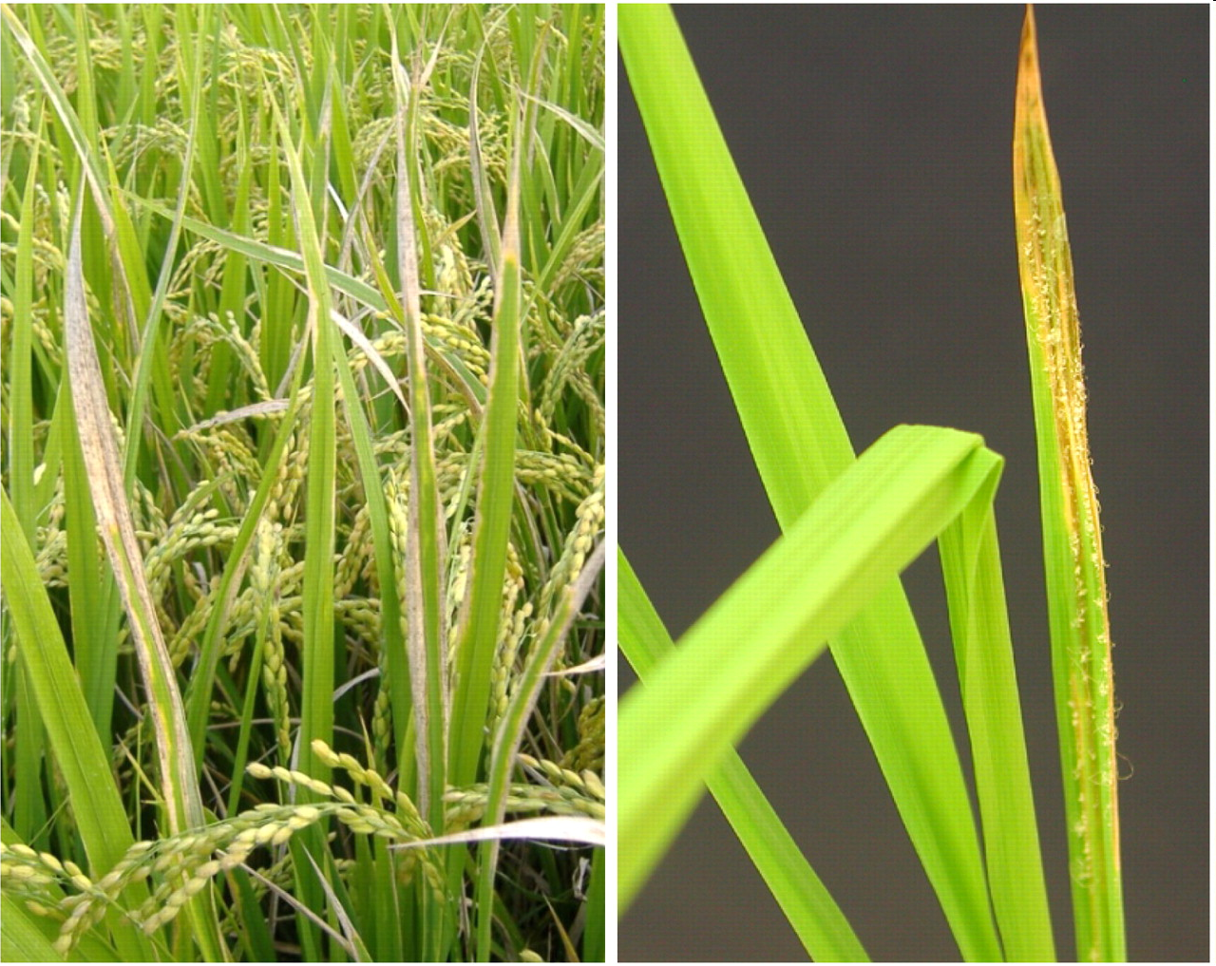
Can’t We Just Do All Modification This Way?
Marker-assisted selection used to protect rice against bacterial blight and blast disease
This type of modification limited to diversity in compatible relatives of crops

Slide 18
What are GMO’s? What GMO’s are in our food? What’s in the pipeline?

Slide 19
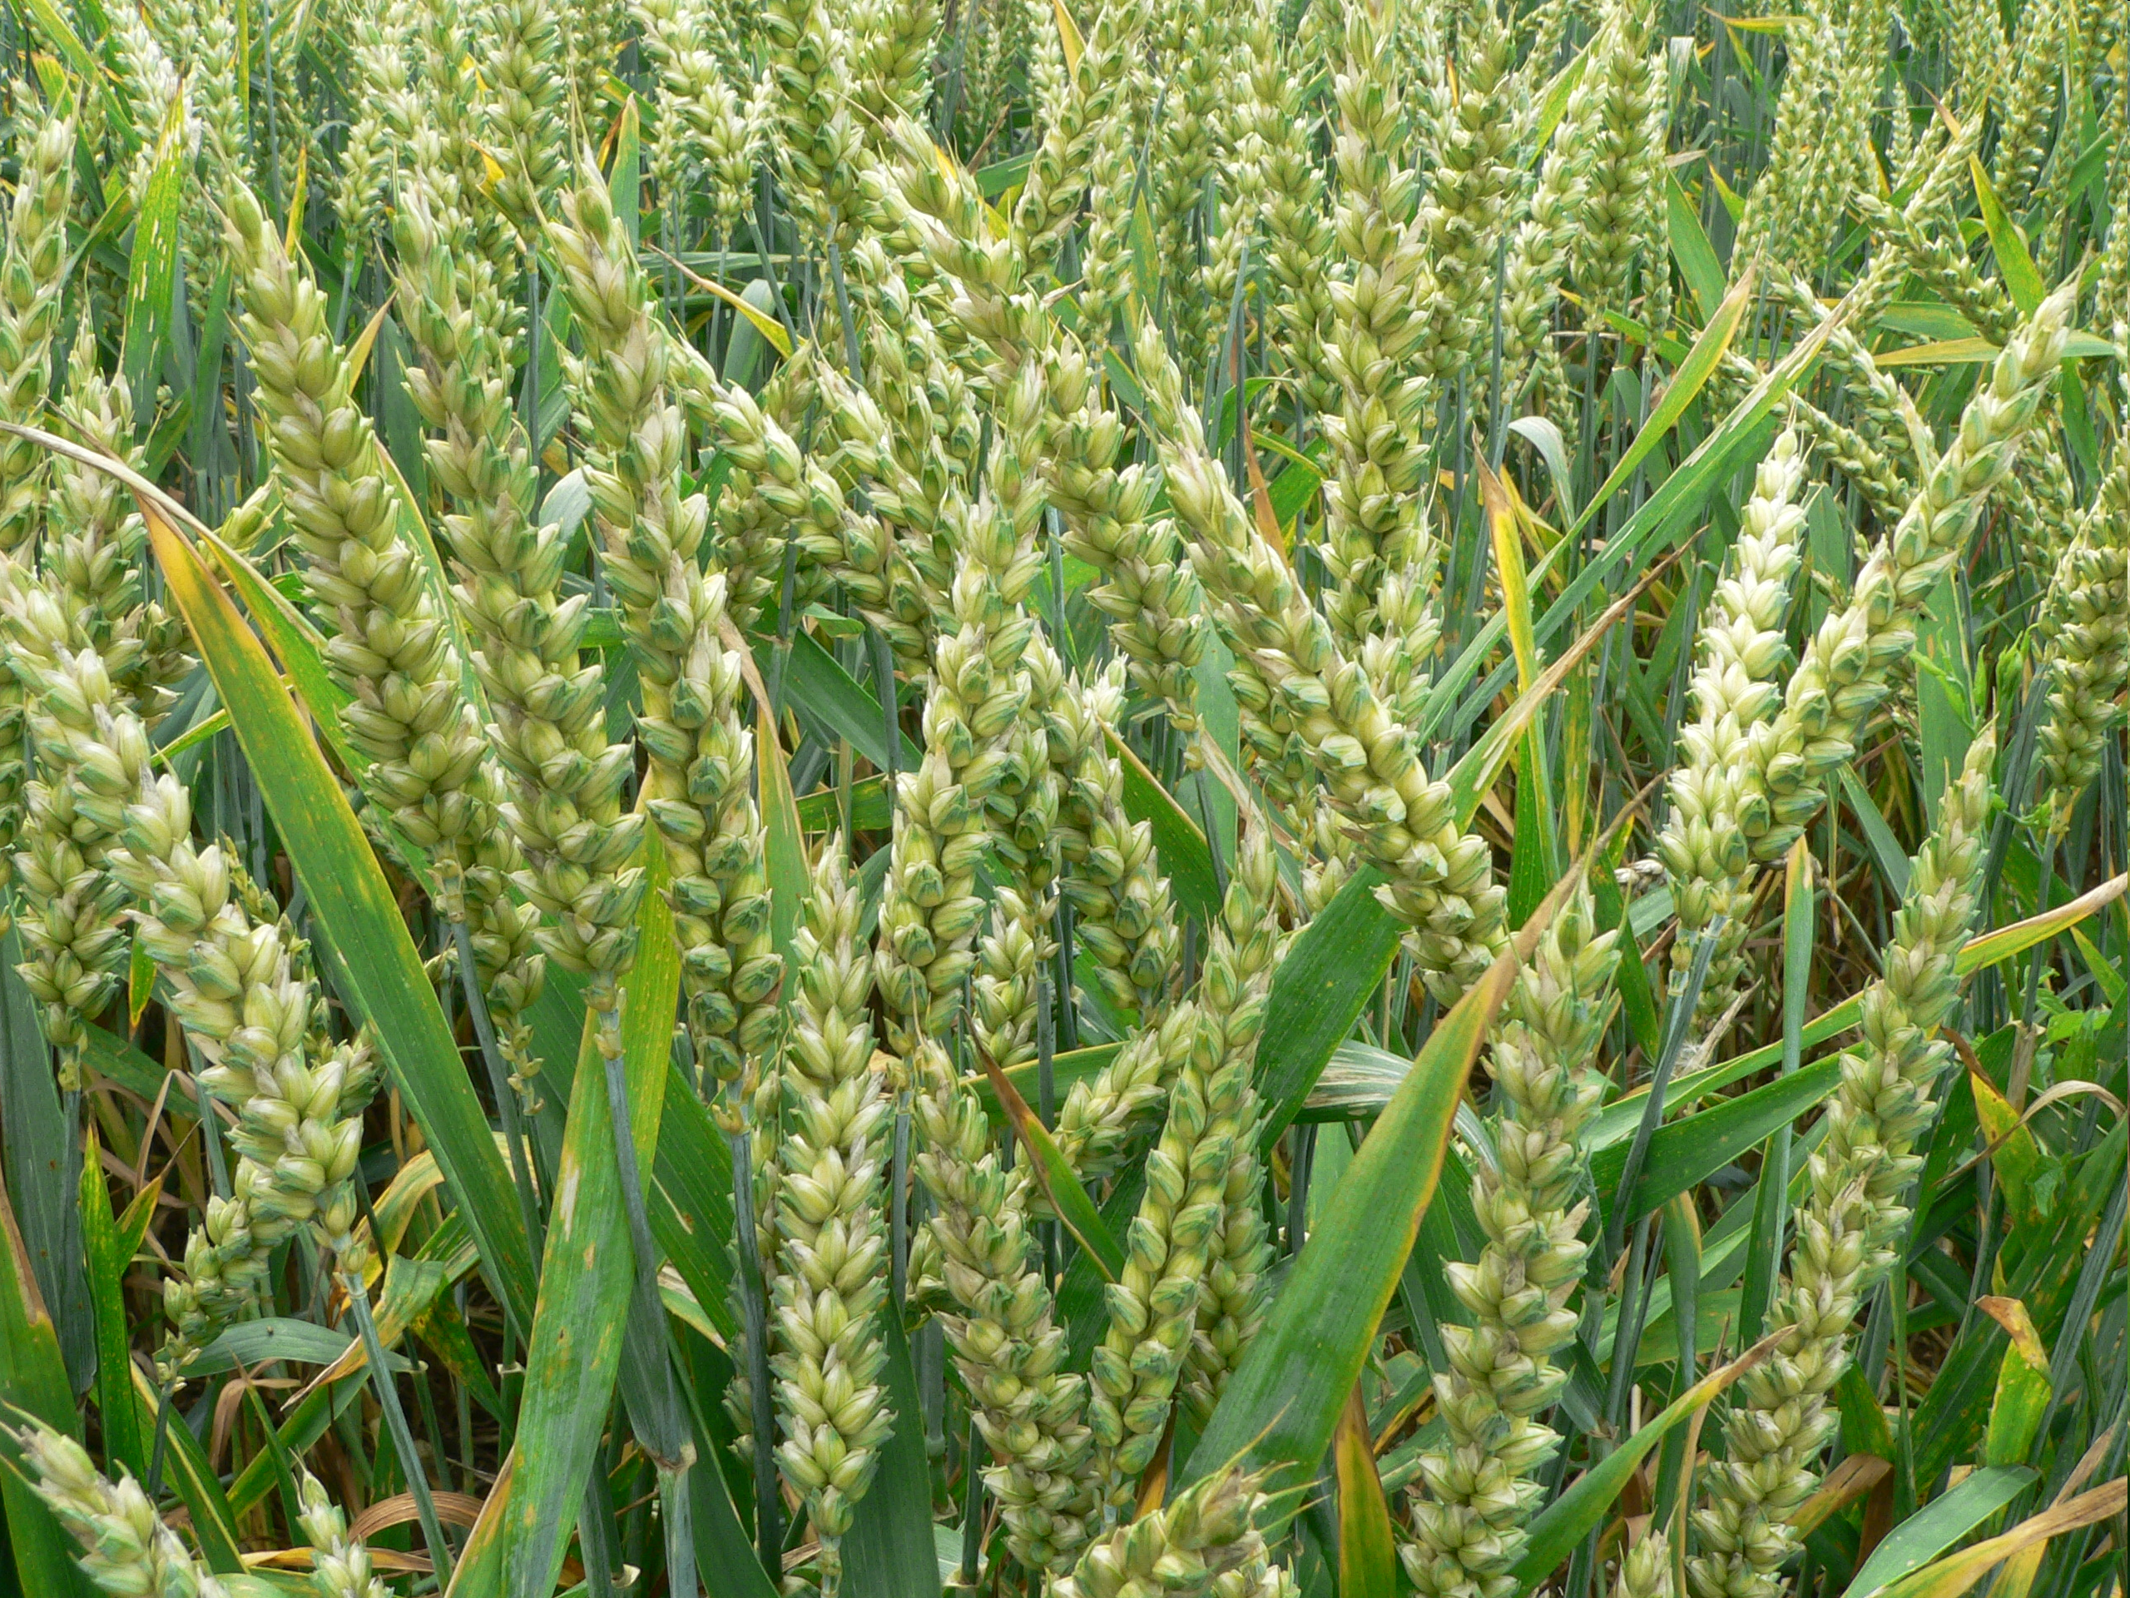
But there are other ways to create new varieties using the modern tools of genetics

Slide 20
Genetic Engineering Methods
Inserts randomly in genome
+
Inserted gene(s)
One-half page equivalent to a gene
1700 books
(or 1.7 million pages)
1700 books
(or 1.7 million pages)
Genetic modification that is GE and GMO

Slide 21
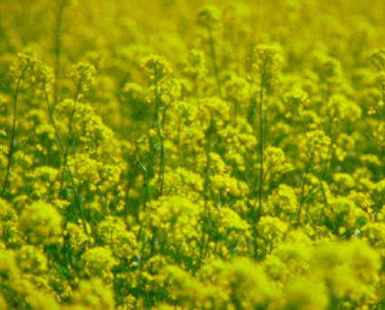
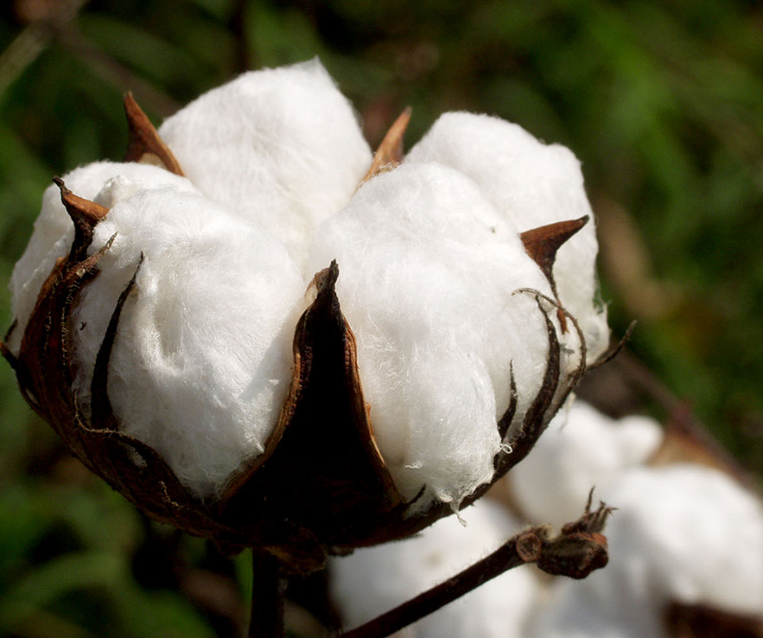
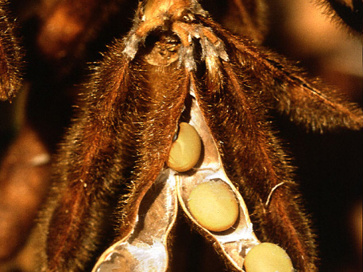
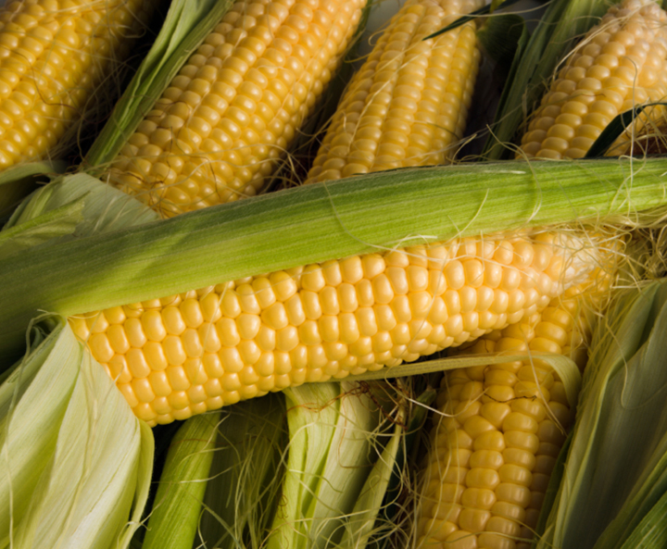
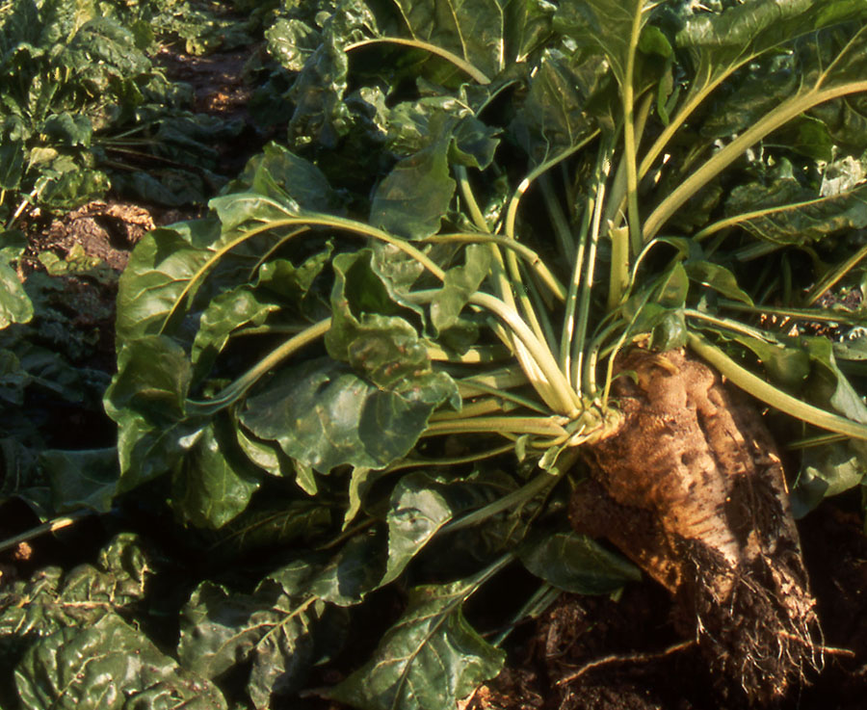
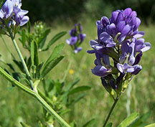
What is commercially available?
GE Canola
93% of 2013 acreage
Number of GE crops is limited
Source: ISAAA, 2011
GE Cotton
96% of 2014 acreage
(Insect Resistant: 5% Herbicide tolerant: 12% Stacked gene: 79%
GE Soybean
94% of 2014 acreage
(Herbicide resistant: 94%)
Source: USDA-ERS, 2014
Source: USDA-ERS, 2012
GE Corn
93% of 2014 acreage
(Insect Resistant: 4% Herbicide resistant: 13% Stacked gene: 76%)
GE Sugarbeet
98% of 2013 acreage
GE Alfalfa
25% of 2014 acreage
Source: USDA-ERS, 2014
Source: ISAAA, 2011
Source: Dan Putnam, UC ANR, 2014
Notes:
March 18, 2013

Slide 22
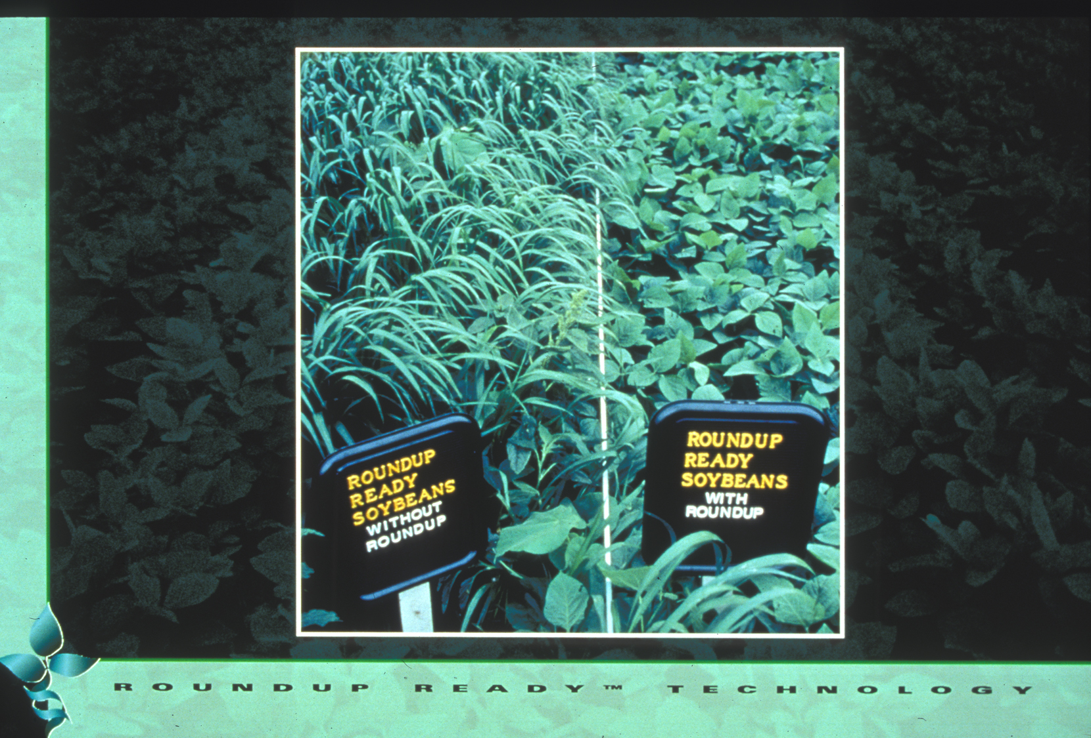
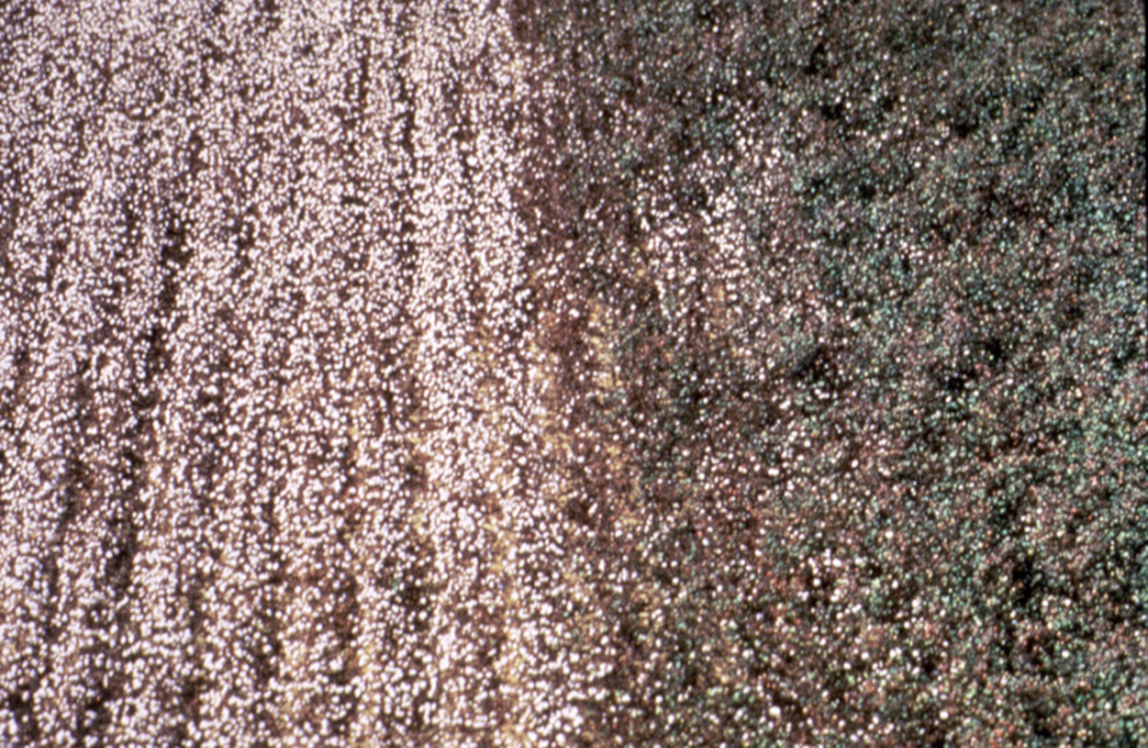
Roundup Ready Soybean™
Number of different traits available in GE crops is also limited
Herbicide-tolerant - engineered with genes to tolerate herbicide application
Bt Crops - engineered for insect resistance using gene from naturally occurring bacterium
Crops with stacked traits - both Bt and HT - are available

Slide 23
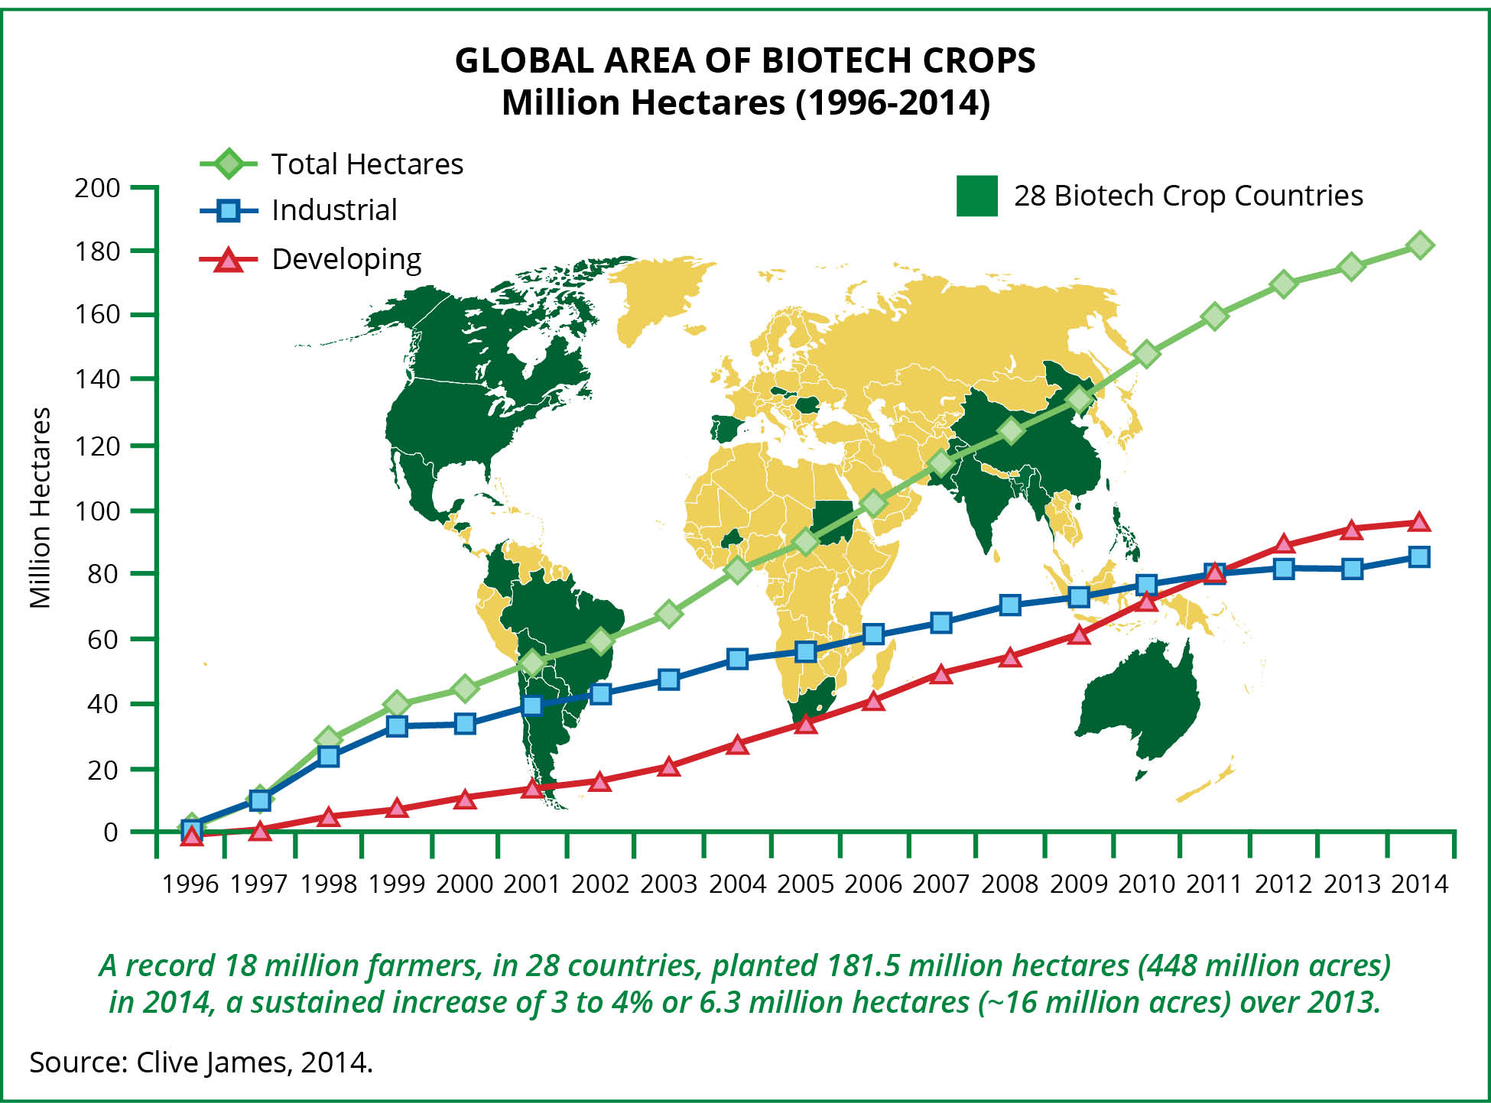
Despite limited crop and trait types, worldwide acreage is increasing in 20 developing, 8 developed countries
2014: 18 million farmers in 28 countries planted
448M acres (>4X size of California)
>90% small acreage farmers in developing countries
Clive James 2014 http://www.isaaa.org/resources/publications/briefs/46/executivesummary/
Notes:
A record 18 million farmers in 28 countries planted 175.3 million hectares (million acres) in 2013, a sustained increase of 3% or 5 million hectares (million acres) over 2012.
Ind = 81.2, Dev = 94.1, total = 175.3

Slide 24
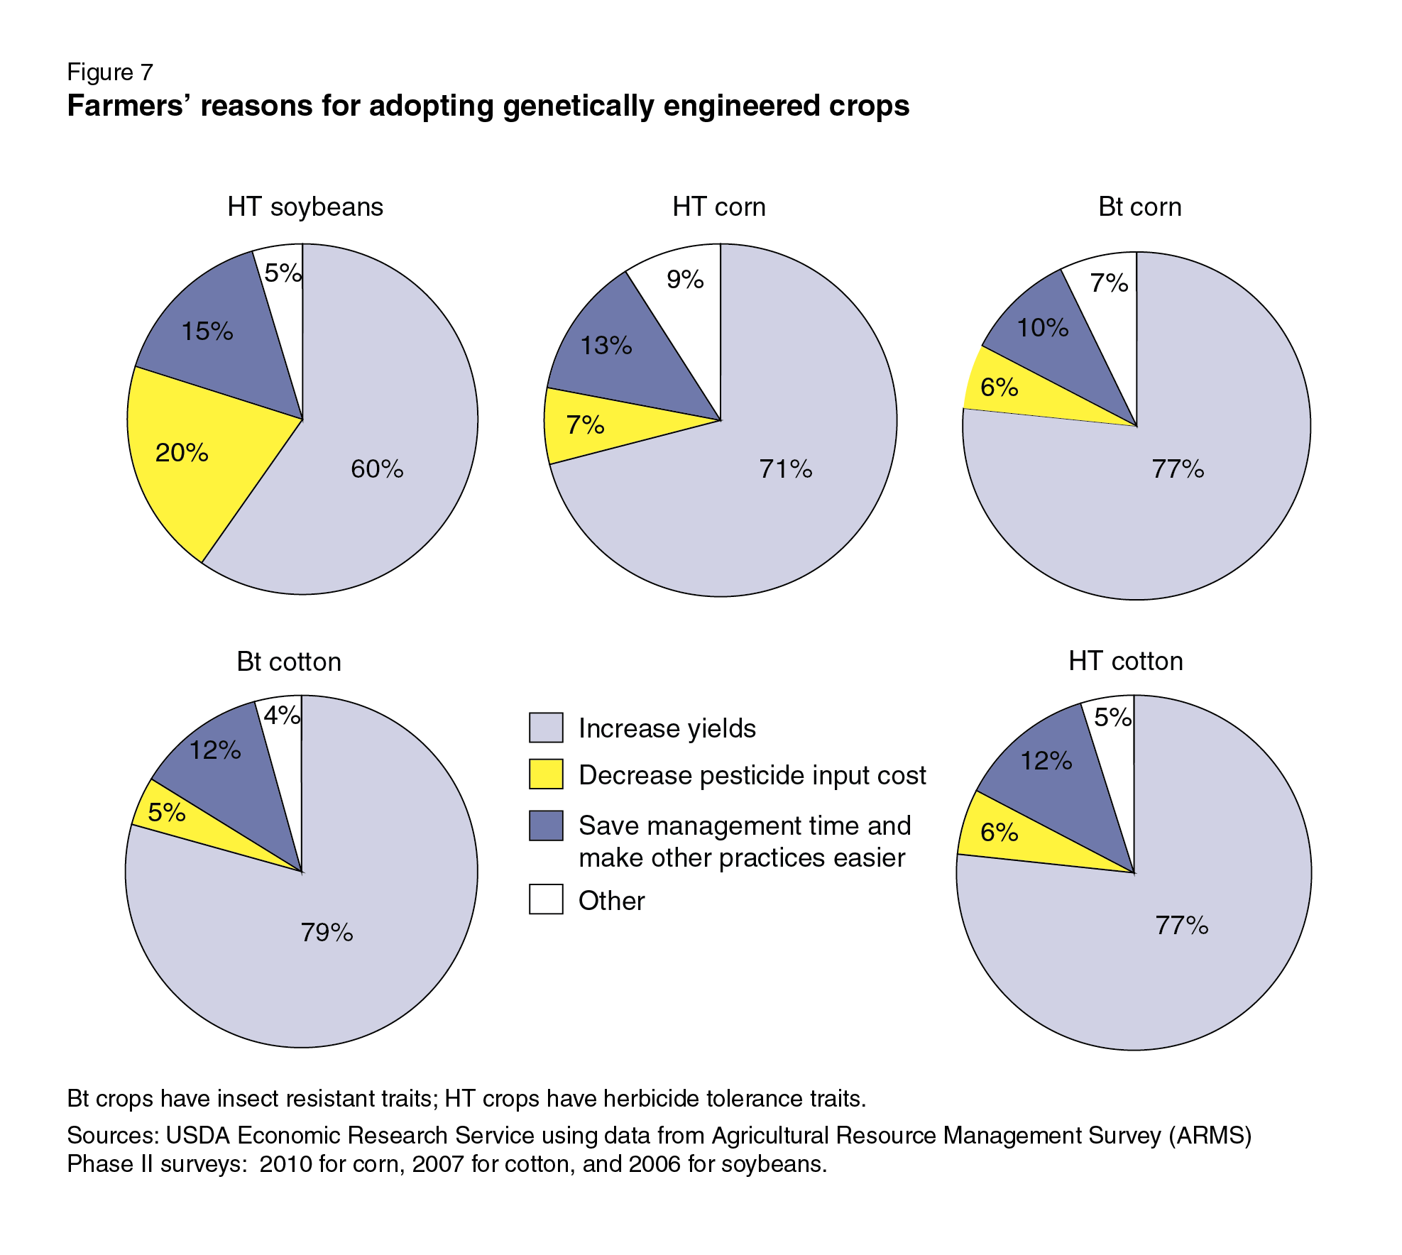
Why do U.S. growers plant GE crops?
Reasons vary from crop-to-crop but primary reason: improved yields
SOURCE: Fernandez-Cornejo, J., Wechsler, S., Livingston, M. and Mitchell, L. 2014. Genetically Engineered Crops in the United States. USDA Economic Research Service Report No. 162, February 2014.
Notes:
March 25, 2014

Slide 25
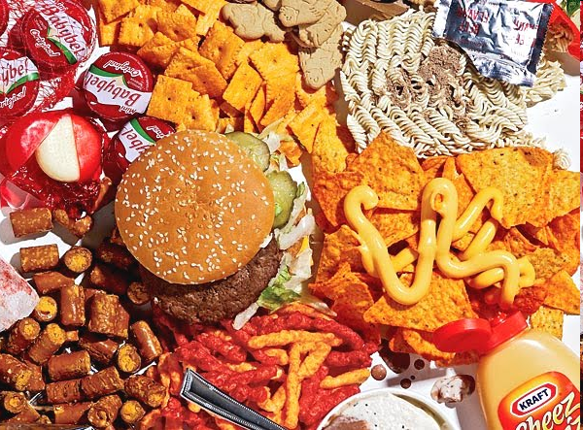
Corn oil
Canola oil
Soy lecithin
Soy protein
Corn starch
Cottonseed oil
These types of large-acreage GE crops lead to estimates that 60-80% of processed foods in U.S. have GE ingredients
SOURCE: https://factsaboutgmos.org/disclosure-statement

Slide 26
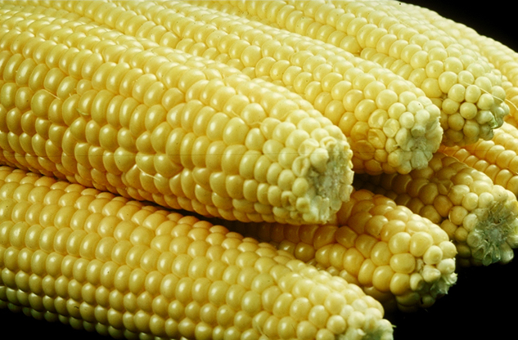
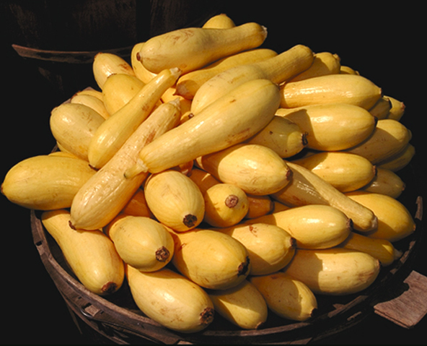
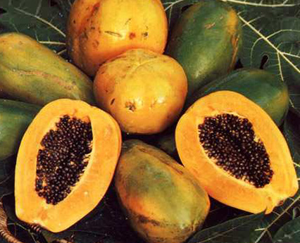
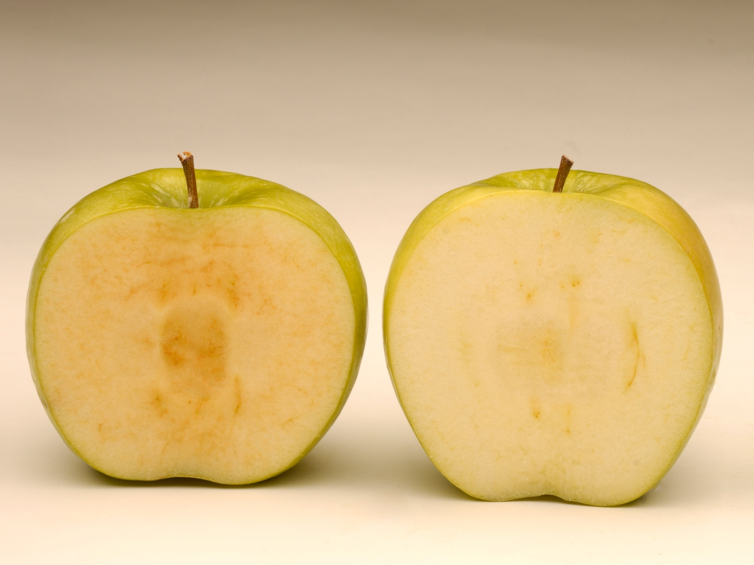
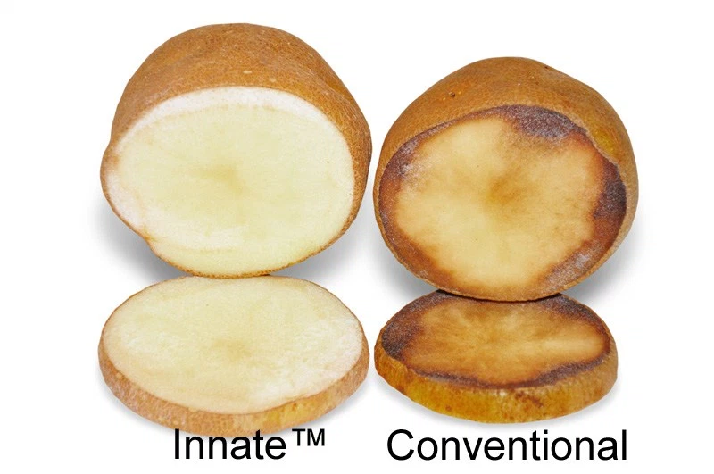
But, only a few whole, GE foods are in the commercial U.S market
GE Sweet Corn
GE Squash
GE Papaya
Two more are just being introduced
Arctic Apple™
Innate™ Potato

Slide 27
What’s in the pipeline?

Slide 28
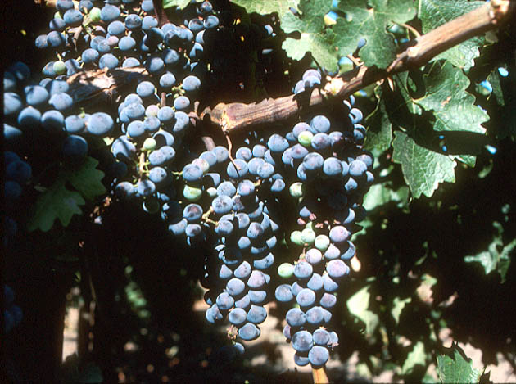
Field Trials in California with Grape Root Stocks Engineered for Resistance to Fanleaf Virus
SOURCE: http://www.democratandchronicle.com/apps/pbcs.dll/article?AID=/20080806/BUSINESS/808060336/1001

Slide 29
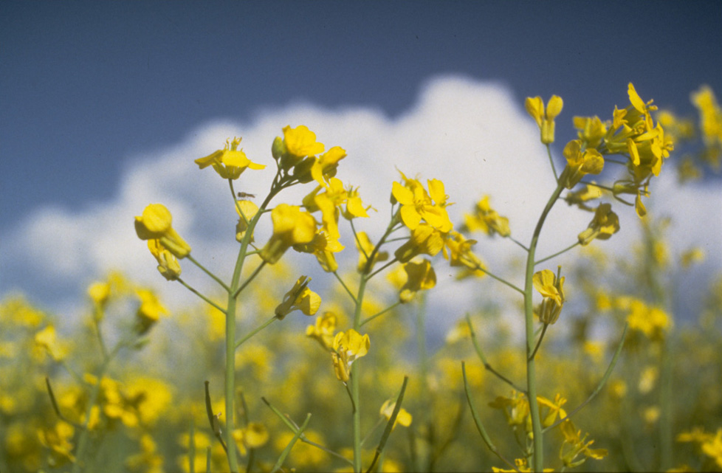
Arcadia Biosciences in Davis developed GE canola that uses 50% less nitrogen fertilizer
SOURCE: http://archives.foodsafety.ksu.edu/agnet/2007/4-2007/agnet_april_10.htm#story0

Slide 30
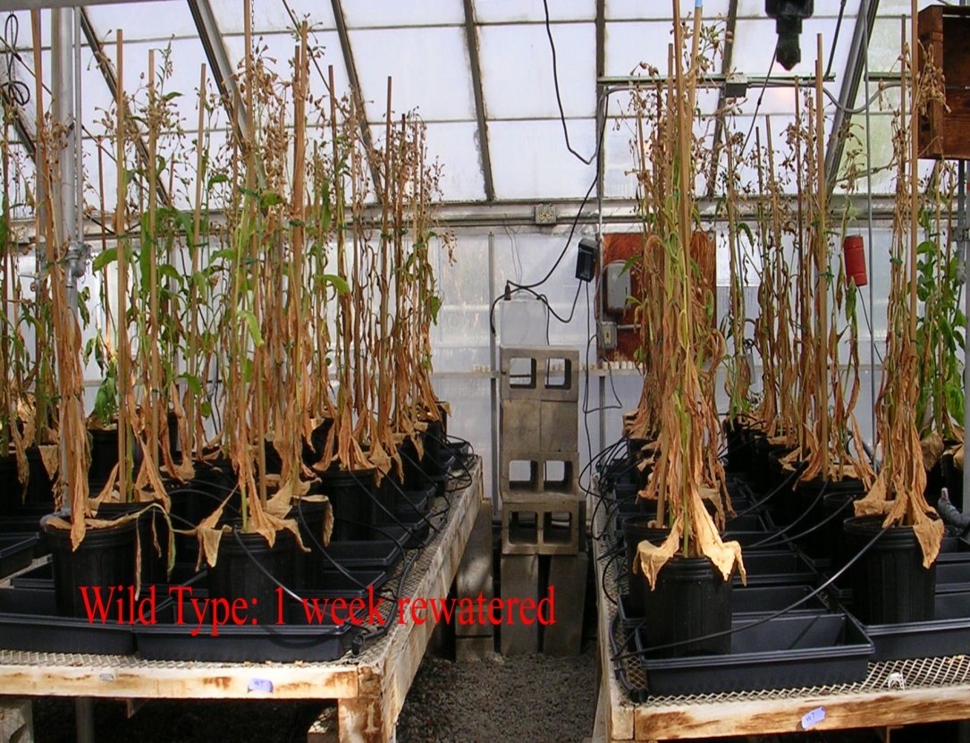
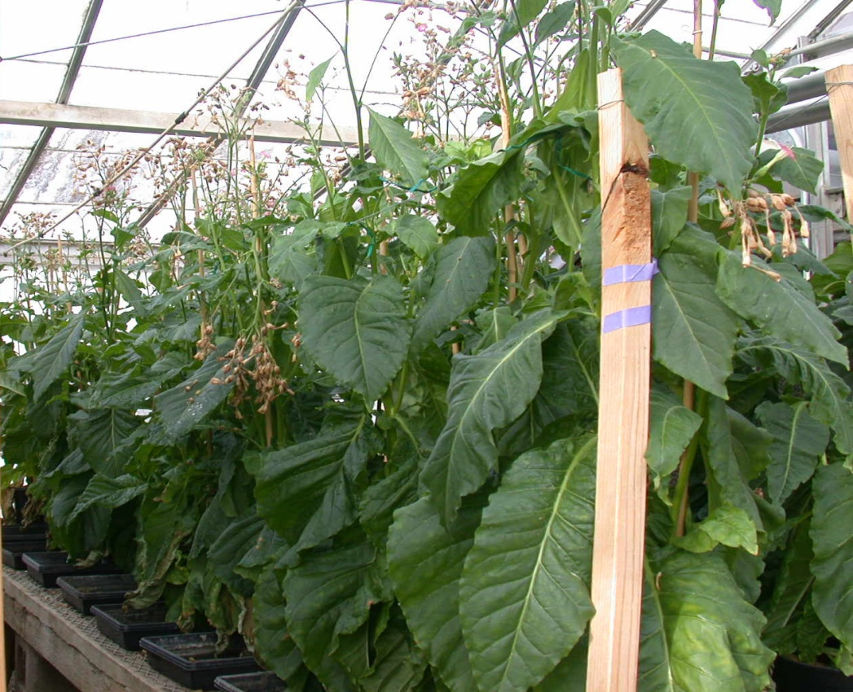

Salinity and Drought Tolerance - UC Davis Professor
Wild type AtNHX1
200 mM NaCl (~1/2 sea water)
Wild type IPT gene
15 days drought, 7 days re-watered
Salt-tolerance
Drought-tolerance
Hanana M. 2011. Environ Rev 19: 121-140; Anjuman A et al. 2013 Mol. Biotechnol 54: 379-392
UCDAVIS

Slide 31
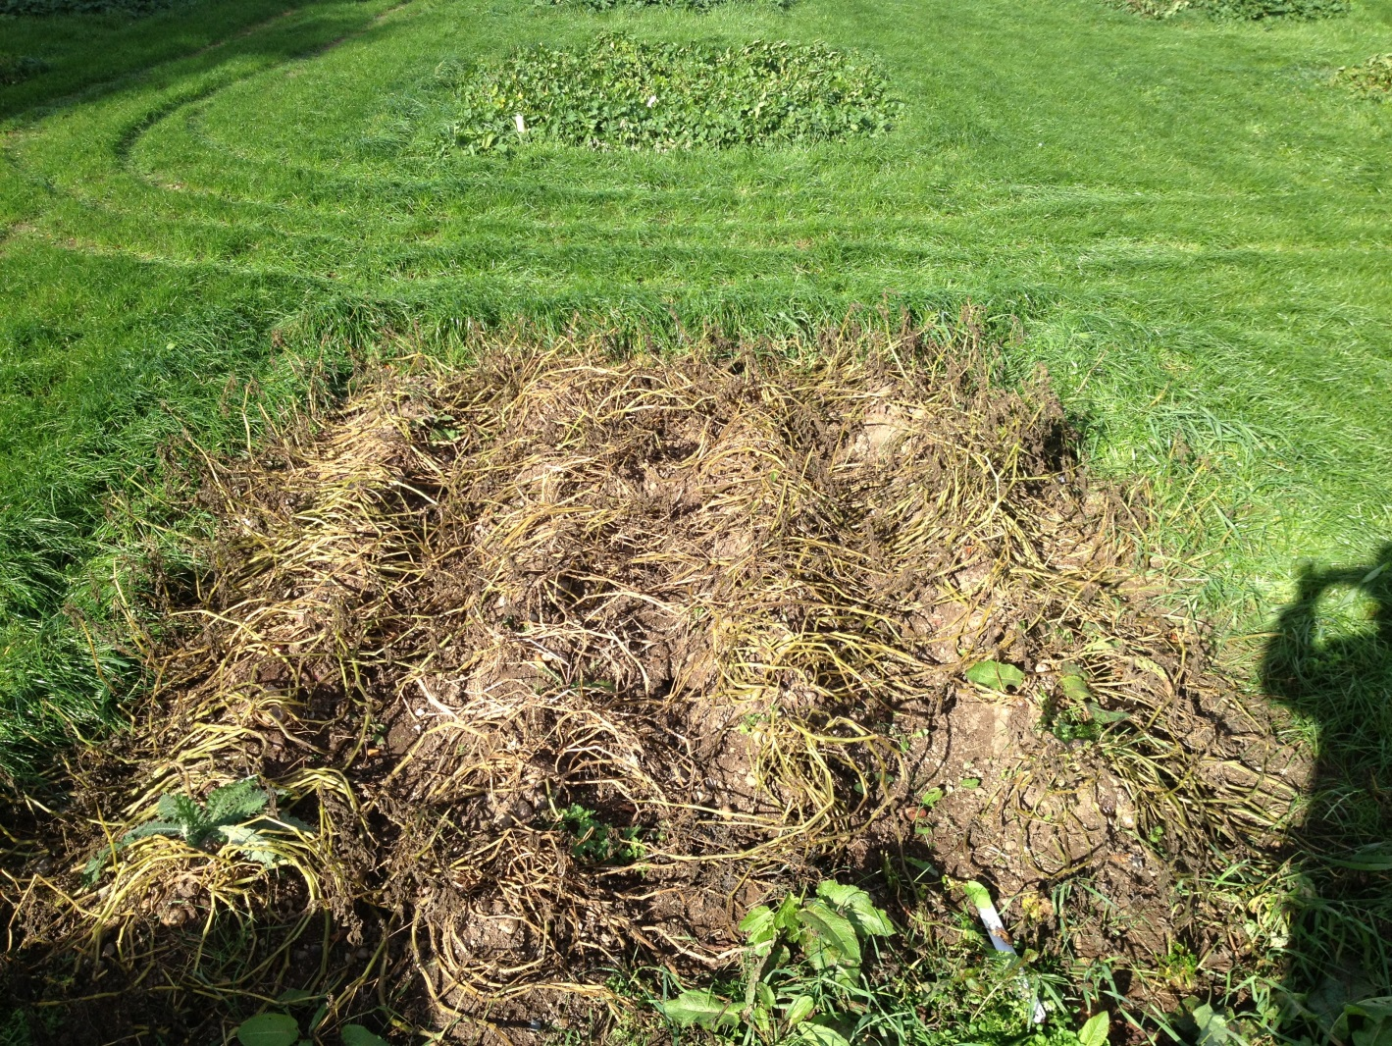



2013 GE potato field study – Ireland
Desiree potato variety, highly susceptible to late blight, engineered with gene from wild potato variety
GE Desiree
Non-GE Desiree

Slide 32
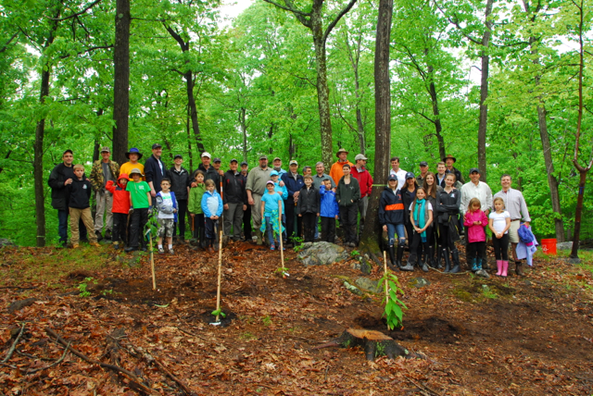
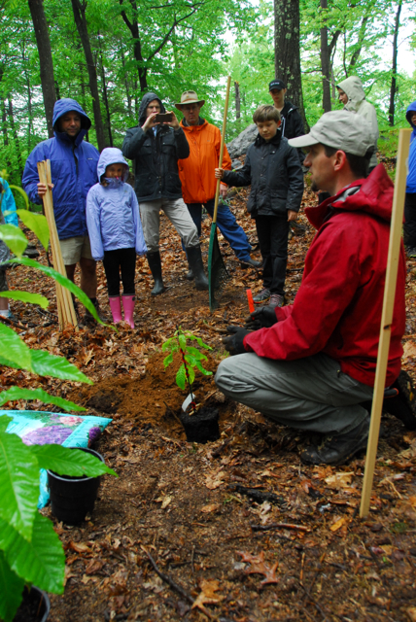
American chestnut engineered with wheat gene prevents cankers from forming; replanted with $104K raised through crowd funding
http://www.newscientist.com/article/dn25644-american-chestnut
Notes:
American chestnut used to be most important tree species in eastern U.S. until it was wiped out by a fungus in the early 1900’s. In total it is estimated that 40B trees were lost to the disease.

Slide 33
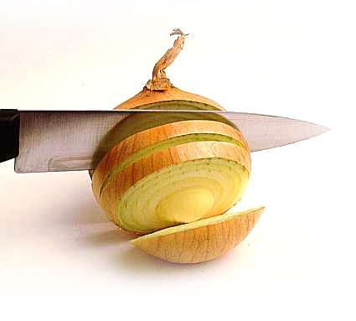
Tear-free onion developed by turning off tear-inducing enzyme
SOURCE: “Scientists create 'no tears' onions”, Herald and Weekly Times, 2/1/08
http://www.checkbiotech.org/green_News_Genetics.aspx?Name=genetics&infoId=16834

Slide 34
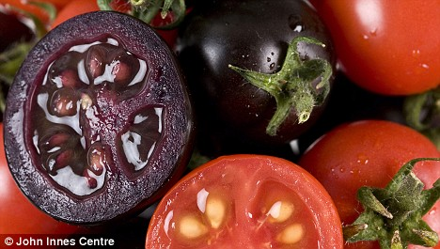
High anthocyanin purple GE tomatoes protect against cardiovascular disease and certain cancers. Diets with 10% purple tomatoes increased lifespan of cancer-prone mice
Notes:
Purple fruit contains same level of anthocyanins as half basket of blueberries. Large orange tomatoes (~100g) have same amount of beneficial compound as 27 bottles of red wine (resveratrol). Yellow-fruited variety contains genistins, in amount equal to 150 g of tofu. Fourth variety has quercetin and kaempferol, health-promoting compounds found in capers, radishes, onions and watercress. Offer protection against inflammation, cancer and cardiovascular disease. http://news.jic.ac.uk/2014/03/bbsrc-most-promising-innovator/

Slide 35
How does the U.S. regulate GE crops and foods?

Slide 36
Three U.S. Regulatory Agencies
USDA
FDA
EPA
Field testing
  Permits
  Notifications
Determination of
non-regulated status
Food safety
Feed safety
Pesticidal plants
  tolerance exemption
  registrations
Herbicide registration
Plant pest?
Danger to people?
Risk to environment?

Slide 37
Are they as safe as conventional foods?
This is based on the concept of
substantial equivalence
Modified food has essentially all characteristics of nonmodified food with respect to food and feed value except for introduced trait
The product of the introduced genetic information is tested separately?
SOURCE: Safety of Genetically Engineered Foods: Aproaches to Assessing Unintended Health Effects 2004. Natl Acad Press

Slide 38
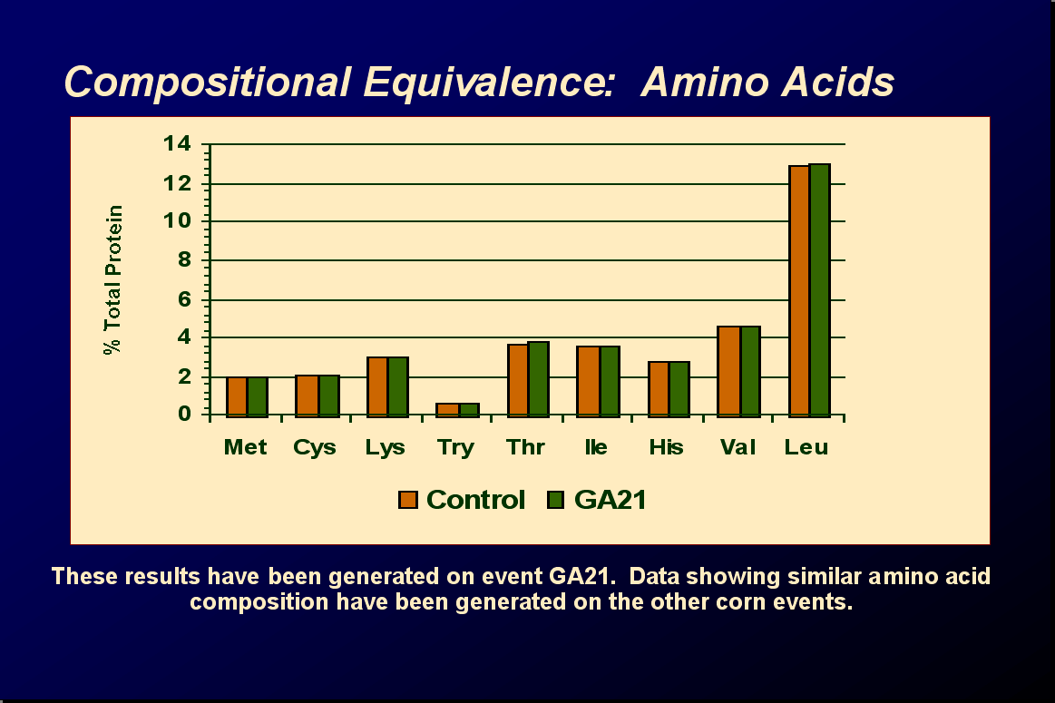
Substantial

Slide 39
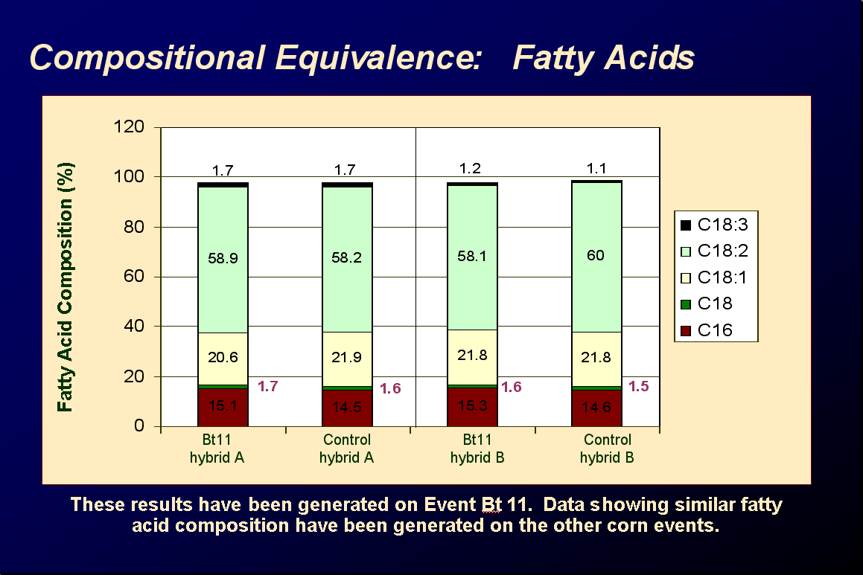
Substantial

Slide 40
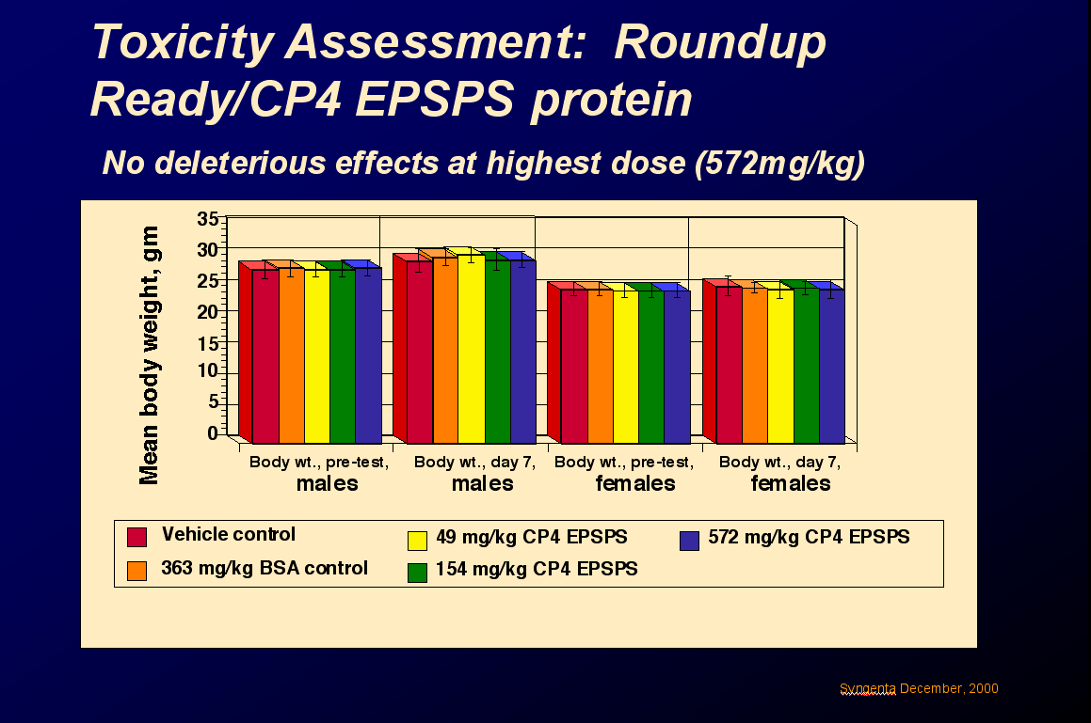

Slide 41
What are some issues around GMO foods?
Are they safe to eat?

Slide 42
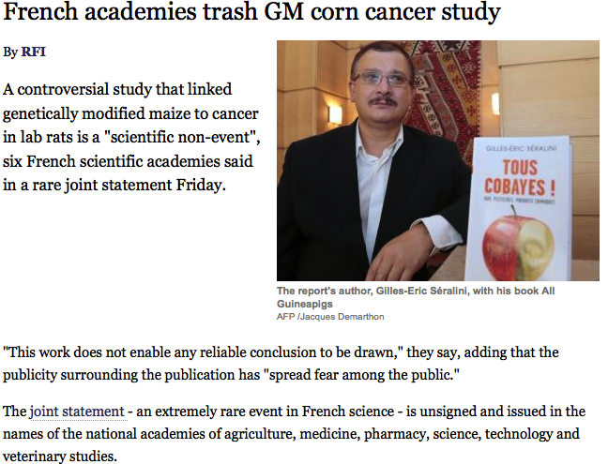
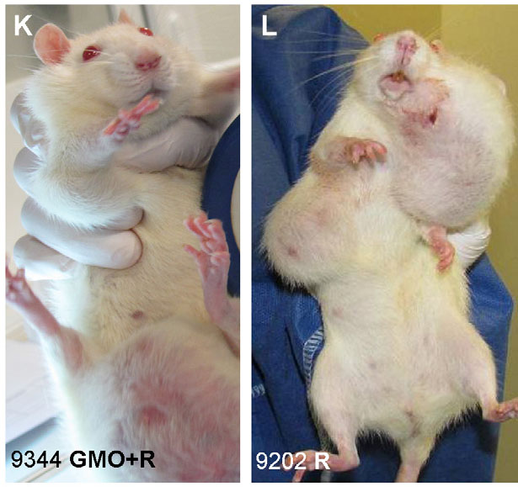
On occasion widely publicized studies cast doubt on safety of GE foods, e.g., a single study by French researcher in Sept. 2012
Featured on Dr. Oz Show
Claim that Monsanto’s RR corn causes tumors in rats
Later reviewed by European Food Safety Authority: study had no merit – but that was not as widely publicized

Slide 43
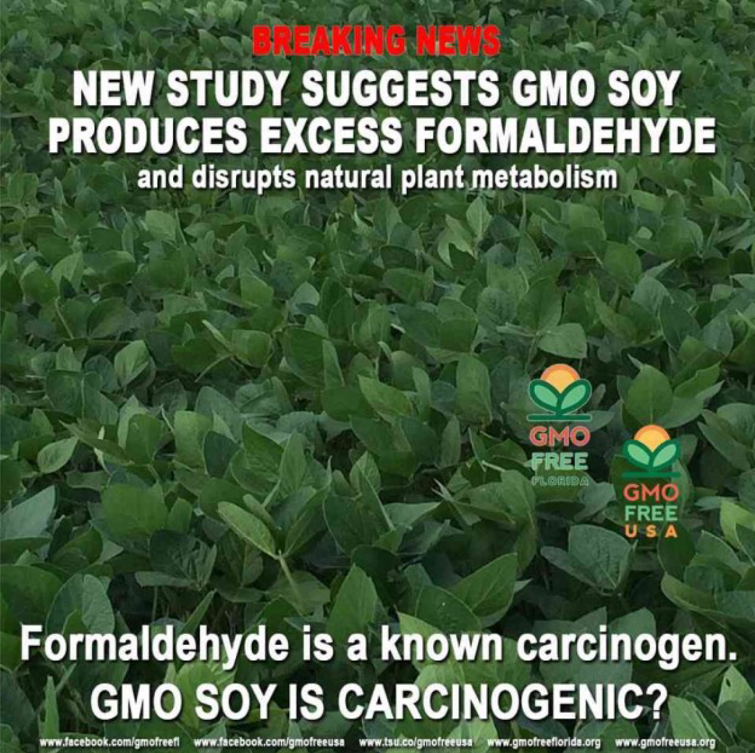
Another single study – not as widely publicized
“European Food Safety Authority has formally examined Ayyadurai’s report on formaldehyde contamination of soy, and criticized both its methods and findings”
SOURCE: “European Union reviews, rebukes bizarre Ayyadurai claim of formaldehyde in GMO soy”, Genetic Literacy Project, 1/8/16.
https://www.geneticliteracyproject.org/2016/01/08/european-union-reviews-rebukes-bizarre-ayyadurai-claim-formaldehyde-gmo-soy/
Notes:
January 11, 2016

Slide 44
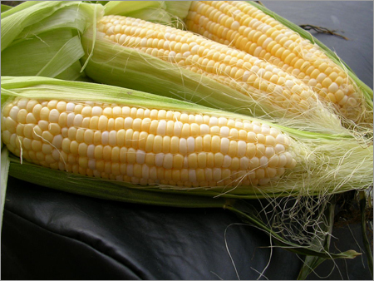




Are GM foods safe?
2012 French meta analysis of many published studies showed:
GM foods are nutritionally equivalent to non GE foods and
Can be safely consumed in food and feed.
Based on 12 long-term (>90d to 2yr) and 12 multigenerational
(2 to 5 generations) feeding trials of GE feed in animals
potato
rice
maize
soy
triticale
SOURCE: Snell C, Bernheim A, Berge J-P, Kuntz M, Pascal G, Paris A, Ricroch AE. 2012. Assessment of the health impact of GM plant diets in long-term and multigenerational animal feeding trials: A literature review. Food and Chemical Toxicology 50: 1134-1148.
Notes:
June 4, 2012

Slide 45

A second larger meta analysis in 2014, using public studies from 1983 to 2011, tracking over 100 billion animals raised on GE feed, concluded:
“no unfavorable or perturbed trends in livestock health and productivity”.
SOURCE: Van Eenennaam, A.L. and Young, A.E. 2014. Prevalence and impacts of genetically engineered feedstuffs on livestock populations. Journal of Animal Science, published online on September 2, 2014, doi:10.2527/jas.2014-8124.
http://www.journalofanimalscience.org/content/early/2014/08/27/jas.2014-8124
Notes:
September 24, 2014

Slide 46
What are some issues around GMO foods?
What about labeling?

Slide 47

Labels already abound on foods– from gluten-free to dolphin-safe – none are mandated. Why aren’t there federally mandated labels on foods with GE ingredients.
Notes:
January 9, 2014

Slide 48
There are FDA labeling rules for engineered foods…
Genetically engineered foods are subject to same
labeling laws as all other foods and food ingredients
GE food must be labeled if there are:
1. Different nutritional characteristics,
2. Genetic materials from a known allergenic source
e.g., peanut, egg
3. Elevated levels of antinutritional or toxic compounds
No label needed if food is essentially equivalent in safety, composition and nutrition

Slide 49

And there are existing PLU labels, which indicate whether whole fresh foods are GE, organic or conventional
Notes:
August 22, 2012

Slide 50
Do consumers want labeling?
Can you think of any information that is not currently included on food labels that you would like to see on food labels? What types of information would that be?
2001 2006 2014
Yes 26% 18 % 26%
  Ingredients (i.e., fats, salt) 6% 3% 23%
  Other 11% 5% 25%
  Genetically altered 2% 1% 0%
No 74% 82% 74%
  (International Food Information Council)
With an open-ended question about what food labeling information is missing, few consumers mention genetically altered foods
SOURCE: IFIC, April 2014.
http://www.foodinsight.org/Press-Release/Detail.aspx?topic=Survey_Finds_Continued_Support_for_FDA_s_Biotech_Foods_Labeling_
Notes:
Question 9

Slide 51
If simply asked whether they want food labeling of genetically engineered foods, two-thirds of U.S. consumers say yes.
66% of Americans favor requiring food
manufacturers put labels on products that contain genetically modified organisms, or foods grown from seeds engineered in labs.
7% opposed to the idea
24% neutral
(Associated Press-GfK poll Jan. 2015)
SOURCE: http://www.cbsnews.com/news/poll-most-americans-want-labels-on-genetically-modified-foods/
Notes:
Question 9

Slide 52


But, do consumers act on labeling information?
“
66% of UK consumers think GE food labeling is important…
But only 2% actively look for GE content when buying foods”
But only 2% actively look for GE content when buying foods
SOURCE: “FSA survey: Majority of UK consumers back GM labelling”, Food Navigator, January 10, 2013. http://www.foodnavigator.com/content/view/print/728839
Link to report: http://www.food.gov.uk/science/research/ssres/foodsafetyss/gm-labelling/#.UPXkHaHr7jm
Notes:
January 15, 2013

Slide 53

One complicating problem with current system: other nations have specific, labeling laws for GE, although rules and enforcement vary dramatically among countries, making international trade difficult
SOURCE: Marchant, G.E., Cardineau, G.A. and Redick, T.P. 2010. Thwarting Consumer Choice: The Case against Mandatory Labeling for Genetically Modified Foods. American Entreprise Institute, p. 71.
Notes:
August 14, 2012

Slide 54

What’s the current status of labeling GE foods in the U.S.?
In some states, like California and Washington voters rejected ballot propositions to require mandatory labeling of foods with GE ingredients.

Slide 55
In other states, like Vermont, labeling laws are set to take effect this year

Slide 56


Companies have also become involved in different ways in GMO labeling.
By 2018, all products in U.S. and Canadian stores must be labeled to indicate whether they contain genetically modified organisms (GMOs)
SOURCE: “Major Grocer to Label Fodos With Gene-Modified Content”, New York Times, 3/8/13
http://www.nytimes.com/2013/03/09/business/grocery-chain-to-require-labels-for-genetically-modified-food.html?ref=opinion&_r=0
Notes:
March 18, 2013

Slide 57

If a decision at the national level is not made soon – in some way – a potpourri of state labeling bills will make interstate commerce very difficult- similar to existing issues with international trade.
SOURCE: “GMO Labeling Bill Voted Down In Senate”, Huffington Post, 5/22/13
http://www.huffingtonpost.com/2013/05/23/gmo-labeling-bill-genetically-modified-food_n_3325972.html
Notes:
May 23, 2013

Slide 58

What is happening at the federal level?
Current bill pending in Congress
Requires safety reviews of GE foods before sale;
Prevents states from having their own labeling laws;
Prevents FDA from requiring labeling of GE foods only if they’re engineered;
Passed in House; awaiting Senate action since Aug 2015
So, labeling issue is not yet resolved and probably won’t be until after the election.
SOURCE: “Food industry seeks voluntary GMO labeling”, Washington Post, February 6, 2014.
http://www.washingtonpost.com/politics/federal_government/food-companies-propose-voluntary-gmo-labels/2014/02/06/78d2487c-8f4e-11e3-878e-d76656564a01_story.html
Notes:
February 11, 2014

Slide 59
In the meantime, more than 30 food companies will participate in SmartLabel™ in late 2015, early 2016
SmartLabelTM will give consumers information on ingredients, allergens, animal welfare, environmental policies and content of GMO’s
SOURCE: http://smartlabel.org/
Source: http://fortune.com/2015/12/02/food-smart-label-grocery/
Notes:
January 5, 2016

Slide 60
Other issues about GMO crops and foods?
Questions?

Slide 61

Where to get more information on the issues?
Notes:
61
February 16, 2012

