Slide 1

Foods: Past, Present and Future
Peggy G. Lemaux, Ph.D.
lemauxpg@berkeley.edu
http:/ucbiotech.org
http://plantandmicrobiology.berkeley.edu/profile/lemaux

Slide 2
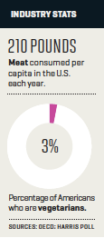
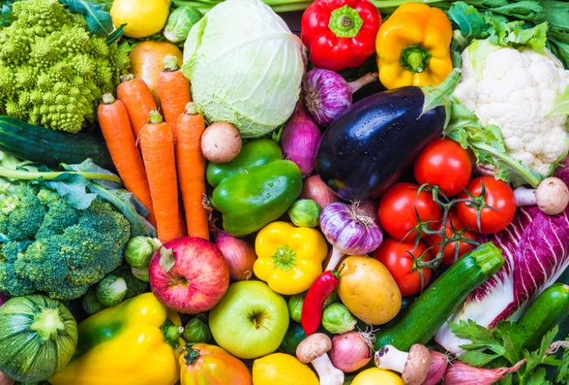


Each year Americans eat an average of 210 pounds of meat per capita, more than double the global average.
Only 3% of Americans are vegetarians
What do we know about what makes a fruit or vegetable look, taste and smell like it does?
versus
Fortune March 2017

Slide 3
First we’ll start with some basics about genetics…

Slide 4

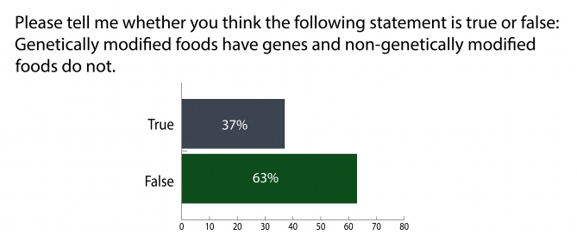
September 2017
SOURCE: Michigan State University Food Literacy and Engagement Poll, September 2017
http://food.msu.edu/articles/msu-food-literacy-and-engagement-poll
Notes:
September 13, 2017

Slide 5
All living things contain DNA – including the foods we eat

Slide 6
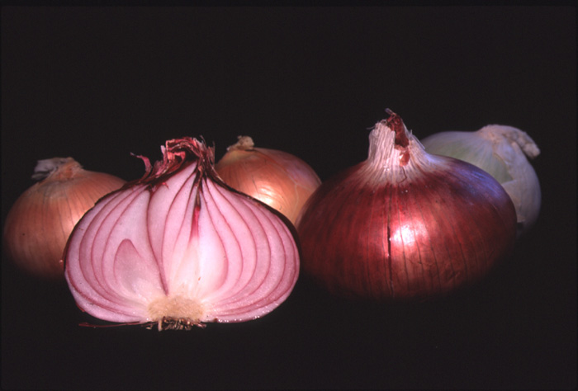
Tour d'Onion
Or what makes an onion, an onion?

Slide 7
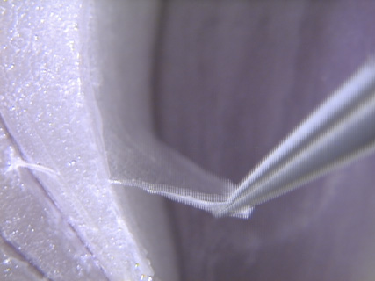
Tissue peel

Slide 8
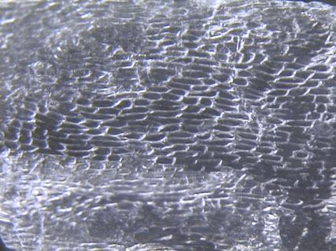
Cells

Slide 9
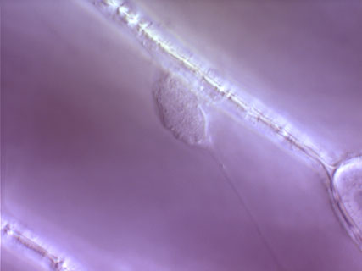
Cell Wall
Nucleus

Slide 10
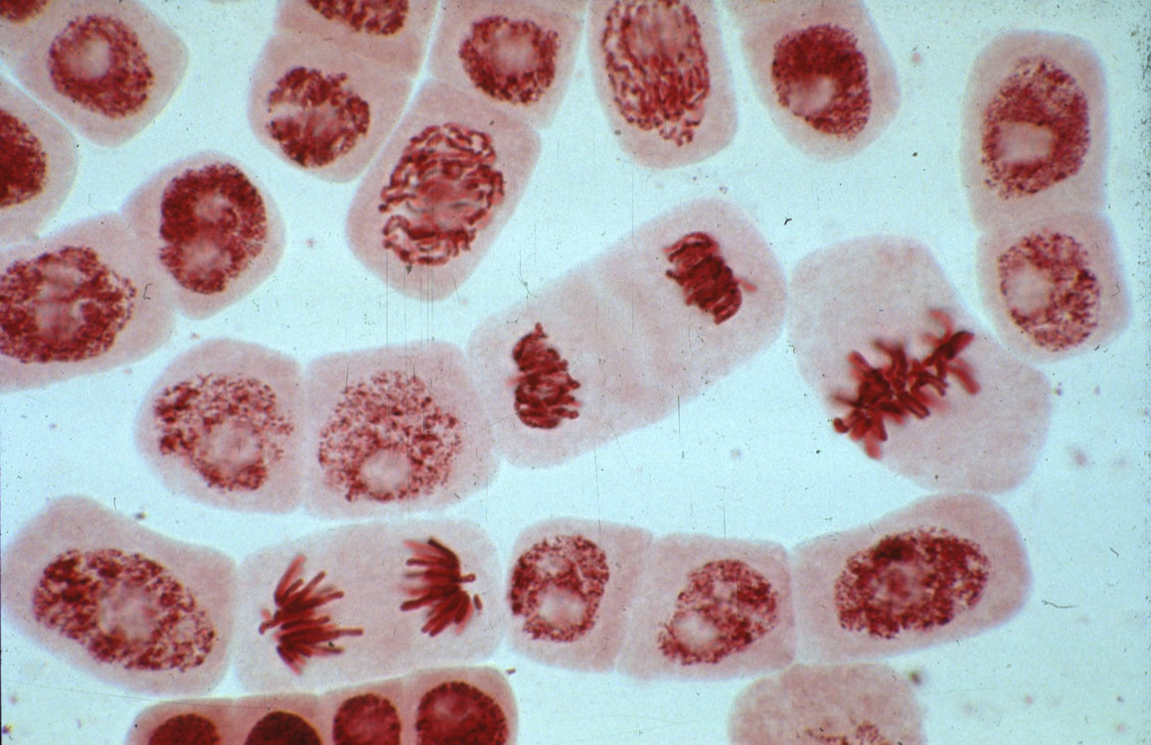
Dividing cell
Chromosomes
Stretched out, the DNA in each cell would be ~ 5 feet long

Slide 11
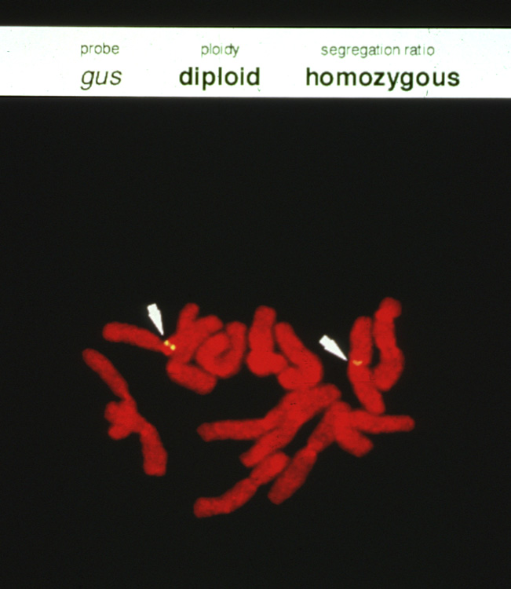
Chromosome
Genes

Slide 12
Genetic information in the genome is responsible for traits
Represent chemical units in genome by alphabetic letters
...CTGACCTAATGCCGTA...
...CTGAACTAATGCCTTA...
Sometimes mistakes happen when copying information in books (genome) → creating changes, called mutations

Slide 13
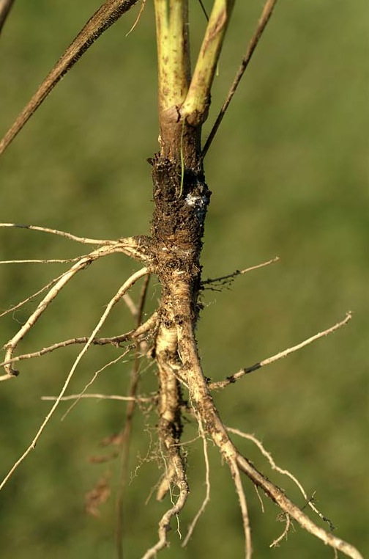
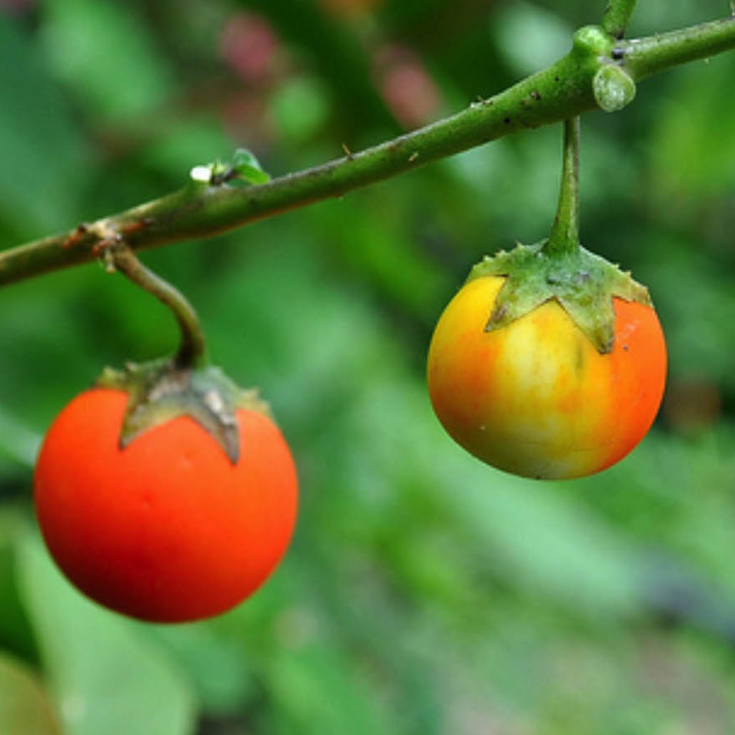
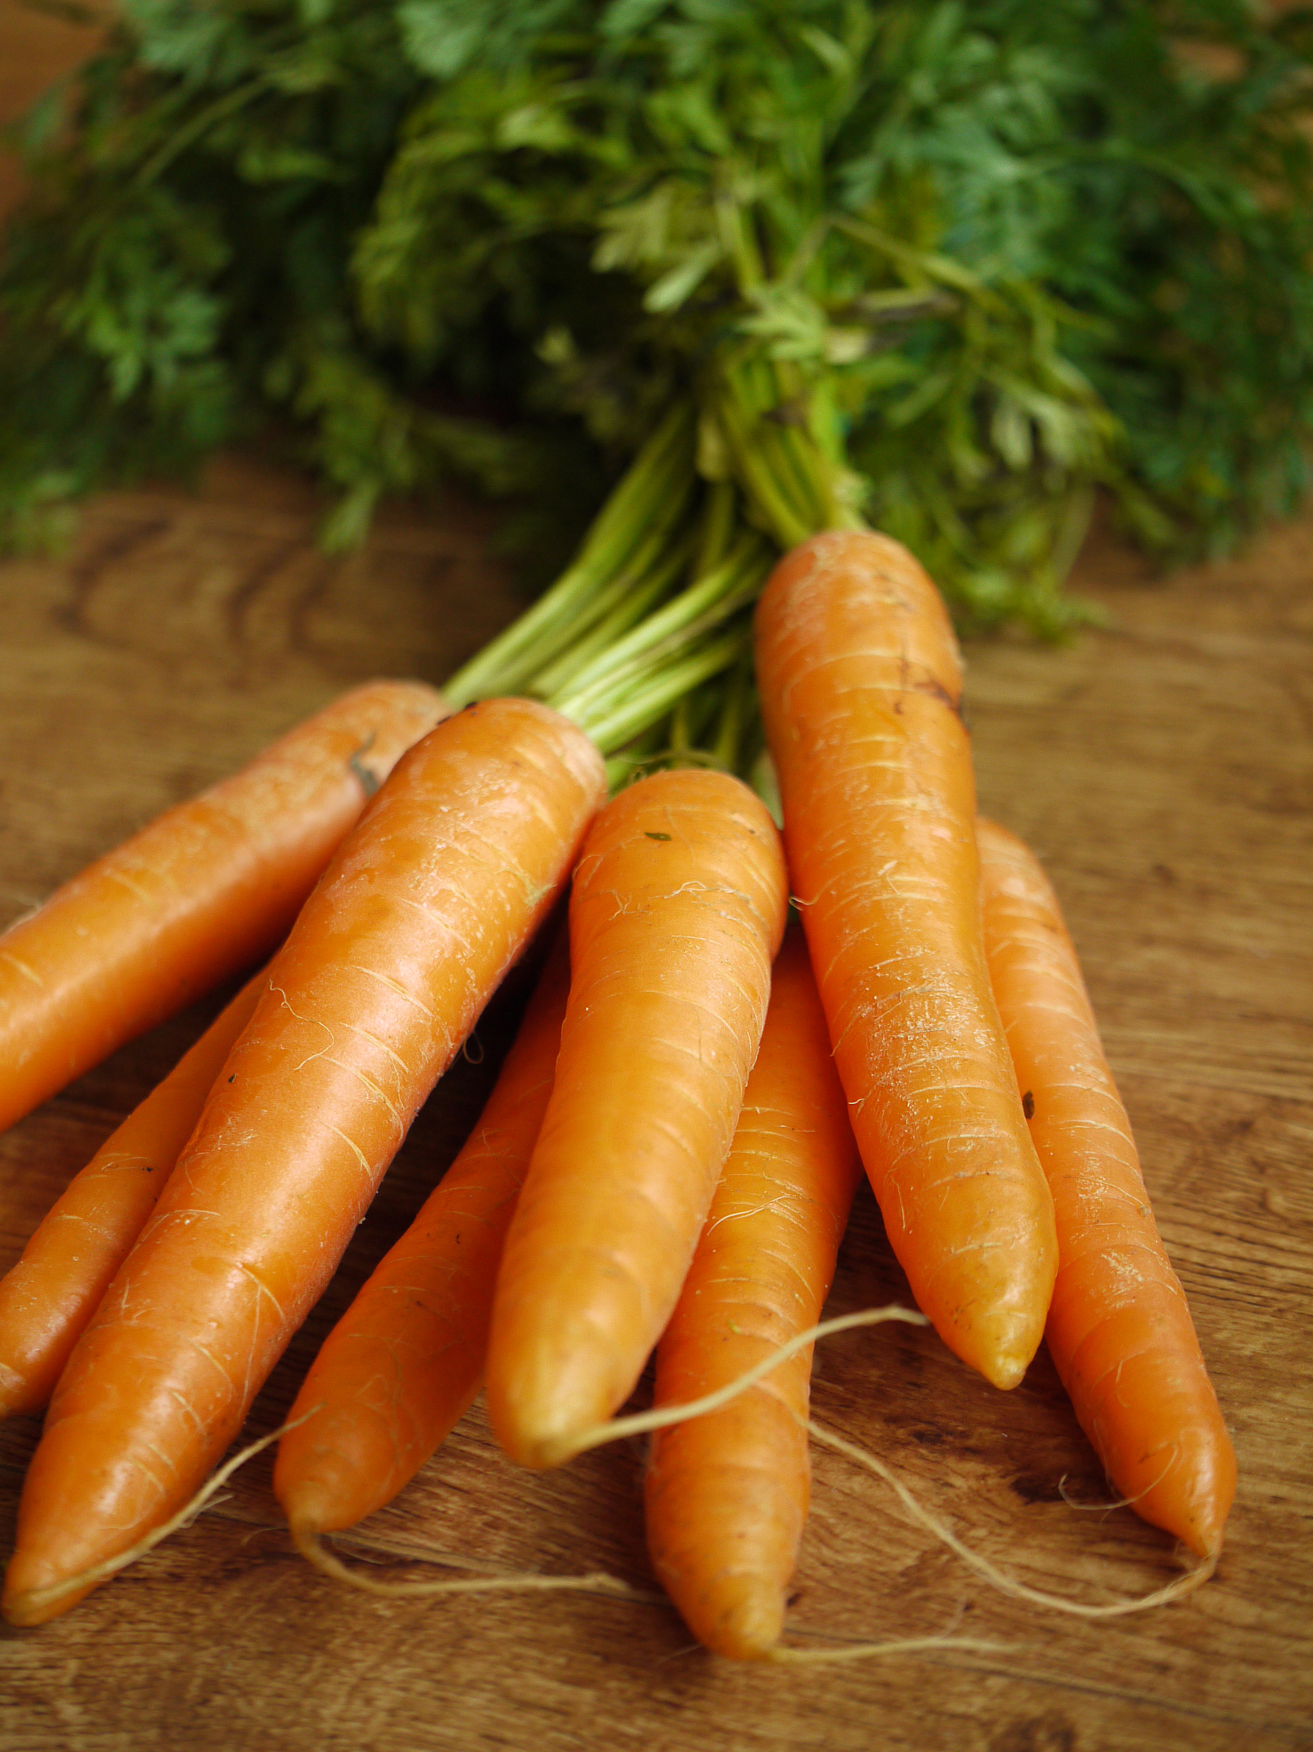
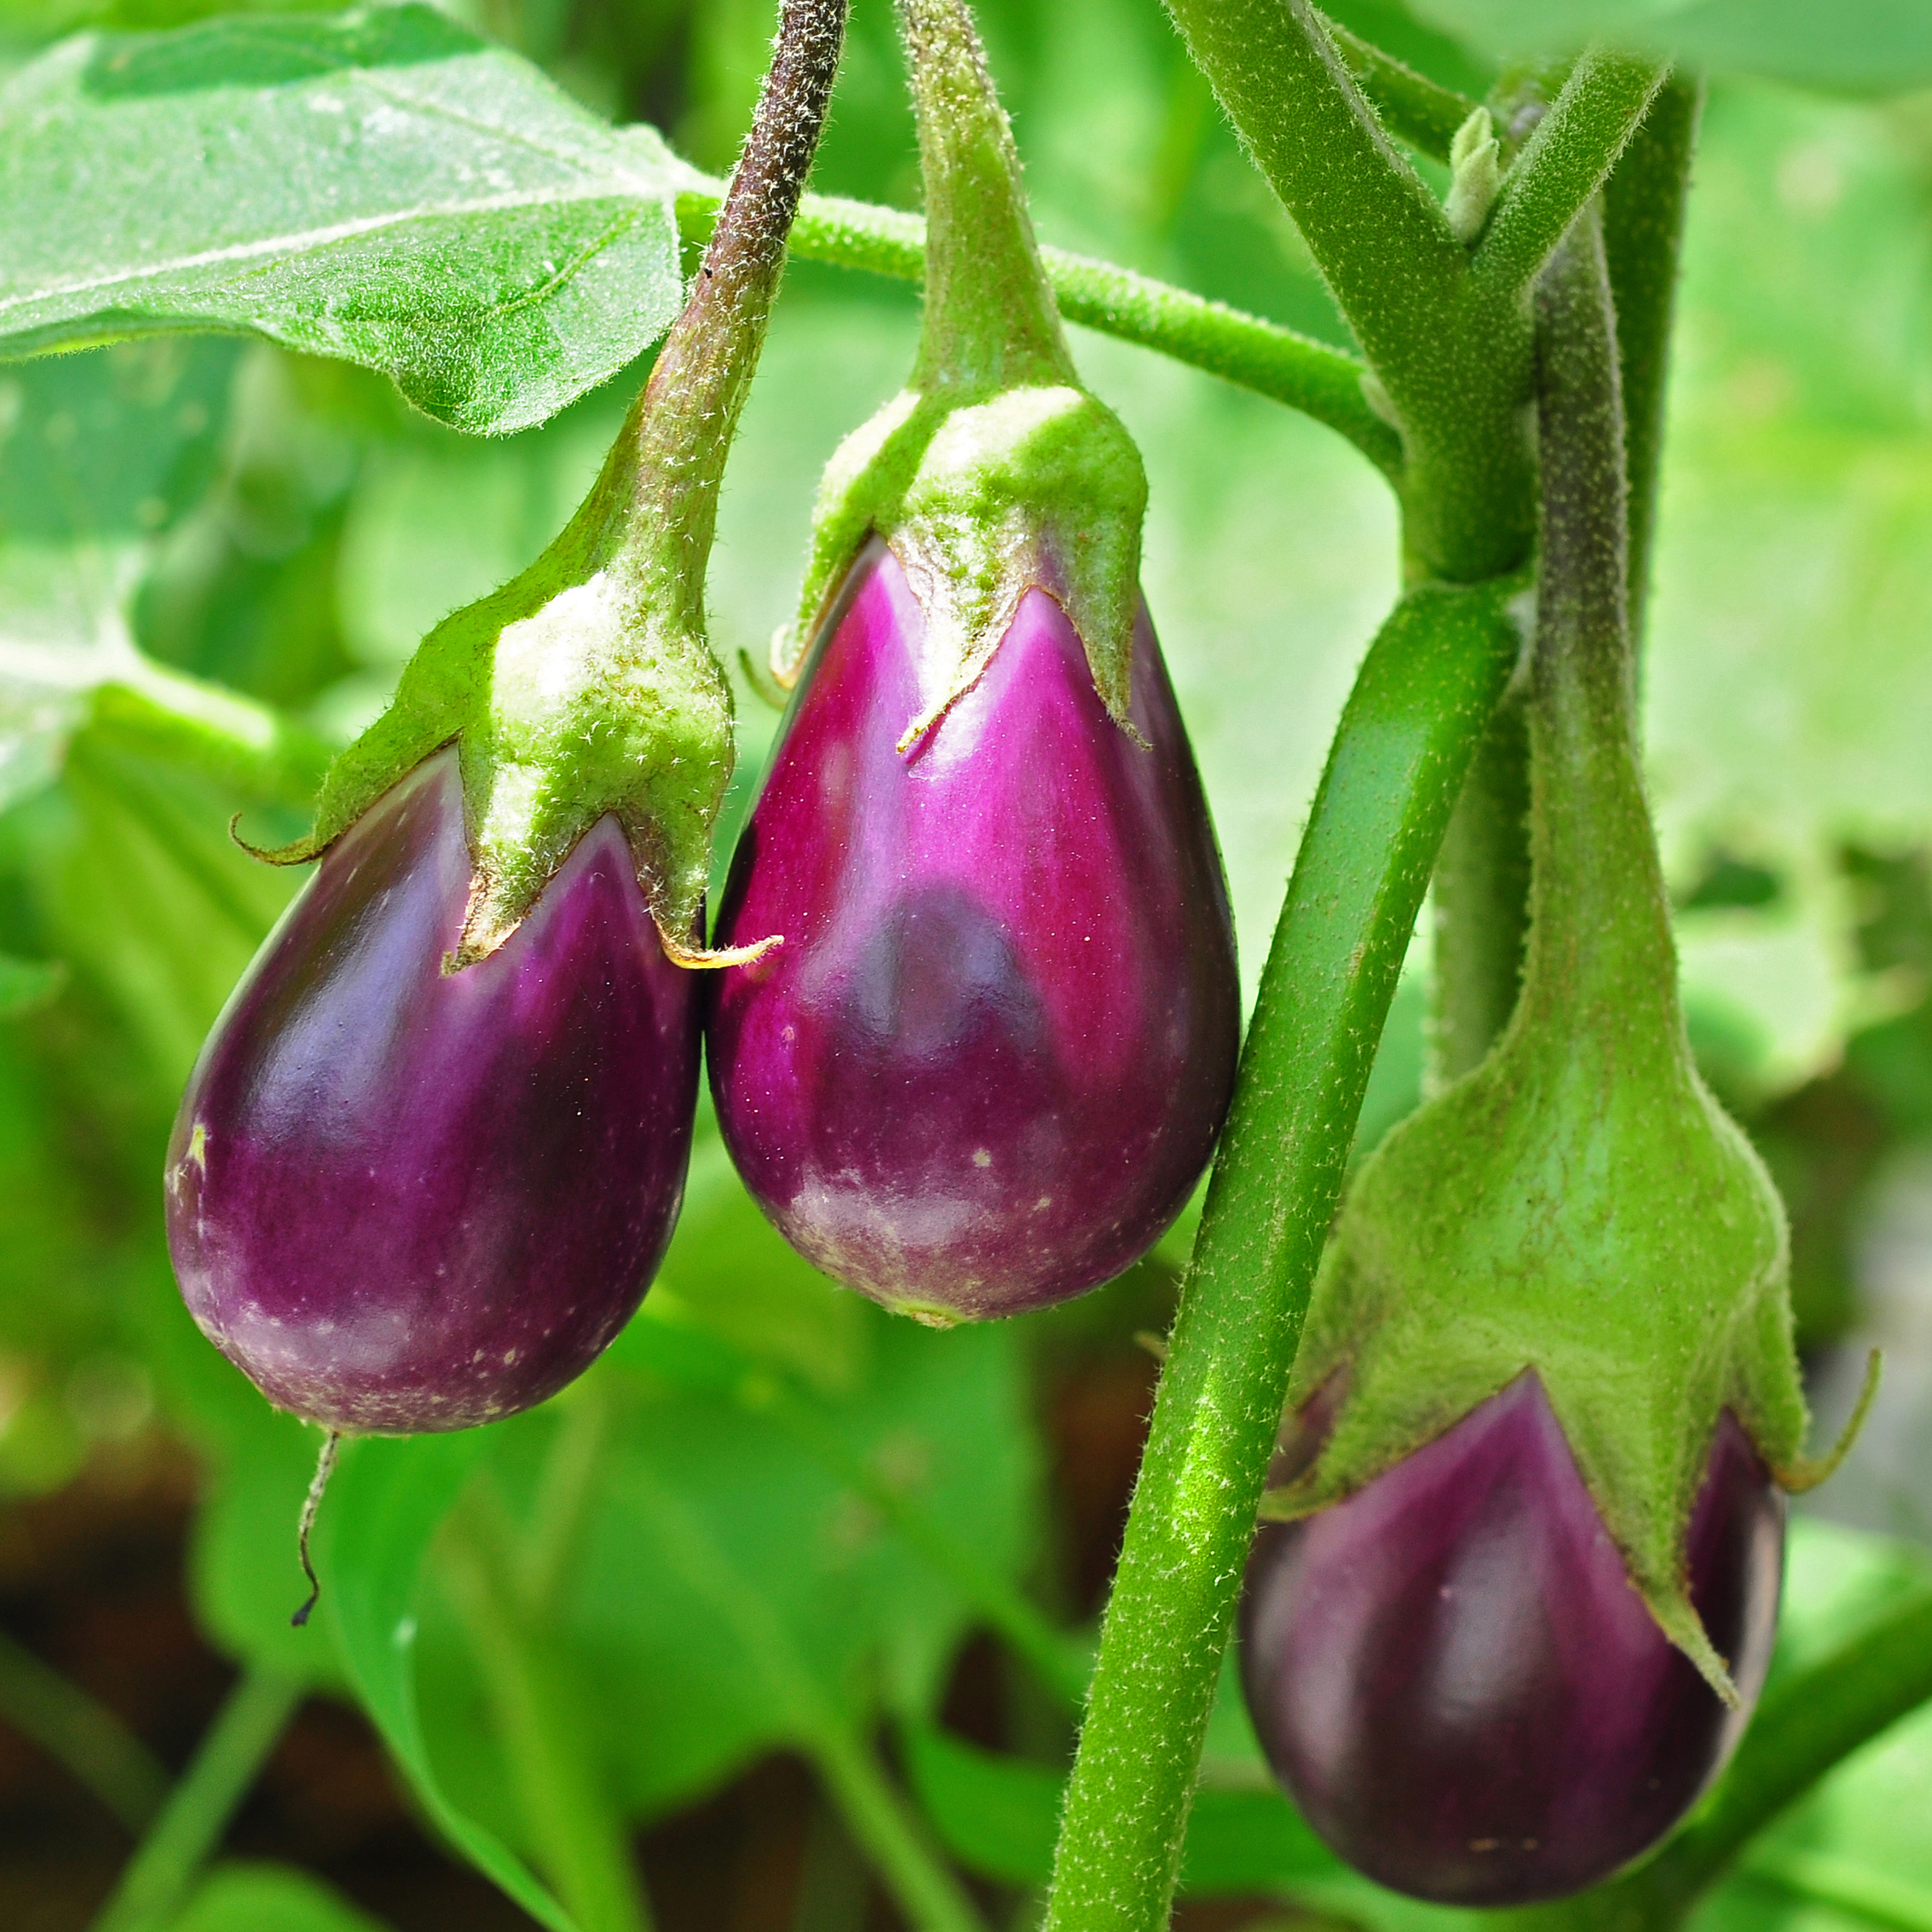
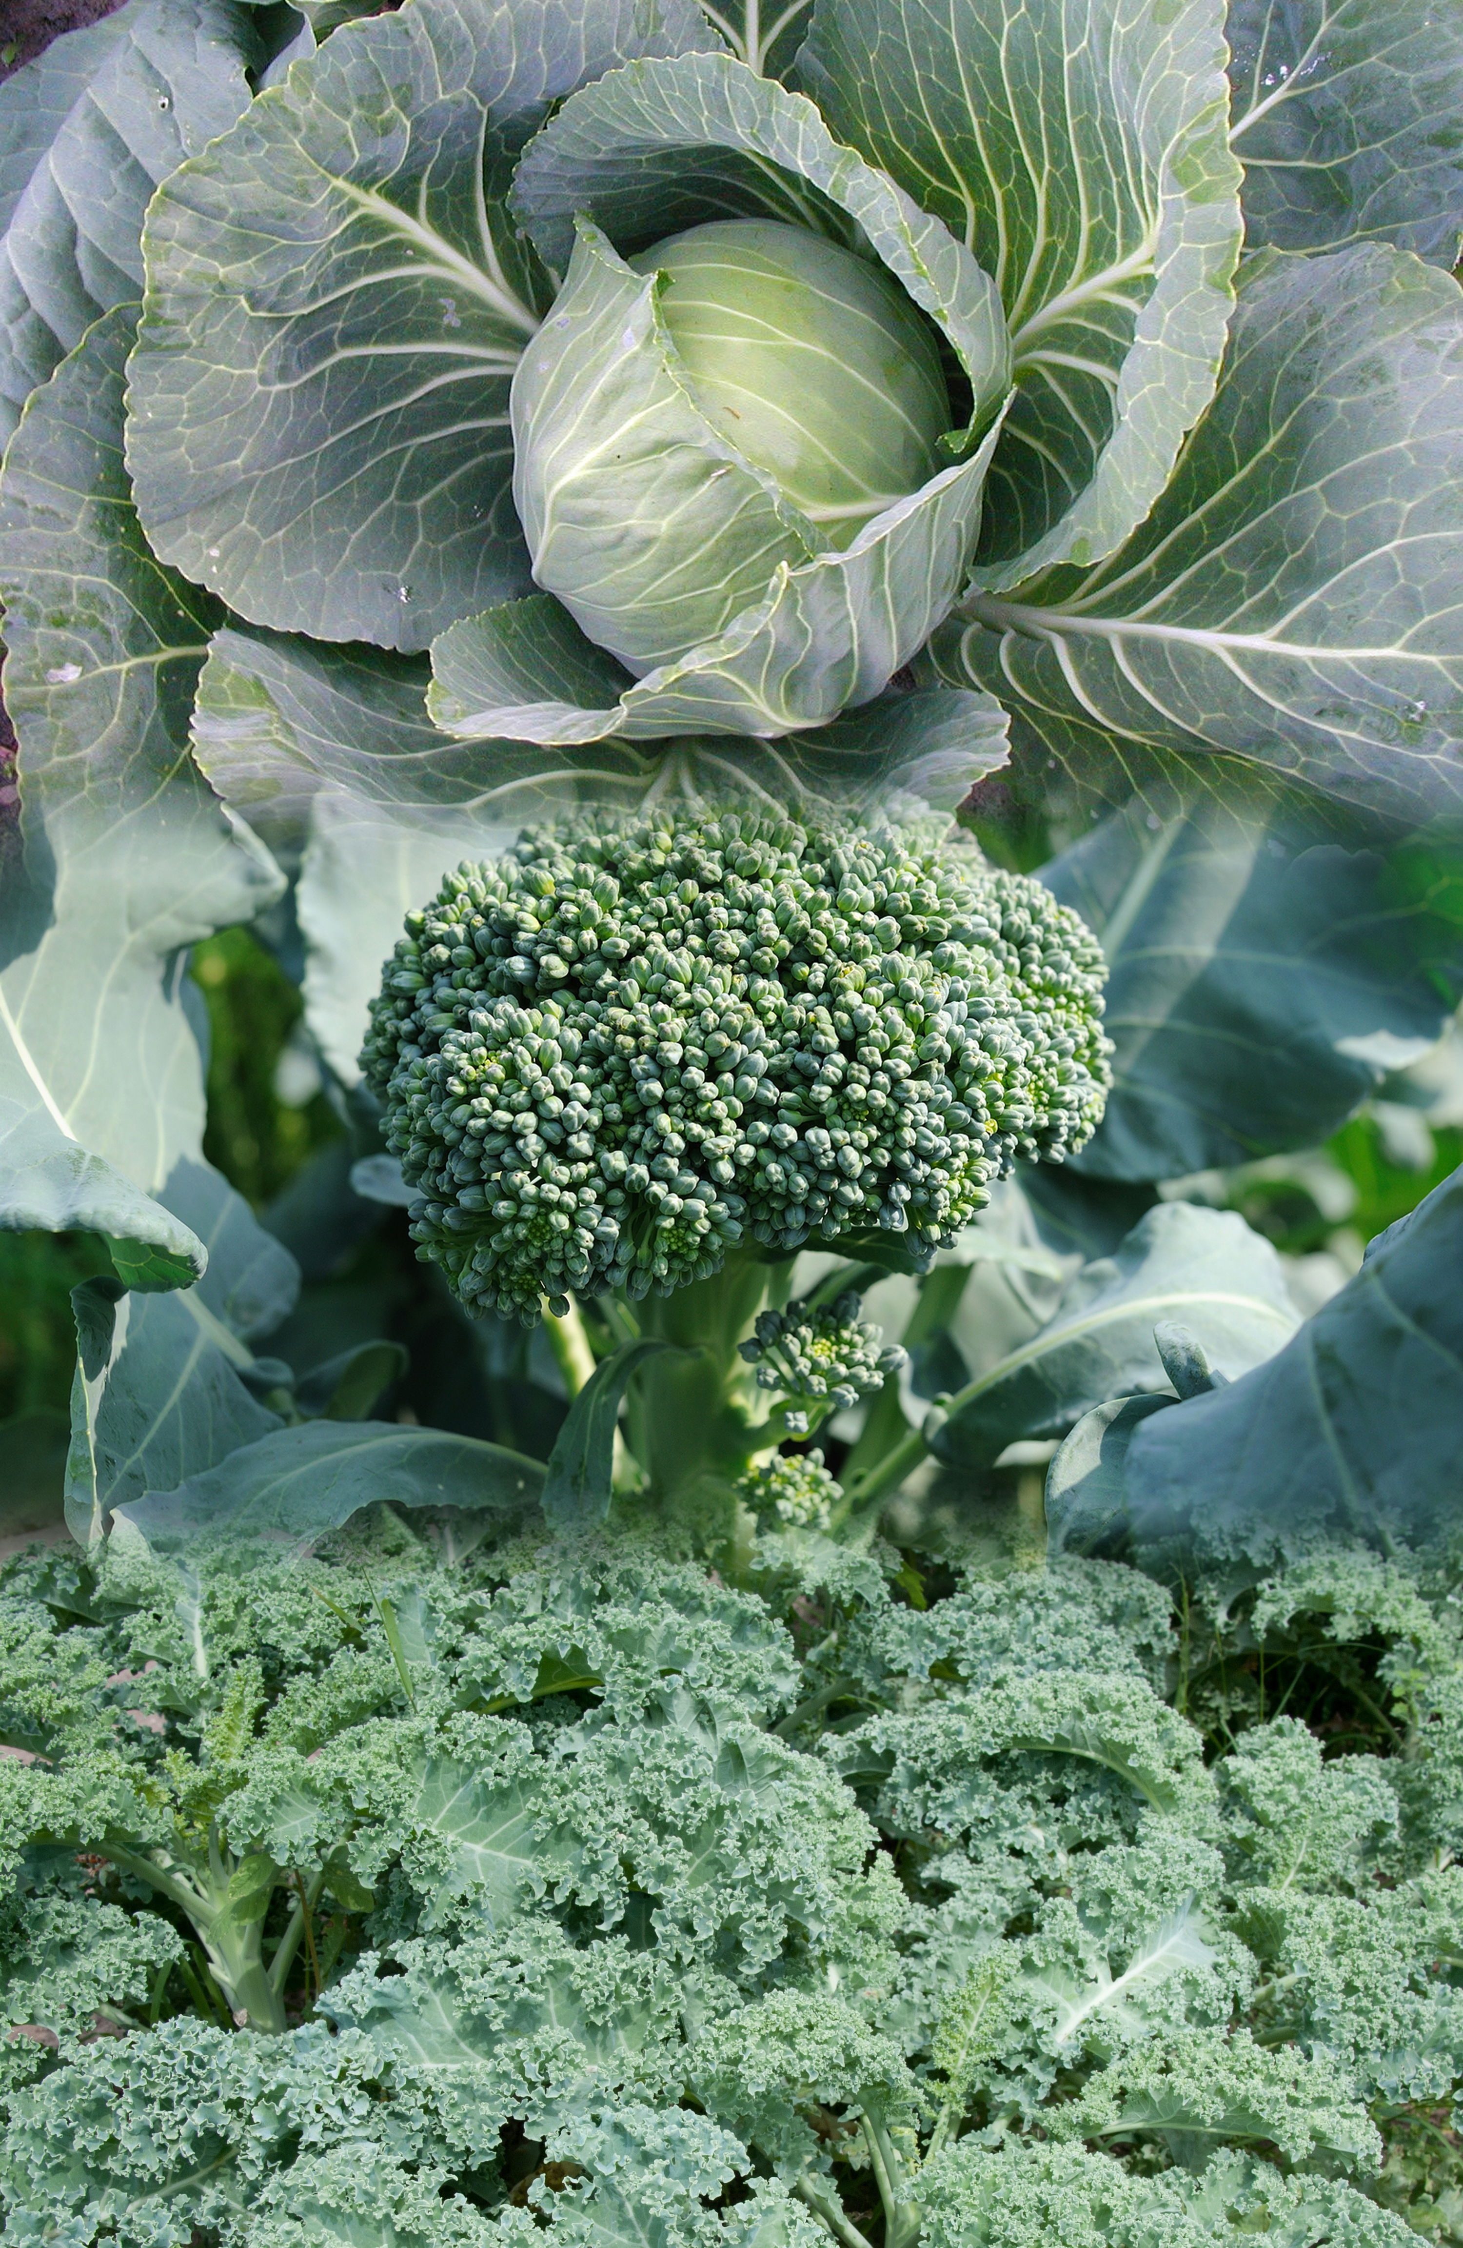
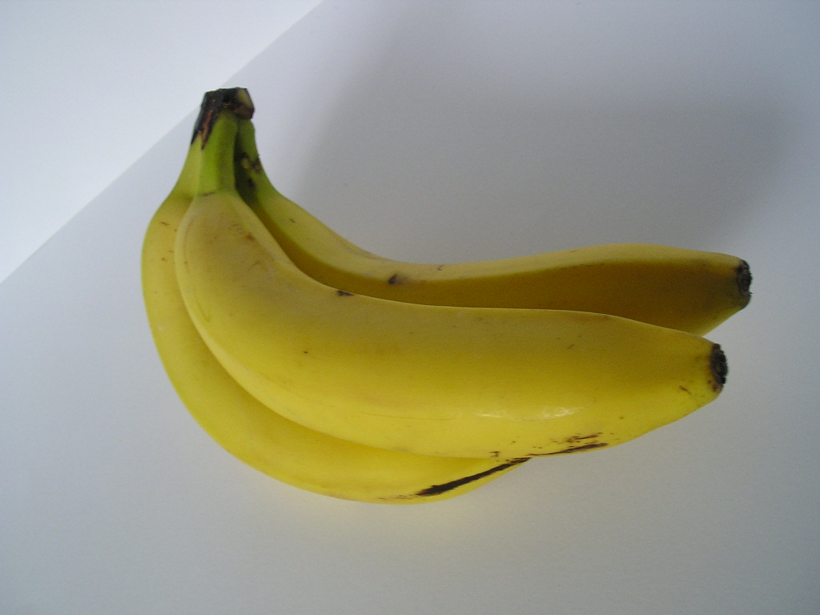
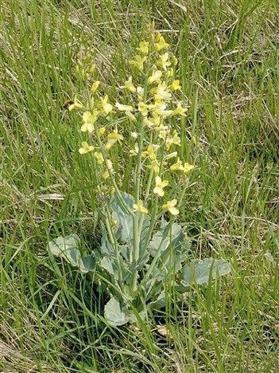
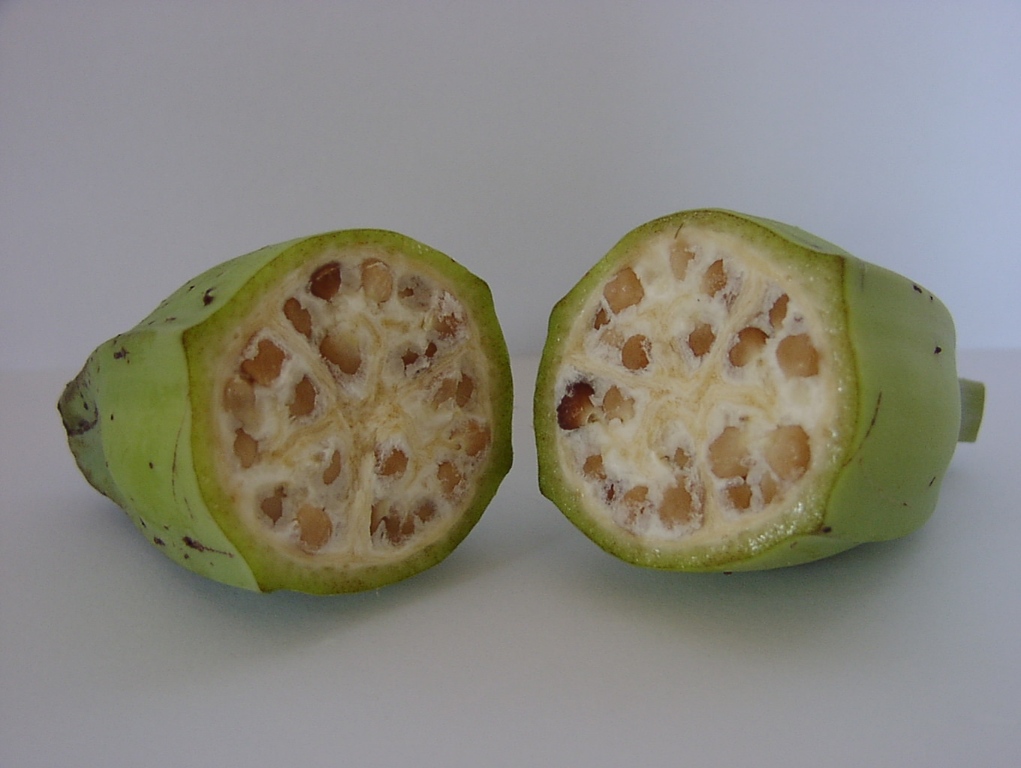
Mutations Have Gotten These Plants from Looking Like This…
To Looking Like They Are Now
Eggplant
Carrot
Banana
Broccoli, Kale, Cabbage

Slide 14
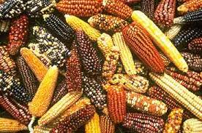
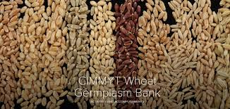
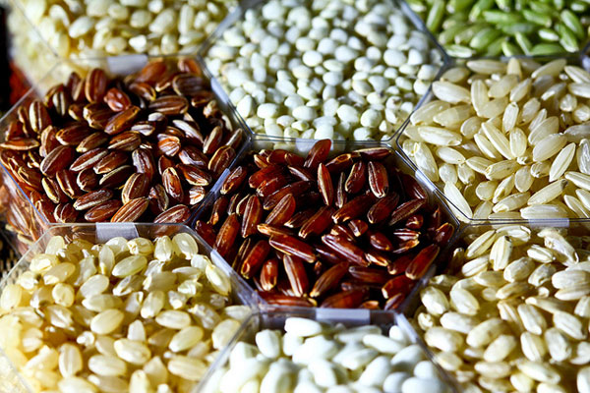
Mutation breeding intentionally makes changes in a crop’s DNA - >3200 officially released crops – like 600 maize, rice, wheat varieties, released since 1950’s.
Van Eenennaam 11/29/2016
Photo by Stephen Ausmus, USDA
Notes:
The methods used in mutation breeding have been in use since the 1950s and are excluded from GMO legislation, because such mutations also occur without human intervention but with a much lower frequency. The occurrence of mutations is considered to be a natural process, commonly used by breeders to exploit natural variation, that is simply boosted by the applied technique. Up to now, more than 3200 officially released cultivars are known to have been obtained by mutation breeding, among them more than 600 cultivated lines of wheat, rice and maize

Slide 15
Modern Example
Japanese Farmer Creates Mongee Banana With Softer, Digestible Skin
2/22/2018 A-peeling? Japanese farmers invent edible banana skin | World news | The Guardian
Notes:
2/22/2018 A-peeling? Japanese farmers invent edible banana skin | World news | The Guardian

Slide 16
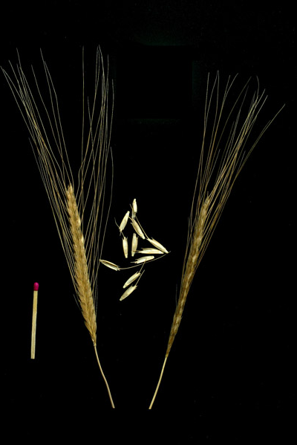
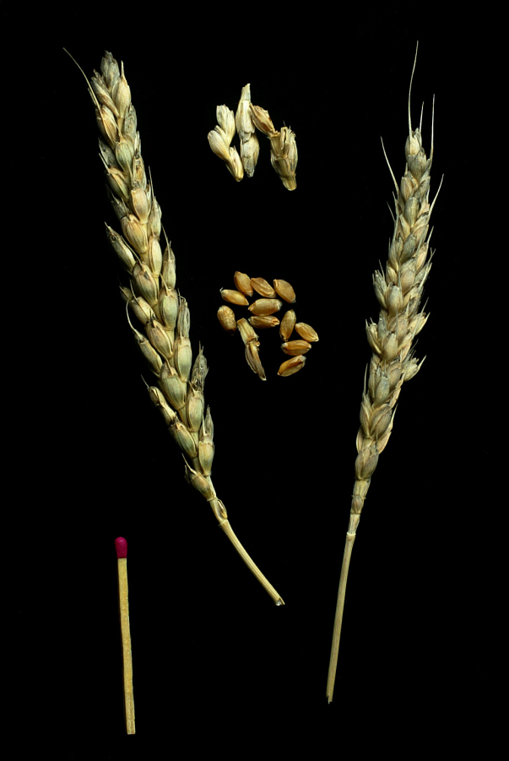
How can genetics be used to create a wheat variety with better nutrition – using ancient wheat?
What happens to the genetic information from the two parents?
X
Triticum monococcum Ancient variety
Triticum aestivum
Modern bread variety

Slide 17
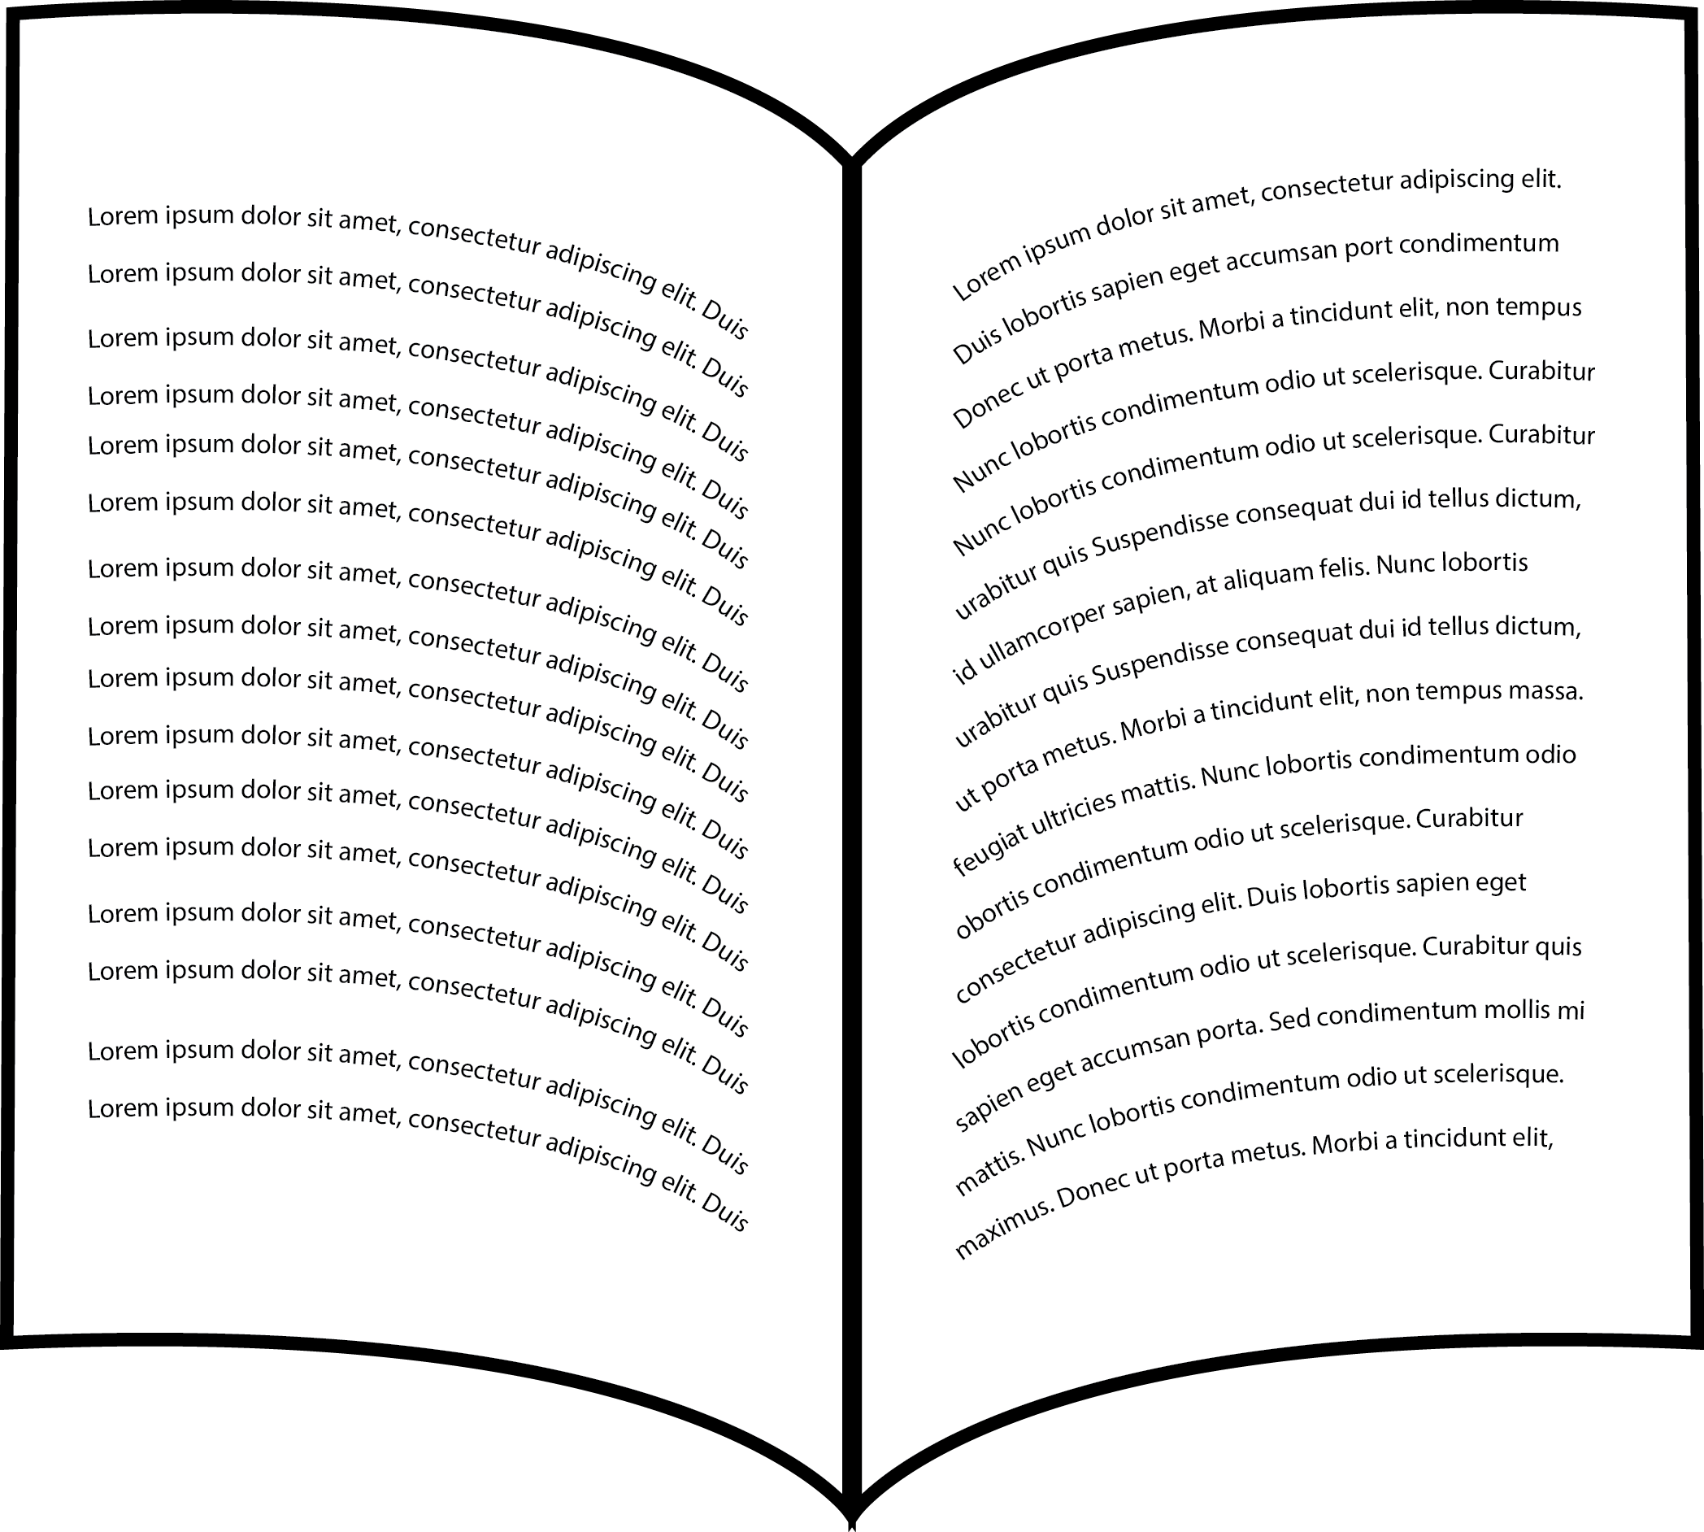
Information in the wheat genome
Chemical units represented by alphabetic letters
...CTGACCTAATGCCGTA...
1700 books
1000 pages each
1700 books
(or 1.7 million pages)

Slide 18
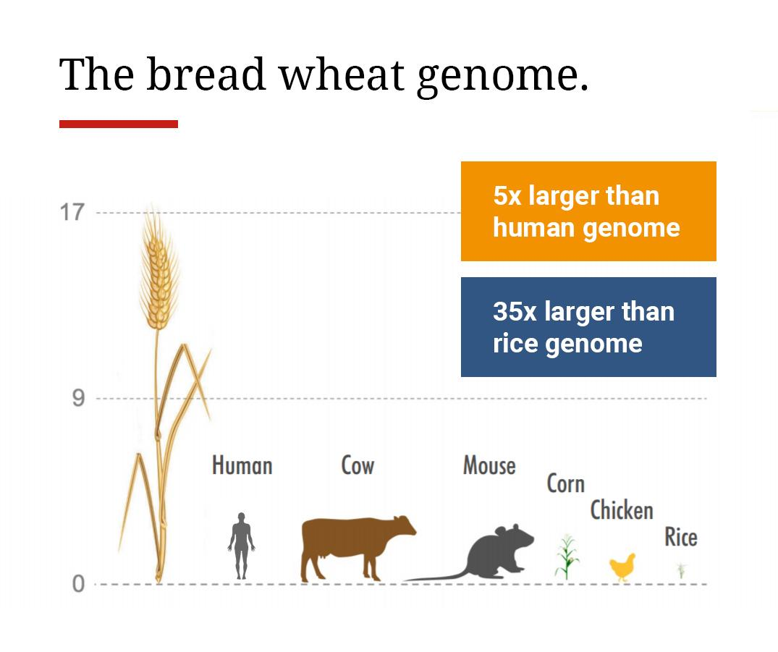
How does the genetic information (genome) in wheat compare to what’s in a human?
Source: Earlham Institute communications team, Chris Bennett

Slide 19
Hybridization or cross breeding of wheat
Random retention of information from each parent
x
1700 books
(or 1.7 million pages)
1700 books
(or 1.7 million pages)
1700 books
(or 1.7 million pages)
Genetic modification by hybridization is not GEn or GMO

Slide 20
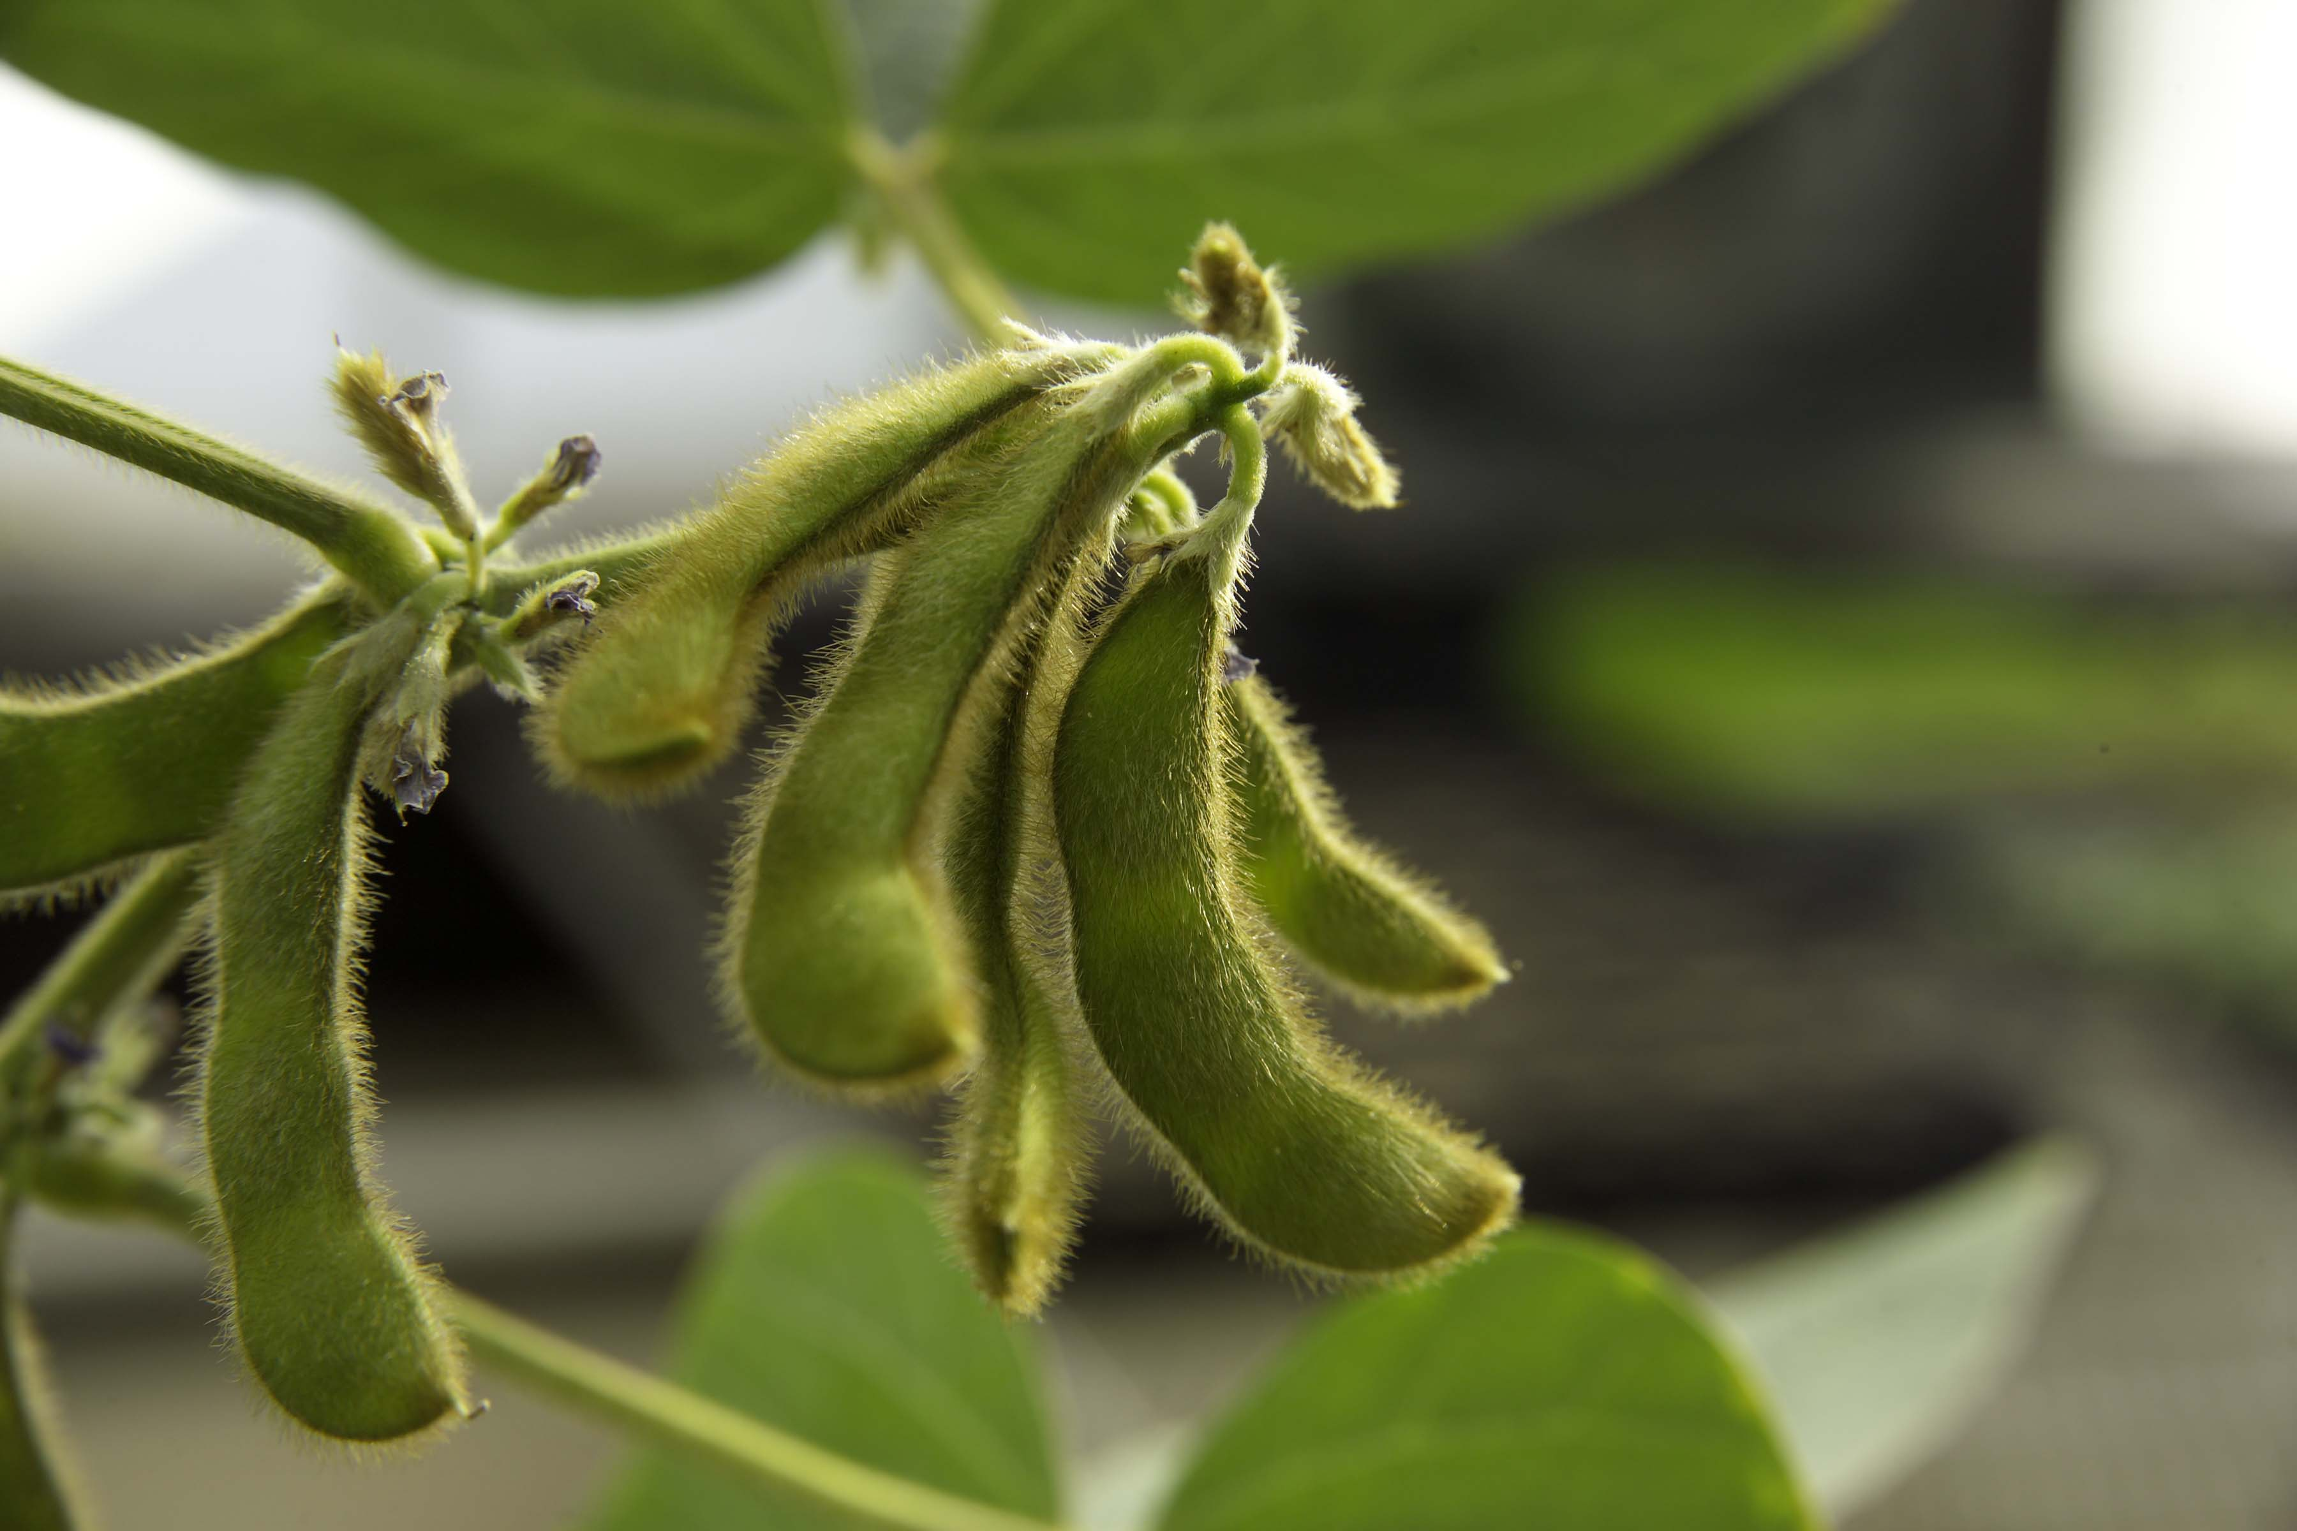
Example: New soybean with lower allergenicity and less anti-nutritional qualities created after many years of breeding
SOURCE: “Triple Null: New Genetically Modified Soybean A Big Benefit For Food Allergies”, Science 2.0, 5/4/15.
http://www.science20.com/news_articles/triple_null_new_genetically_modified_soybean_a_big_benefit_for_food_allergies-155306
Notes:
May 12, 2015

Slide 21
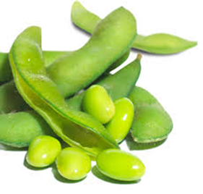
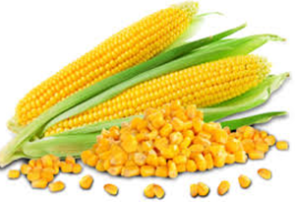
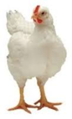
Putting this in context, these breeding efforts were critical to increasing crop production…
Product | 2014 total production | 2014 acreage | Acreage needed at 1950’s rate | Additional Resources needed
Soybeans | 3.927.090,000 bu 235,562,540,000 lb | 82,591,000 acres | 180,971,889 acres | ~98 million acres (= size CA)
Corn | 14,215,532,000 bu | 83,136,000 acres | 372,134,346 acres | ~289 million acres (= 3X size CA)
Broiler Chickens | 51,373,100,000 lbs | 8,544,100,000 head | 16,679,545,455 head | ~8 billion head requiring 81.5 billion lbs feed
Van Eenennaam 11/29/2016
Notes:
FCR = feed conversion ratio

Slide 22
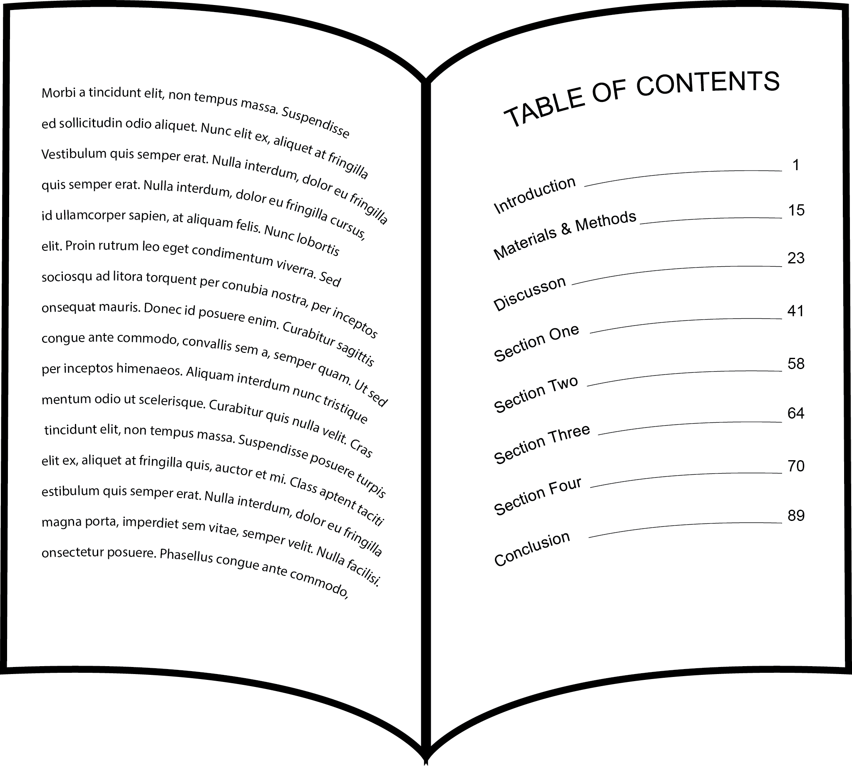
New breeding methods
Uses table of contents of genes for marker assisted selection
...CTGACCTAATGCCGTA...
1700 books
(or 1.7 million pages)
Genetic modification that is not GEn or GMO

Slide 23
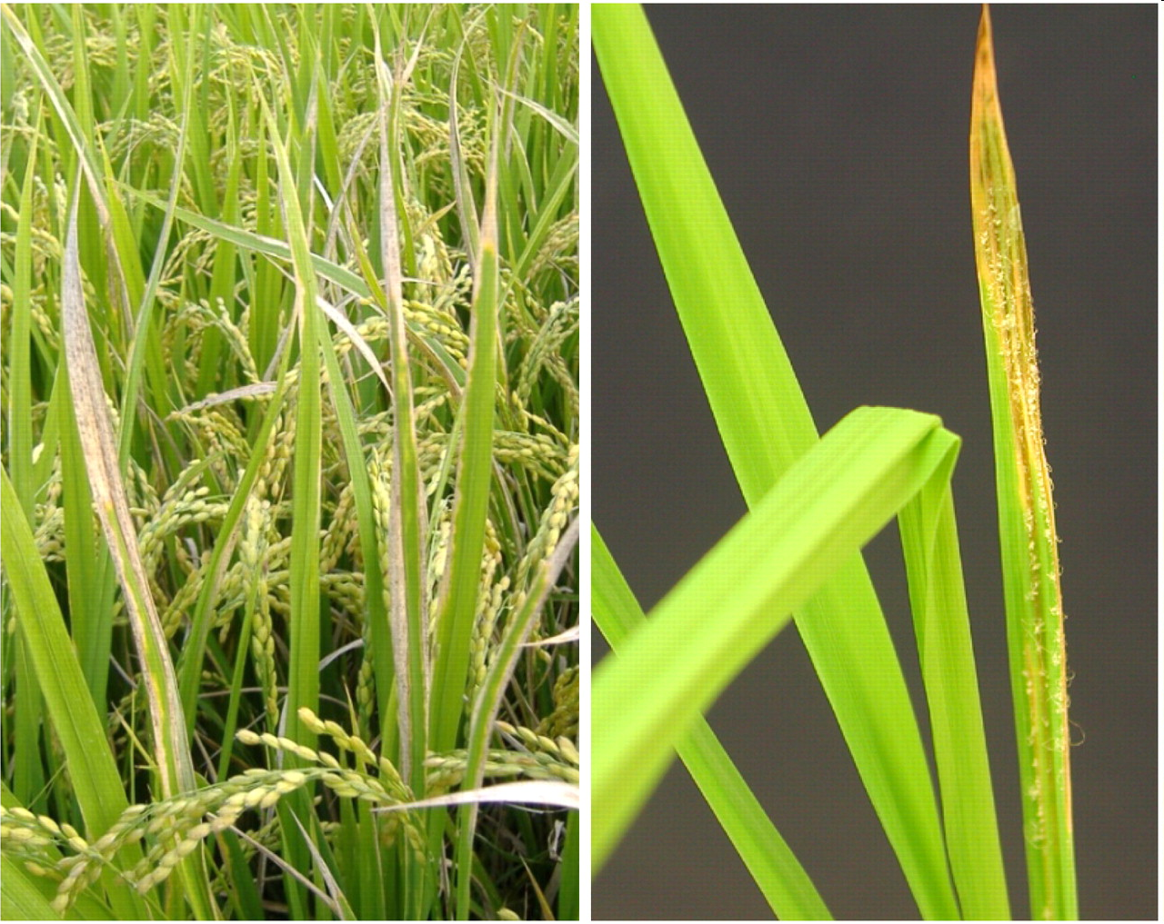
Can’t we just do all modifications this way?
Marker-assisted selection used to protect rice against bacterial blight and blast disease
Limited to diversity in crop and compatible relatives

Slide 24
Another means to modify genomes uses genetic engineering (GEn) to create “GMOs”
Inserts randomly in genome
What Kinds of GEn Crops and Foods Are in the Commercial Market?
+
Inserted gene(s)
One-half page equivalent to a gene
1700 books
(or 1.7 million pages)
Genetic modification
that is GEn and GMO
1700 books
(or 1.7 million pages)

Slide 25
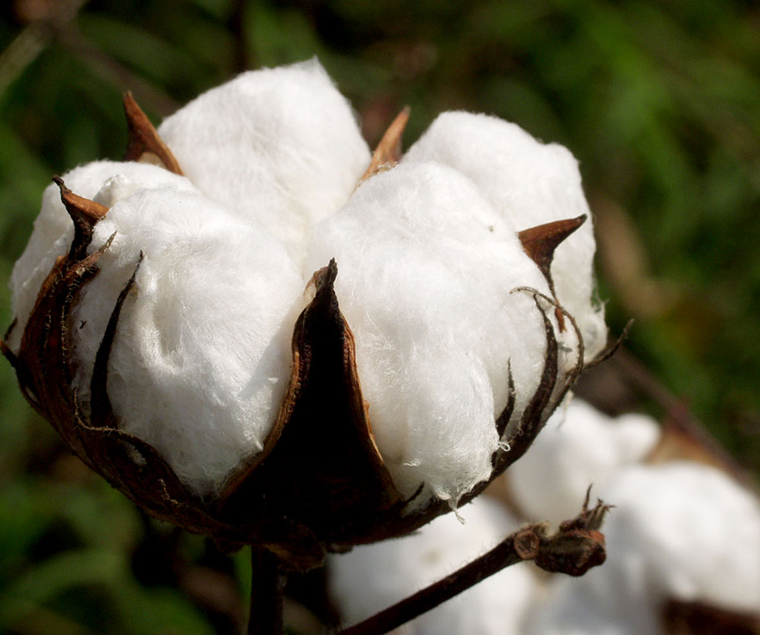

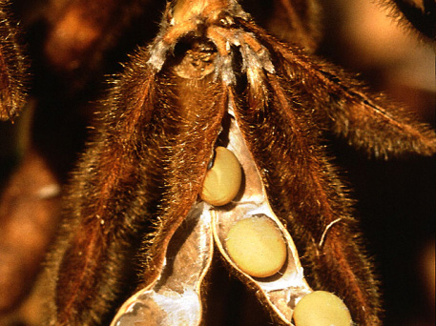
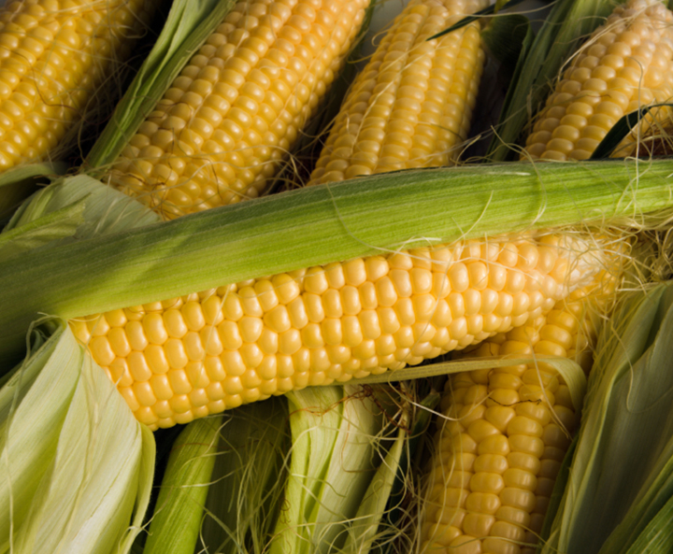
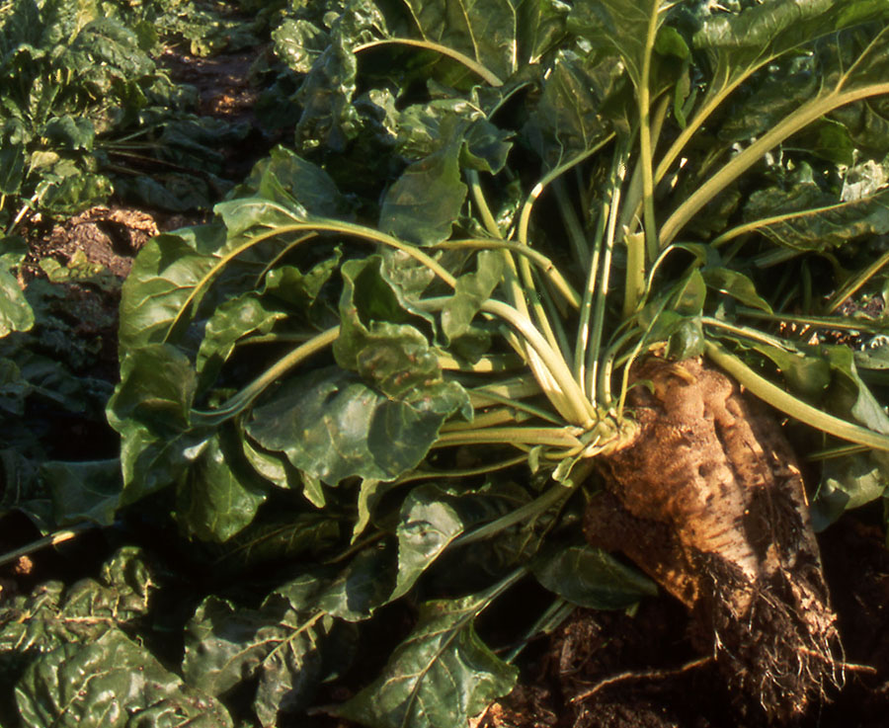
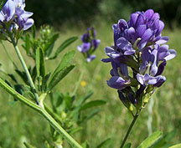
Number of different commercially available, large acreage GEn (GMO) crops is limited
GE Cotton
96% of 2014 acreage
(Insect Resistant: 5% Herbicide tolerant: 12% Stacked gene: 79%
GE Canola
93% of 2013 acreage
GE Soybean
94% of 2014 acreage
(Herbicide resistant: 94%)
Source: USDA-ERS, 2014
Source: ISAAA, 2011
Source: USDA-ERS, 2012
GE Corn
93% of 2014 acreage
(Insect Resistant: 4% Herbicide resistant: 13% Stacked gene: 76%)
GE Sugarbeet
98% of 2013 acreage
GE Alfalfa
25% of 2014 acreage
Source: USDA-ERS, 2014
Source: ISAAA, 2011
Source: Dan Putnam, UC ANR, 2014
Notes:
August 20, 2014

Slide 26
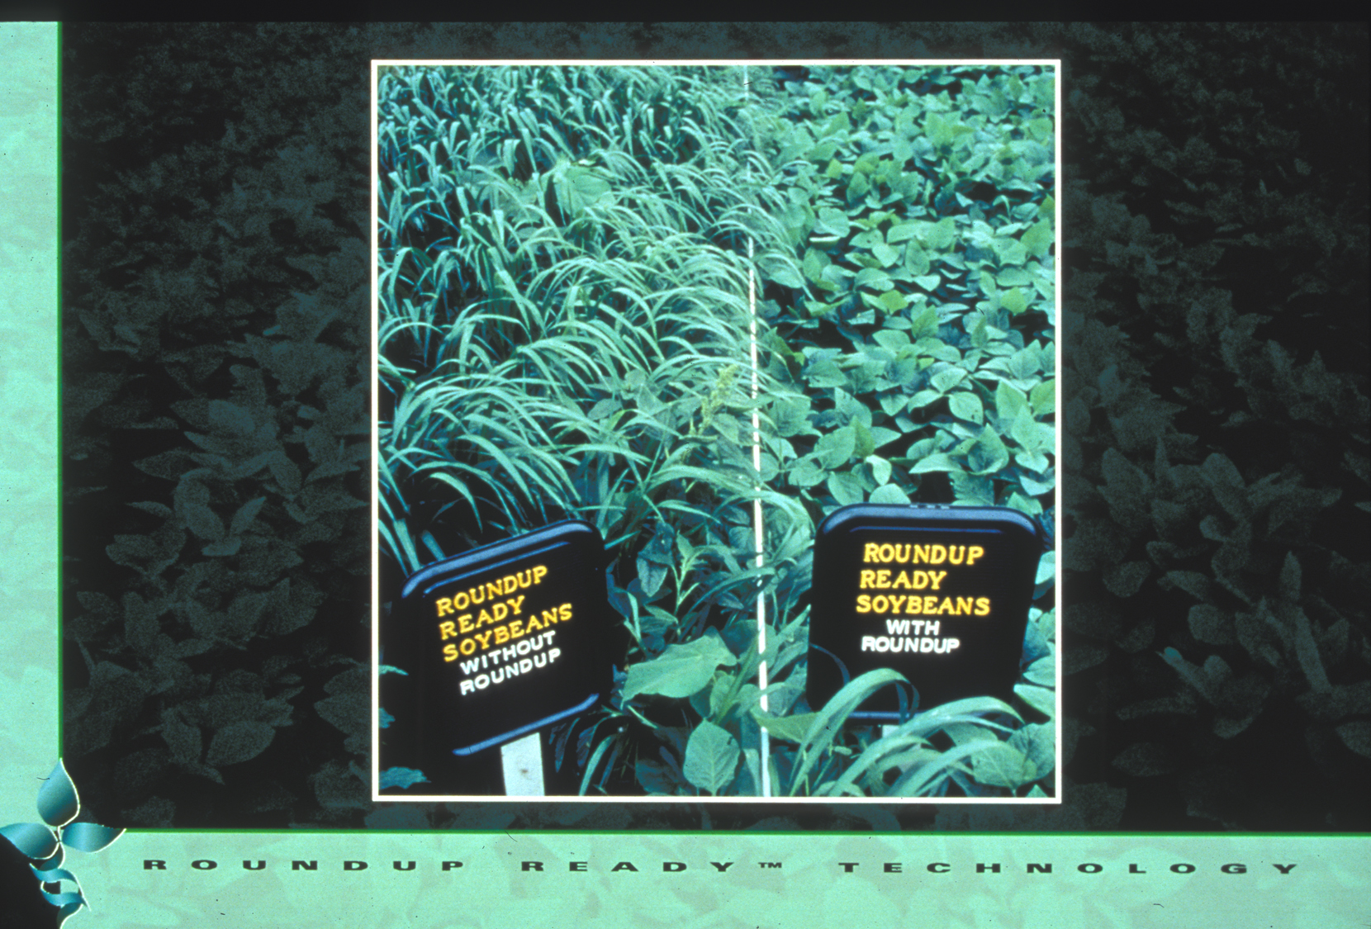
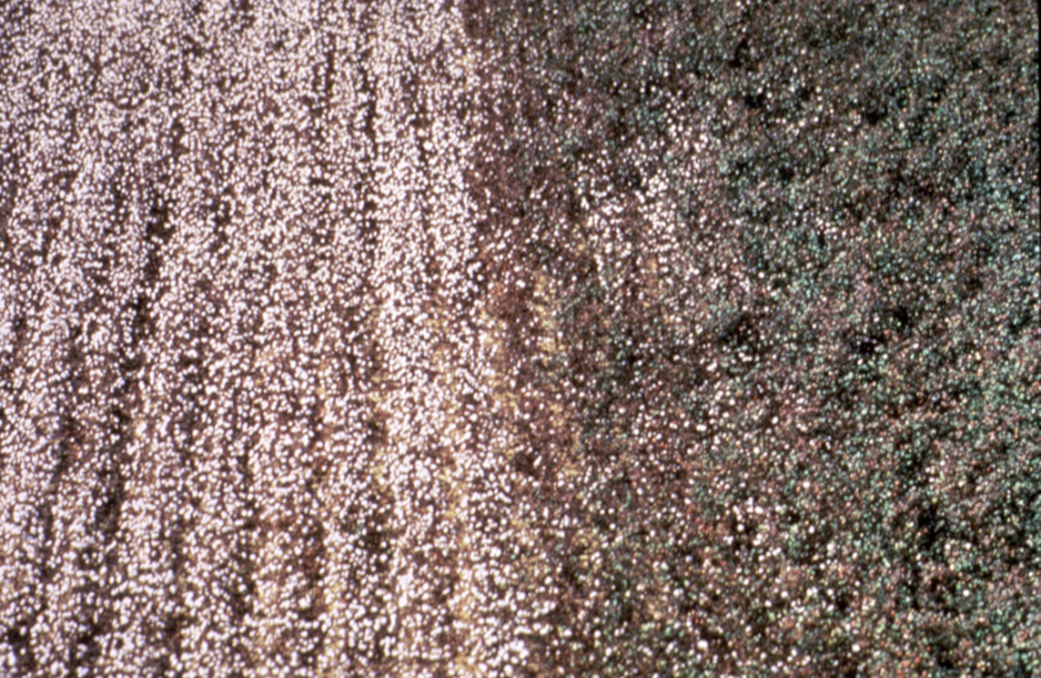
Roundup Ready Soybean™
These traits are not aimed at changing nutritional qualities
Herbicide-tolerant - engineered with gene to tolerate herbicide application
Insect-tolerant Bt crops - engineered for resistance using gene from naturally occurring bacterium

Slide 27
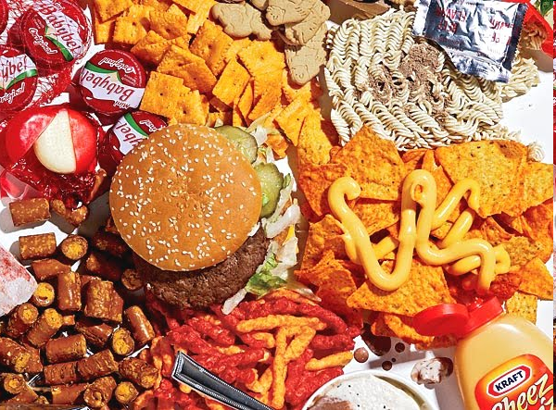
Corn oil
Canola oil
Soy lecithin
Soy protein
Corn starch
Cottonseed oil
But because these are large-acreage GEn crops, it leads to estimates that 60-80% of processed foods in U.S. have GEn or GMO ingredients – mostly minor
SOURCE: https://factsaboutgmos.org/disclosure-statement

Slide 28
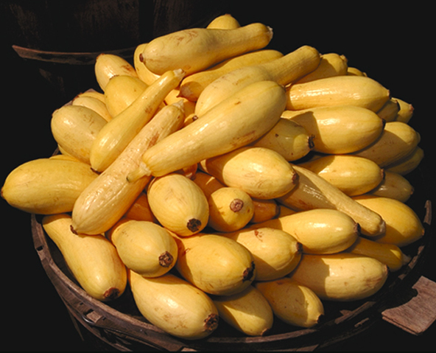
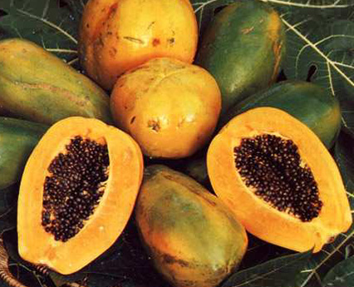
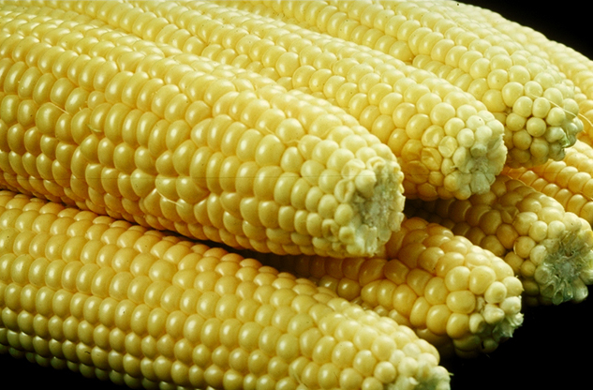

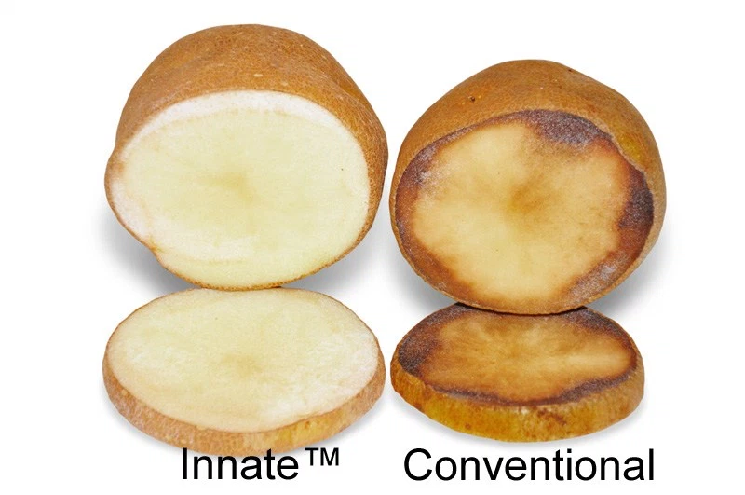
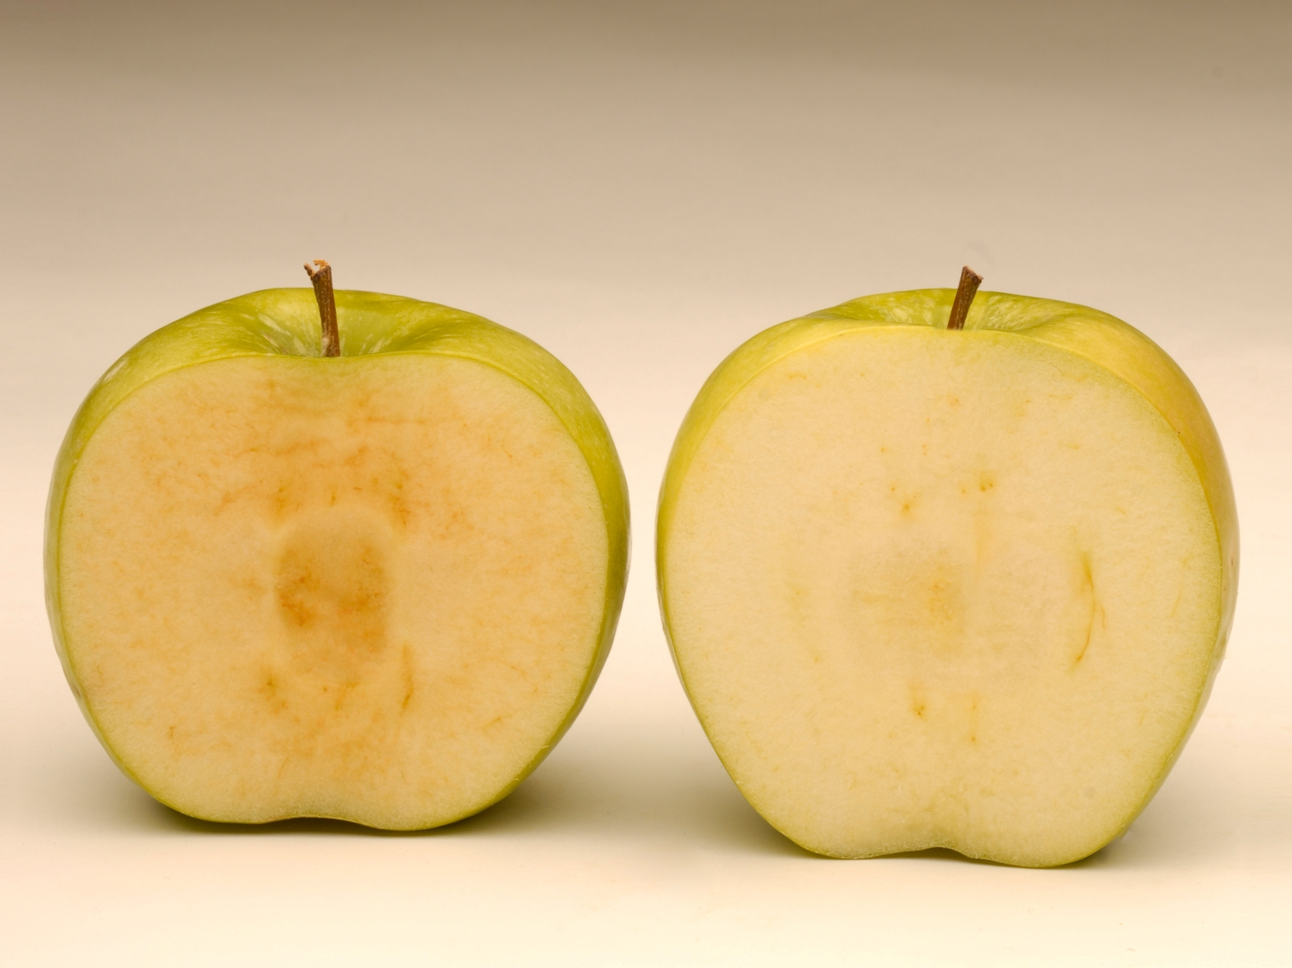
There are only a few whole, genetically engineered foods in the U.S market
GE Squash
~25,000 acres in 2011
GE Papaya
≥77% of 2009 acreage
from Hawaii
GE Sweet Corn
Acreage unknown
Source: Non-GMO Project
Source: USDA, Hilo, HI, 9/2011
Two more are just being introduced
Arctic Apple™
Innate™ Potato
Introduced in 400 Midwest stores in Oct. 2017

Slide 29
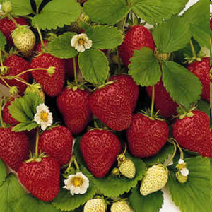
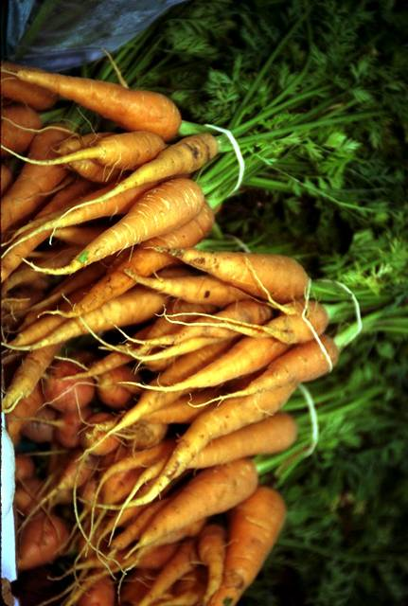
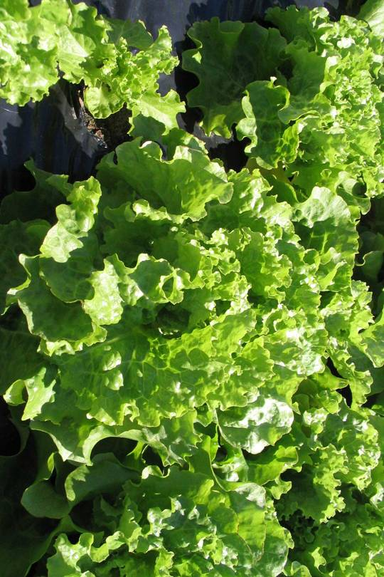
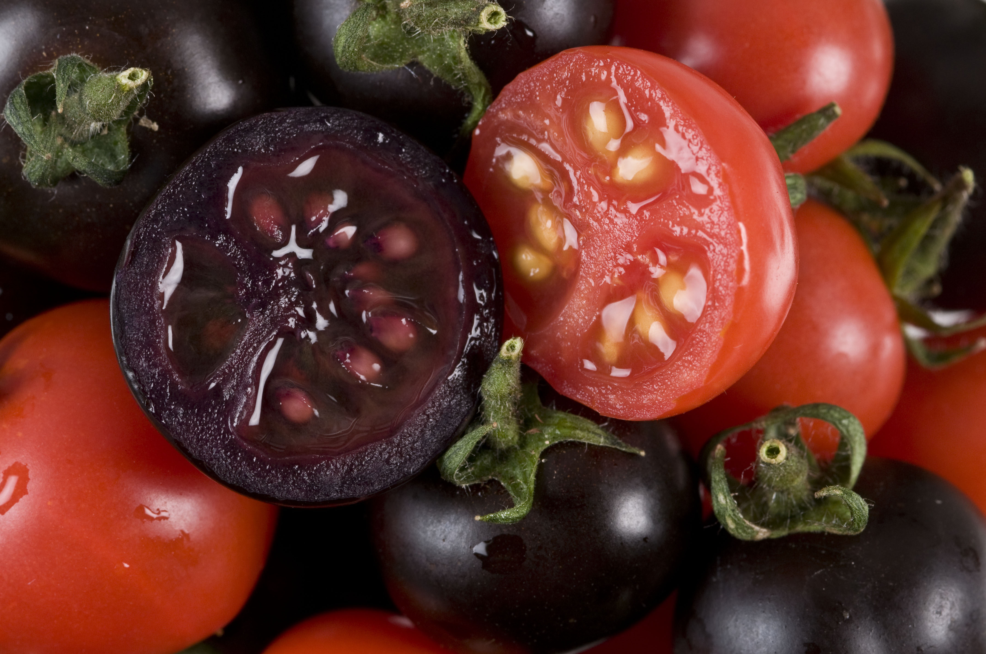
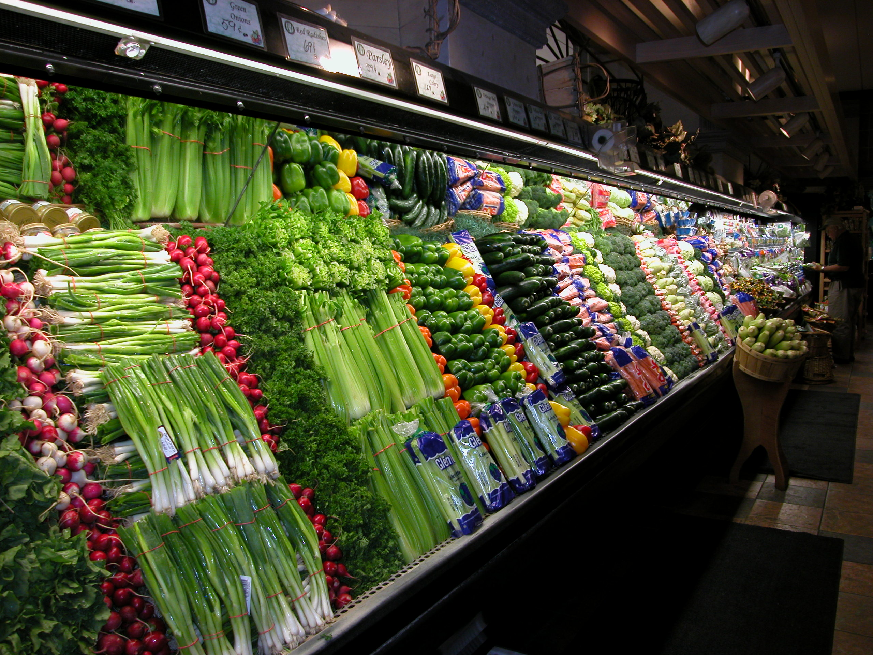
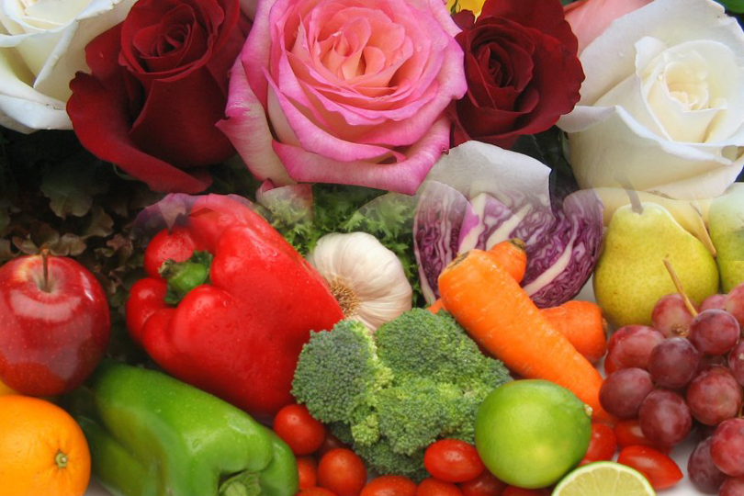
What’s in the pipeline?

Slide 30
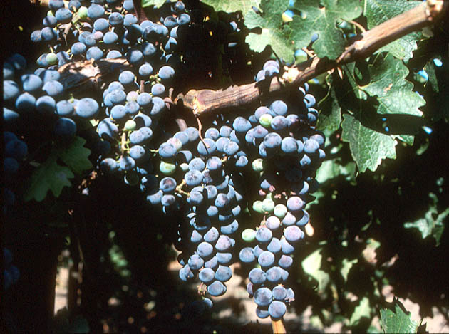
Field Trials in California with Grape Root Stocks Engineered for Resistance to Fanleaf Virus
SOURCE: http://www.democratandchronicle.com/apps/pbcs.dll/article?AID=/20080806/BUSINESS/808060336/1001

Slide 31




2013 engineered potato field study – Ireland
Desiree potato variety, highly susceptible to late blight, engineered with gene from wild potato variety
GEn Desiree
Non-GEn Desiree

Slide 32

Tear-free onion developed by turning off tear-inducing enzyme
SOURCE: “Scientists create 'no tears' onions”, Herald and Weekly Times, 2/1/08
http://www.checkbiotech.org/green_News_Genetics.aspx?Name=genetics&infoId=16834

Slide 33

First Multi-nutrient Rice Engineered with Increased Iron, Zinc and Vitamin A
SOURCE: “Multi-nutrient rice against malnutrition”, Morning Ag Clips, 8/8/17 (https://www.morningagclips.com/multi-nutrient-rice-against-malnutrition/)
Singh et al. 2017. Single genetic locus improvement of iron, zinc and β-carotene content in rice grains, doi:10.1038/s41598-017-07198-5. https://www.nature.com/articles/s41598-017-07198-5
Notes:
August 10, 2017

Slide 34

Used genetics to knock out” 35 of the 45 gliadin genes involved in coeliac; efforts
Sanchez-Leon S. et al., 2017. Plant Biotechnology Journal September 18, 2017 DOI: 10.1111/pbi.12837
Notes:
New Scientist Sept. 26, 2017
Francisco Barro: Cordoba Spain
Using CRISPR to knock out 35 of 45 gliadin genes
Biotechnology Journal DOI: 10.1111/pbi.12837
https://www.newscientist.com/article/2148596-genetically-modified-wheat-used-to-make-coeliac-friendly-bread/#.Wc7Dv_mnOMk.email

Slide 35

High anthocyanin purple engineered tomatoes protect against cardiovascular disease and certain cancers. Diets with 10% purple tomatoes increased lifespan of cancer-prone mice
Notes:
Purple fruit contains same level of anthocyanins as half basket of blueberries. Large orange tomatoes (~100g) have same amount of beneficial compound as 27 bottles of red wine (resveratrol). Yellow-fruited variety contains genistins, in amount equal to 150 g of tofu. Fourth variety has quercetin and kaempferol, health-promoting compounds found in capers, radishes, onions and watercress. Offer protection against inflammation, cancer and cardiovascular disease. http://news.jic.ac.uk/2014/03/bbsrc-most-promising-innovator/

Slide 36


And now there is a new method of genetic modification:
Genome Editing (GEd)
Advanced genome-editing techniques used to create wheat resistant to powdery mildew by deleting genes that repress defenses against mildew
SOURCE: “Chinese Researchers Stop Wheat Disease with Gene Editing”, MIT Technology Review, July 21, 2014
http://www.technologyreview.com/news/529181/chinese-researchers-stop-wheat-disease-with-gene-editing/
Notes:
September 10, 2014

Slide 37

Also use genome editing to make tomatoes with more inner compartments and higher yields
Rodriguez-Leal, A. et al. 2017. Engineering Quantitative Trait Variation for Crop Improvement by Genome Editing. Cell 171: 480-490.

Slide 38

New Genetic Method: Genome Editing-1
It is this one sentence which will be modified
It is that new sentence which will be modified
+
Inserts gene edits in specific locations in genome
Find target text, paste in new modified text at specific location
Notes:
Question 1

Slide 39




EXAMPLES of such edited products:
University
Company
Company
Company

Slide 40

Cellectis, a company creating edited crops, hosted a dinner at Benoit New York, the Alain Ducasse Manhattan restaurant, and served dishes made from its gene-edited soybeans and potatoes. Guests included professors, journalists and celebrities like actor, Neil Patrick Harris.

Slide 41
New Genetic Method: Genome Editing-2
It is a different…kind of sentence which will be modified INSERTION
It is that new sentence which will be modified
It is that sentence which will be modified DELETION
Inserts gene edits specifically in genome
+
Find target text, paste in new modified text at defined location
Notes:
Question 1

Slide 42
Michael will give you more information on
Genome Editing
Notes:
42
February 16, 2012

