Slide 1

ANGST in the GROCERY AISLE
The Debate over Genetically Modified Foods
Peggy G. Lemaux
University of California, Berkeley
http://ucbiotech.org
http://pmb.berkeley.edu/profile/plemaux#a1
Notes:
genetic engineering and implications for our audience
* science and consumer perceptions
* clarification of genetics and practical application
* understanding how general public perceives GMO's
issues facing to employ this technology
Darrin Monteiro from our board of directors
Harrah's AV person ( Danielle or Jason)

Slide 2
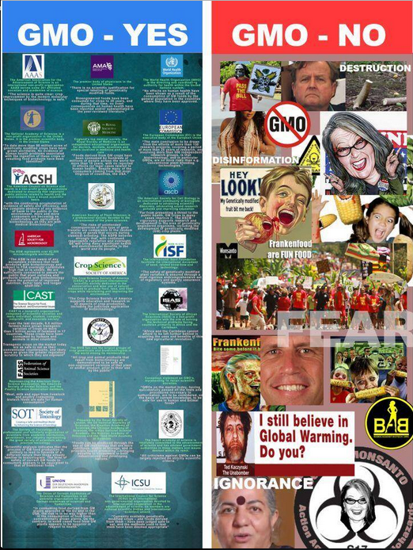

The debate over GMO’s has gone on for some time.
But is public concern just about genetically engineered foods (GMO’s)?

Slide 3

There seems to be angst about many contemporary issues
Consider the March 2015 National Geographic article highlighting public concerns and discussing the role science plays in people’s thinking about…
Climate Change
Evolution
Vaccination
Moon Landing
Genetically Modified Foods, GMO’s
Do scientists’ views differ from the public’s on certain topics?
Notes:
March 8, 2015

Slide 4
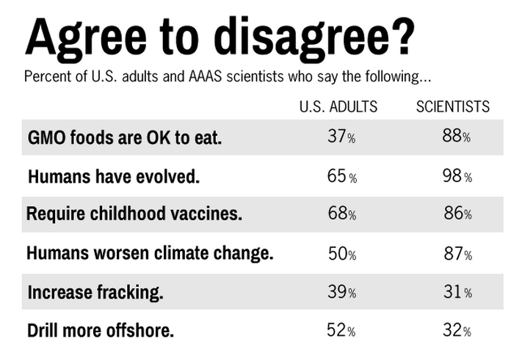
Yes, views of the public and scientists often disagree
SOURCE: Pew Research Center, January 29, 2015, “Public and Scientists’ Views on Science and Society”
http://www.pewinternet.org/2015/01/29/public-and-scientists-views-on-science-and-society/
Notes:
February 2, 2015

Slide 5


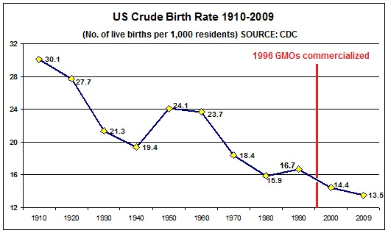
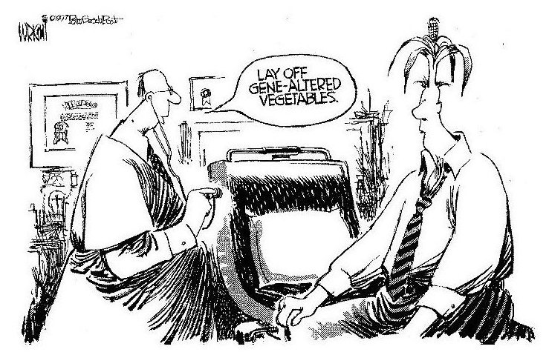
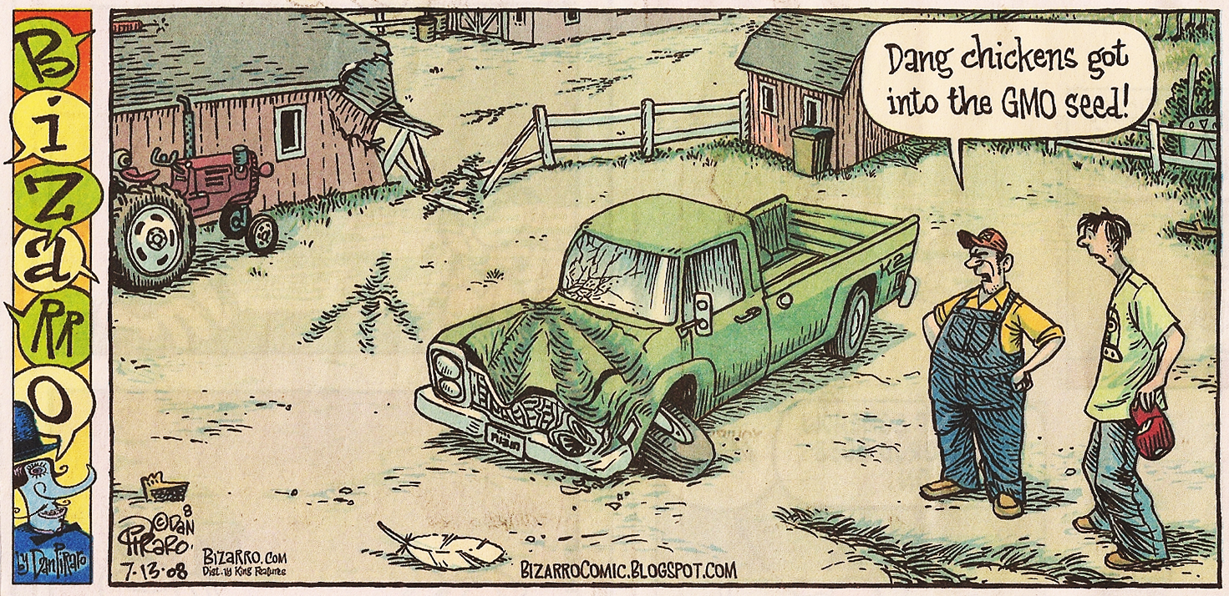
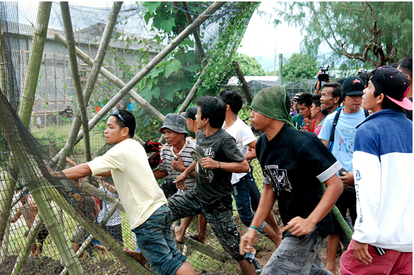
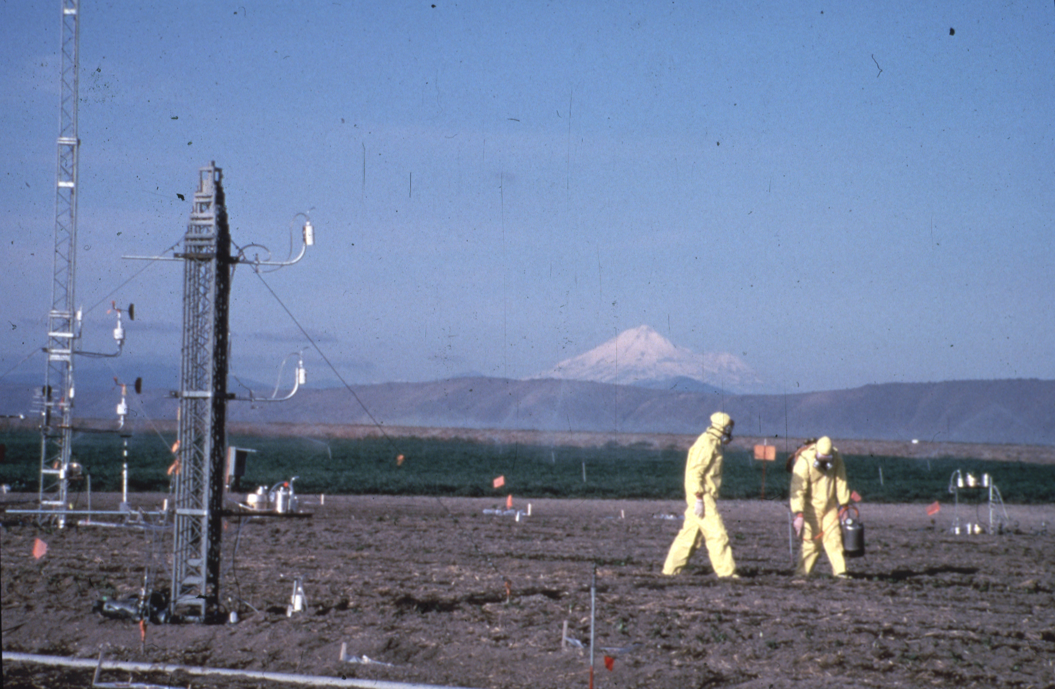
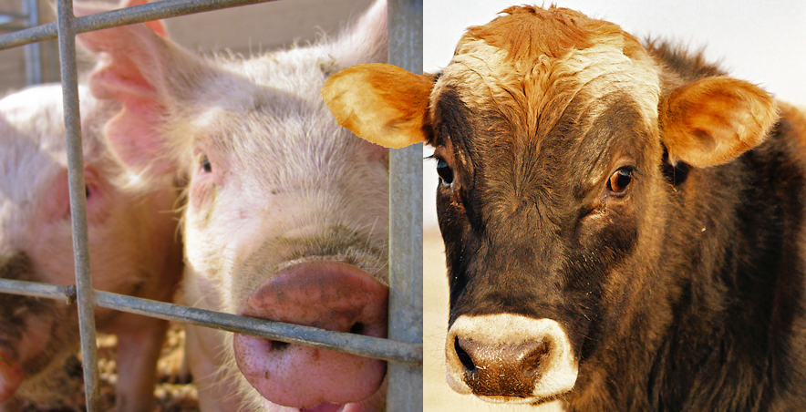
My presentation will focus on issues related to genetically engineered (GE, GMO) crops and animals.
Let’s first talk about how genetic modification has historically played a role in changing our foods
Farmers say pigs and cows became sterile

Slide 6
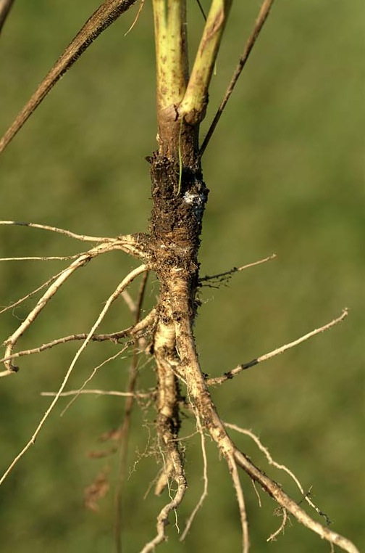
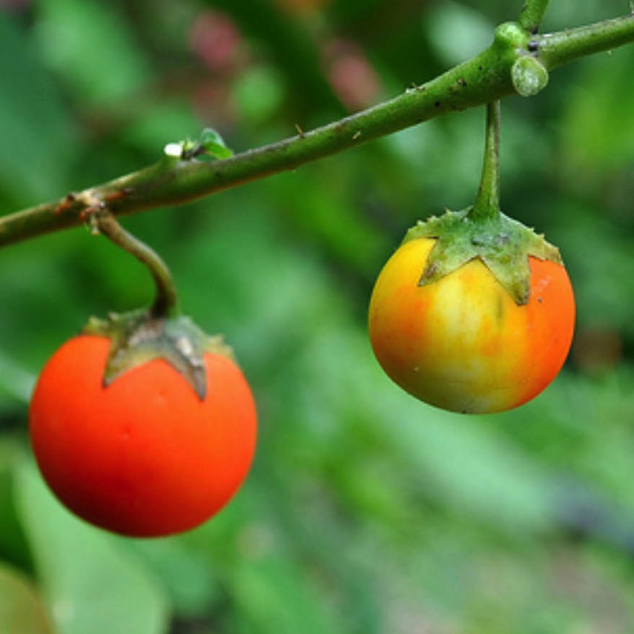
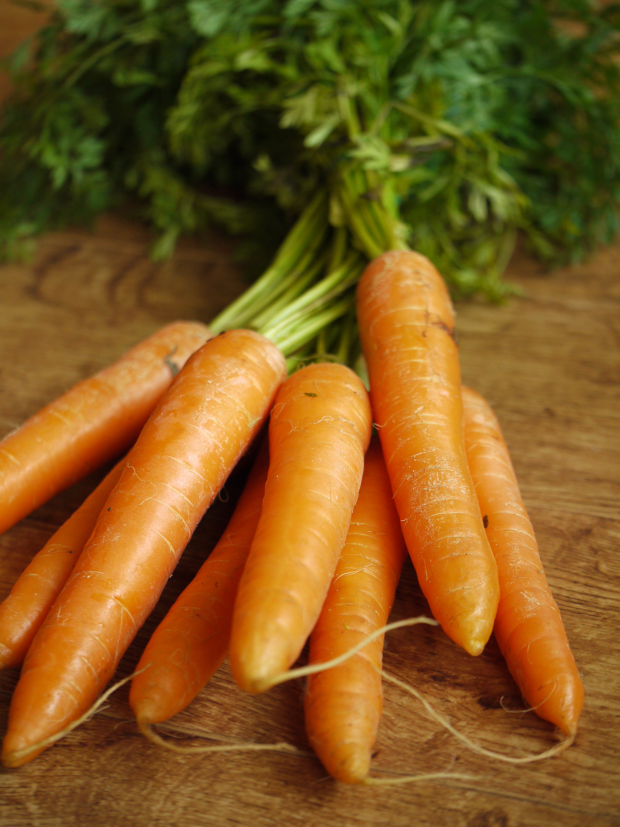

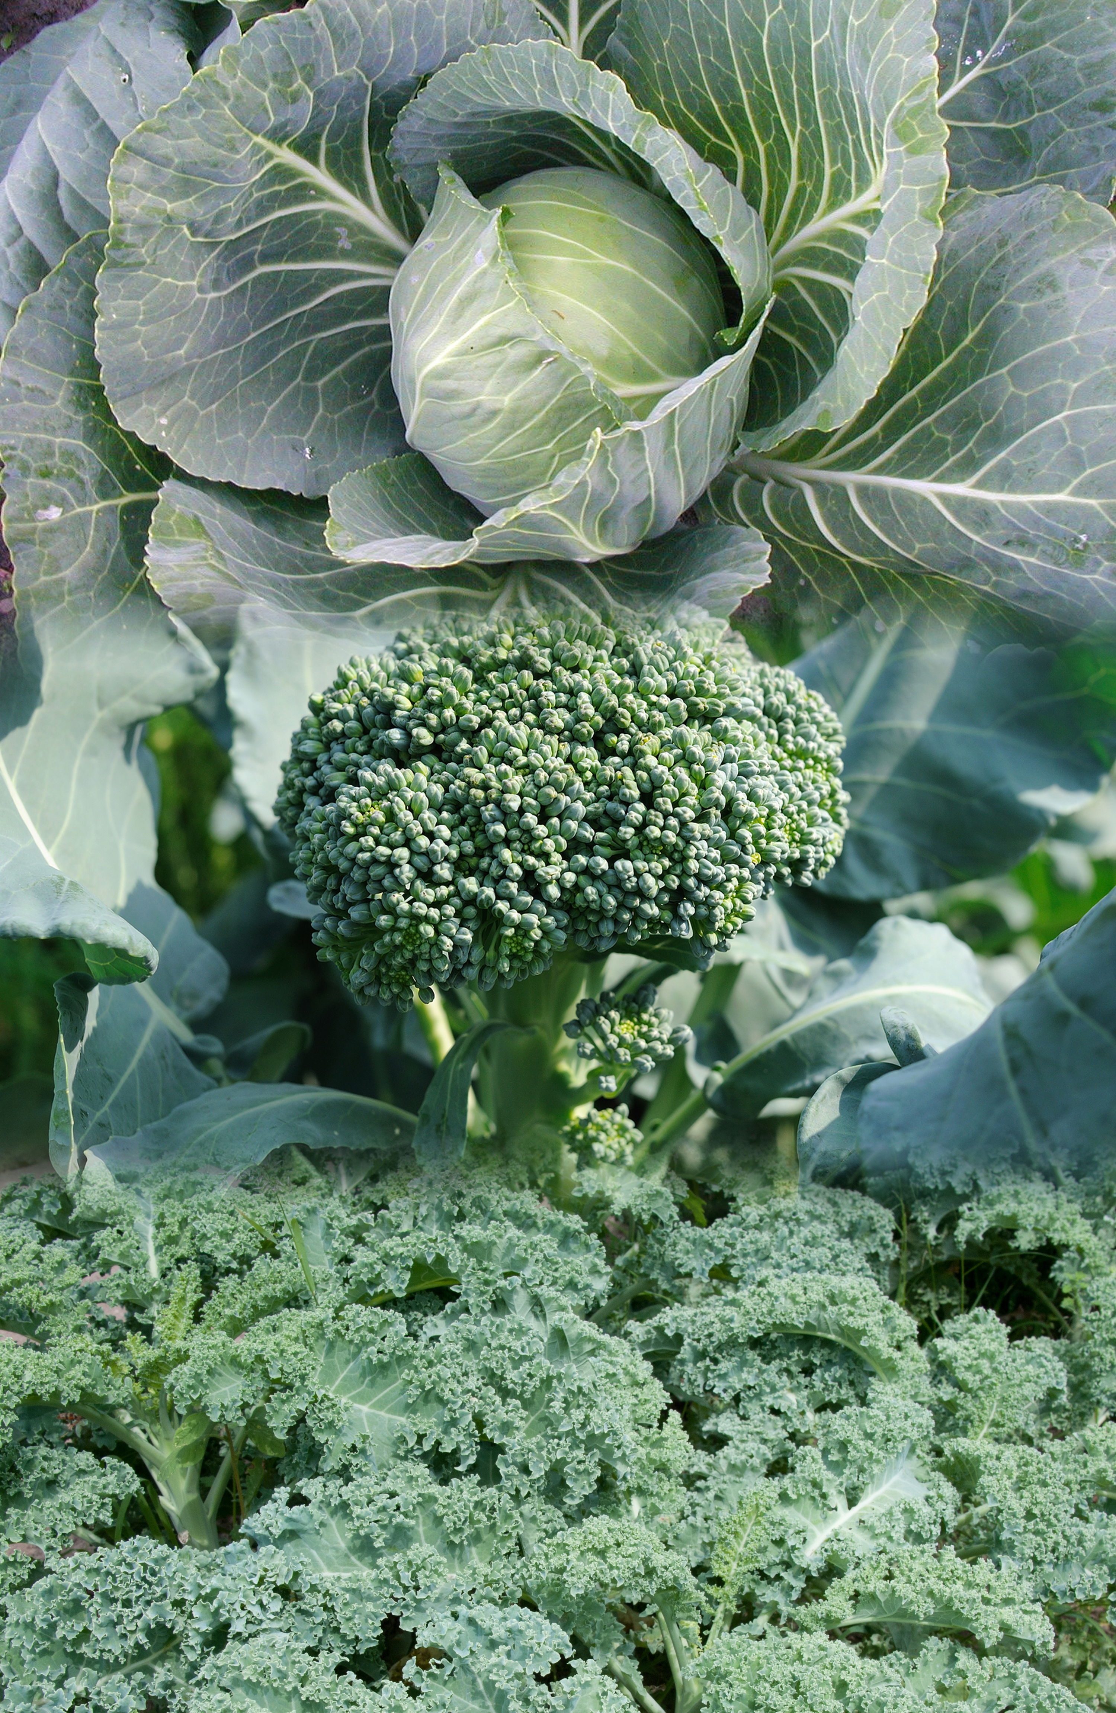
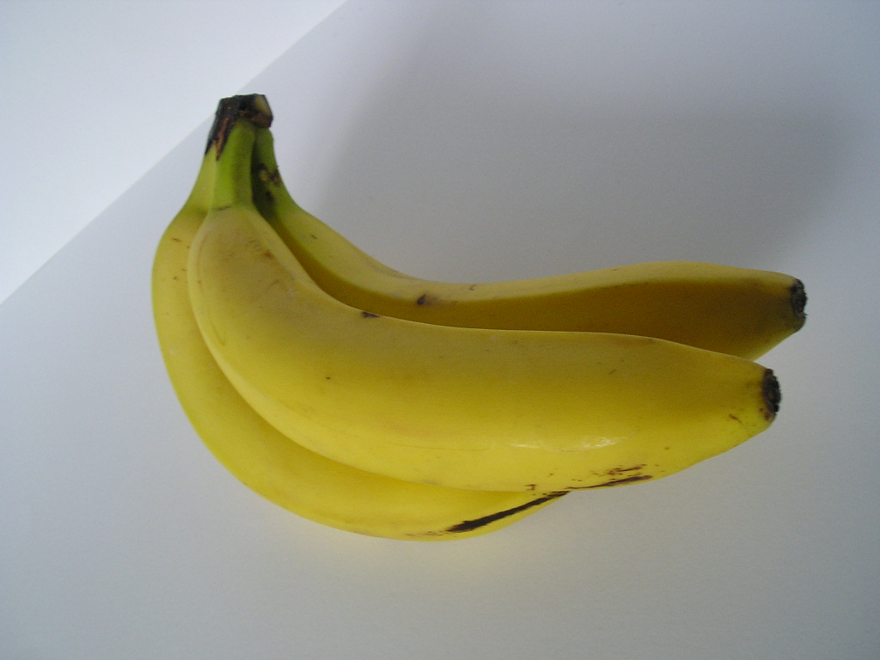
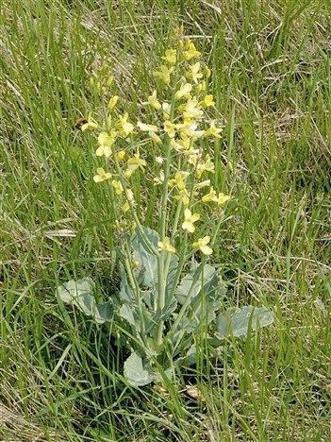
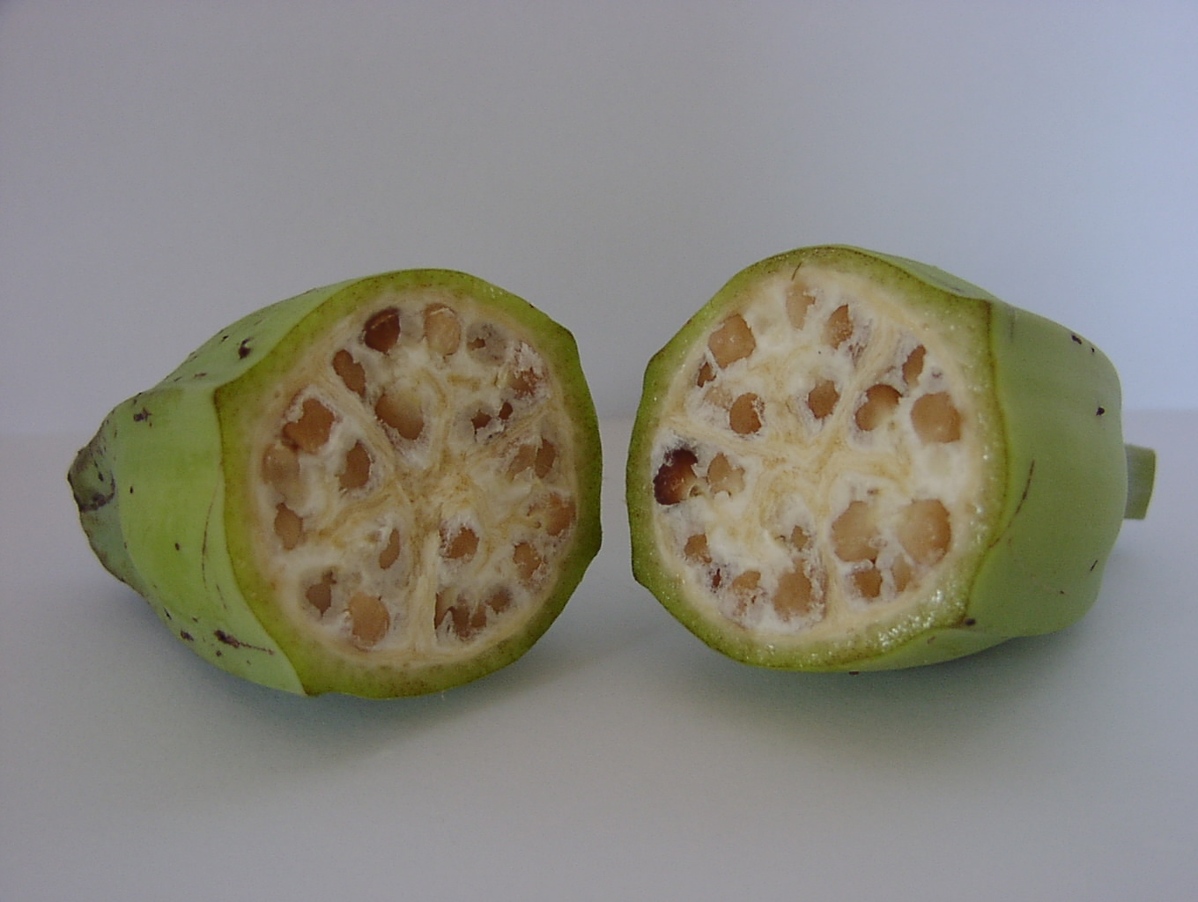
Do Foods Look Different Today than They Did Before?
Eggplant
Carrot
WHY?
Modifications happened via spontaneous mutations, intercrossing and natural selection
Banana
Broccoli, Kale, Cabbage

Slide 7
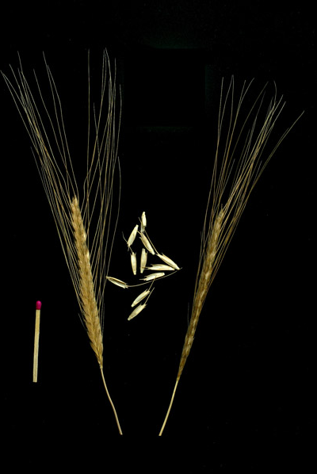
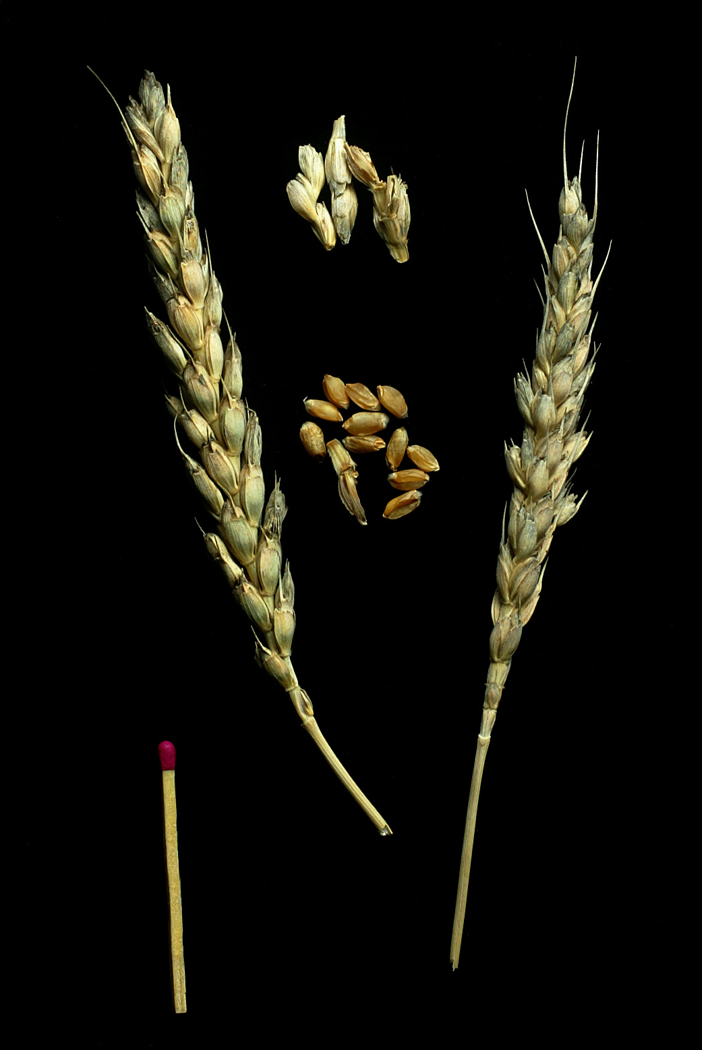
More recently humans have intentionally modified plants using classical breeding?
What happens genetically during breeding?
Triticum monococcum
Ancient variety
Triticum aestivum
Modern bread variety

Slide 8
Genetic Information in Cells of Wheat Plant
Chemical units represented by alphabetic letters
...CTGACCTAATGCCGTA...
1700 books
1000 pages each
1700 books
(or 1.7 million pages)

Slide 9
What happens during classical breeding?
Random retention of ~50% of information from each parent
x
What is the outcome of the cross?
1700 books
(or 1.7 million pages)
1700 books
(or 1.7 million pages)
1700 books
(or 1.7 million pages)
Genetic modification that is not GE or GMO

Slide 10
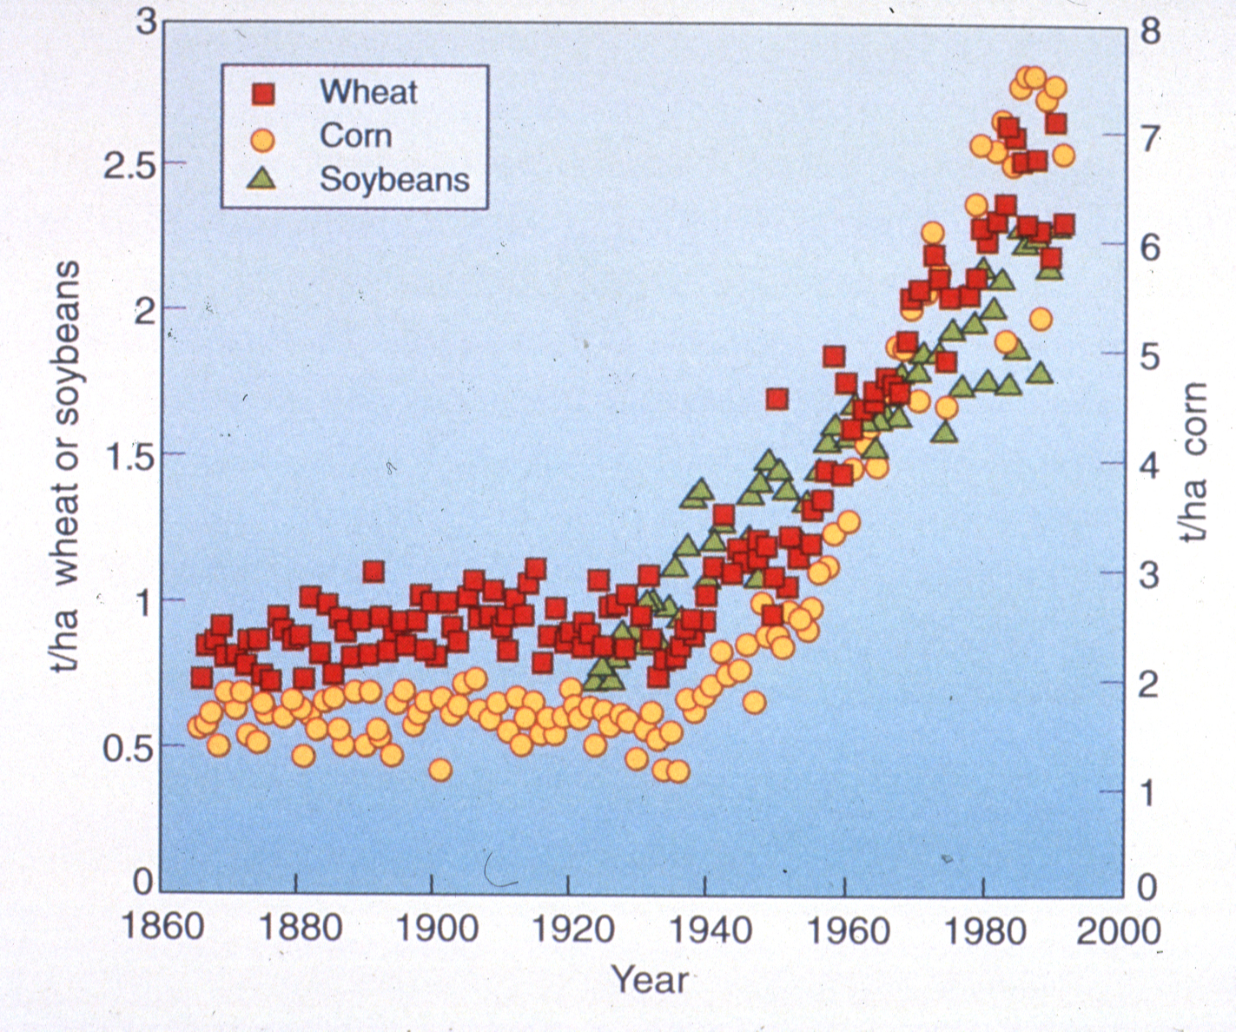
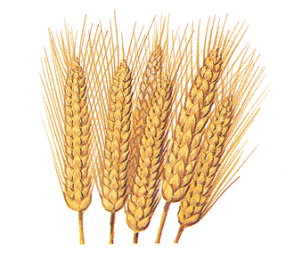
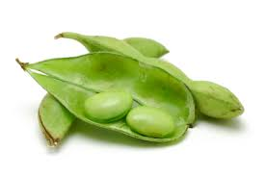
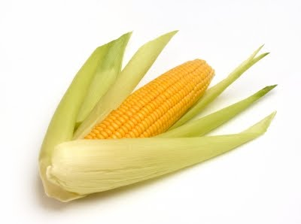
Yield increase by year

Slide 11
New ways to do breeding…
Uses table of contents of genes (genomics) for
marker assisted selection
...CTGACCTAATGCCGTA...
Increases speed of breeding process
1700 books
(or 1.7 million pages)
Genetic modification that is not GE or GMO

Slide 12
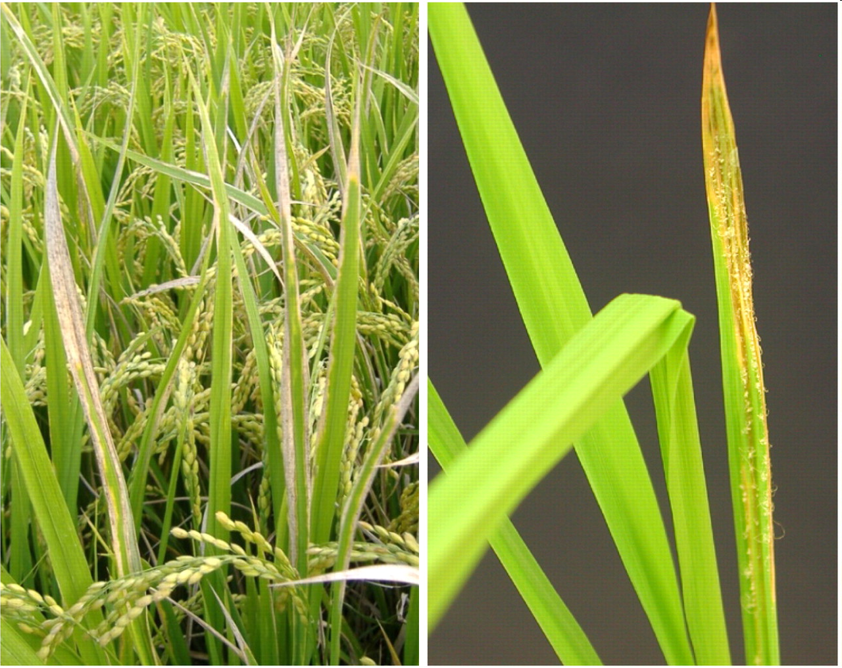
Can’t We Just Do All Modification This Way?
Marker-assisted selection used to protect rice against bacterial blight and blast disease
Limited to diversity in crop and compatible relatives

Slide 13
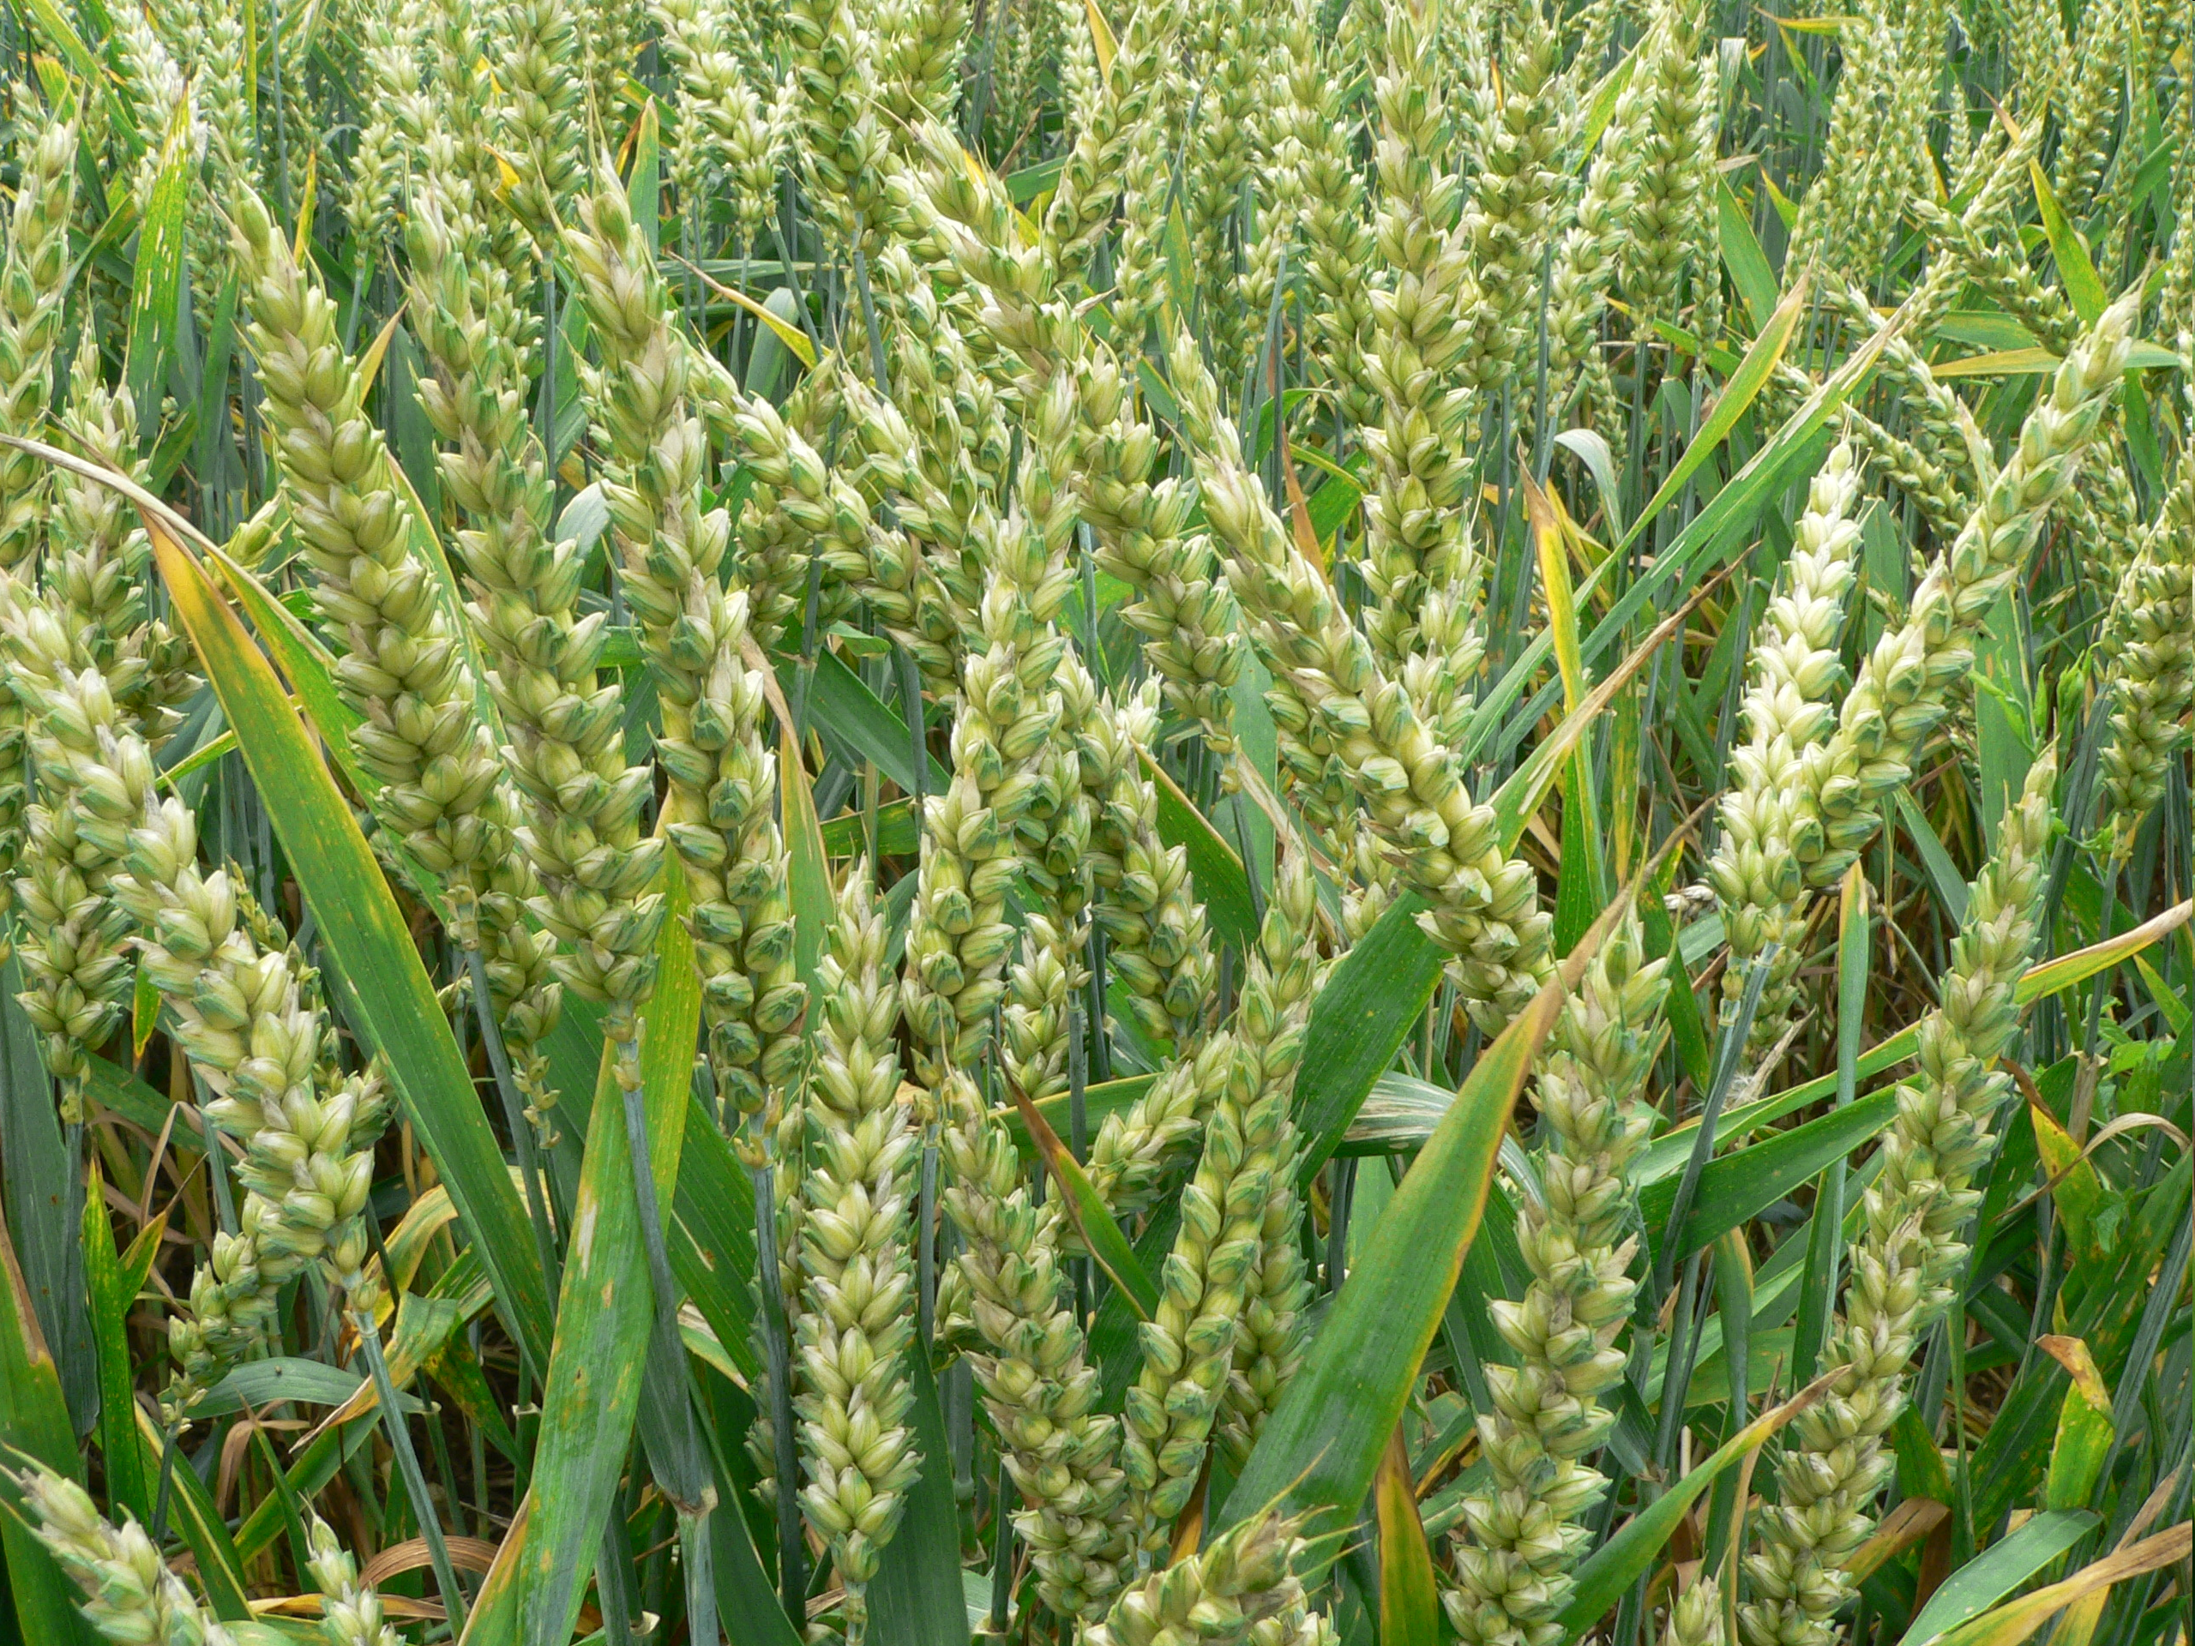
What other ways can the modern tools of genetics be used to create new varieties?

Slide 14
Genetic Engineering
Inserts randomly in genome
+
What Kinds of GE Crops and Foods Are in the Commercial Market?
Inserted gene(s)
One-half page equivalent to a gene
1700 books
(or 1.7 million pages)
1700 books
(or 1.7 million pages)
Genetic modification that is GE and GMO

Slide 15
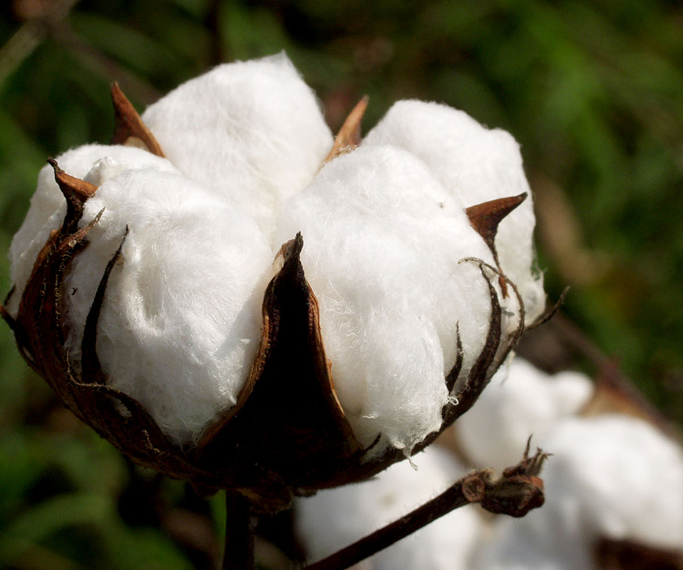
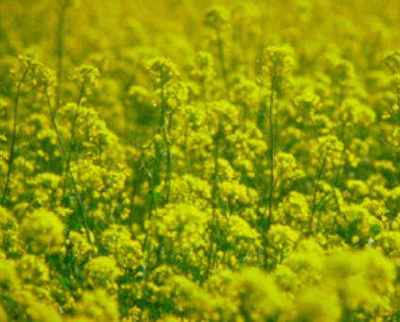
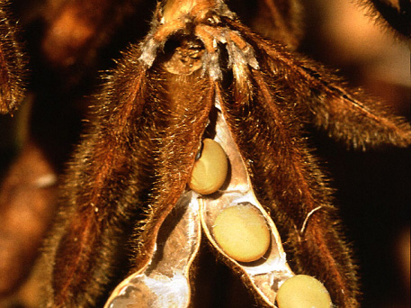
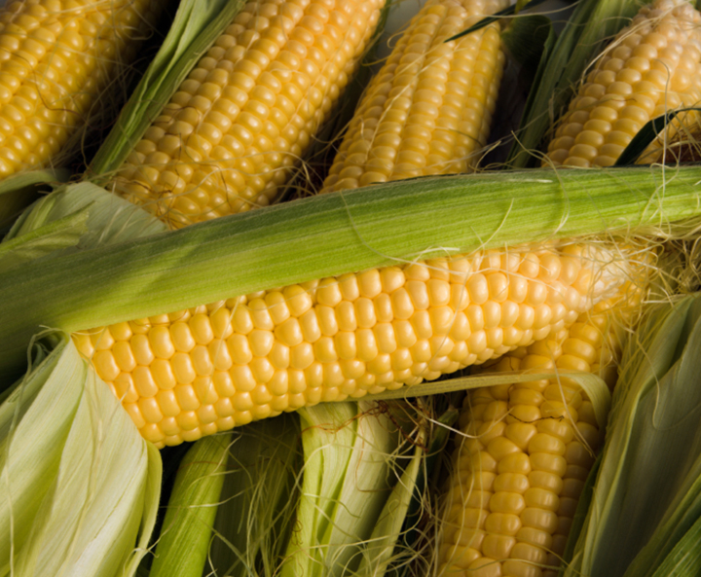
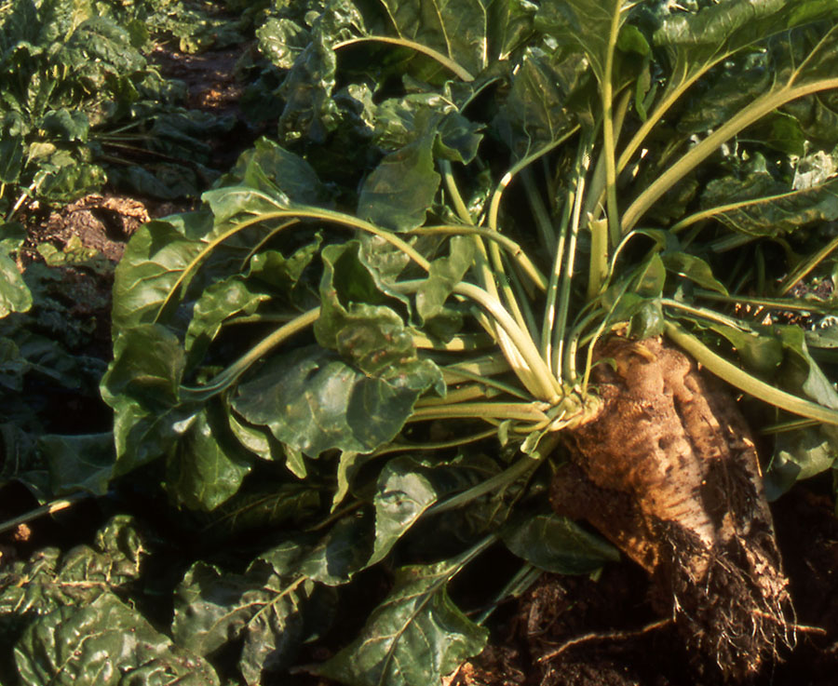
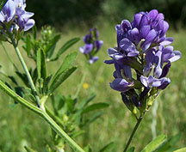
Number of commercial large acreage GE crops in U.S. is limited
GE Cotton
96% of 2014 acreage
(Insect Resistant: 5% Herbicide tolerant: 12% Stacked gene: 79%
GE Canola
93% of 2013 acreage
GE Soybean
94% of 2014 acreage
(Herbicide resistant: 94%)
Source: USDA-ERS, 2014
Source: ISAAA, 2011
Source: USDA-ERS, 2012
GE Corn
93% of 2014 acreage
(Insect Resistant: 4% Herbicide resistant: 13% Stacked gene: 76%)
GE Sugarbeet
98% of 2013 acreage
GE Alfalfa
25% of 2014 acreage
Source: USDA-ERS, 2014
Source: ISAAA, 2011
Source: Dan Putnam, UC ANR, 2014
Notes:
August 20, 2014

Slide 16
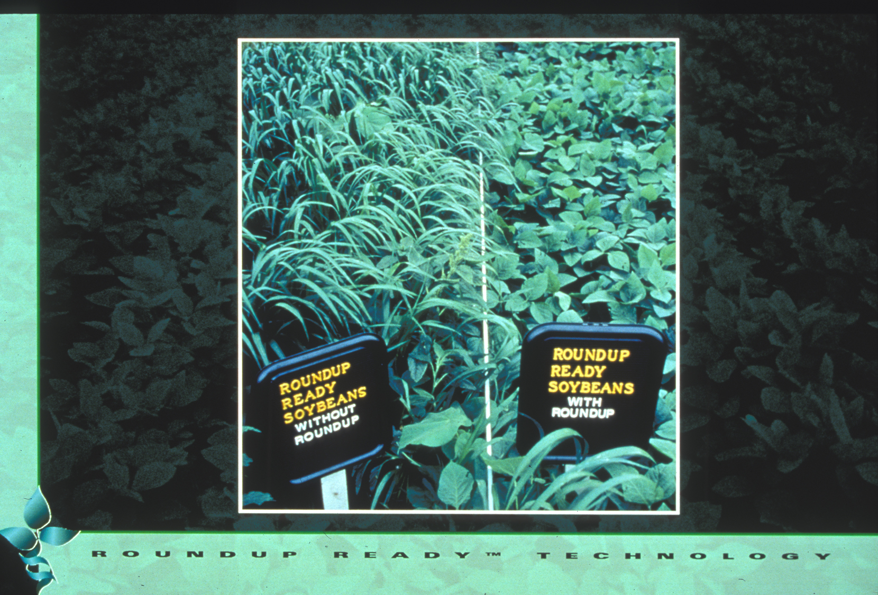
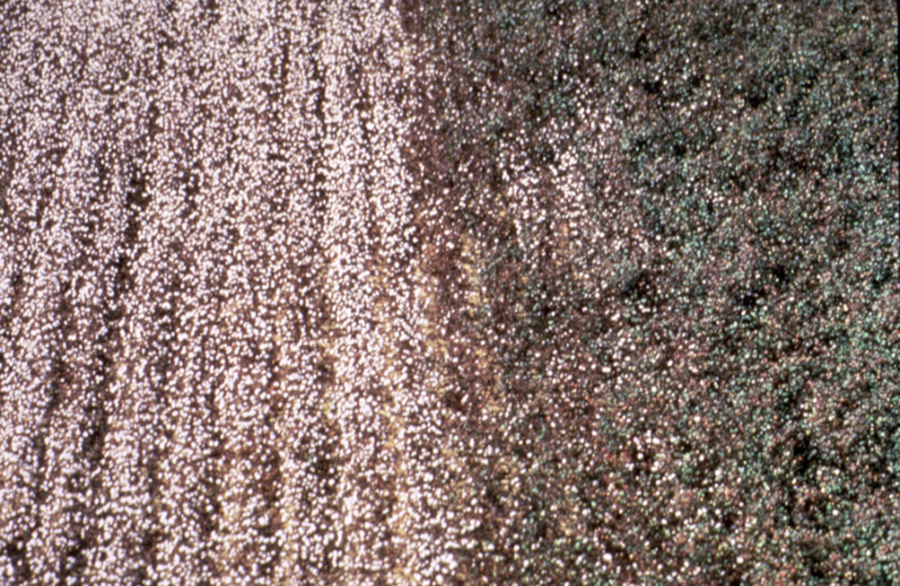
Roundup Ready Soybean™
Number of different traits available in large acreage GE crops is also limited
Herbicide-tolerant - engineered with gene to tolerate herbicide application
Insect-tolerant Bt crops - engineered for resistance using gene from naturally occurring bacterium
Crops with stacked traits - both Bt and HT - are available

Slide 17
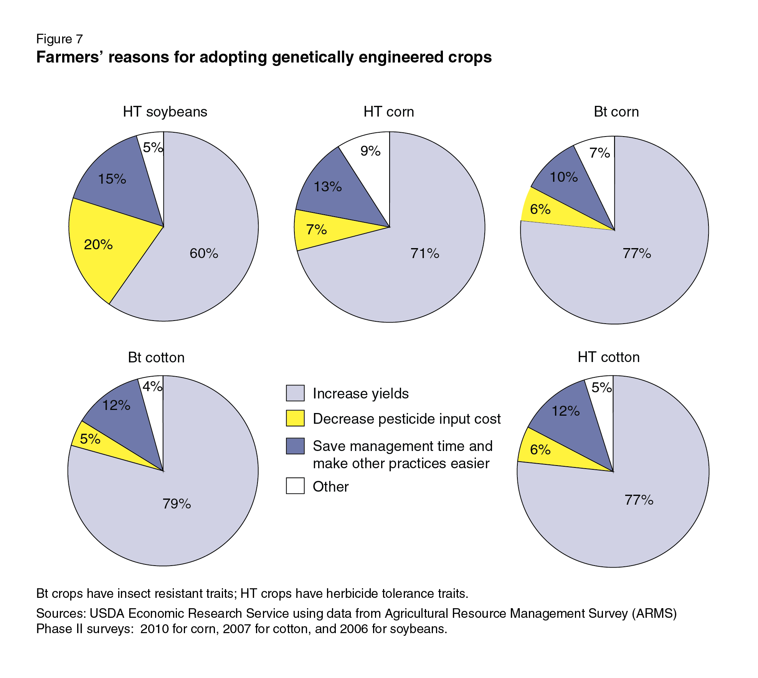
Why do U.S. growers use GE crops?
Reasons vary from crop-to-crop but primary reason is improved yields
SOURCE: Fernandez-Cornejo, J., Wechsler, S., Livingston, M. and Mitchell, L. 2014. Genetically Engineered Crops in the United States. USDA Economic Research Service Report No. 162, February 2014.
Notes:
March 25, 2014

Slide 18
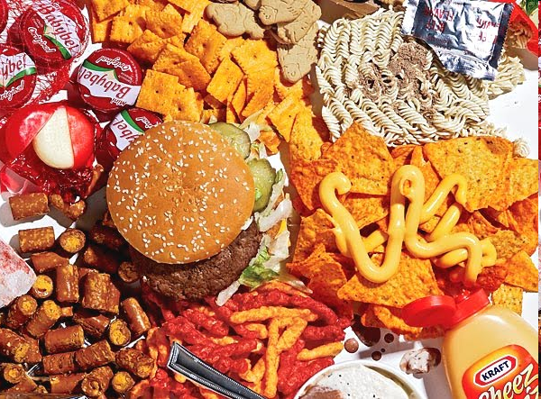
Corn oil
Canola oil
Soy lecithin
Soy protein
Corn starch
Cottonseed oil
These types of large-acreage GE crops lead to estimates that 60-80% of processed foods in U.S. have GE ingredients
SOURCE: https://factsaboutgmos.org/disclosure-statement

Slide 19
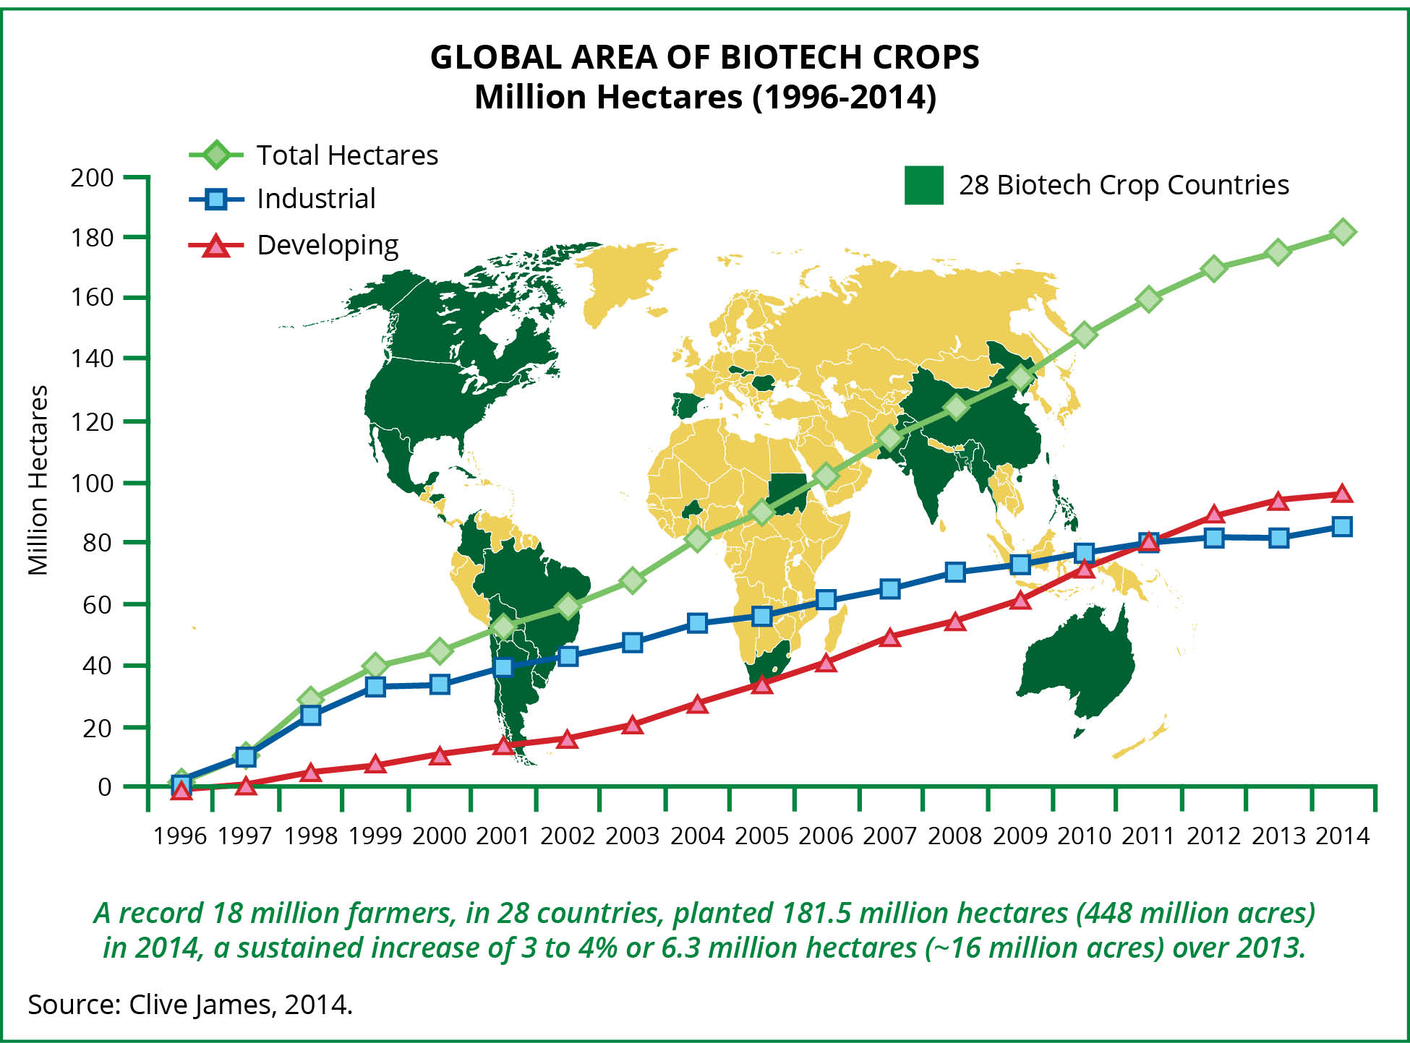
What about worldwide? Despite limited crop and trait types, acreage is increasing in 20 developing, 8 developed countries
2014: 18 million farmers in 28 countries planted
448M acres (>4X size of California)
>90% small acreage farmers in developing countries
Clive James 2014 http://www.isaaa.org/resources/publications/briefs/46/executivesummary/
Notes:
A record 18 million farmers in 28 countries planted 175.3 million hectares (million acres) in 2013, a sustained increase of 3% or 5 million hectares (million acres) over 2012.
Ind = 81.2, Dev = 94.1, total = 175.3

Slide 20
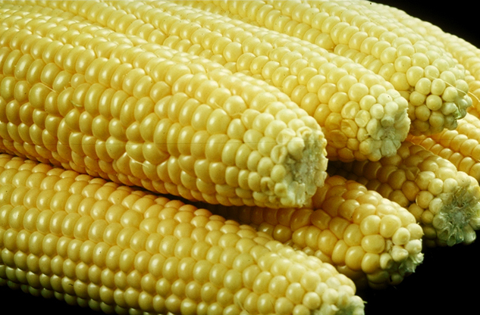
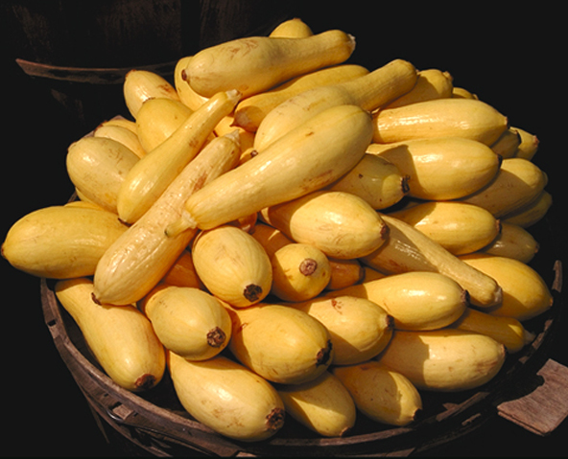
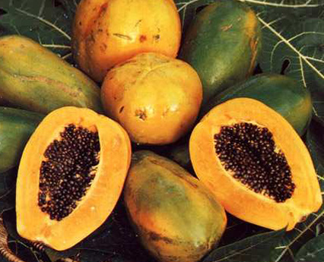
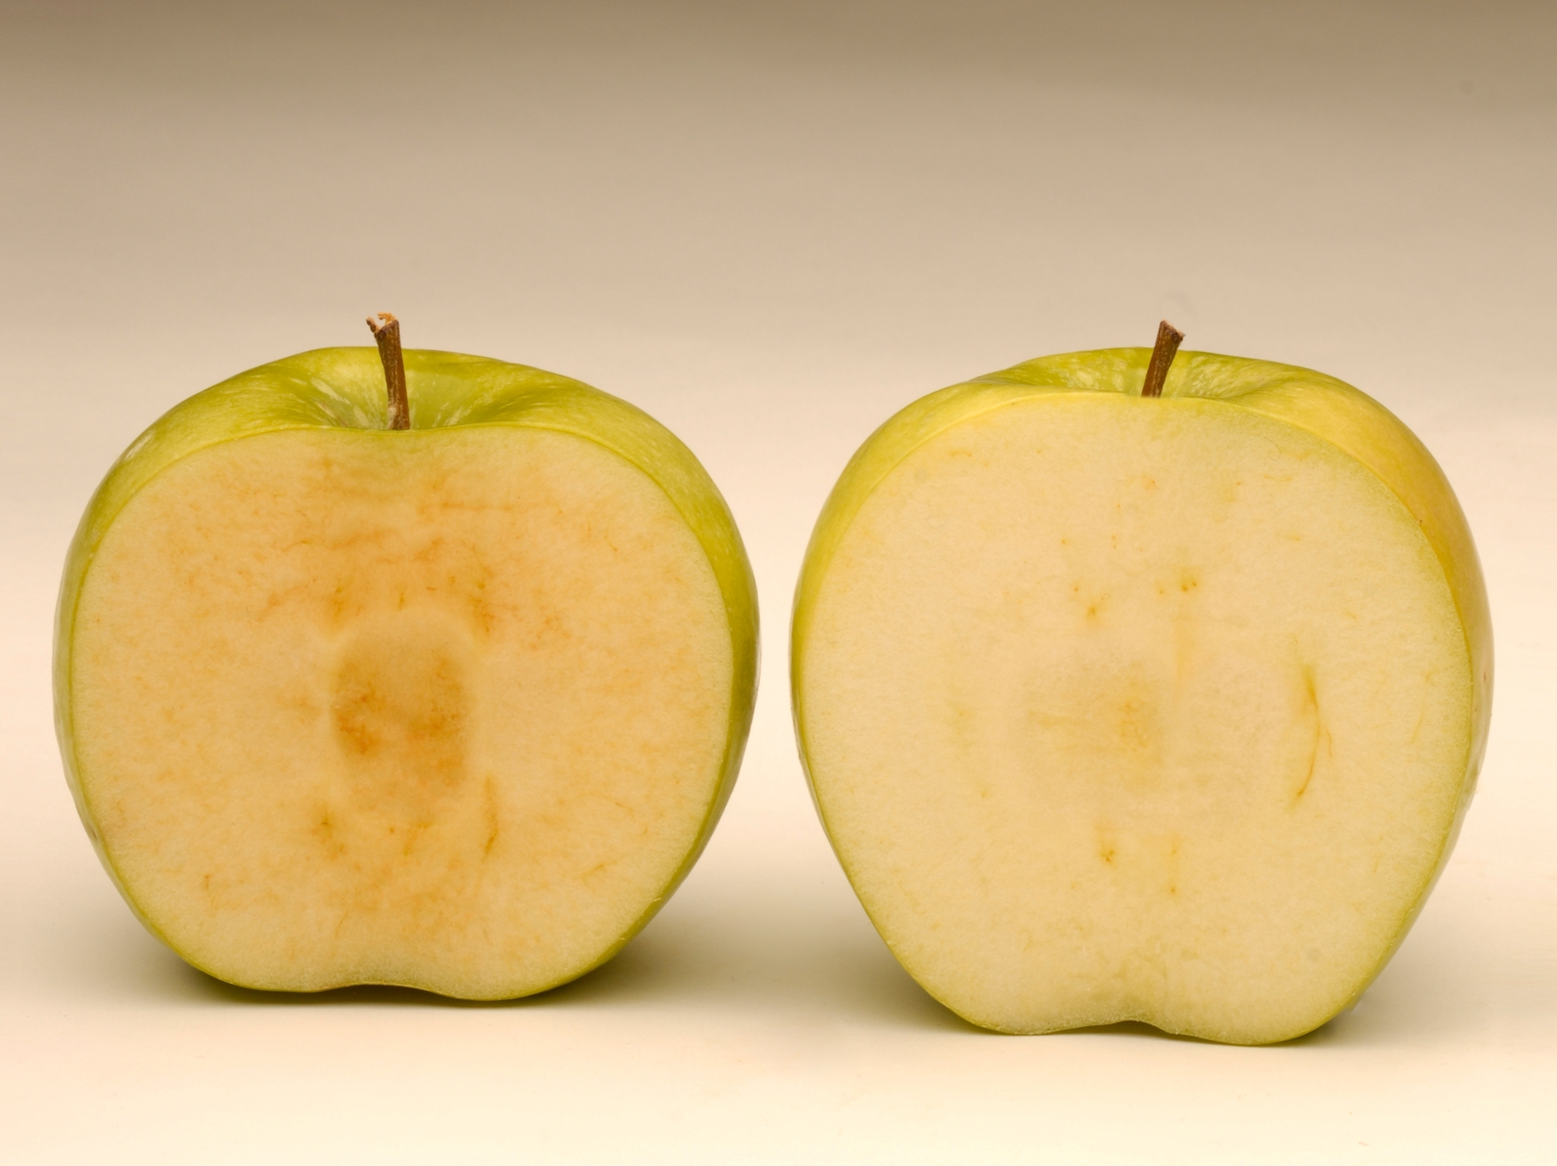
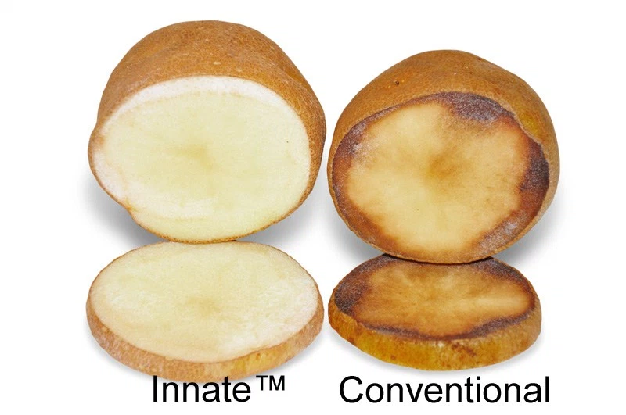
There are only a few whole, GE foods that have been commercialized
GE Sweet Corn
GE Squash
GE Papaya
Two more are just being introduced
Arctic Apple™
Innate™ Potato

Slide 21
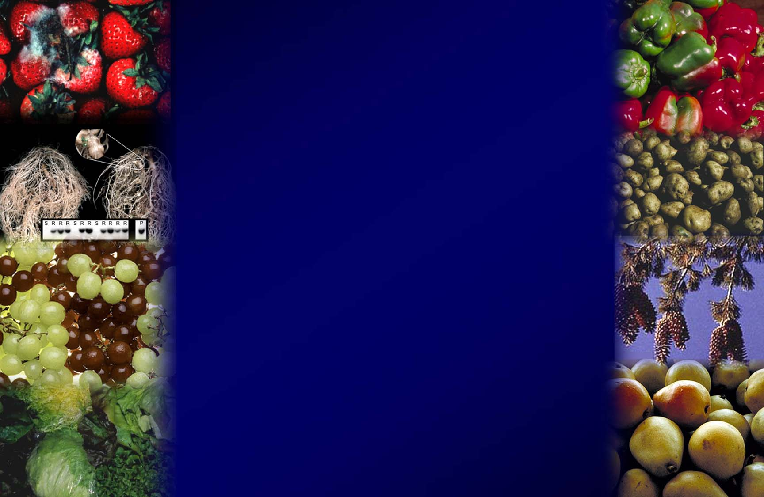
WHAT’S IN THE
PIPELINE?

Slide 22
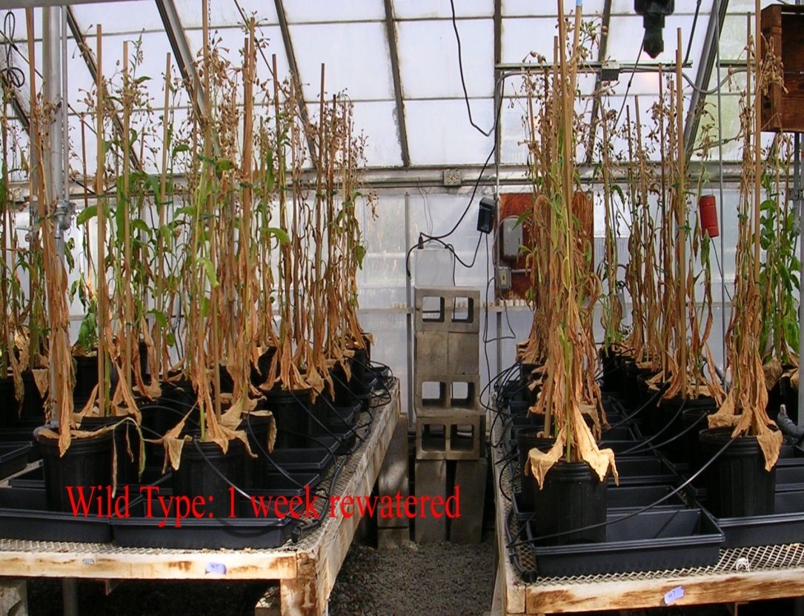
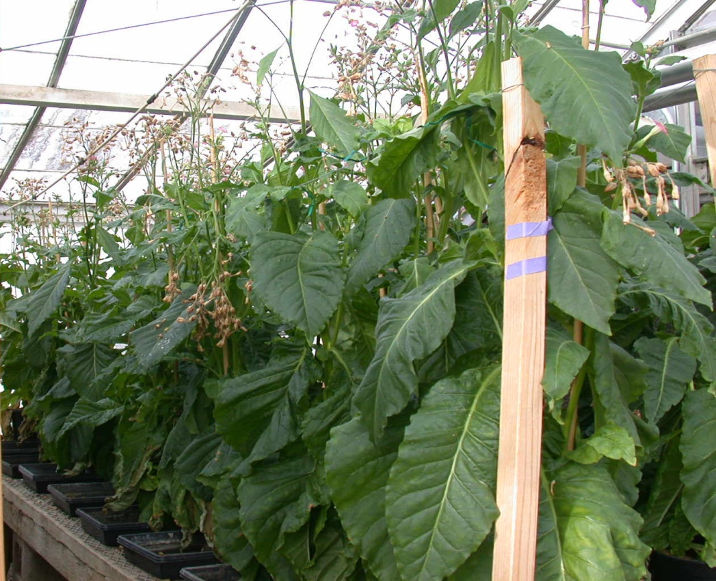
UCD researcher engineers drought tolerance: results in vigorous growth after prolonged drought
Tobacco after 2 weeks without water then 1 week watered
Control, non-GE
GE tobacco
SOURCE: Rivero, R.M., Kojima, M., Gepstein, A., Sakakibara, H., Mittler, R., Gepstein, S. and Blumwald, E. 2007. Delayed leaf senescence induces extreme drought tolerance in a flowering plant. Proceedings of the National Academy of Sciences USA 104: 19631-19636.

Slide 23
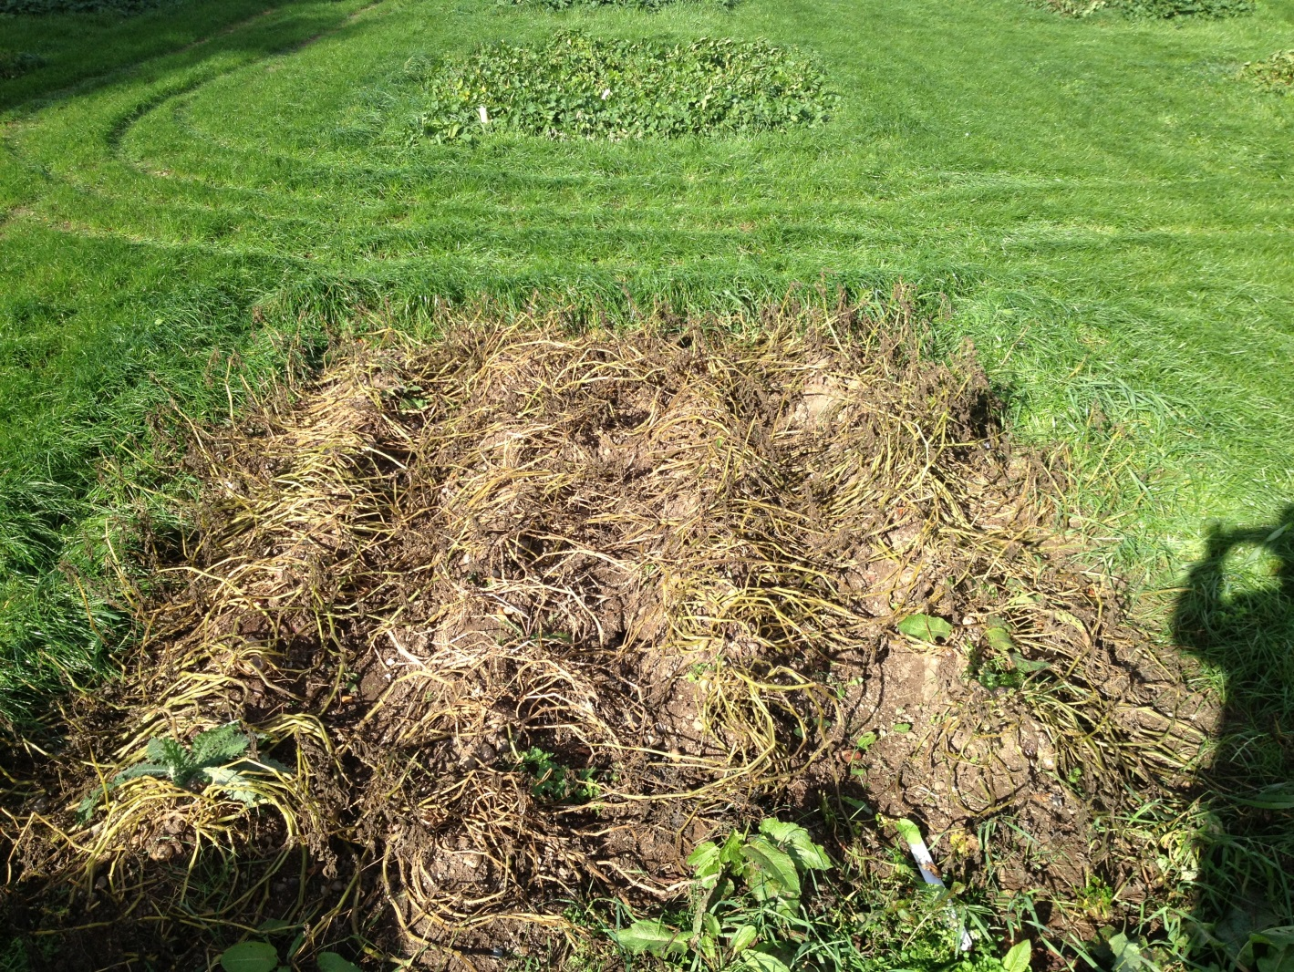

E.U. scientists create potato with gene from wild relative that protects against late blight disease, cause of Irish potato famine
2013 AMIGA GM potato field study – Ireland
Impact of vnt1.1 on P. infestans resistance in the highly susceptible var. Desiree
GE Desiree
Non-GE Desiree
www.amigaproject.eu
Jo KR et al. 2014 Development of Late Blight Resistant Potato by Cis-gene Stacking. BMC Biotechnol

Slide 24
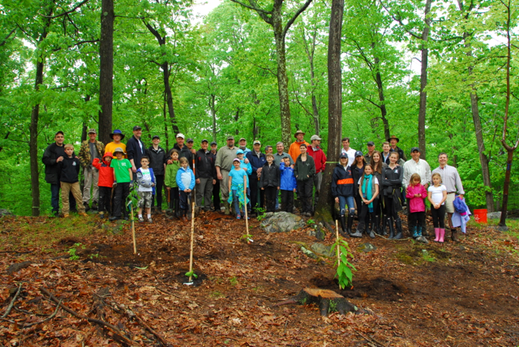
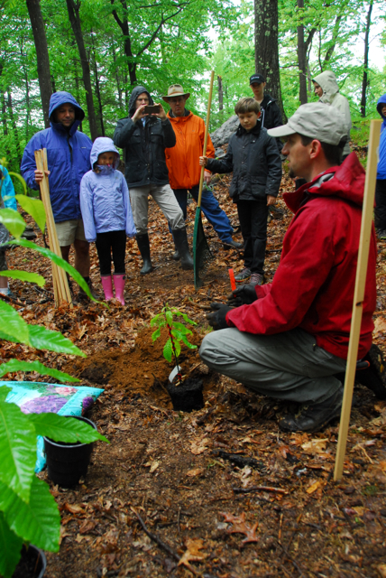
Engineered American chestnut making comeback -engineered with wheat gene to prevents canker; replanted with $104K raised through crowd funding
Coghlan A. 2014. New Scientist “American Chestnut Set for Genetically Modified Revival”.
Notes:
American chestnut 4B trees – one quarter of American hardwood. Fungus introduced from Asia in 1900. By 1950 most chestnut trees were wiped out.

Slide 25
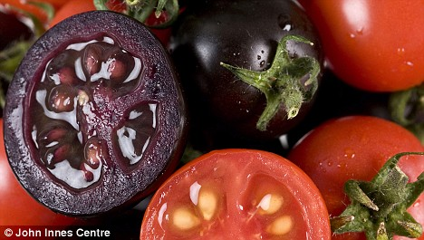
High anthocyanin purple GE tomatoes. Diets with 10% purple tomatoes increased lifespan of cancer-prone mice
Butelli et al. 2008. https://www.jic.ac.uk/staff/cathie-martin/purple-tomatoes.html
Notes:
Purple fruit contains same level of anthocyanins as half basket of blueberries. Large orange tomatoes (~100g) have same amount of beneficial compound as 27 bottles of red wine (resveratrol). Yellow-fruited variety contains genistins, in amount equal to 150 g of tofu. Fourth variety has quercetin and kaempferol, health-promoting compounds found in capers, radishes, onions and watercress. Offer protection against inflammation, cancer and cardiovascular disease. http://news.jic.ac.uk/2014/03/bbsrc-most-promising-innovator/ Produce 100 fold higher levels of anthocyanins than conventional blue tomatoes

Slide 26
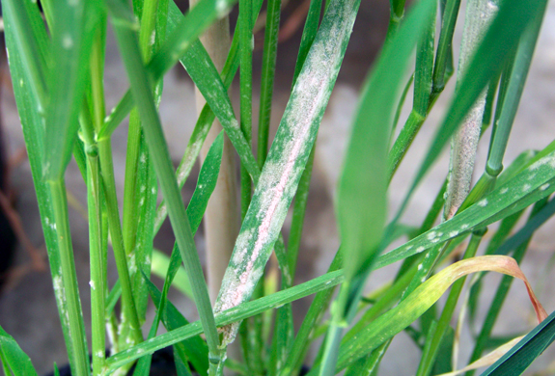
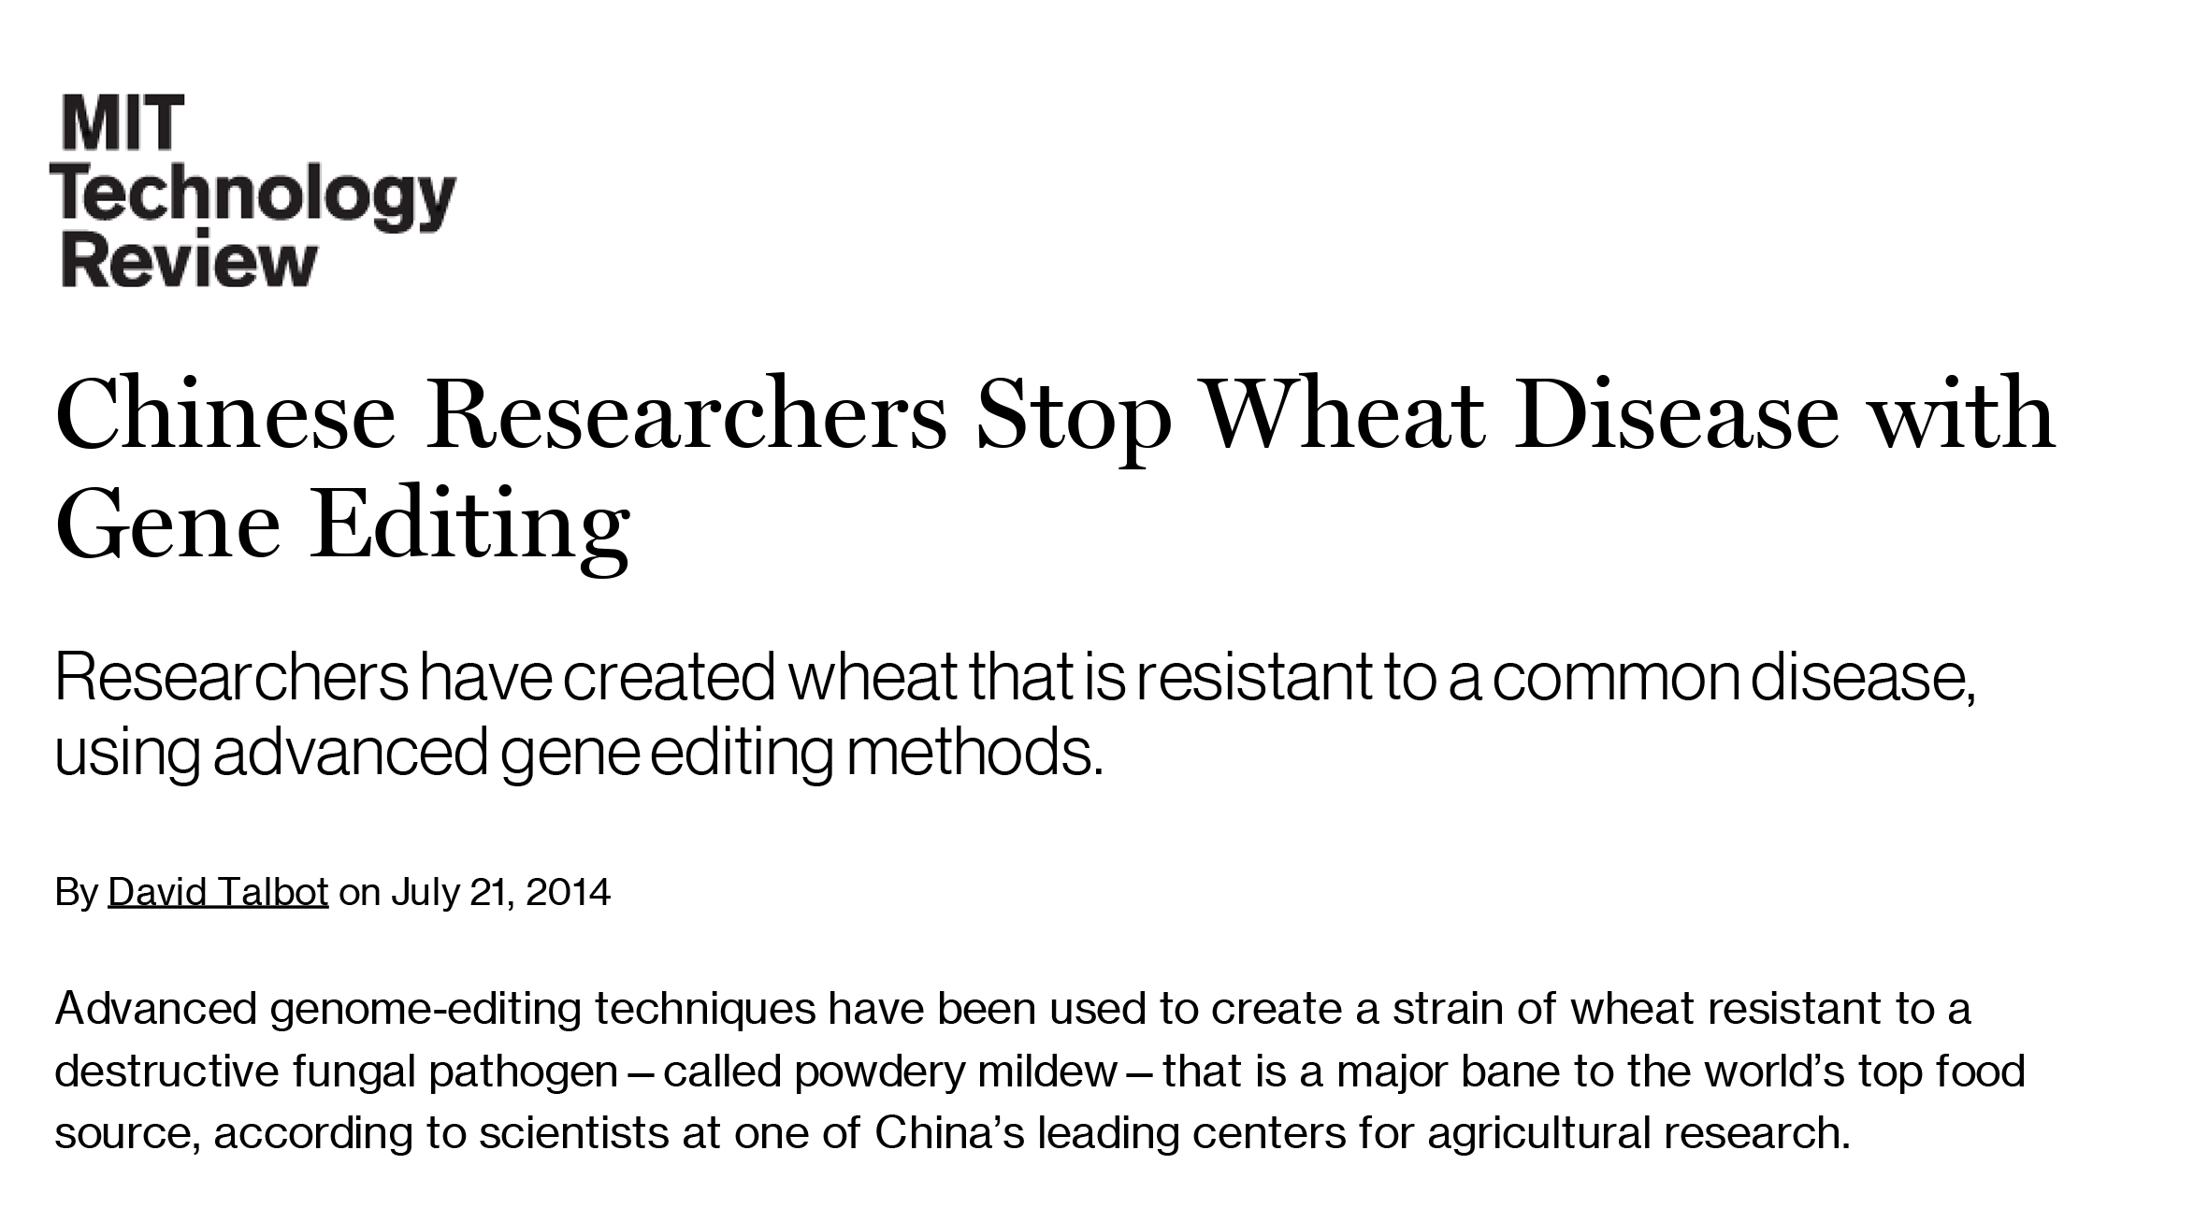
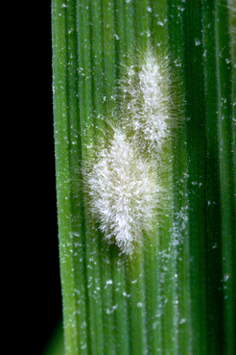
Wheat resistant to powdery mildew created using new genome-editing techniques
SOURCE: “Chinese Researchers Stop Wheat Disease with Gene Editing”, MIT Technology Review, July 21, 2014
http://www.technologyreview.com/news/529181/chinese-researchers-stop-wheat-disease-with-gene-editing/
Notes:
September 10, 2014

Slide 27
What is Genome Editing?
It is this one sentence which will be modified
It is that new sentence which will be modified
Inserts specifically in genome
+
Insert gene edits
Find target text, cut out, paste in new modified text
1700 books
(or 1.7 million pages)
1700 books
(or 1.7 million pages)
Genome editing is not GE or GMO

Slide 28
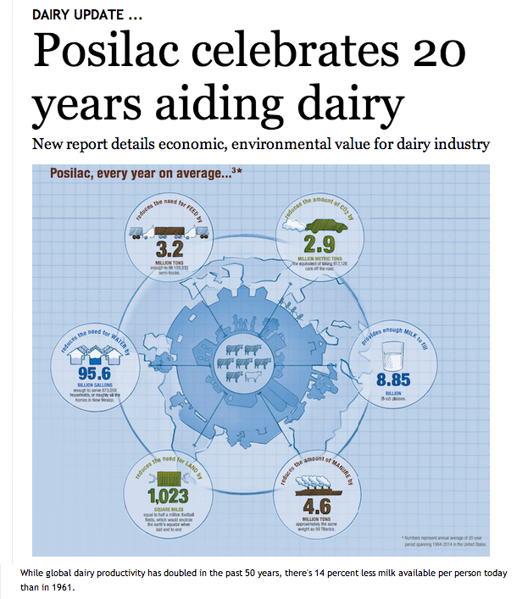
What is happening with animals?
Engineered microbe produces rBST for dairy, introduced in 1994 before GE crop products
Used on 37M cows over 20 years
Reduced costs by $6.3 B
Leads to 10 lbs more milk per day
What else has been engineered?
SOURCE: “Posilac celebrates 20 years aiding dairy”, Morning Ag Clips, February 13, 2014.
http://www.morningagclips.com/index.php?cID=6011#.UwPBrkJdVLO
Notes:
February 18, 2014

Slide 29


Engineered animal feed: China commercializes corn that reduces need to add phosphorus to animal feed
What about engineered animals?
SOURCE: “Origin Agritech Announces Final Approval of World’s First Genetically Modified Phytase Corn”, GEN, http://www.genengnews.com/news/bnitem_print.aspx?name=69131238 2009
Notes:
29
November 25, 2009

Slide 30


Slide 31

2012: Engineering downregulation of major milk allergen in calf reduces potential for allergic responses in humans
SOURCE: Jabed, A., Wagner, S., McCracken, J., Wells, D.N. and Laible, G.. 2012. Targeted microRNA expression in dairy cattle directs production of b-lactoglobulin-free, high-casein milk. Proceedings of the National Academy of Sciences USA, published ahead of print October 1, 2012, doi:10.1073/pnas.1210057109.
Notes:
October 9, 2012

Slide 32

2015: Chinese scientists engineer cows with mouse gene to protect against tuberculosis
SOURCE: “Tuberculosis-resistant cows engineered in China”, Popular Science, 3/4/15.
http://www.popsci.com/tuberculosis-resistant-cows-bred-china
Notes:
April 13, 2015

Slide 33

Triploid, all-female genetically engineered Atlantic salmon (AquAdvantage Salmon), grown-out only in the physically-contained freshwater culture facilities
FDA approved AquAdvantage Salmon for consumption on November 19, 2015
SOURCE: ”GE salmon draft environmental assessment released”, Crop Biotech Update, 1/23/13
http://www.isaaa.org/kc/cropbiotechupdate/article/default.asp?ID=10554
Notes:
February 6, 2013

Slide 34
U.S. Regulatory Agencies
USDA
FDA
EPA
How Are All of These Things Regulated?
Field testing
  Permits
  Notifications
Determination of
non-regulated status
Food safety
Feed safety
Pesticidal plants
  tolerance exemption
  registrations
Herbicide registration
Plant pest?
Danger to people?
Risk to environment?

Slide 35

What are some issues with GE crops?

Slide 36
What are some food safety issues?
Regulatory oversight
Lack of peer-reviewed food safety tests
Consumer attitudes and labeling

Slide 37
What are some food safety issues?
Regulatory oversight
Lack of peer-reviewed food safety tests
Consumer attitudes and labeling

Slide 38



Outdated regulatory system, created in 1986, causing problems:
New products emerge with no rules to govern them
Old products are not on the market because there are no clear pathways for commercialization
New products created to step around regulatory system
EXAMPLES:
April 2016: USDA APHIS decided not to regulate a mushroom and corn genetically modified with CRISPR–Cas9 genome editing. Reason: no DNA from other species introduced.

Slide 39

These types of examples have resulted in loud calls for revamping U.S. regulatory oversight
A first step taken on July 2, 2015 by a White House Initiative to modernize biotech regulation
Charge: update 1986 Coordinated Framework to clarify roles of three agencies to determine what products fall under authority of what agencies.
Also need to decide how to regulate products created with genome editing tools.
Camacho et al. 2014. Nature Biotech. 32:1087-1091

Slide 40
What are some food safety issues?
Regulatory oversight
Lack of peer-reviewed food safety tests
Consumer attitudes and labeling

Slide 41


Occasionally there are widely publicized studies that cast doubt on safety of GE foods - one published by French researcher in Sept. 2012
Featured on Dr. Oz Show
Claim that Monsanto’s RR corn causes tumors in rats
Later reviewed by European Food Safety Authority and found to have no merit
But did you ever hear that on Dr. Oz?
What have other published studies shown?

Slide 42





Meta-analysis from France in 2012 showed GE foods are nutritionally equivalent to non GE foods and can be safely consumed in food and feed.
Based on 12 long-term (>90d to 2yr) and 12 multigenerational (2 to 5 generation) feeding trials of GE feed in animals
potato
rice
maize
soy
triticale
SOURCE: Snell C, Bernheim A, Berge J-P, Kuntz M, Pascal G, Paris A, Ricroch AE. 2012. Assessment of the health impact of GM plant diets in long-term and multigenerational animal feeding trials: A literature review. Food and Chemical Toxicology 50: 1134-1148.
Notes:
June 4, 2012

Slide 43




2014 study
9 B food-producing animals in U.S
95% consumed feed with GE ingredients
Analysis of publically available data from 1983 to 1996, before GE crops, versus 1996 to 2011, included >100 B animals
Conclusion:
No unfavorable or perturbed trends in livestock health and productivity.
No differences in nutritional profile of animal products from GE-fed animals.
SOURCE: “Prevalence and impacts of genetically engineered feedstuffs on livestock populations”
A. L. Van Eenennaam and A. E. Young, J. Animal Science September 2014
Notes:
October 21, 2014

Slide 44
What are some food safety issues today?
Regulatory oversight
Lack of peer-reviewed food safety tests
Consumer attitudes and labeling

Slide 45
What does the milk label mean?
Milk had to address the labeling issue long before GE foods

Slide 46
What about GE foods from plants?

Slide 47
Thinking about your diet over the past few months, are there any foods or ingredients that you have avoided or eaten less of?
Jan. Apr. July Apr. Apr.
2001 2003 2006 2010 2014
Yes 54% 53% 59% 54% 53%
No 46% 46% 40% 46% 47%
Don’t Know/Refused 0% 1% 1% 0% 0%
SOURCE: IFIC, April 2014.
http://www.foodinsight.org/Press-Release/Detail.aspx?topic=Survey_Finds_Continued_Support_for_FDA_s_Biotech_Foods_Labeling_
Notes:
June 9, 2014

Slide 48
What food or ingredients did you avoid or eat less of?
Jan. July Apr. Apr.
2001 2006 2010 2014
Sugars 31% 50% 51% 55%
Fats/cholesterol 41% 33% 32% 26%
Animal products 28% 28% 18% 25%
Other 9% 11% 14% N/A
Snacks/Fast food N/A 16% 16% 20%
Salt/spices 11% 12% 20% 18%
Caffeine 4% N/A N/A N/A
Soda 4% N/A N/A N/A
Genetically engineered 0% 0% 0% 2%
SOURCE: IFIC, April 2014.
http://www.foodinsight.org/Press-Release/Detail.aspx?topic=Survey_Finds_Continued_Support_for_FDA_s_Biotech_Foods_Labeling_
Notes:
June 9, 2014

Slide 49
Can you think of any information that is not currently included on food labels that you would like to see on food labels? And what types of information would that be?
Jan. Apr. July Apr. Apr.
2001 2003 2006 2010 2014
Yes 26% 17% 18% 18% 26%
  Ingredients (i.e., fats, salt) 6% 4% 3% 20% 23%
  Other 11% 9% 5% 25% 4%
  Genetically altered 2% 2% 1% 0 0
No 74% 77% 82% 82% 74%
Don’t know/refused -- 6% -- -- 14%
Open-ended poll that doesn’t use term, GMO
SOURCE: IFIC, April 2014.
http://www.foodinsight.org/Press-Release/Detail.aspx?topic=Survey_Finds_Continued_Support_for_FDA_s_Biotech_Foods_Labeling_
Notes:
June 9, 2014

Slide 50
What if you ask people directly about labeling of GMO foods?
May 2016 Harris Poll
When asked if they supported labeling legislation for G.M.O.’s:
75% of respondents, yes
9% no
16% didn’t know
SOURCE: Harris Poll Finds Support for Federal G.M.O. Labeling. Food Business News May 26, 2016

Slide 51
This has led to numerous statewide labeling laws for GE foods that could lead to a patchwork of regulation – causing problems for commerce and enforcement
SOURCE: “GE Labeling Resurrected in California, Petition For Ballot Measure Circulating in Colorado”, March 25, 2014, Food Safety News.
http://www.foodsafetynews.com/2014/03/gm-labeling-resurrected-in-california-petition-circulating-for-initiative-in-colorado/#.UznX9q1dVLM
Notes:
Prevents FDA from requiring the labeling of bioengineered foods only on the grounds that the foods are bioengineered. Dairy products from animals fed bioengineered foods and foods developed using bioengineered processing aids or enzymes could still be labelled as non-bioengineered. Prevents states from issuing their own food labeling requirements for bioengineered foods

Slide 52

While waiting for federal laws, there are non-legislative labeling efforts, like the popular Non-GMO Project label
SOURCE: “GMO Labeling: These Numbers Will Astound You”, The Motley Fool, 2/7/15
http://www.fool.com/server/printarticle.aspx?file=/investing/general/2015/02/07/gmo-labeling-these-numbers-will-astound-you.aspx
SOURCE: Costanigro, M. and Lusk, J.I. 2014. The signaling effect of mandatory labels on genetically engineered food. Food Policy 49: 259-267
Notes:
February 23, 2015

Slide 53

Another option: "USDA offers to verify food companies’ claims that products contain no GMO’s”
“This decision adds GE ingredients to the agency's audit program that verifies various food claims, e.g., grass-fed, antibiotic-free and humanely raised. Program is voluntary. Producers asking for non-GMO verification will pay a fee”
SOURCE: “U.S. action on GMOs stops far short of mandatory labels”, San Francisco Chronicle, 5/14/15.
http://www.sfgate.com/science/article/U-S-plan-to-vouch-for-GMO-free-foods-disappoints-6264407.php
Notes:
May 18, 2015

Slide 54

With the Vermont labeling law set for
July 1, companies were left with a decision.
“We can’t label our products for only one state without significantly driving up costs for our consumers, and we simply will not do that. ” General Mills
Others: Campbell’s Soup Co., Mars, Kellogg’s and ConAgra Foods have said they will label food with GMOs in time to comply with Vermont’s deadline and compatible with the law’s standards.
SOURCE: “General Mills to add GMO labeling on its products”, SF Gate, 3/18/16
http://www.sfgate.com/food/article/General-Mills-to-add-GMO-labeling-on-its-products-6922250.php
Notes:
March 21, 2016

Slide 55


Hot off the press…
June 23, 2016: Senators Pat Roberts (R, KN) and Debbie Stabenow (D, MI) proposed a bill to set a mandatory national system for GM disclosures on food products. If passed, would nullify the Vermont labeling law, which takes effect July 1, 2016
Clearly the labeling issue is not yet resolved.

Slide 56

Where to get more information on the issues?
Notes:
56
February 16, 2012

