Slide 1
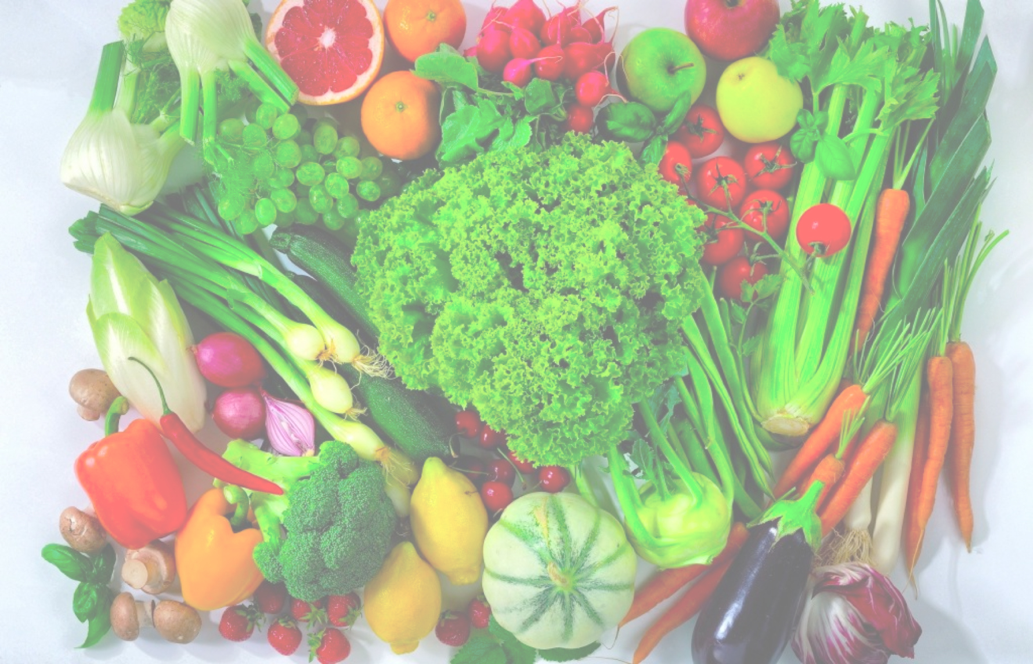
Crops, Food, Biotechnology and Some Other Thoughts
Peggy G. Lemaux
University of California, Berkeley
http:/ucbiotech.org
http://pmb.berkeley.edu/lemaux
https://clear-project.org

Slide 2

What will be covered?
1. Background on genes, genomes, genetic engineering, genome editing
2. What GE crops are commercialized? In the pipeline?
3. What is the regulatory structure for GE crops?
4. What are some food safety issues with GE foods?
5. What are some environmental issues with GE crops?
6. Some food for thought…

Slide 3
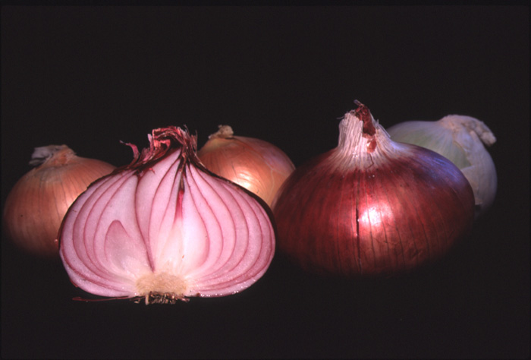
Tour d'Onion
Or, what makes an onion and onion?

Slide 4
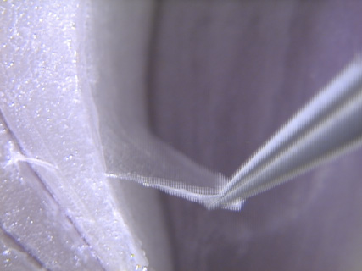

Slide 5
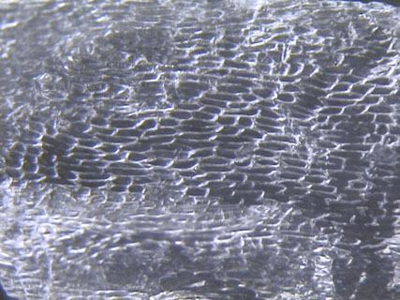
CELLS

Slide 6
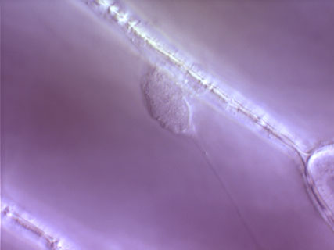
Cell Wall
Nucleus

Slide 7
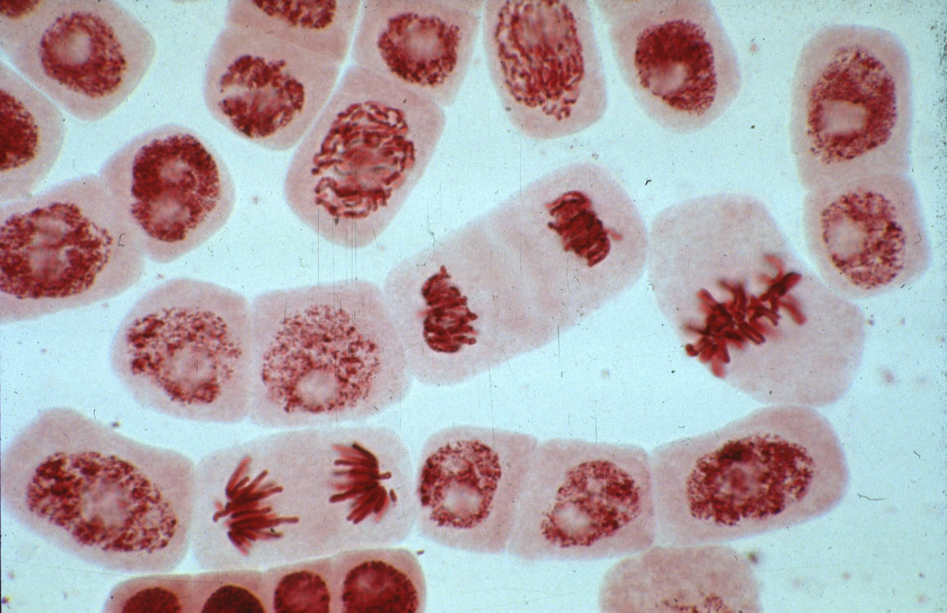
Dividing cell
Chromosomes

Slide 8
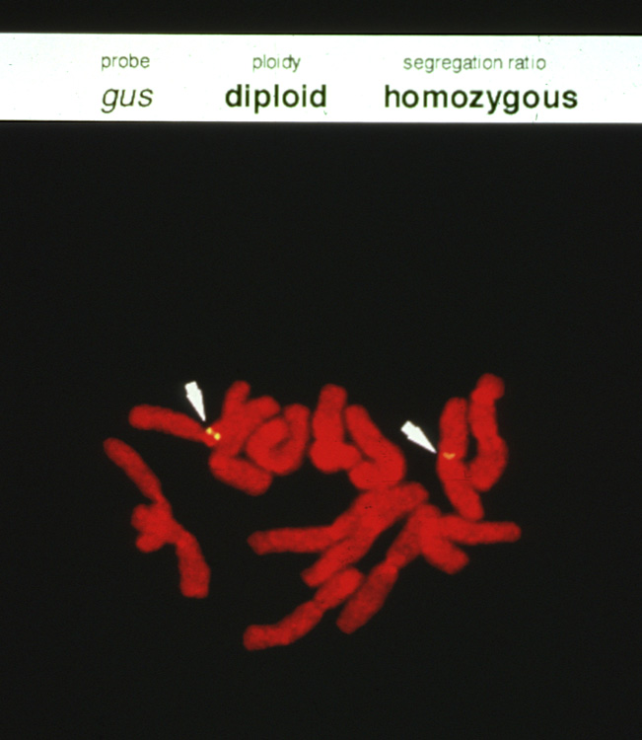
Chromosome
Genes

Slide 9
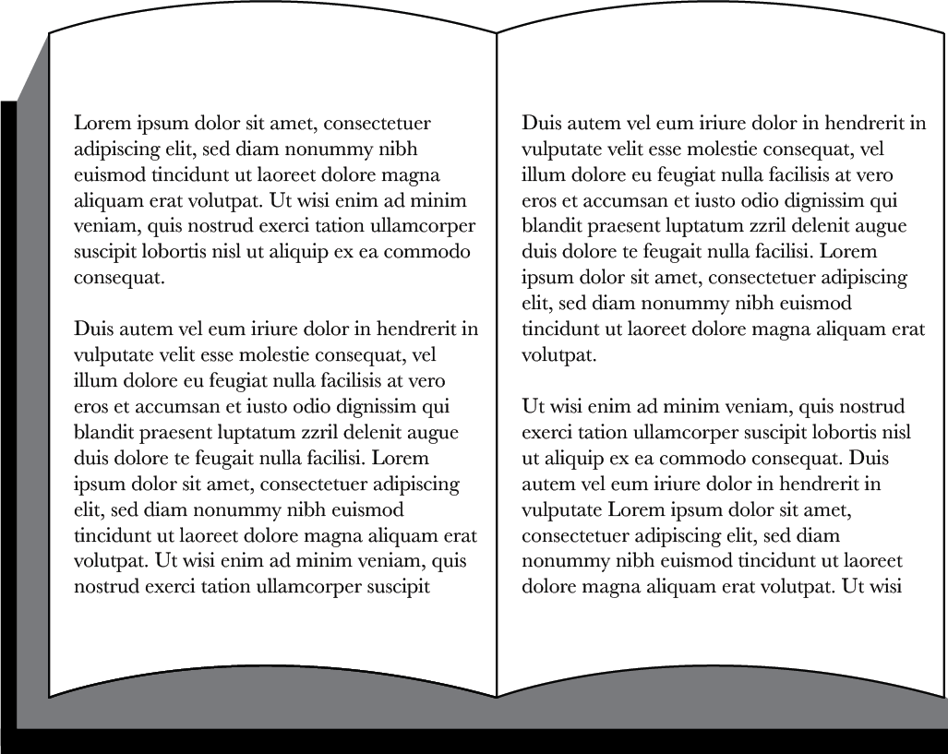
Genetic information in cell is responsible for traits
Chemical units in DNA represented by alphabetic letters
...CTGACCTAATGCCGTA...
...CTGAACTAATGCCTTA...
Genome
1700 books
1000 pages each
1700 books
(or 1.7 million pages)
Sometimes mistakes happen when copying information in books (genomes) → creating changes, called mutations

Slide 10
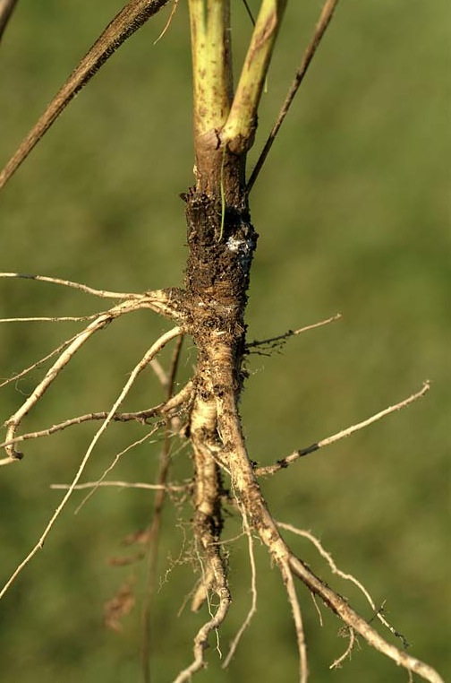
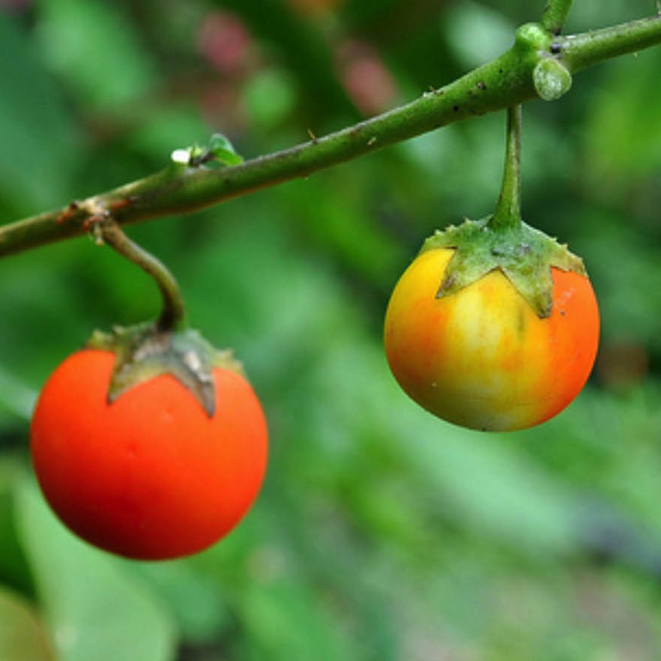
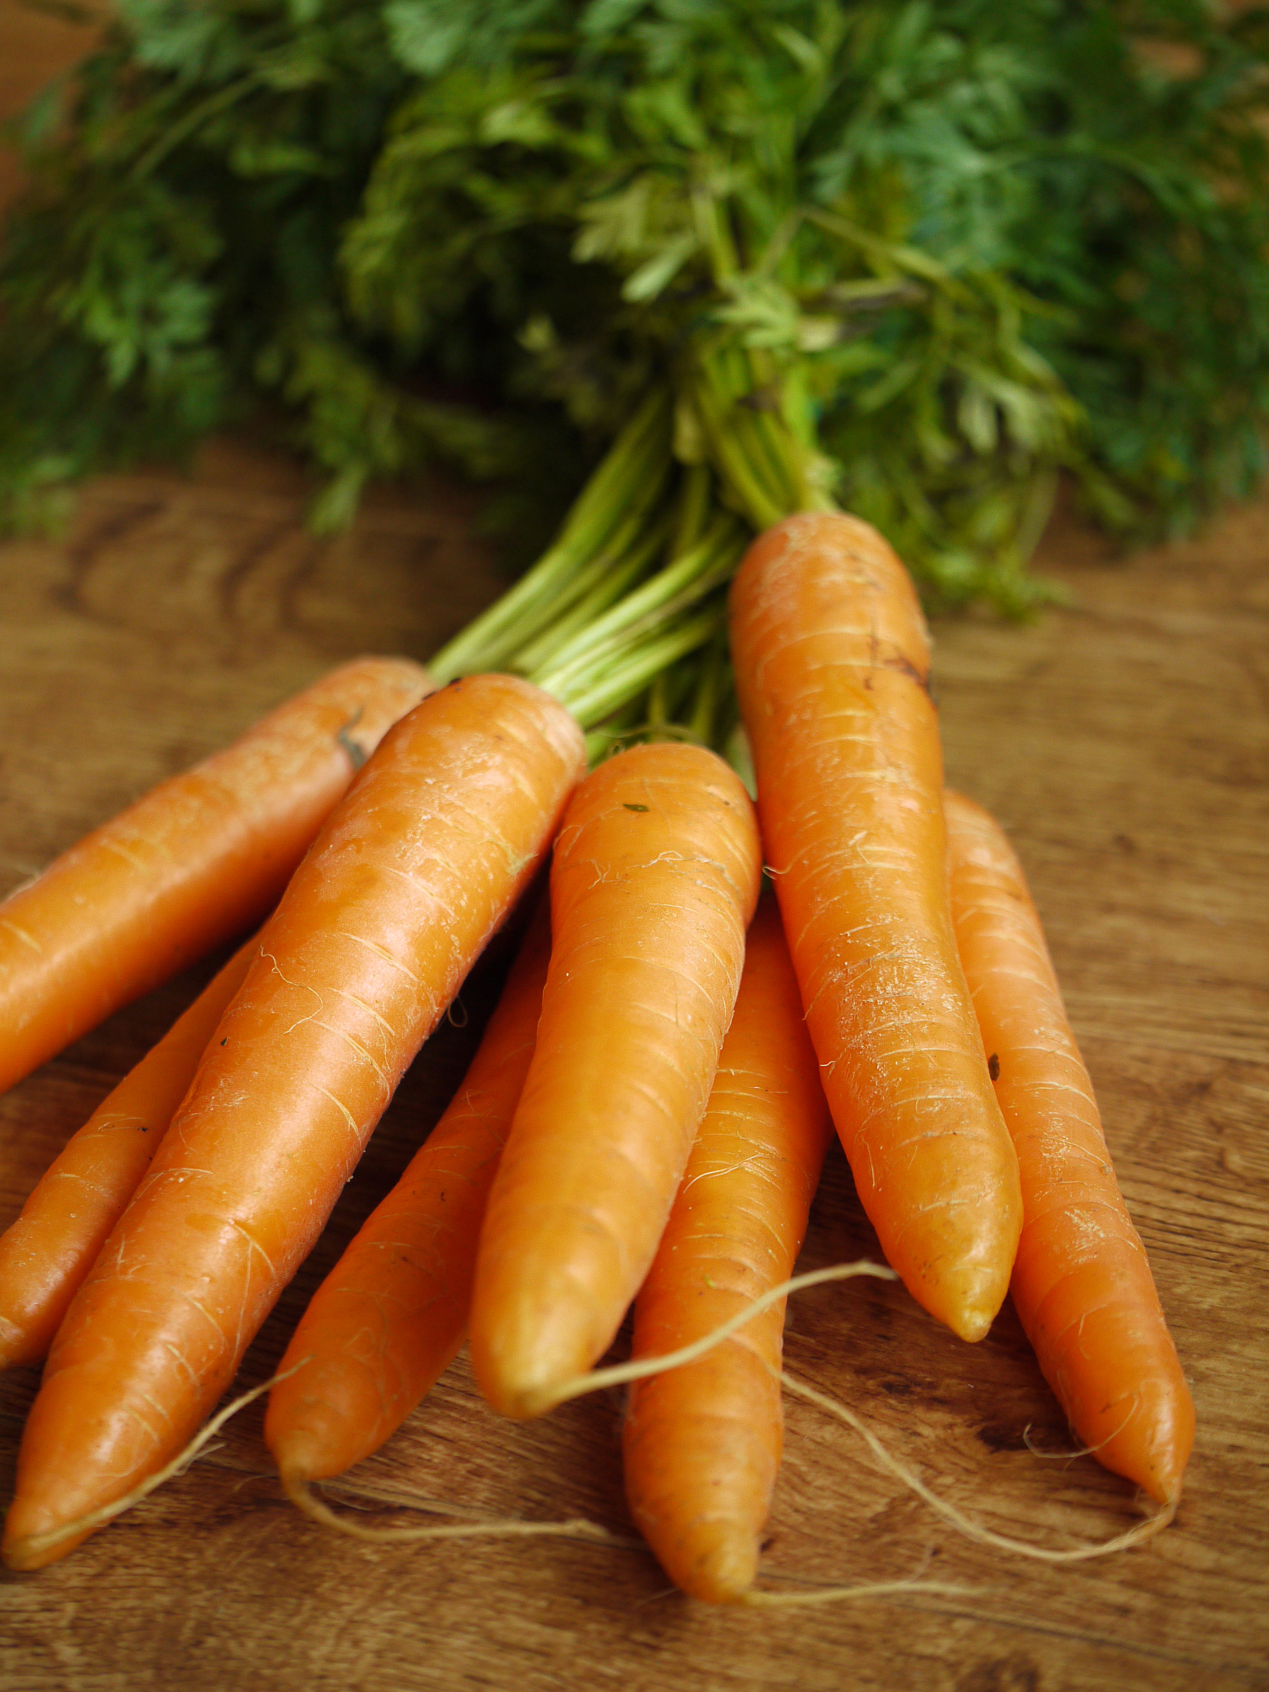
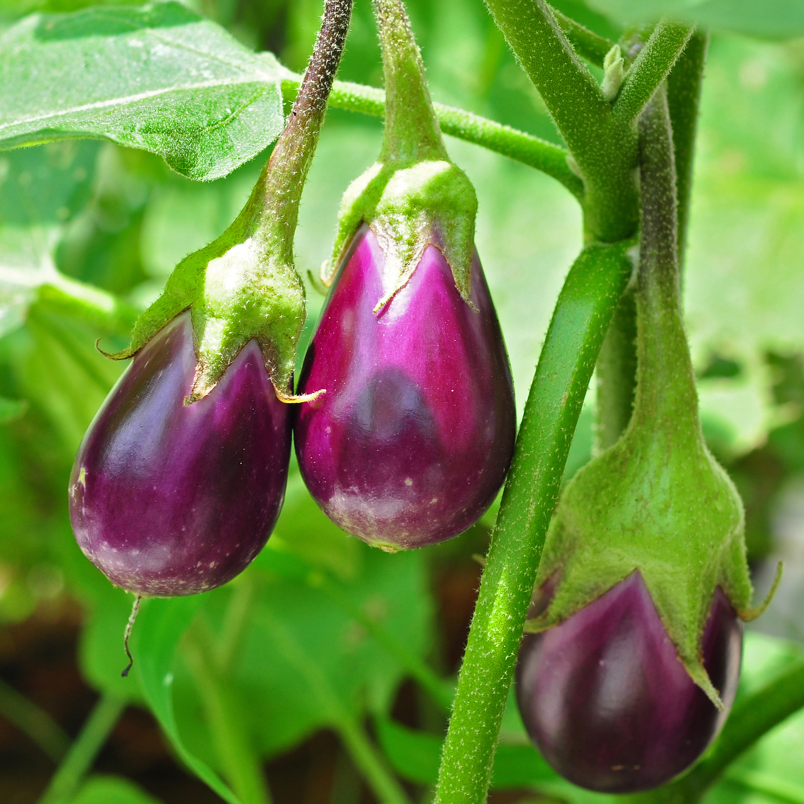
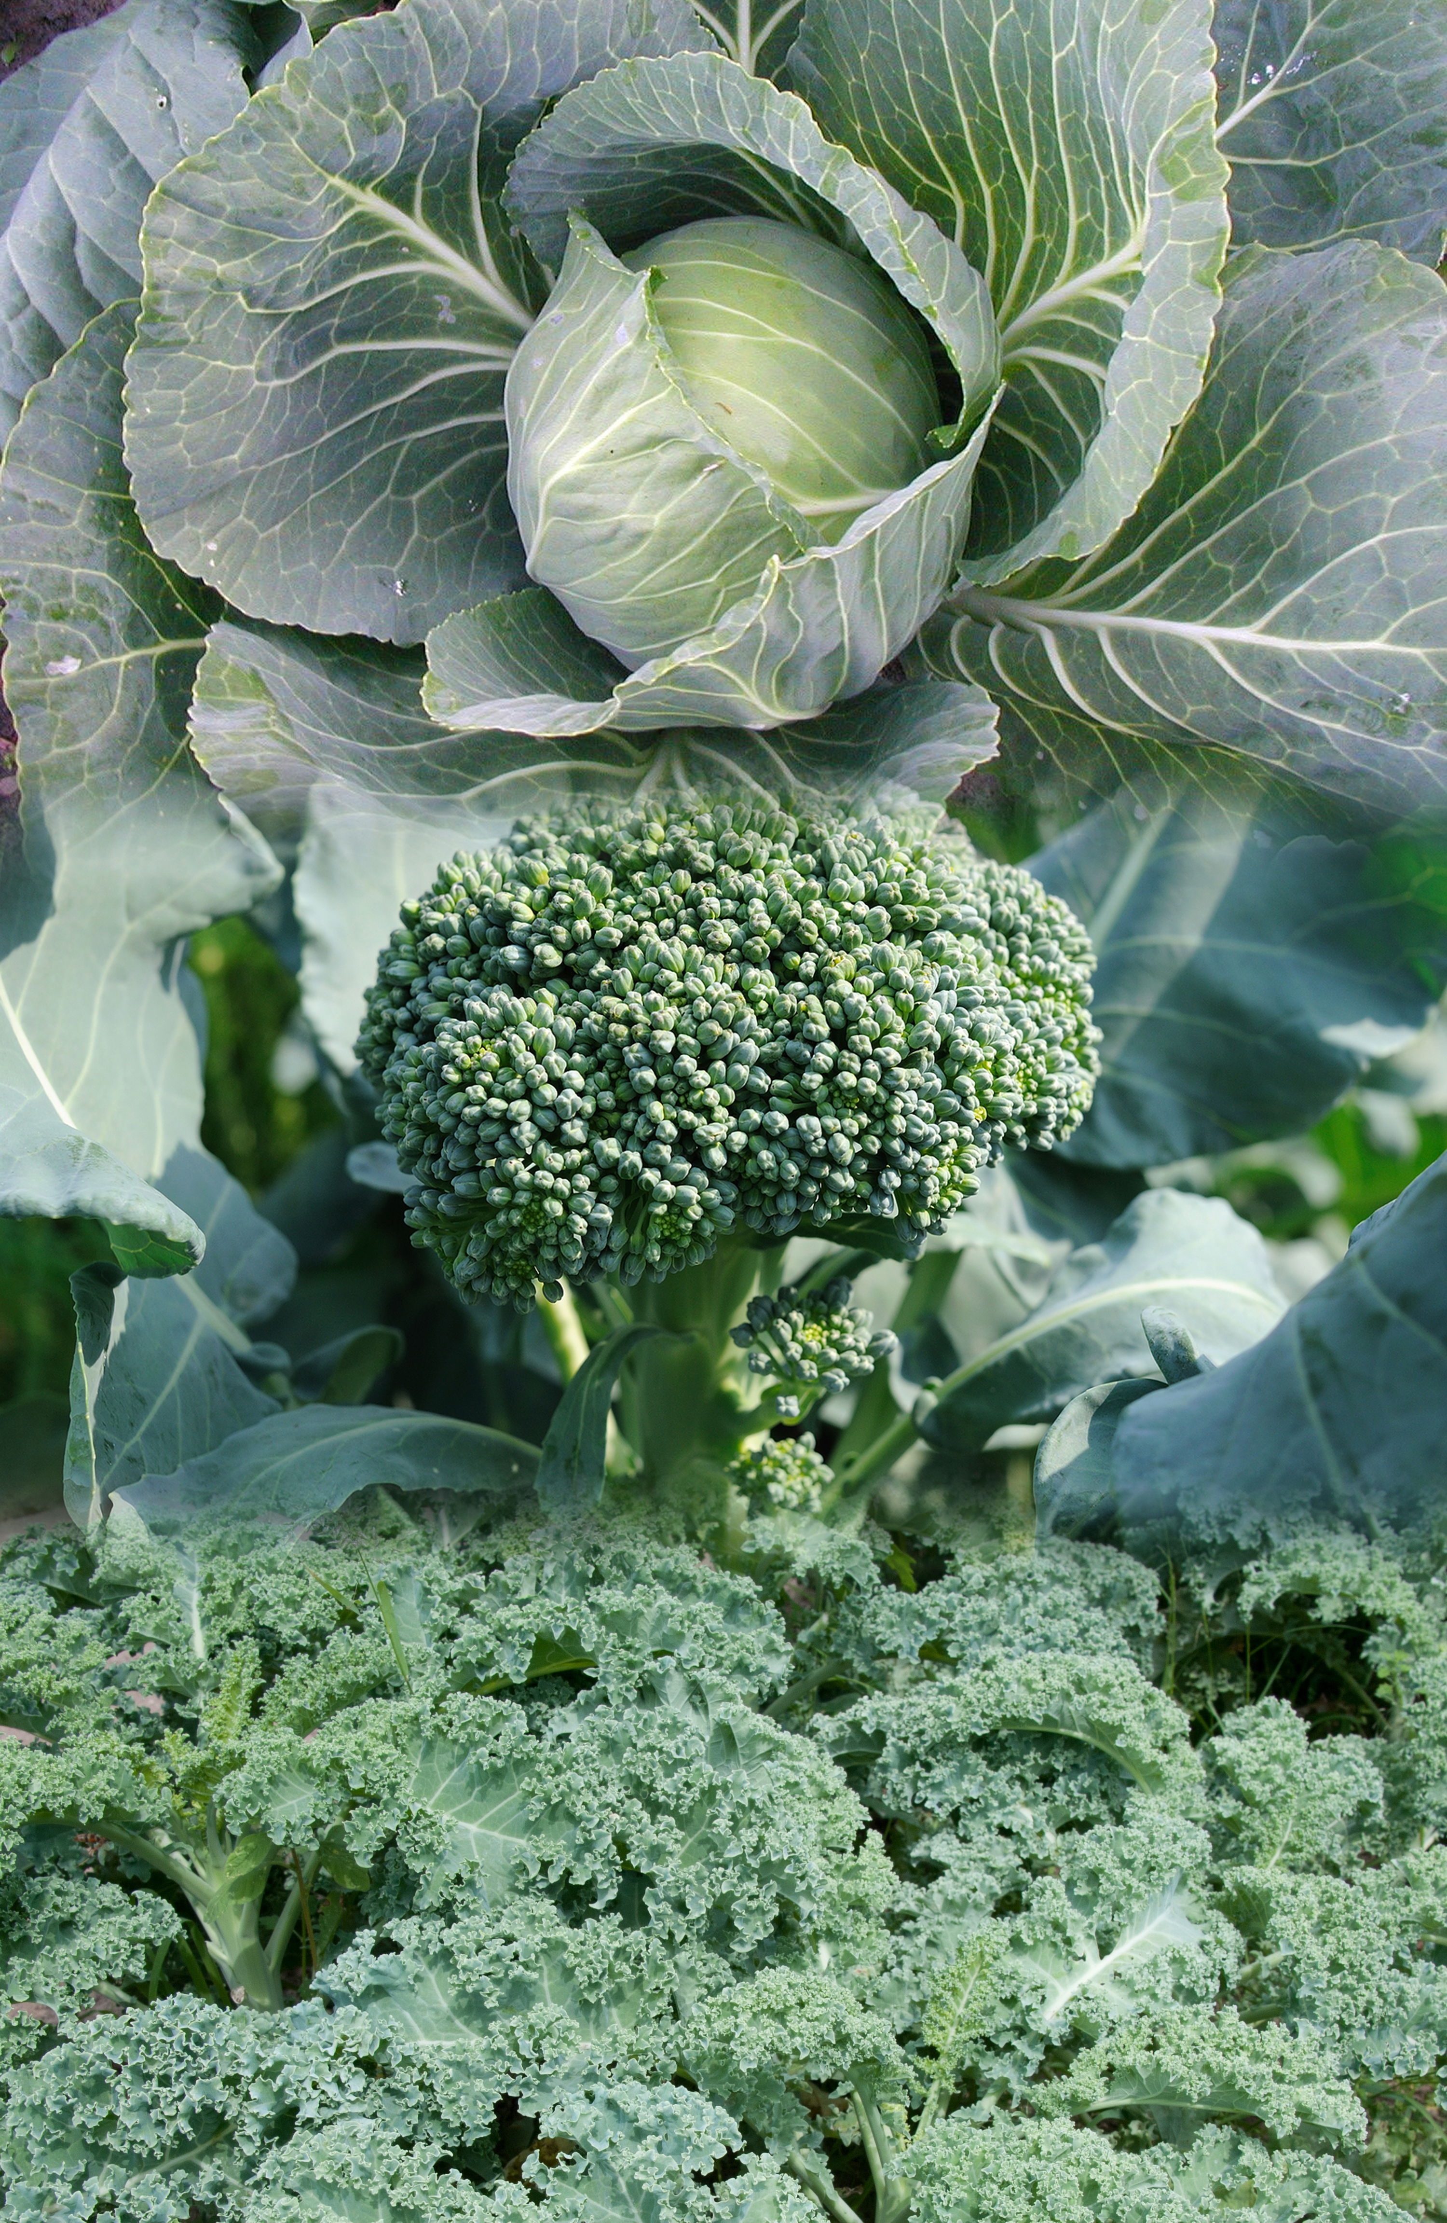
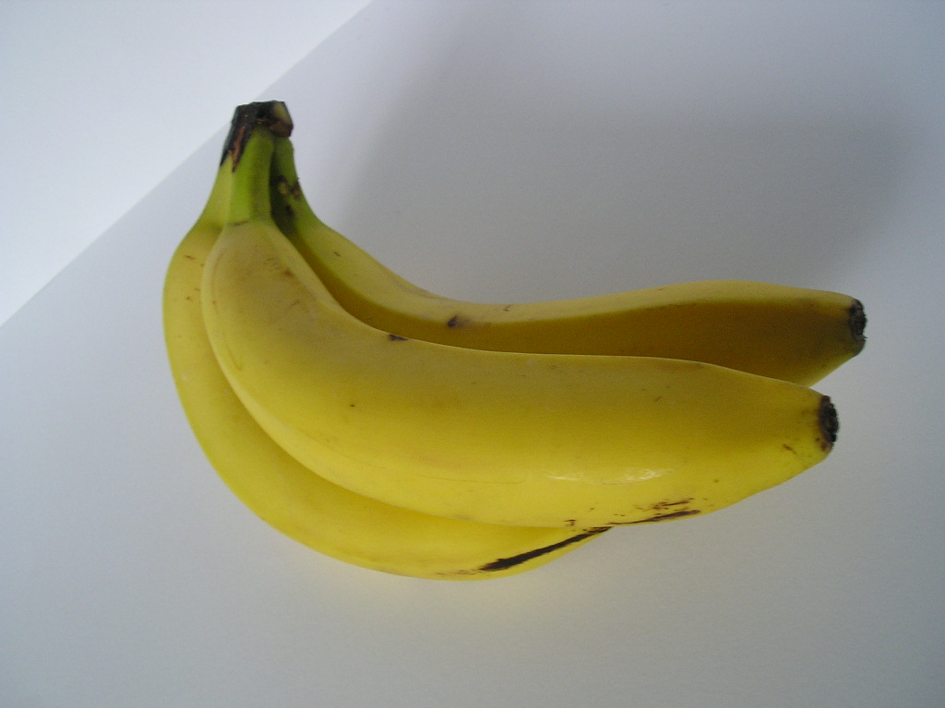
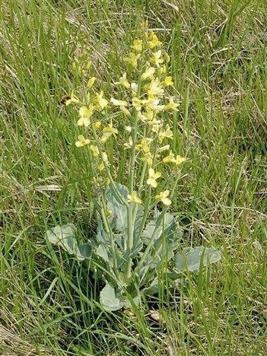
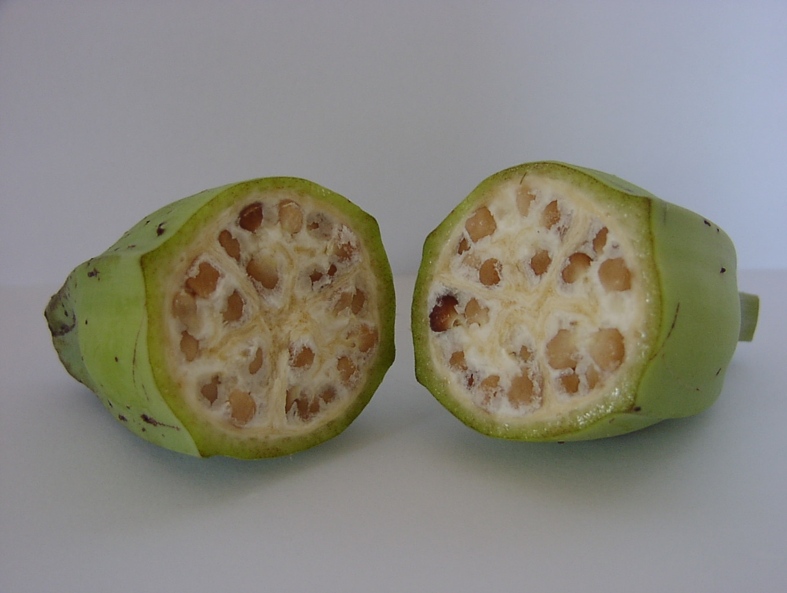
Mutations Have Gotten These Plants from Looking Like This…
To Looking Like They Are Now
Eggplant
Carrot
Banana
Broccoli, Kale, Cabbage

Slide 11
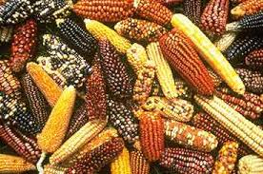
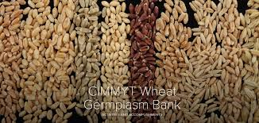
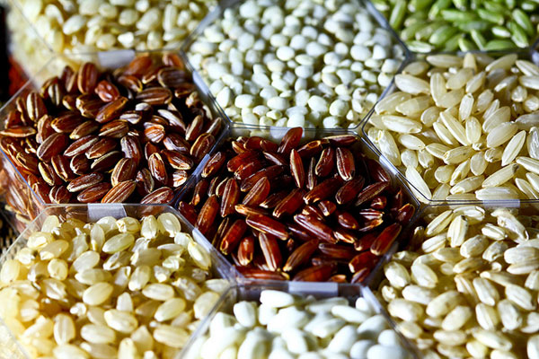
Since 1950’s intentional mutation breeding has created >3200 crops – e.g., 600 maize, rice, wheat varieties. Although modified genetically, they are not under regulations for genetically engineered (GMO) varieties.
Van Eenennaam 11/29/2016
Photo by Stephen Ausmus, USDA
Notes:
The methods used in mutation breeding have been in use since the 1950s and are excluded from GMO legislation, because such mutations also occur without human intervention but with a much lower frequency. The occurrence of mutations is considered to be a natural process, commonly used by breeders to exploit natural variation, that is simply boosted by the applied technique. Up to now, more than 3200 officially released cultivars are known to have been obtained by mutation breeding, among them more than 600 cultivated lines of wheat, rice and maize

Slide 12
Modern Example
Japanese Farmer Creates Mongee Banana With Softer, Digestible Skin
2/22/2018 A-peeling? Japanese farmers invent edible banana skin | World news | The Guardian
Notes:
2/22/2018 A-peeling? Japanese farmers invent edible banana skin | World news | The Guardian

Slide 13
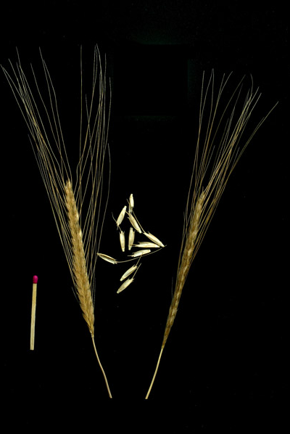
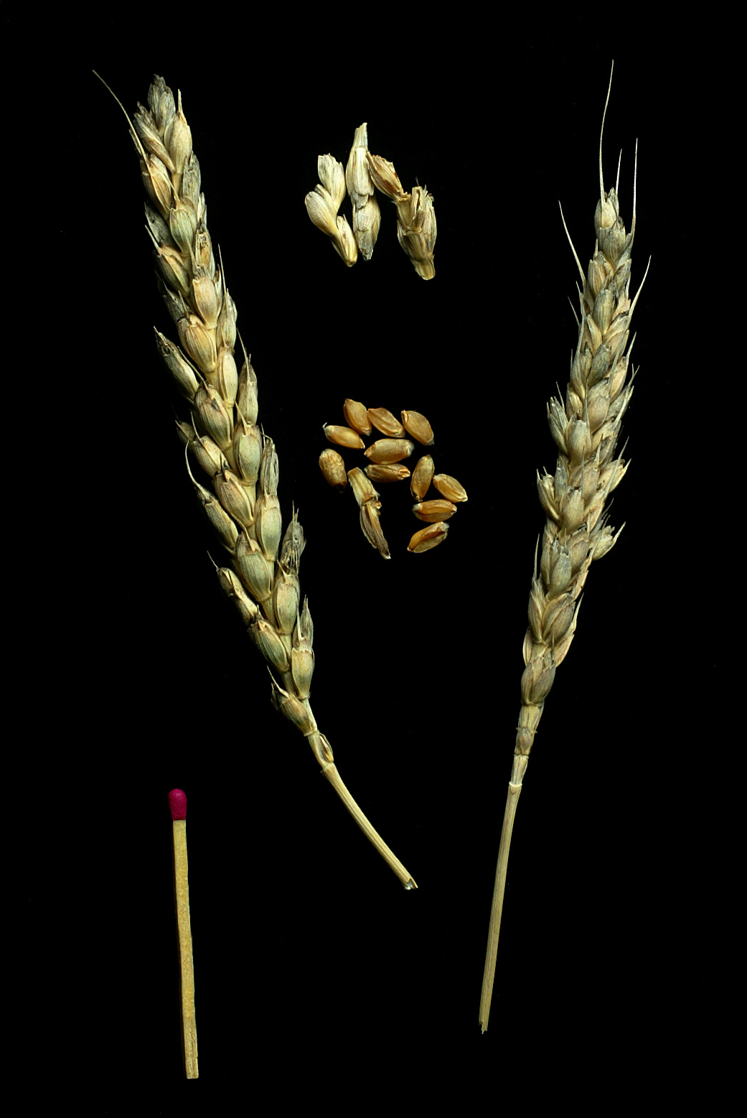
But genomes have also been modified by classical breeding to create new plant varieties?
Triticum monococcum
Ancient variety
Triticum aestivum
Modern bread variety

Slide 14


Hybridization or Cross-breeding of Wheat
x
Random retention of information from each parent
1700 books
(or 1.7 million pages)
1700 books
(or 1.7 million pages)
1700 books
(or 1.7 million pages)
Genetic modification by hybridization is not GE or GMO

Slide 15
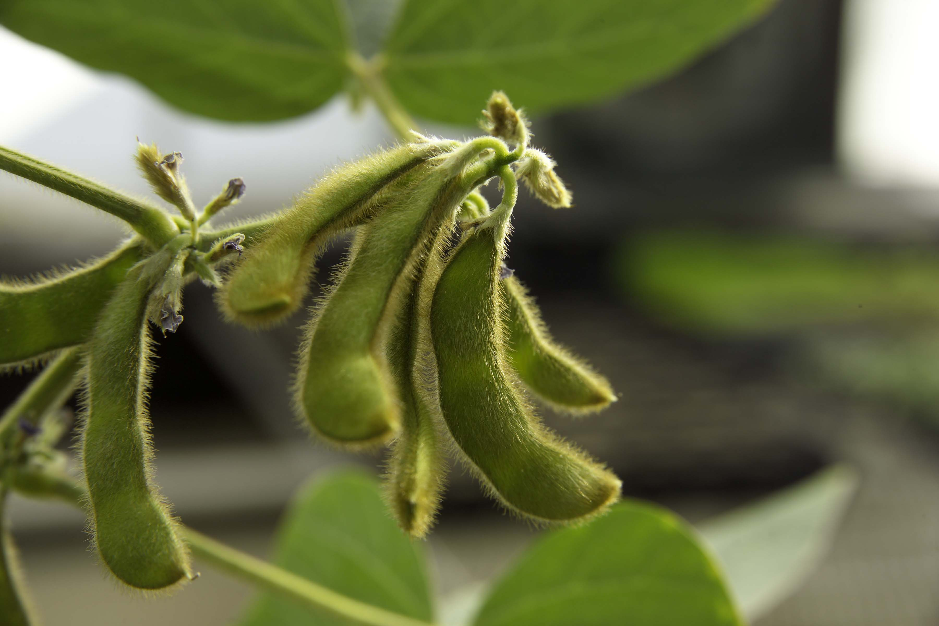
Example: Soybean variety with less allergenicity and anti-nutritional qualities after years of classical breeding efforts.
SOURCE: “Triple Null: New Genetically Modified Soybean A Big Benefit For Food Allergies”, Science 2.0, 5/4/15.
http://www.science20.com/news_articles/triple_null_new_genetically_modified_soybean_a_big_benefit_for_food_allergies-155306
Notes:
May 12, 2015

Slide 16
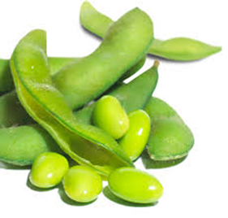
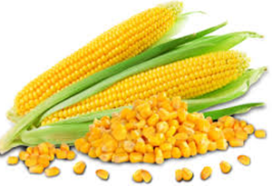
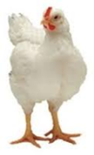
Breeding efforts were critical to increases in crop production…
Product | 2014 acreage | Acreage needed at 1950’s rate | Additional Resources needed
Soybeans | 82,591,000 acres | 180,971,889 acres | ~98 million acres (= size CA)
Corn | 83,136,000 acres | 372,134,346 acres | ~289 million acres (= 3X size CA)
Broiler Chickens | 8,544,100,000 head | 16,679,545,455 head | ~8 billion head requiring 81.5 billion lbs feed
Van Eenennaam 11/29/2016
Notes:
FCR = feed conversion ratio

Slide 17
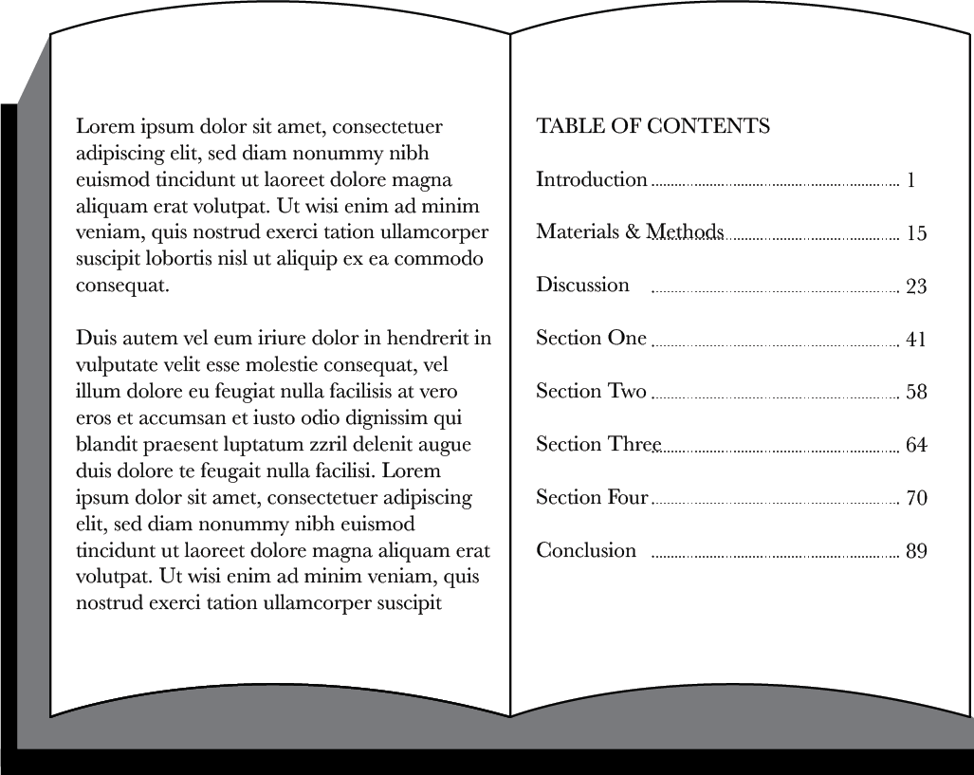
New Breeding Method
Uses table of contents of genes for marker assisted selection
...CTGACCTAATGCCGTA...
Disease tolerance
1700 books
(or 1.7 million pages)
Genetic modification that is not GE or GMO

Slide 18
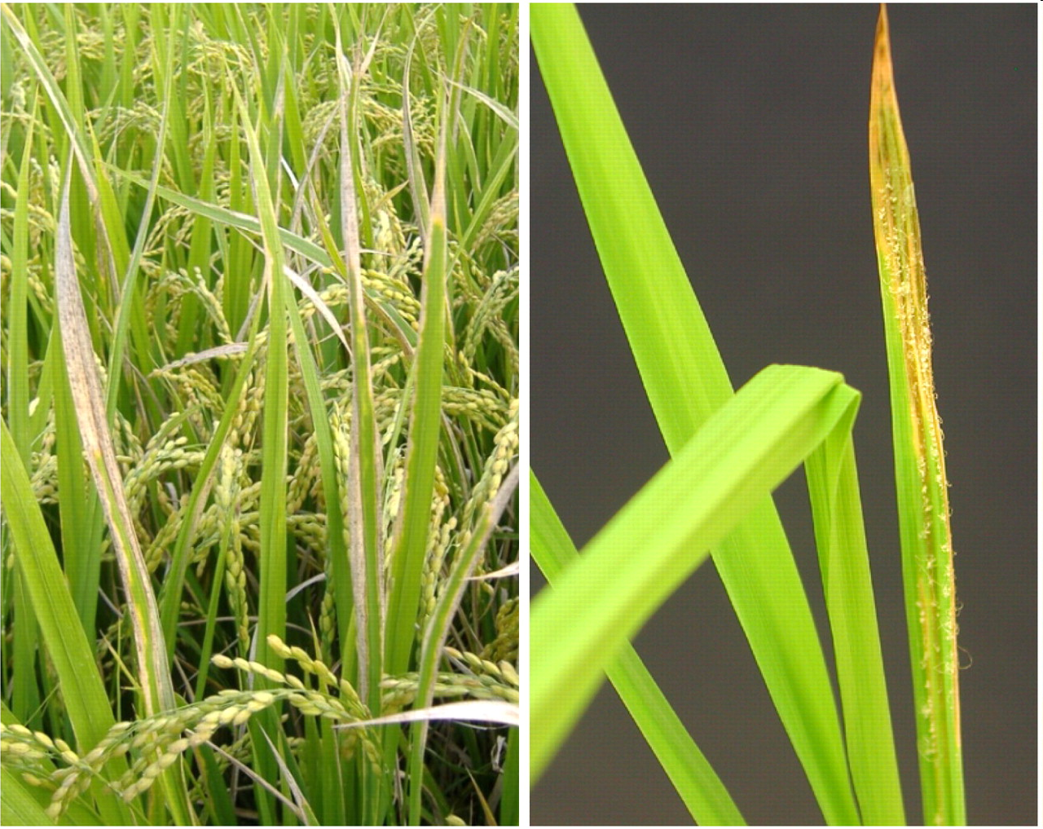
Can’t we just do all modifications this way?
Marker-assisted selection used to protect rice against bacterial blight and blast disease
Protection limited to diversity in crop and compatible relatives

Slide 19
Also modify genomes with genetic engineering → GMOs
What Kinds of GE Crops and Foods Are in the Commercial Market?
+
Inserts gene(s) randomly in genome
One-half page equivalent to a gene
1700 books
(or 1.7 million pages)
1700 books
(or 1.7 million pages)
Genetic modification by genetic engineering is GE or GMO

Slide 20
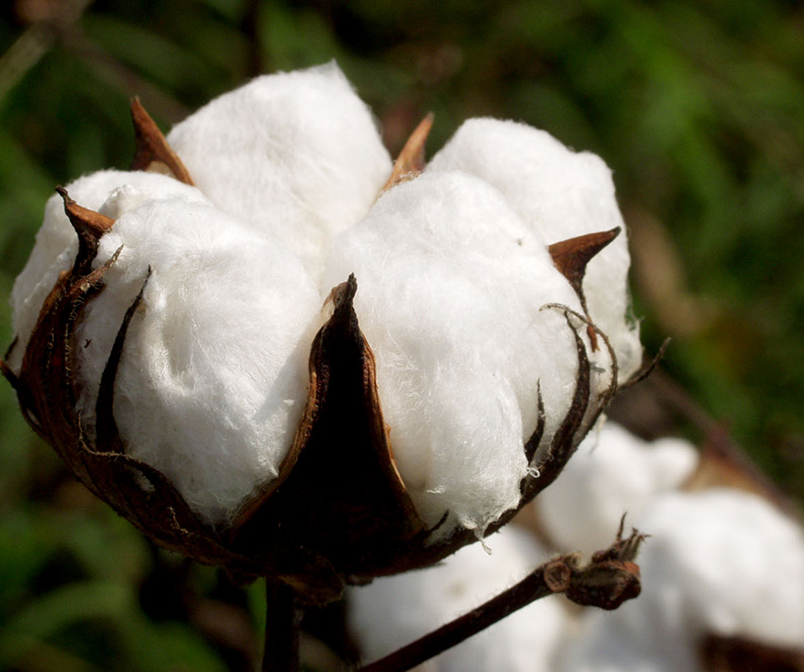
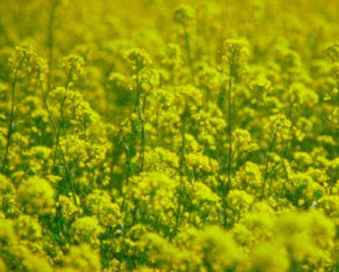
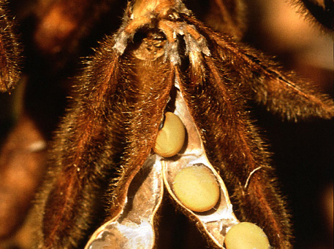
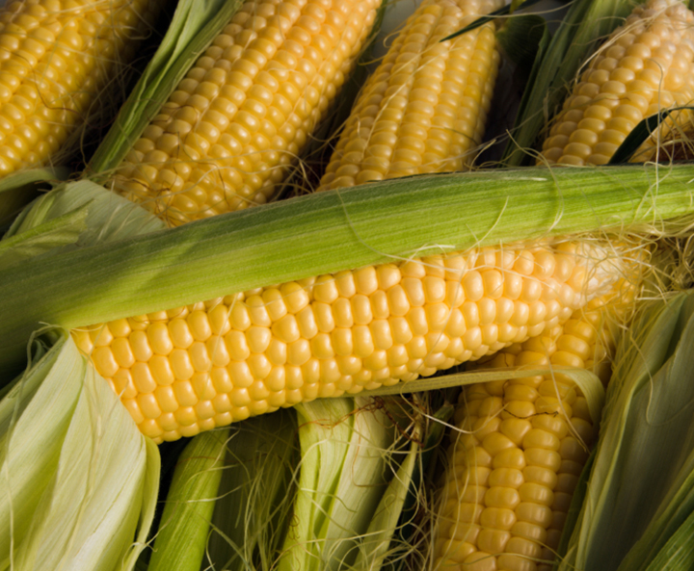
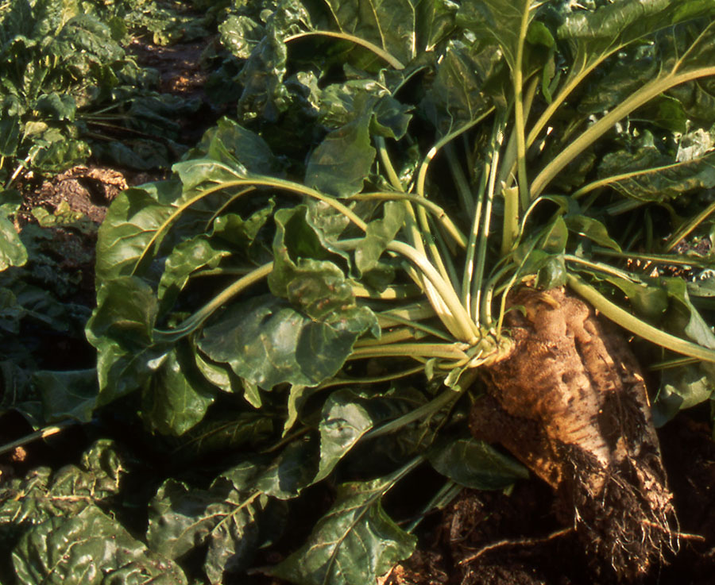
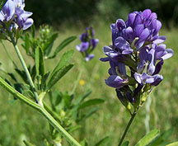
Number of different commercially available, large acreage GE (GMO) crops is limited
GE Cotton
94% of 2018 acreage
(Insect Resistant: 3% Herbicide tolerant: 9% Stacked gene: 82%
GE Canola
100% of 2017 acreage
GE Soybean
94% of 2018 acreage
(Herbicide resistant: 94%)
Source: USDA-ERS, 2018
Source: ISAAA, 2017
Source: USDA-ERS, 2018
GE Corn
92% of 2018 acreage
(Insect Resistant: 2% Herbicide resistant: 10% Stacked gene: 80%)
GE Sugarbeet
100% of 2017 acreage
GE Alfalfa
14.4% of 2017 acreage
Source: USDA-ERS, 2018
Source: ISAAA, 2017
Source: ISAAA, 2017
Notes:
August 20, 2014

Slide 21
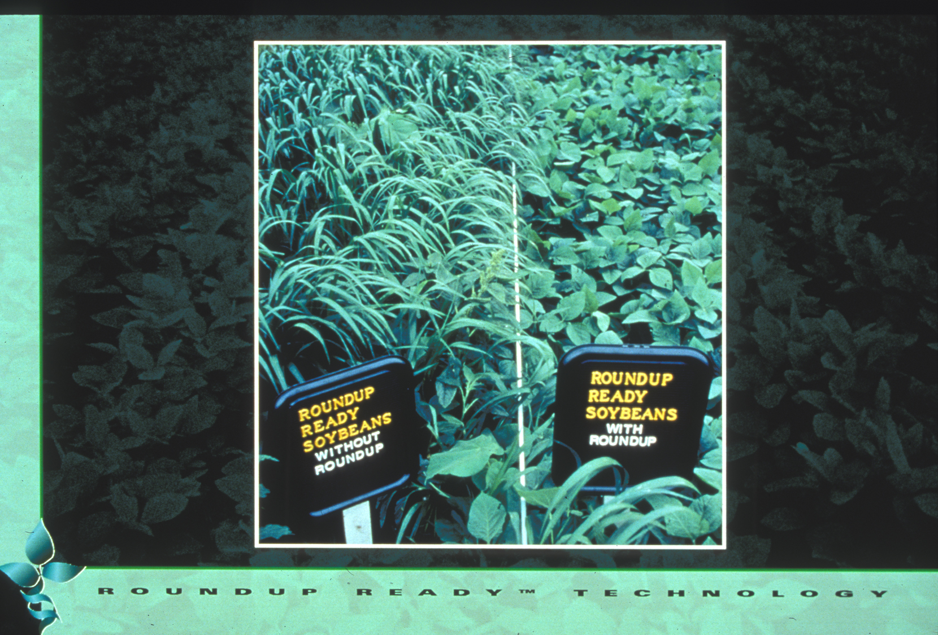
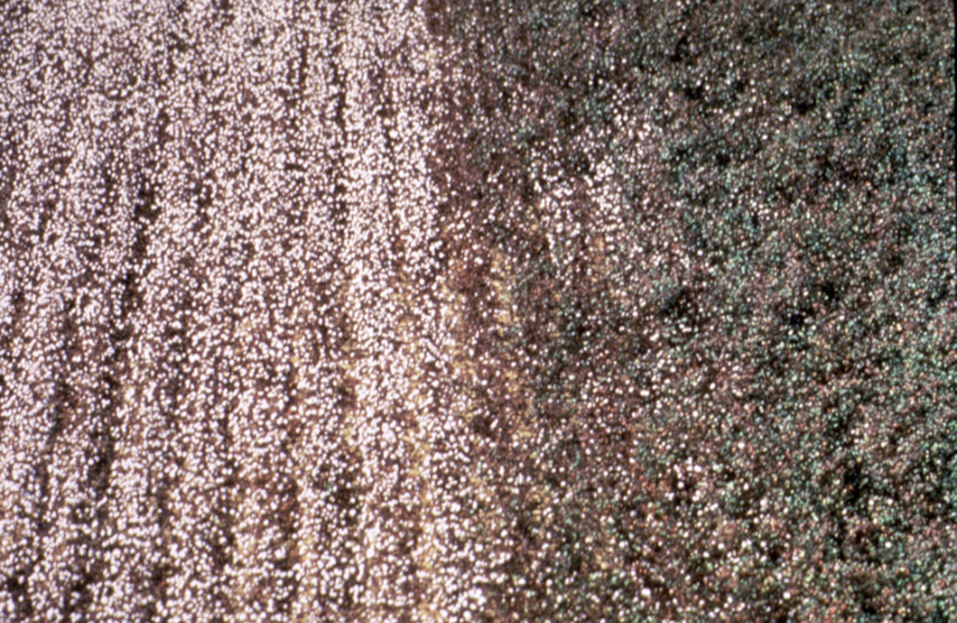
Roundup Ready Soybean™
Number of different traits available in large acreage GE crops is also limited
Herbicide-tolerant - engineered with gene to tolerate herbicide application
Insect-tolerant Bt crops - engineered for resistance using gene from naturally occurring bacterium
Crops with stacked traits - Bt and HT - are available

Slide 22
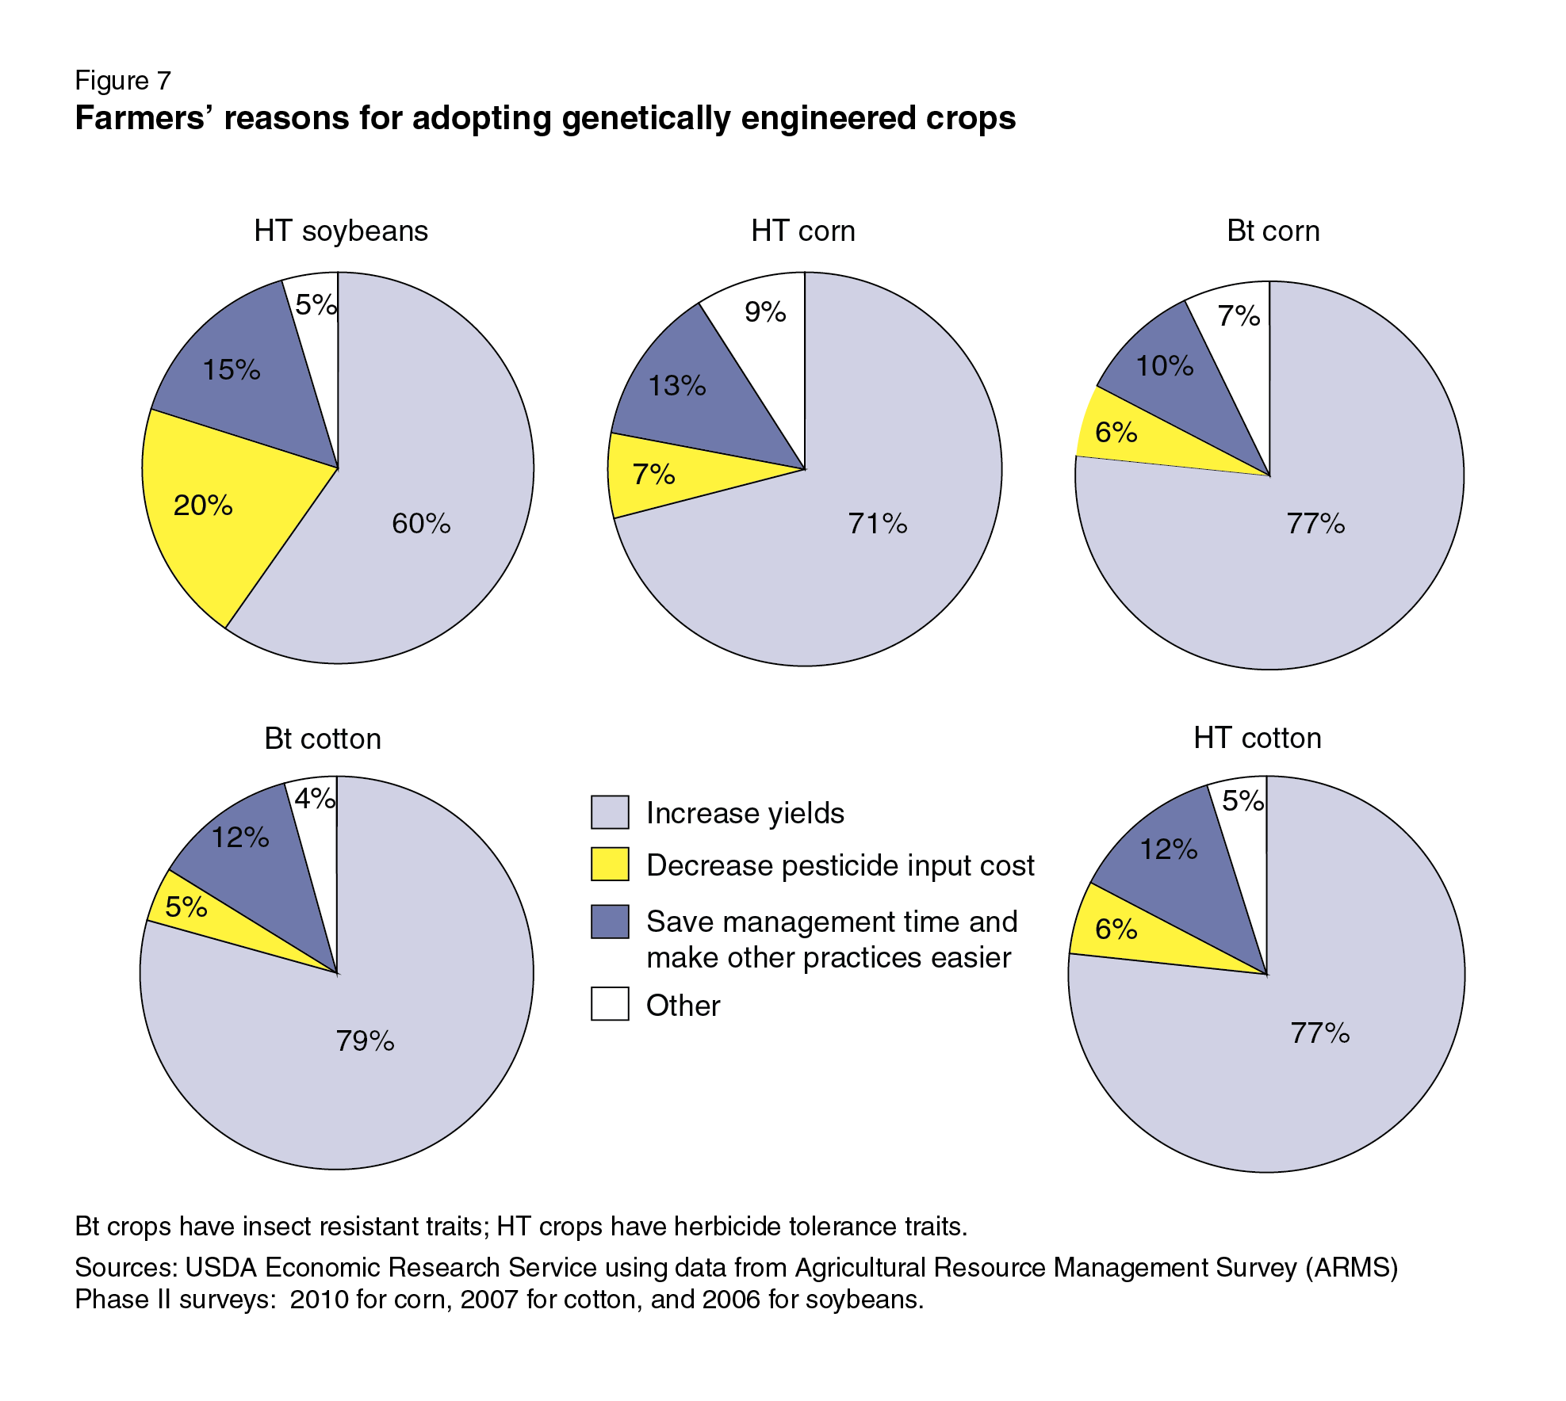
Why do U.S. growers use GE crops?
Reasons vary from crop-to-crop but primary reason is improved yields
SOURCE: Fernandez-Cornejo, J., Wechsler, S., Livingston, M. and Mitchell, L. 2014. Genetically Engineered Crops in the United States. USDA Economic Research Service Report No. 162, February 2014.
Notes:
March 25, 2014

Slide 23
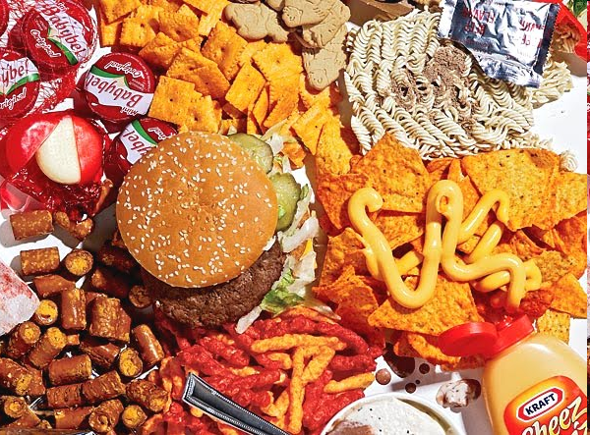
Corn oil
Canola oil
Soy lecithin
Soy protein
Corn starch
Cottonseed oil
These types of large-acreage GE crops lead to estimates that 60-80% of processed foods in U.S. have GE ingredients – often only a minor ingredient
SOURCE: https://factsaboutgmos.org/disclosure-statement

Slide 24
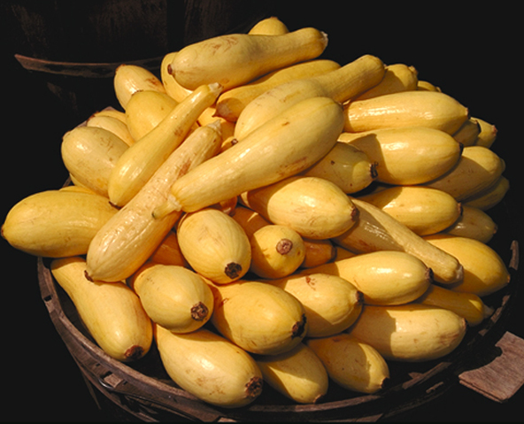
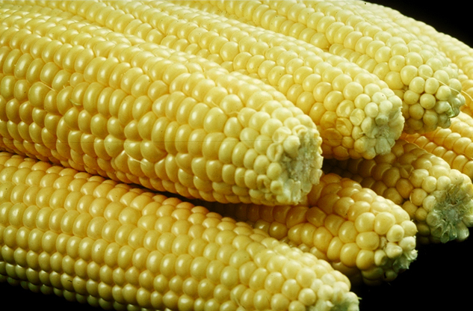
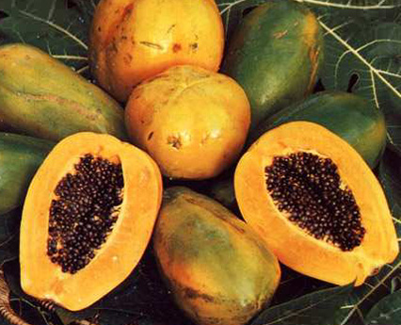
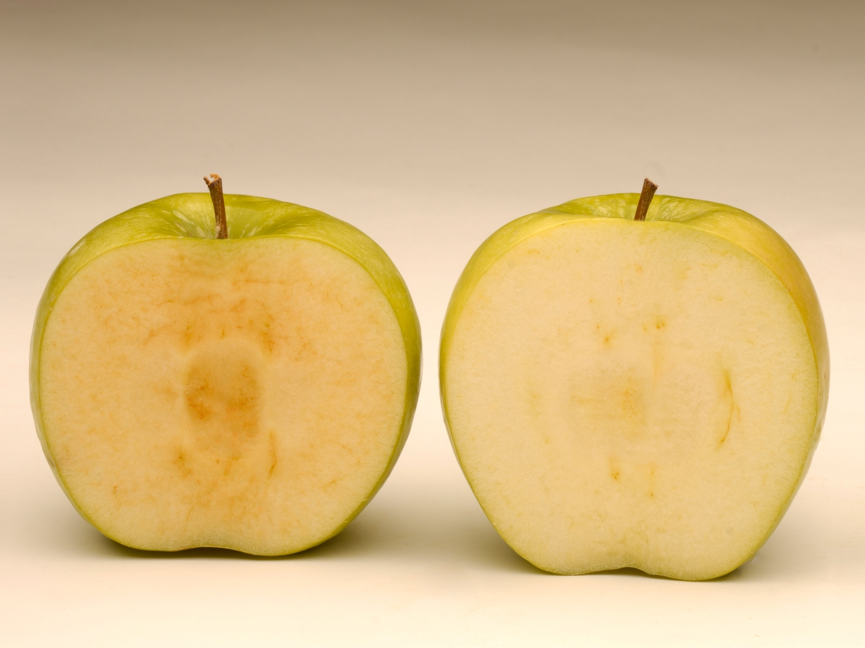
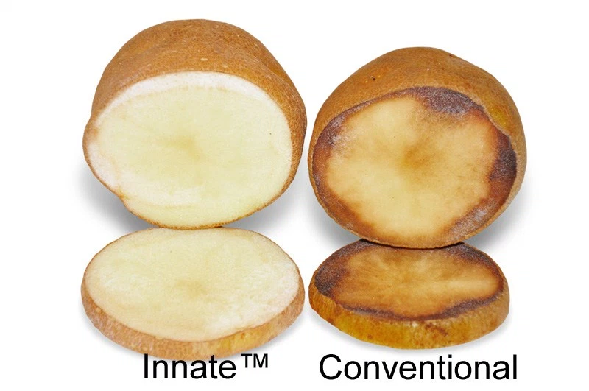
There are only a few whole, genetically engineered foods in the U.S market
GE Squash
~2,417 acres in 2017
GE Sweet Corn
33% of 2017 acreage
GE Papaya
77% of 2017 acreage
from Hawaii
Source: ISAAA, 2017
Source: ISAAA, 2017
Source: ISAAA, 2017
Two more are just being introduced
Arctic Apple™
249 acres in 2017
Innate™ Potato
Generation 1: ~4,000 acres in 2017
Generation 2: ~2,000 acres in 2017
Source: ISAAA, 2017
Source: ISAAA, 2017

Slide 25
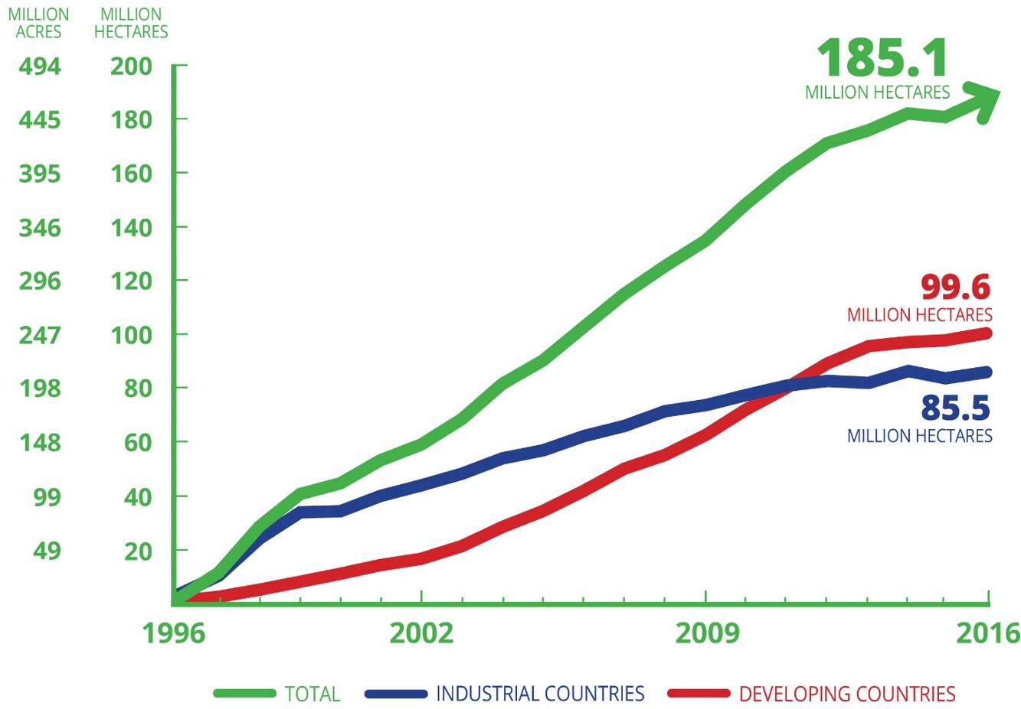
Despite the same limited U.S. crop and trait types, worldwide acreage is increasing in 19 developing, 7 developed countries
Global Area of Biotech Crops, 1996 to 2016: Industrial
and Developing Countries (Million Hectares, Million Acres)
In 2016 ~18M farmers in 26 countries planted 457M acres (>4X size of California) – 54% in developing countries; 41% stacked traits
ISAAA, 2016
James, C. 2016 http://www.isaaa.org/resources/publications/briefs/52/default.asp

Slide 26
WHAT’S IN THE
PIPELINE?

Slide 27
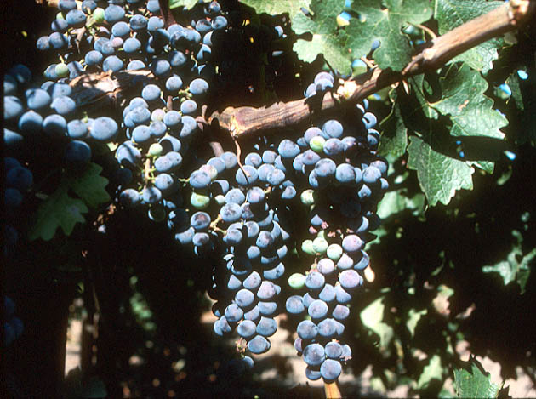
Field Trials in California with Grape Root Stocks Engineered for Resistance to Fanleaf Virus
SOURCE: http://www.democratandchronicle.com/apps/pbcs.dll/article?AID=/20080806/BUSINESS/808060336/1001

Slide 28
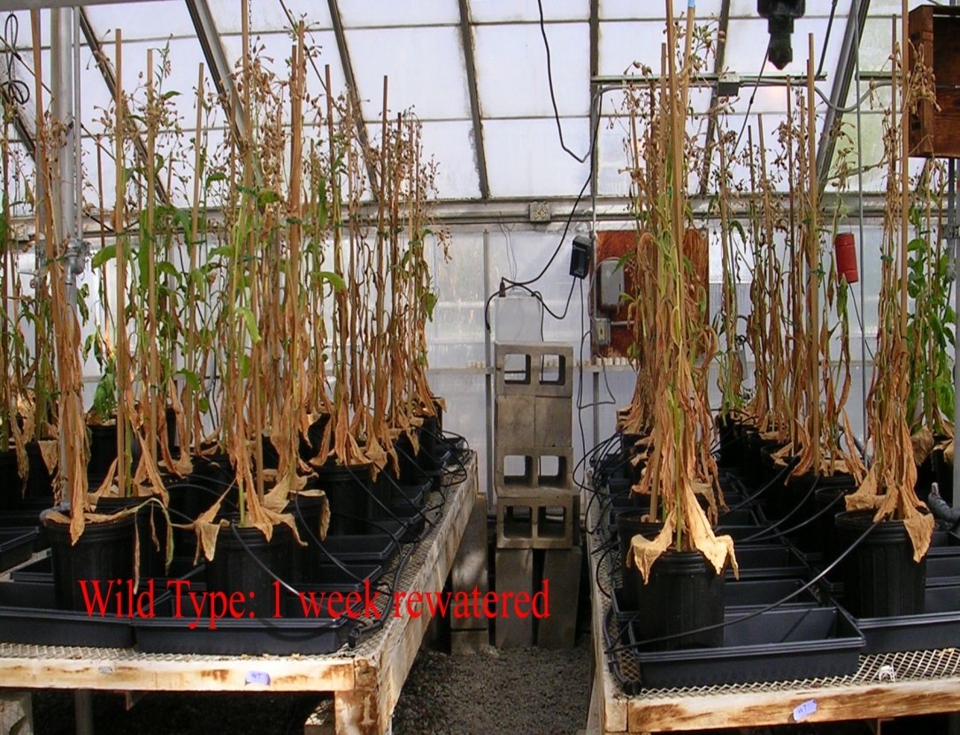
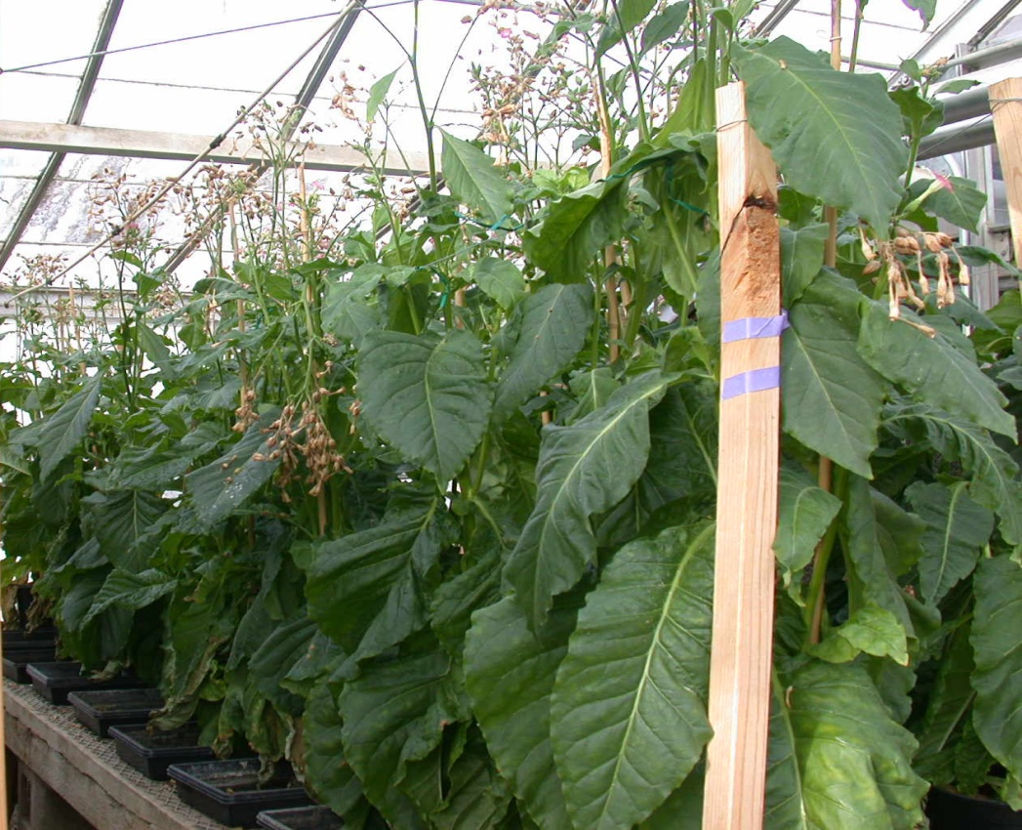
Salinity and Drought Tolerance - UC Davis
Wild type AtNHX1
200 mM NaCl (~1/2 sea water)
Wild type IPT gene
15 days drought, 7 days re-watered
Salt-tolerance
Drought-tolerance
Hanana M. 2011. Environ Rev 19: 121-140; Anjuman A et al. 2013 Mol. Biotechnol 54: 379-392

Slide 29
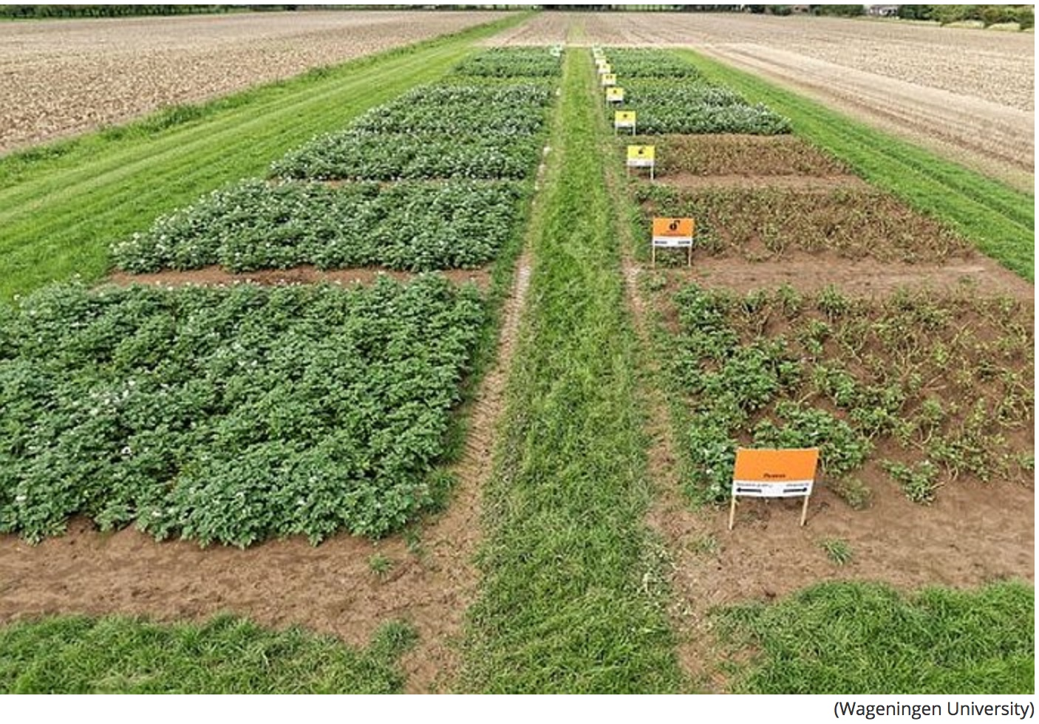
GE potato + pest management controls potato blight - reducing chemical fungicide use by up to 90%:
Kessel, GJT. 2018. Development and validation of IPM strategies for the cultivation of cisgenically modified late blight resistant potato. Eur J Agron. 96:146.

Slide 30
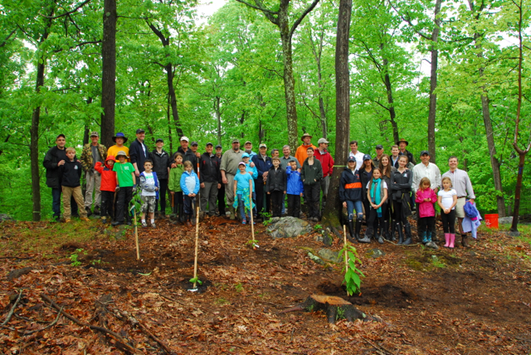
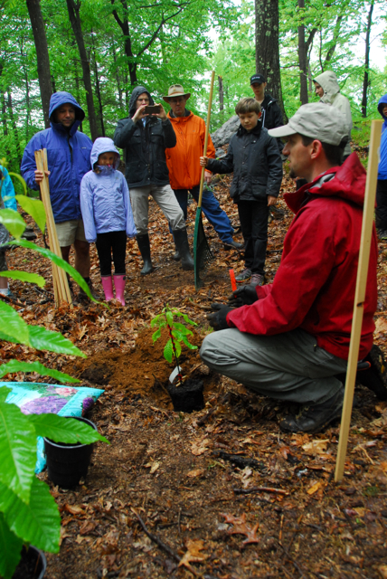
Chestnuts engineered with a wheat gene prevents cankers from forming; replanted with $104K raised through crowd funding campaign
http://www.newscientist.com/article/dn25644-american-chestnut
Notes:
American chestnut used to be major

Slide 31
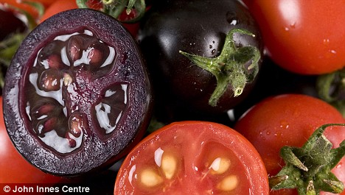
High anthocyanin purple GE tomatoes. Diets with 10% purple tomatoes increased lifespan of cancer-prone mice
Butelli et al. 2008. https://www.jic.ac.uk/staff/cathie-martin/purple-tomatoes.html
Notes:
Purple fruit contains same level of anthocyanins as half basket of blueberries. Large orange tomatoes (~100g) have same amount of beneficial compound as 27 bottles of red wine (resveratrol). Yellow-fruited variety contains genistins, in amount equal to 150 g of tofu. Fourth variety has quercetin and kaempferol, health-promoting compounds found in capers, radishes, onions and watercress. Offer protection against inflammation, cancer and cardiovascular disease. http://news.jic.ac.uk/2014/03/bbsrc-most-promising-innovator/ Produce 100 fold higher levels of anthocyanins than conventional blue tomatoes

Slide 32

New genome editing technology used to turn off expression of genes responsible for traits
“Knocked out” 35 of the 45 gliadin genes involved in coeliac;
efforts now using genome editing (CRISPR)
Sanchez-Leon S. et al., 2017. Plant Biotechnology Journal September 18, 2017 DOI: 10.1111/pbi.12837
Notes:
New Scientist Sept. 26, 2017
Francisco Barro: Cordoba Spain
Using CRISPR to knock out 35 of 45 gliadin genes
Biotechnology Journal DOI: 10.1111/pbi.12837
https://www.newscientist.com/article/2148596-genetically-modified-wheat-used-to-make-coeliac-friendly-bread/#.Wc7Dv_mnOMk.email

Slide 33

New Genetic Method: Genome Editing-Mutation
Find target text, inserts gene edit at specific location in genome

Slide 34




EXAMPLES of edited products:
University
Company
Company
Company
In 2016/2017, USDA said they can’t regulate these edited crops because no DNA from plant pests or pathogens is introduced

Slide 35

Another Way of Genome Editing-Modification
Inserts edits specifically in genome
INSERTION
DELETION
This type of genome editing may or may not be GE or GMO for federal regulation

Slide 36

Why Are GE (GMO) Crops and Foods So Controversial?

Slide 37

Look what greeted residents in Tule Lake in late 80’s during first field test of GE “ice minus bacterium” – men in moon suits spraying the organism on local fields.
Then they went to Monterey – and were not welcomed there either!

Slide 38


But large-scale pushback started in the late 90’s in Europe. Factors that fueled and continue to fuel controversy there:
Food safety scares
Involuntary nature of change
Cultural differences
Economic incentives
1999
Lord Melchett participating in GM protest
And there are issues in the U.S. too
2014
GM maize protest in Germany

Slide 39
What are some issues with GE crops & foods?
Regulatory oversight
Lack of peer-reviewed food safety tests
Consumer attitudes and labeling
Environmental issues
Some additional food for thought…

Slide 40
What are some issues with GE crops & foods?
Regulatory oversight
Lack of peer-reviewed food safety tests
Labeling
Environmental issues
Some additional food for thought…

Slide 41
U.S. Regulatory Agencies
USDA
FDA
EPA
Field testing
  Permits
  Notifications
Determination of
non-regulated status
Food safety
Feed safety
Pesticidal plants
  tolerance exemption
  registrations
Herbicide registration
Plant pest?
Danger to people?
Risk to environment?

Slide 42
Are they as safe as conventional foods?
This is based on the concept of
substantial equivalence
Modified food has essentially all characteristics of nonmodified food with respect to food and feed value except for introduced trait
Product of introduced genetic information tested for safety separately
How is substantial equivalence tested?
SOURCE: Safety of Genetically Engineered Foods: Aproaches to Assessing Unintended Health Effects 2004. Natl Acad Press

Slide 43

Substantial

Slide 44

Regulation based on a 1986 regulatory system, creating problems:
New products emerge with no rules to govern them
Old products not on market because no clear pathways for commercialization
New products created to step around regulatory system
A first step taken on July 2, 2015 by a White House Initiative to modernize biotech regulation
But to date not a lot of progress made in US but EU and other countries are making decisions – some accepting, some not

Slide 45
What are some issues with GE crops & foods?
Regulatory oversight
Lack of peer-reviewed food safety tests
Labeling
Environmental issues
Some additional food for thought…

Slide 46


Occasional widely publicized studies cast doubt on safety of GE foods - one in Sept. 2012 by French researcher
Featured on Dr. Oz Show
Later reviewed by European Food Safety Authority and found to have no merit
Claim that Monsanto’s RR corn causes tumors in rats
But did you ever hear that on Dr. Oz?
What about other published studies?

Slide 47





Meta-analysis from France in 2012 showed GE foods are nutritionally equivalent to non GE foods and can be safely consumed in food and feed.
Based on 12 long-term (>90d to 2yr) and 12 multigenerational (2 to 5 generation) feeding trials of GE feed in animals
potato
rice
maize
soy
triticale
SOURCE: Snell C, Bernheim A, Berge J-P, Kuntz M, Pascal G, Paris A, Ricroch AE. 2012. Assessment of the health impact of GM plant diets in long-term and multigenerational animal feeding trials: A literature review. Food and Chemical Toxicology 50: 1134-1148.
Notes:
June 4, 2012

Slide 48




2014 study
9B food-producing animals in U.S
95% consumed feed with GE ingredients
Analysis of public data from 1983 to 1996, before GE crops, vs. 1996 to 2011
Conclusions:
No unfavorable or perturbed trends in livestock health and productivity.
No differences in nutritional profile of animal products from GE-fed animals.
SOURCE: “Prevalence and impacts of genetically engineered feedstuffs on livestock populations”
A. L. Van Eenennaam and A. E. Young, J. Animal Science September 2014
Notes:
October 21, 2014

Slide 49
What are some issues with GE crops & foods?
Regulatory oversight
Lack of peer-reviewed food safety tests
Labeling
Environmental issues
Some additional food for thought…

Slide 50

There are already many labels on foods– from gluten-free to dolphin-safe – none are mandated.
Notes:
January 9, 2014

Slide 51

What about labeling for GE foods?
July 8, 2016: Senate passes bill for mandatory national system for GM disclosures on food products; Obama signed on July 29. Nullified Vermont’s labeling law
Proposed symbols for foods with GE ingredient – must use bioengineered, not genetically modified
Law requires USDA to decide what ingredients in food are from GE organisms; labels to be added using words, pictures or a scannable bar code for smartphones. Starting in 2020.
http://deltafarmpress.com/soybeans/senate-passes-roberts-stabenow-gmo-labeling-bill-preempts-vermonts

Slide 52
What are some issues with GE crops & foods?
Regulatory oversight
Lack of peer-reviewed food safety tests
Labeling
Environmental issues
Some additional food for thought…

Slide 53
Insect Resistance
B.t. cotton and corn engineered for insect resistance with gene(s) from naturally occurring bacterium.
Development of herbicide-tolerant weeds or resistant insects
To date minimal insect resistance has occurred

Slide 54

What about Herbicide Tolerance?
Environmental impact of herbicide use, measured by Environmental Impact Quotient, fell by 17.1%
But is there a consequence?
SOURCE: Brookes, G. 2012. Genetically Engineered Crops: Environmental Impacts 1996-2009. ISB Report, January 2012, pp. 1-5
Brookes, G. and Barfoot, P. 2011. Global impact of biotech crops: Environmental effects 1996-2009. GM Crops 2: 34-49
Notes:
March 8, 2012

Slide 55

“When any single herbicide mechanism of action is used repeatedly without alternative management tactics, selection pressure becomes intense for plants tolerant or resistant to that herbicide.”
SOURCE: Council for Agricultural Science and Technology (CAST). 2012. Herbicide-resistant Weeds Threaten Soil Conservation Gains: Finding a Balance for Soil and Farm Sustainability. Issue Paper 49. CAST, Ames, Iowa. http://bit.ly/w0AXOq
Notes:
February 27, 2012

Slide 56

Glyphosate- Resistant Weeds – USA
December 13, 2010 – adapted from: www.weedscience.org
Glyphosate-resistant weeds due to mutation, gene flow, weed shift – exacerbated when same herbicide is used repeatedly
Ambrosia artemisiifolia
Common Ragweed
Amaranthus tuberculatus (syn. rudis)
Tall Waterhemp
Ambrosia trifida
Giant Ragweed
Lolium multiflorum
Italian Ryegrass
Poa annua
Annual Bluegrass
Kochia scoparia
Kochia
Lolium rigidum
Rigid Ryegrass
Conyza canadensis
Horseweed
Didn’t we already learn this?
Conyza bonariensis
Hairy Fleabane
Eleusine indica
Goosegrass
Sorghum halepense
Johnsongrass
Amaranthus palmeri
Palmer Amaranth
K. Neil Harker
AAFC - Lacombe, AB
Notes:
April 26, 2011
The arrows on the slide are colored as follows:
- Black = species biotype resistant to glyphosate
- Yellow = species biotype resistant to glyphosate + one more herbicide mode of action
- Red = species biotype resistant to glyphosate + two more herbicide modes of action
- Green = First confirmed species biotype resistant to glyphosate in Canada
Keep in mind that the map is only “up-to-date” for December 13, 2010.
56

Slide 57

And there are/were ways to avoid this
Example: “Sugar beet engineered for resistance to three herbicides gives growers more options”
SOURCE: “Breeders working on new GM sugar beet variety”, Capital Press, December 18, 2015
http://www.capitalpress.com/Idaho/20151218/breeders-working-on-new-gm-sugar-beet-variety
Notes:
January 19, 2016

Slide 58
What are some issues with GE crops & foods?
Regulatory oversight
Lack of peer-reviewed food safety tests
Labeling
Environmental issues
Some additional food for thought…

Slide 59


Consider This…
Nigeria: little over twice the size of California
75% more arable land than U.S.
But 5 times less land per capita than in U.S.
In 2050, expected to be third most populous country in the world overtaking the U.S.
Source: United Nations http://www.un.org/apps/news/story.asp?NewsID=51526#.WRC5wFPytp8
Notes:
http://www.un.org/apps/news/story.asp?NewsID=51526#.WRC5wFPytp8

Slide 60

And this…
If food waste were a country, it would rank behind only the US and China for greenhouse gas emissions.
And…production of wasted food uses 28% of the world’s agricultural area.
XiaoZhi Lim | January 27, 2017 | Genetic Literacy Project

Slide 61

Lastly this
Big mergers “could change food supplies and costs worldwide”
U.S.: Dow Chemical bought Dupont-Pioneer
Germany: Bayer bought Monsanto
China: ChemChina buys Syngenta
This $170B in consolidations will profoundly affect future global agriculture
And frankly this scares me!
SOURCE: “China’s $43 billion bid for food security”, Fortune Magazine, 5/1/17
http://fortune.com/2017/04/21/chemchina-syngenta-acquisition-deal/
Source” Colvin, G. “China’s $43Billion Bid for Food Security” Fortune May 2017: 79-86.
Notes:
May 8, 2017

Slide 62

Where to get more information on issues?
Copies of my talks are here
Notes:
62
February 16, 2012

