Slide 1
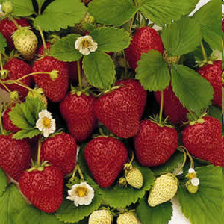
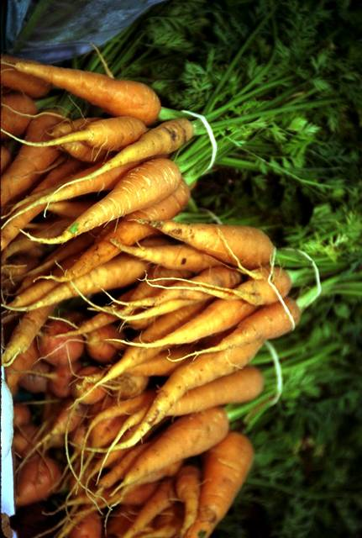
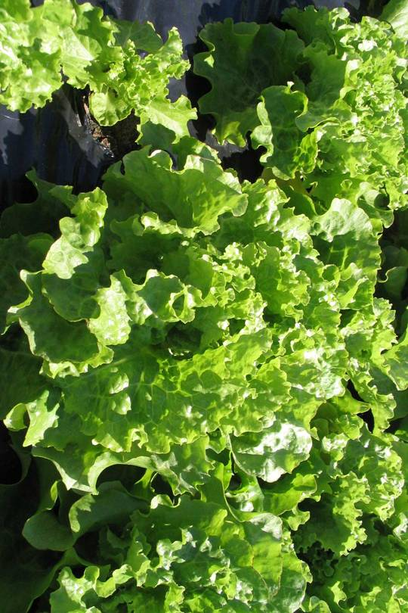
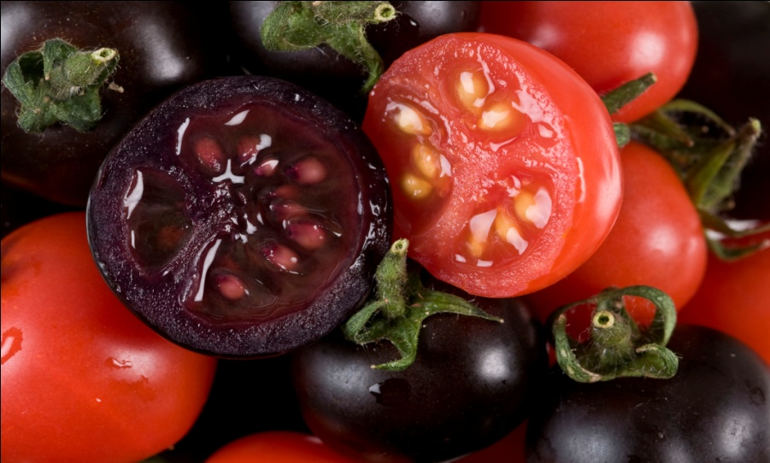
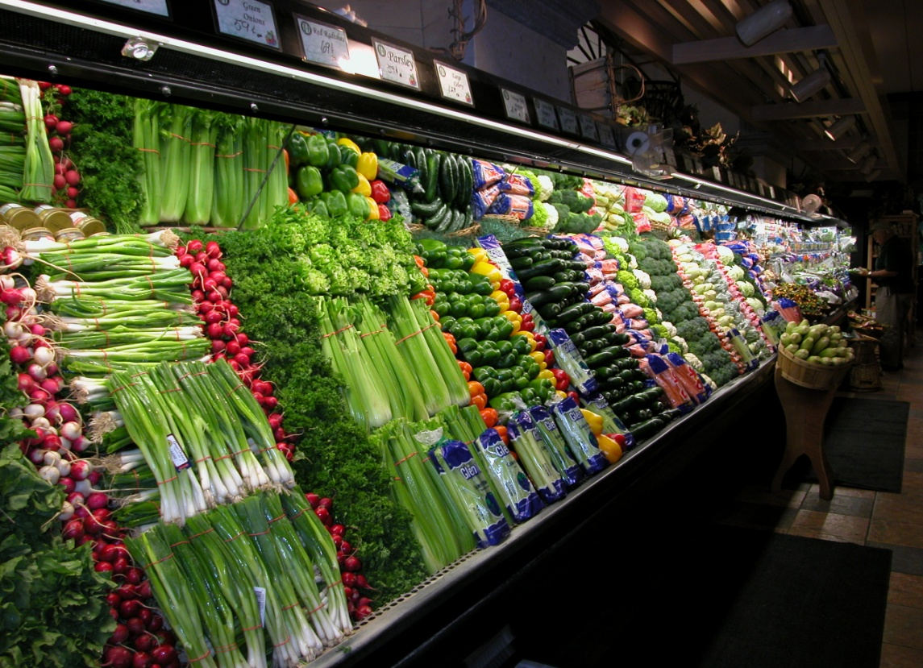
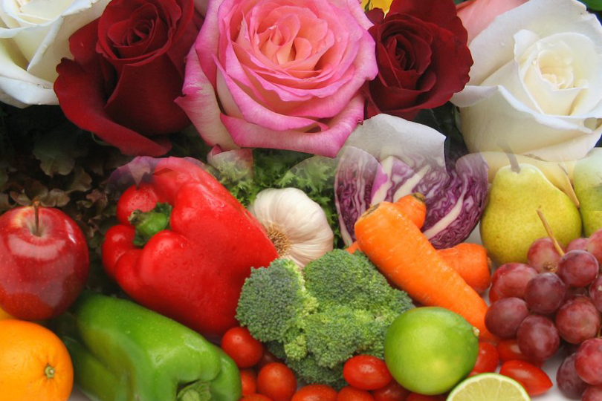

Genetically Engineered Foods
What Do I Need to Know?
Peggy G. Lemaux
University of California, Berkeley
http://ucbiotech.org
http://pmb.berkeley.edu/profile/plemaux#a1

Slide 2
What will be covered?
1. Background on genes, genetics, genetic engineering
2. What GE crops are commercialized? In the
pipeline?
3. What is the regulatory situation for GE crops and foods?
4. What are some of the food safety issues with GE foods?

Slide 3
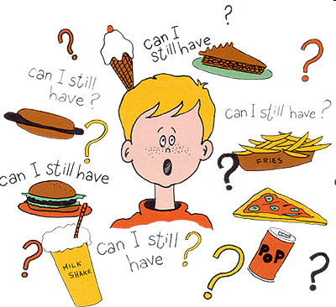
As dietitians, you play an important role informing consumers about foods, diet and nutrition
In 2009, 33% of consumers said medical sources, like dietitians, physicians, and nutritionists are the most believable information resource on genetics as it relates to diet and nutrition.
So, let’s take a look at the genetics of foods
Intl Food Information Council,
2009 Functional Foods/Foods For Health Consumer Trending Survey

Slide 4
All living things contain DNA – including the foods we eat
First we’ll start with some basics of genetics…

Slide 5
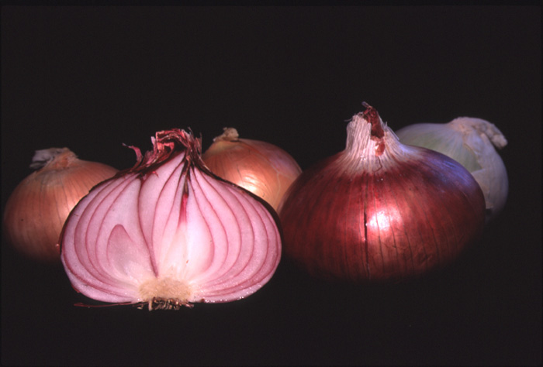
Tour d'Onion
Or what makes an onion, an onion?

Slide 6
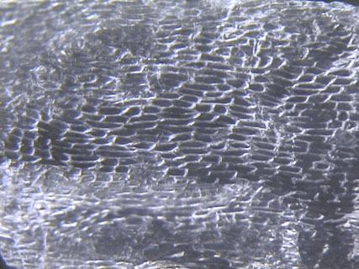
Cells

Slide 7
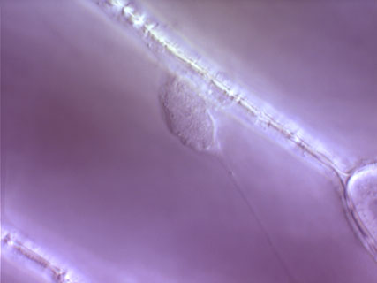
Cell Wall
Nucleus

Slide 8
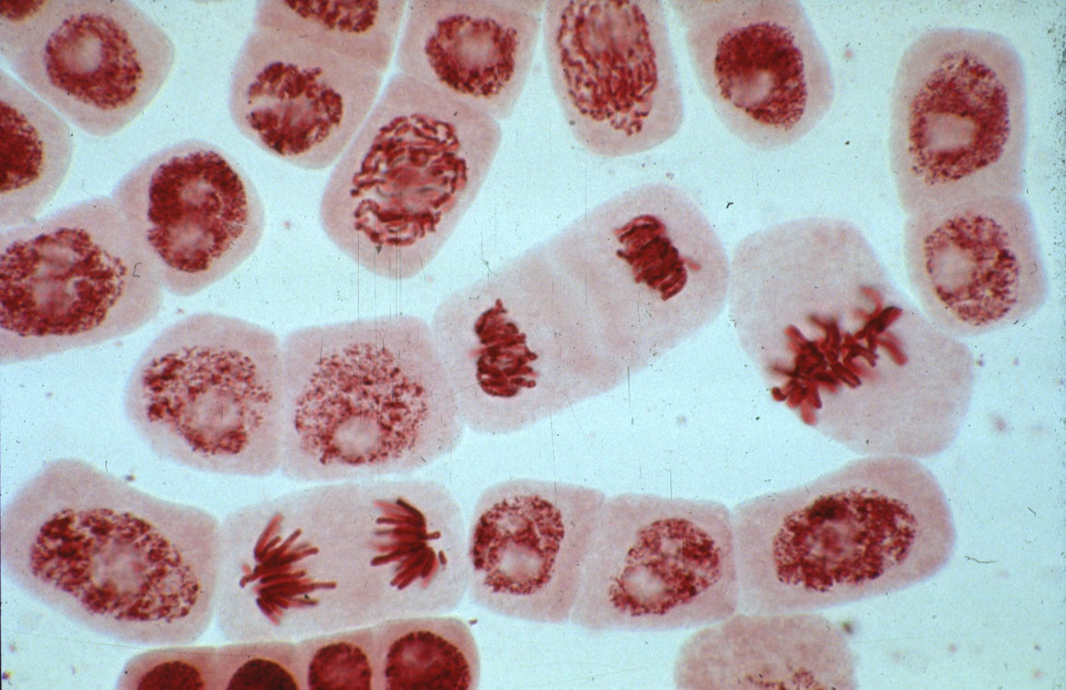
Dividing cell
Chromosomes
Stretched out, the DNA in each cell would be ~ 5 feet long

Slide 9
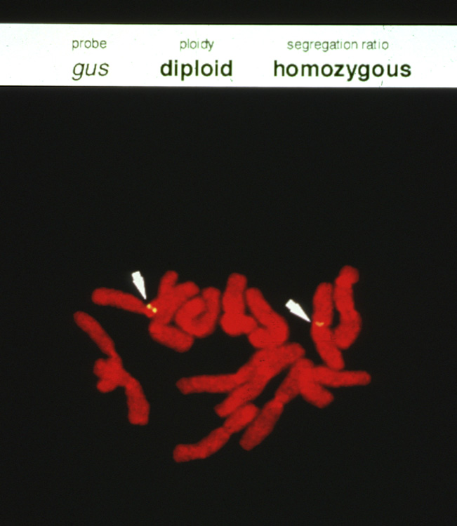
Chromosome
Genes

Slide 10
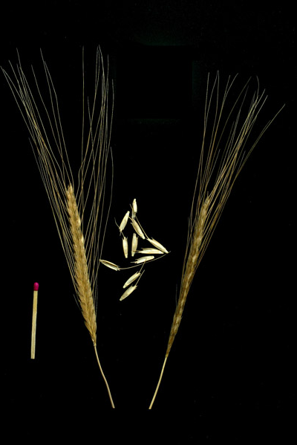
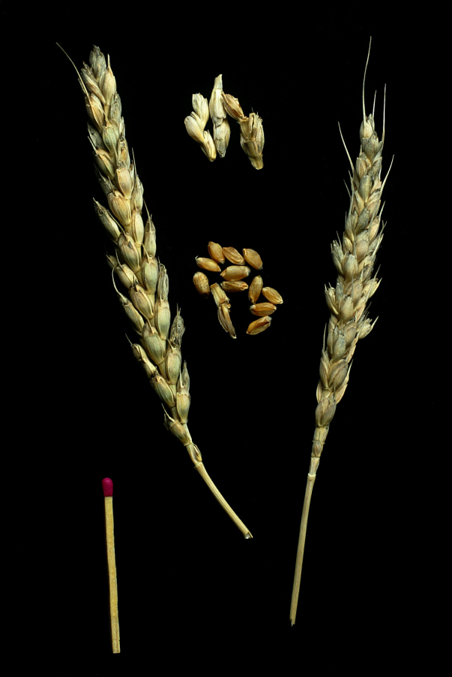
How can you use genetics to create a new wheat – with better nutritional qualities –
using an ancient variety?
What happens to the genetic information from the two parents?
Triticum monococcum Ancient variety
Triticum aestivum
Modern bread variety

Slide 11
Information in the wheat genome
Chemical units represented by alphabetic letters
...CTGACCTAATGCCGTA...
1700 books
1000 pages each
1700 books
(or 1.7 million pages)

Slide 12
Hybridization or cross breeding of wheat
x
Random retention of information from each parent
1700 books
(or 1.7 million pages)
1700 books
(or 1.7 million pages)
1700 books
(or 1.7 million pages)

Slide 13
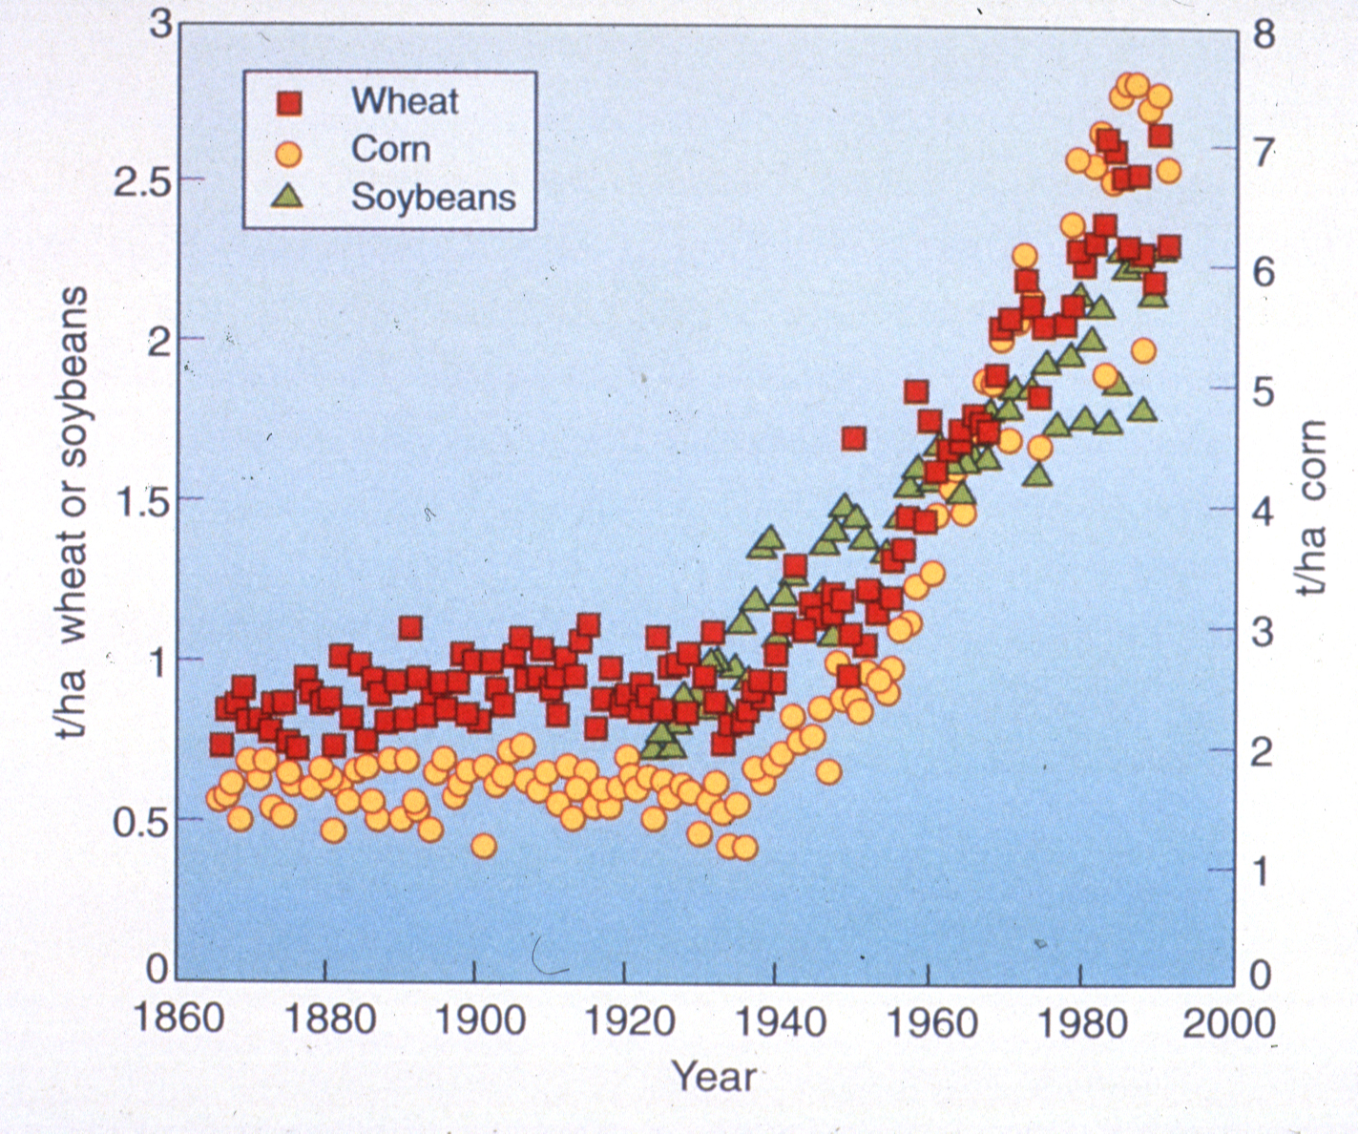
Yield Increase by year in U.S.

Slide 14
Table of contents for genes in wheat
...CTGACCTAATGCCGTA...
Used for Marker-Assisted Selection
Genomics
1700 books
(or 1.7 million pages)

Slide 15
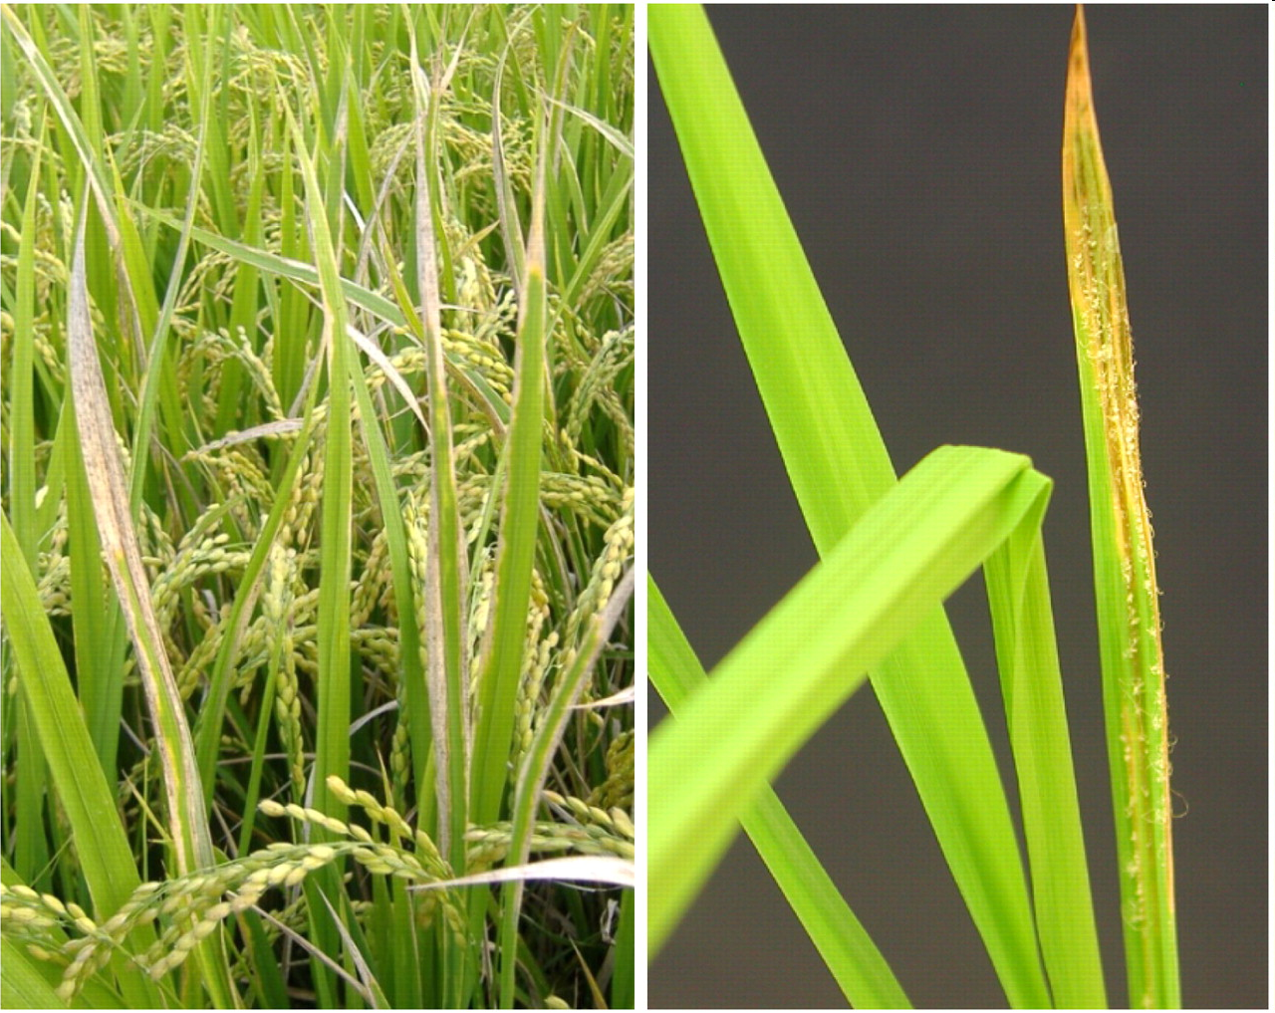
Marker-assisted selection used to protect rice against bacterial blight and blast disease
Protection limited to diversity in crop and compatible relatives

Slide 16
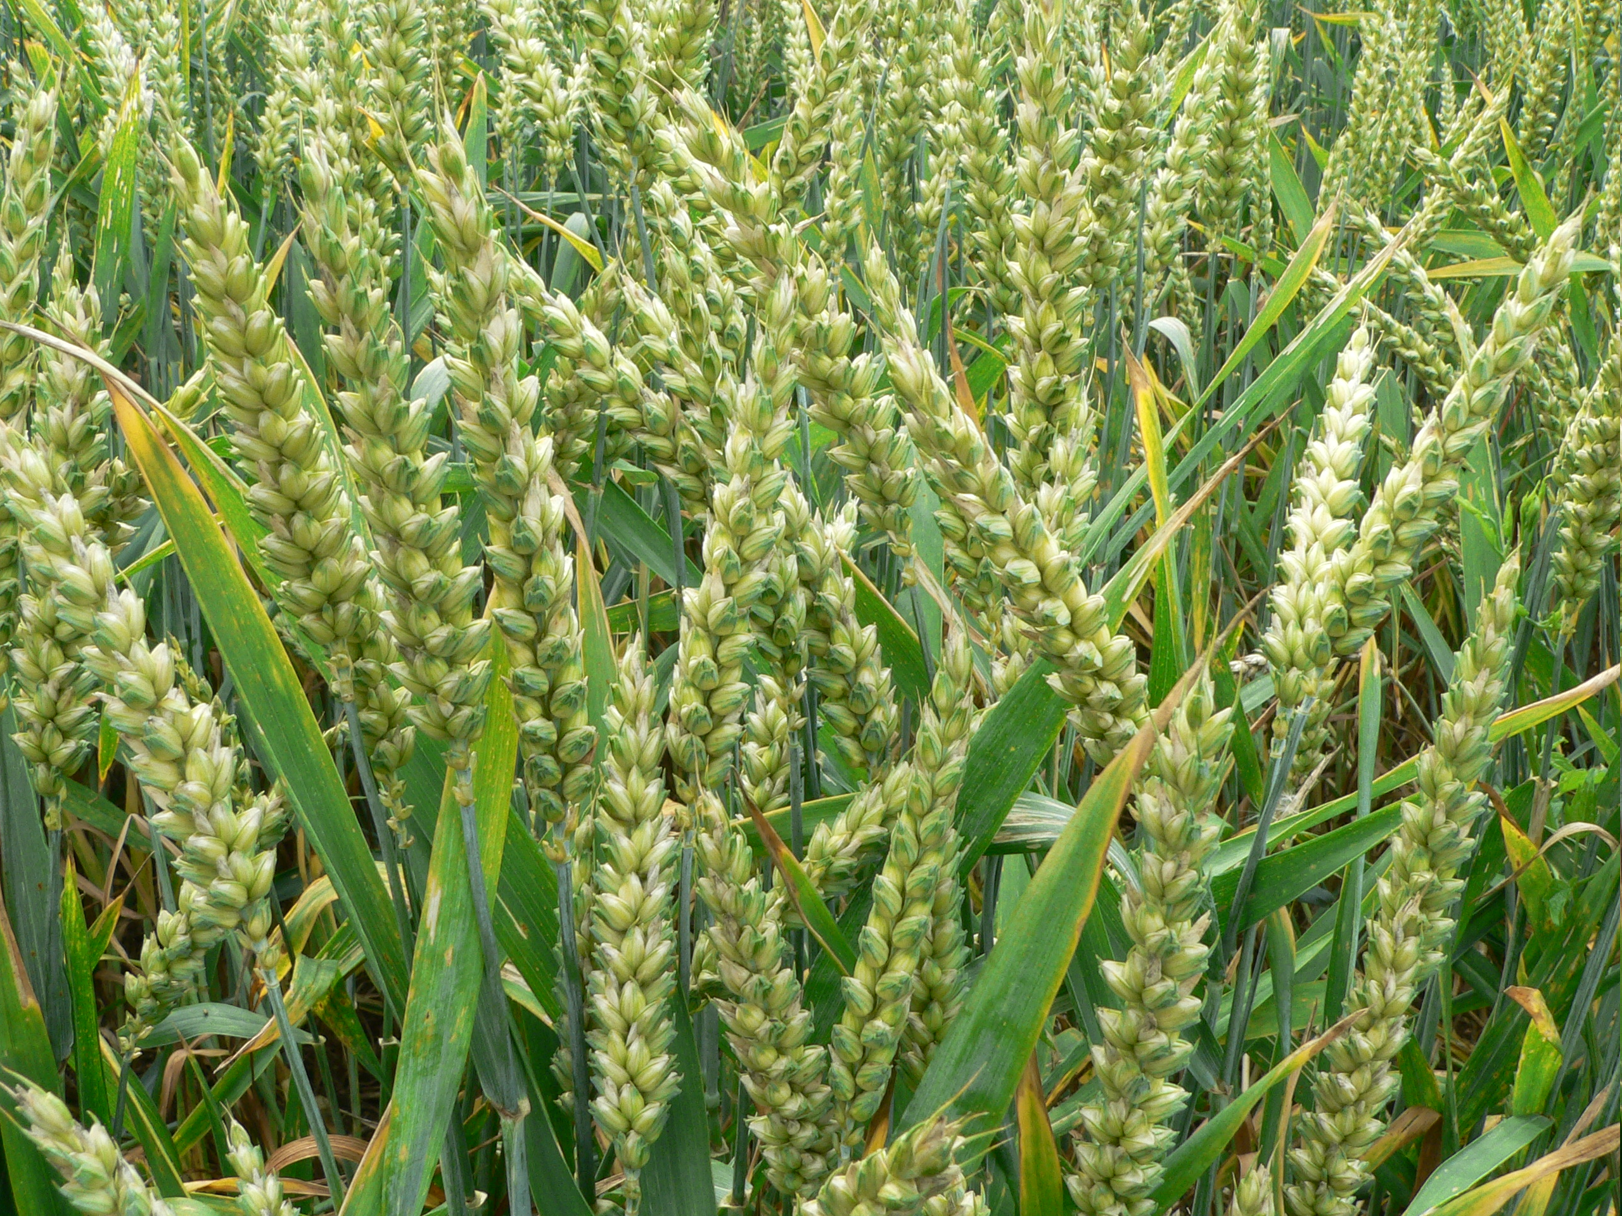
But there are other ways to create new varieties using the modern tools of genetics

Slide 17
Genetic Engineering Methods
Inserts randomly in genome
+
Inserted gene(s)
One-half page equivalent to a gene
1700 books
(or 1.7 million pages)
1700 books
(or 1.7 million pages)

Slide 18
Classical Genetic
Breeding compared to Engineering
Uses plant machinery in plant
Uses plant machinery in plant
Uses plant machinery in laboratory
Uses plant machinery in laboratory
Gene exchange is random involving whole genome
Gene exchange is specific involving single or few genes
When/where gene expressed not controlled by breeder
When/where gene expressed controlled precisely
Source of gene primarily within genera – not between kingdoms like plants & bacteria
Source of gene from any organism

Slide 19
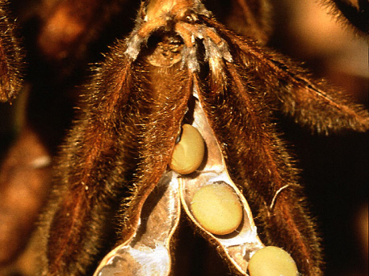
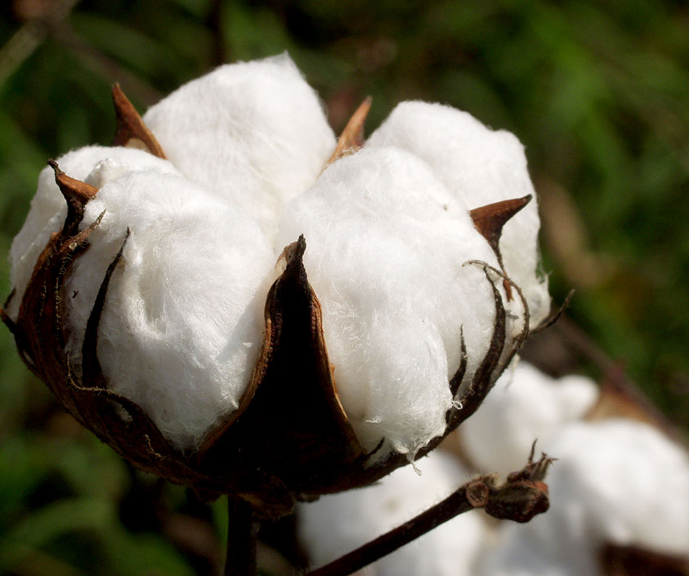
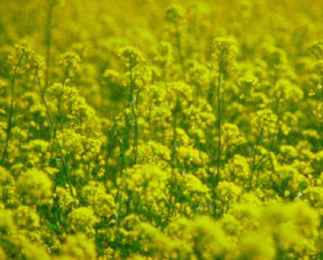
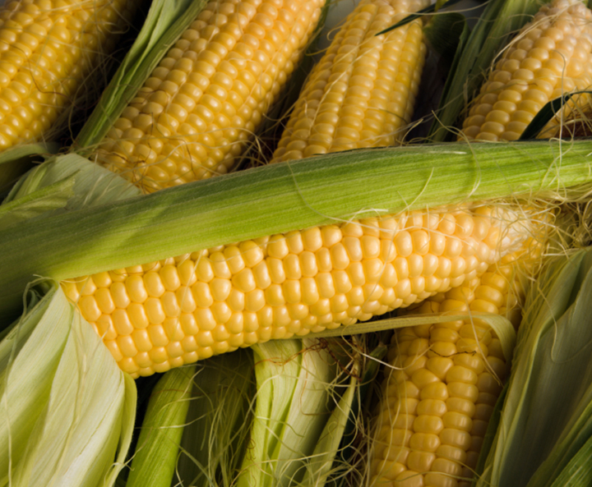
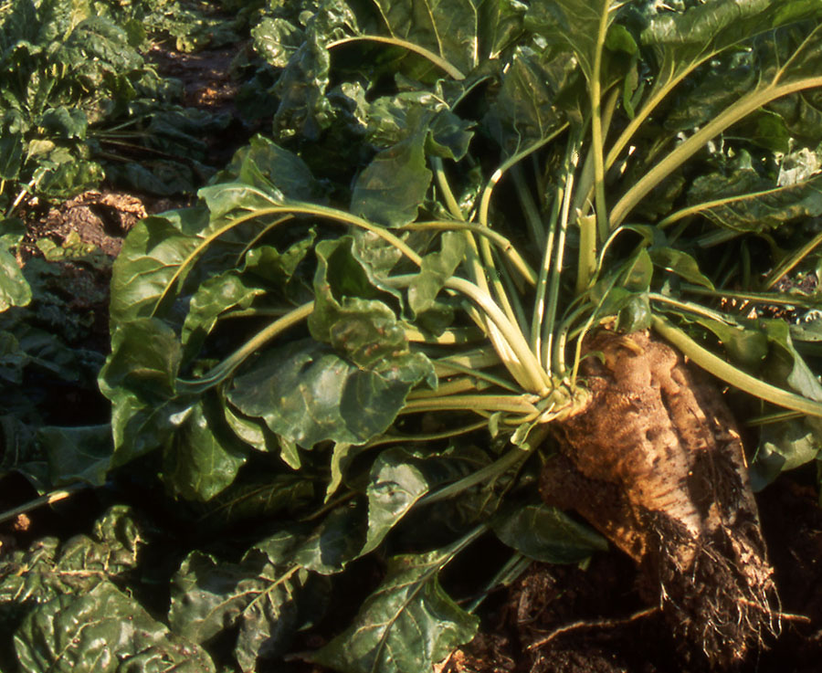
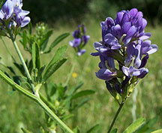
GE Soybean
93% of 2012 acreage
(Herbicide resistant: 93%)
Number of different commercially available GE crops is limited
Source: USDA-ERS, 2012
GE Cotton
94% of 2012 acreage
(Insect Resistant: 14% Herbicide tolerant: 17% Stacked gene: 63%
GE Canola
88% of 2010 acreage
Source: USDA-ERS, 2012
Source: ISAAA, 2011
GE Corn
88% of 2012 acreage
(Insect Resistant: 15% Herbicide resistant: 21% Stacked gene: 52%)
1% of corn with Bt (ECB) + Bt (rootworm) + herbicide
GE Sugarbeet
96% of 2010 acreage
GE Alfalfa
20% of 2012 acreage
Source: USDA-ERS, 2012
Source: ISAAA, 2011
Source: Dan Putnam, UC ANR, 2013
Notes:
March 18, 2013

Slide 20
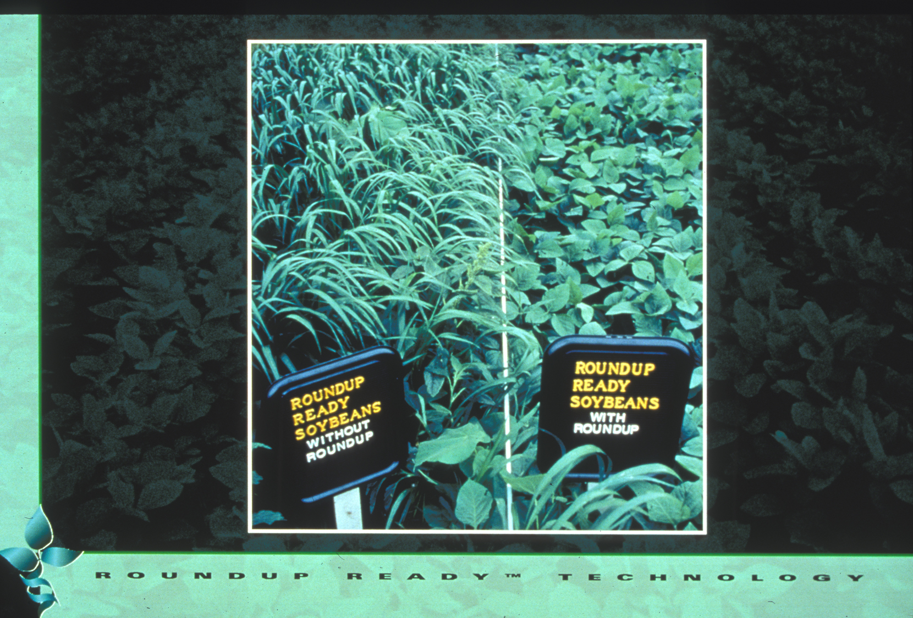
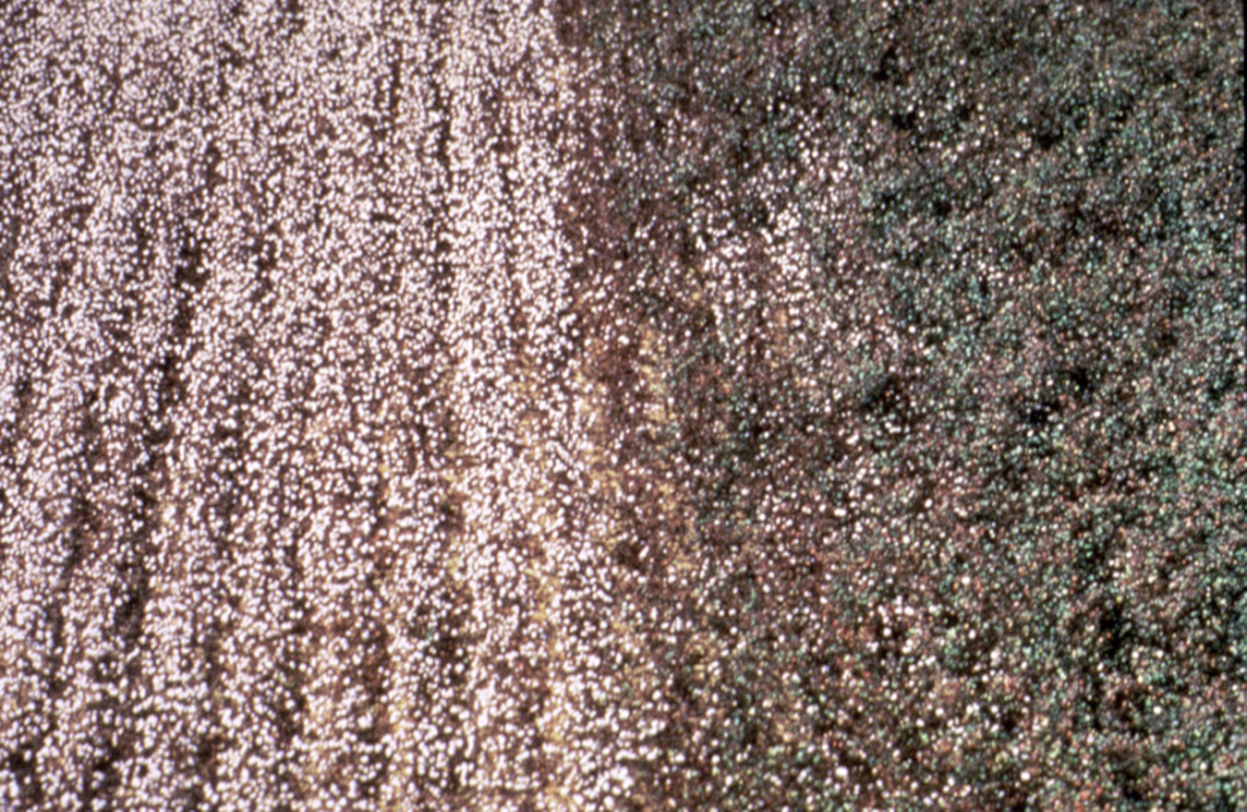
Roundup Ready Soybean™
Number of different traits available in GE crops is limited
Herbicide-tolerant – tolerate herbicide application
Bt Crops – insect resistance using gene from naturally occurring bacterium

Slide 21
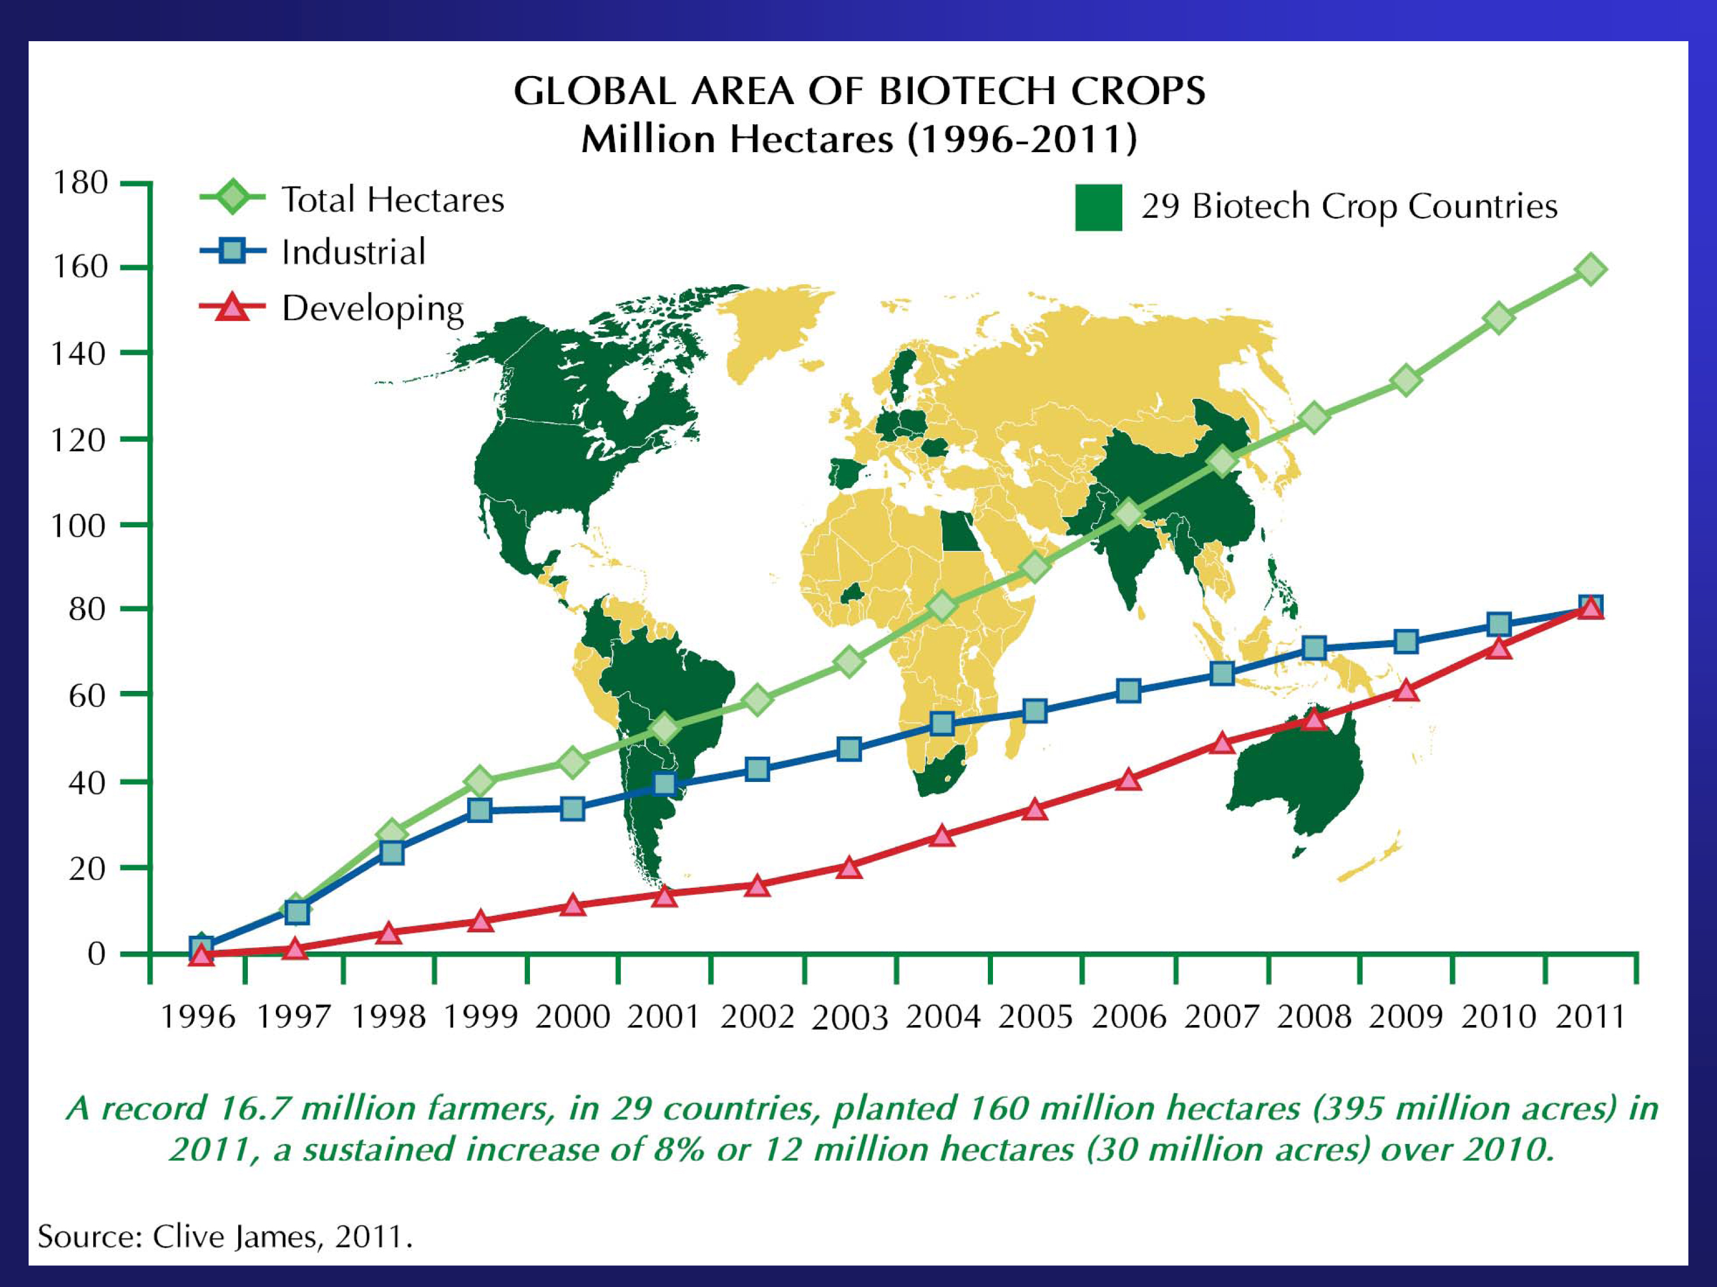
Despite limited crop and trait types, worldwide acreage is increasing
Total worldwide area cultivated = Areas of
Texas + California + Colorado + Louisiana

Slide 22
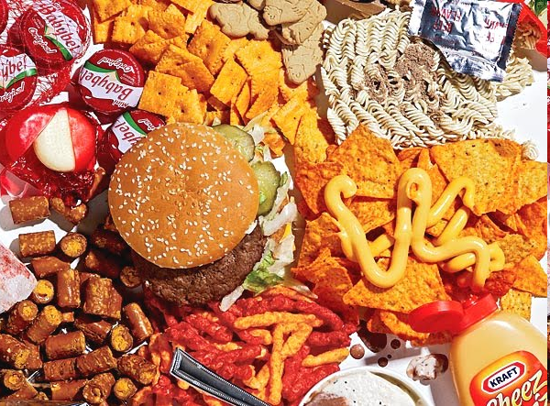
Types of GE Crops Leads To Estimates that 75% of Processed Foods in U.S. Have GE Ingredients

Slide 23
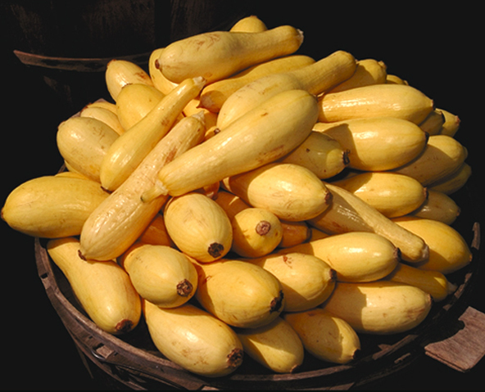
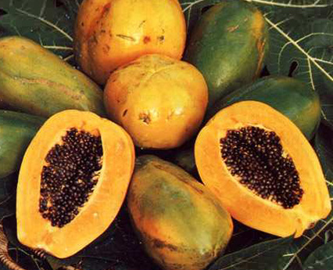
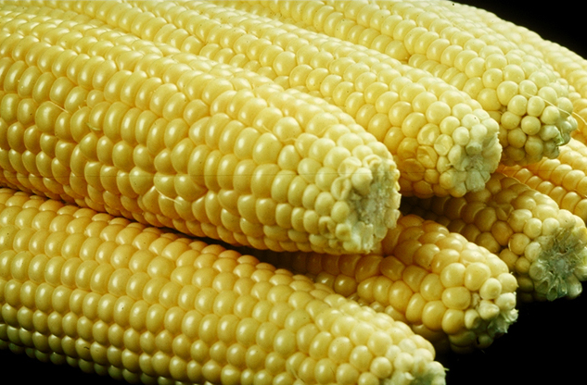
Only a few whole foods on the market are genetically engineered
GE Squash
10% of 2004 acreage
GE Papaya
≥77% of 2009 acreage
from Hawaii
Source: ISAAA, 2004
GE Sweet Corn
Source: USDA, Hilo, HI, 9/2011

Slide 24
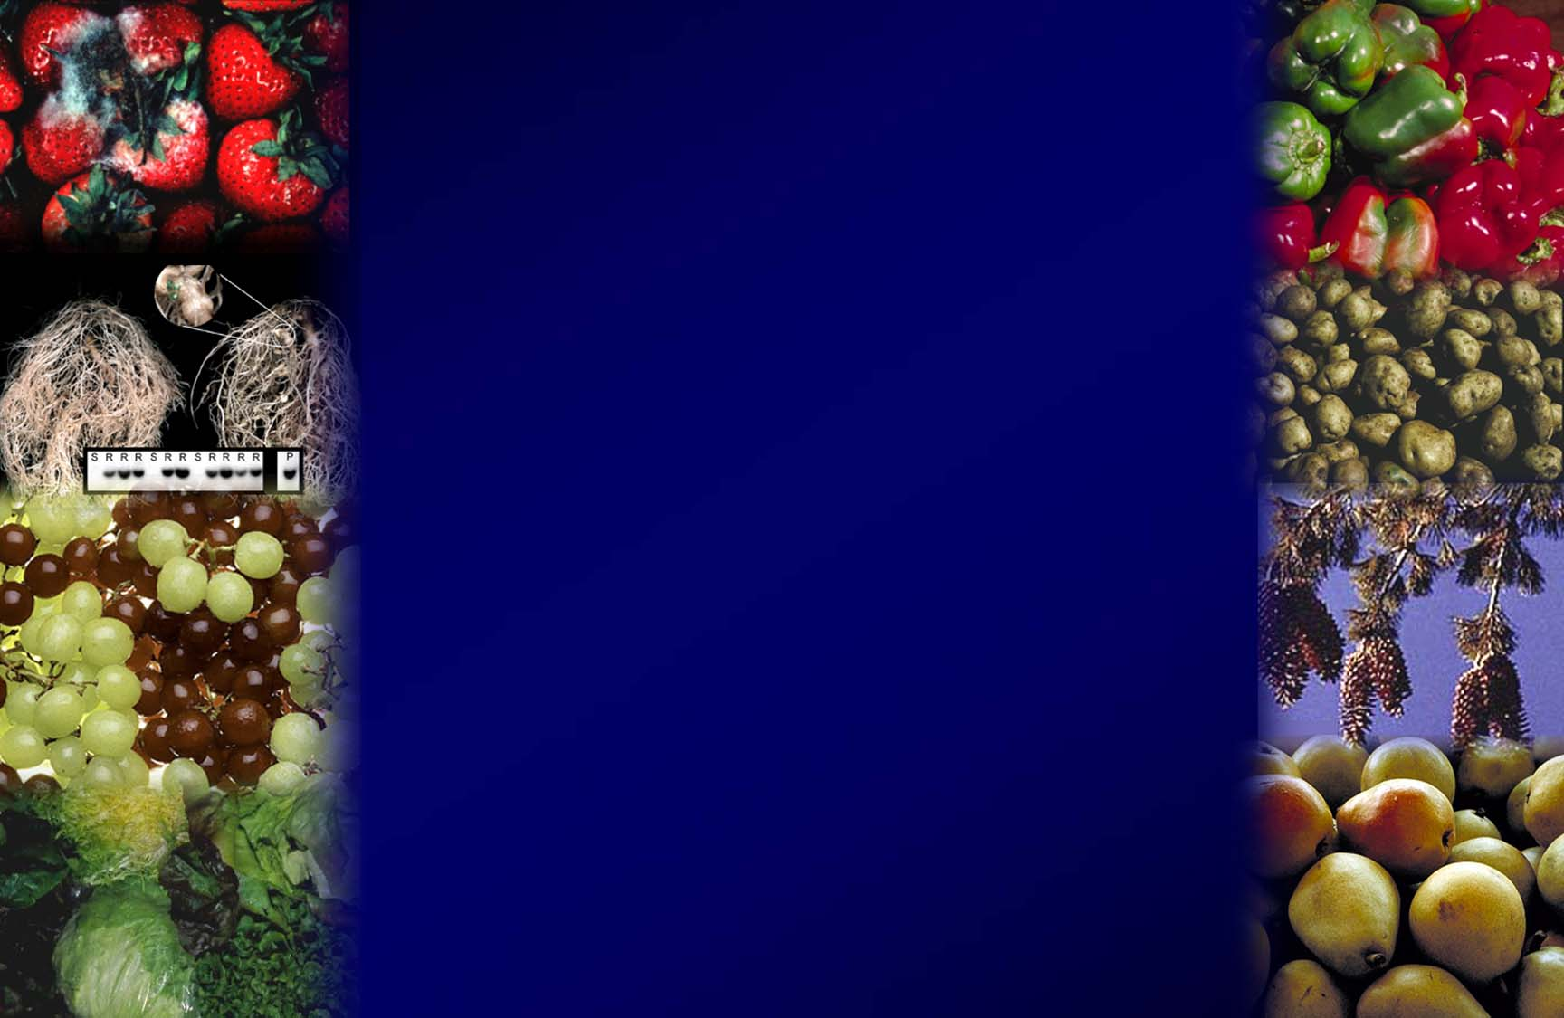
WHAT’S IN THE
PIPELINE?

Slide 25
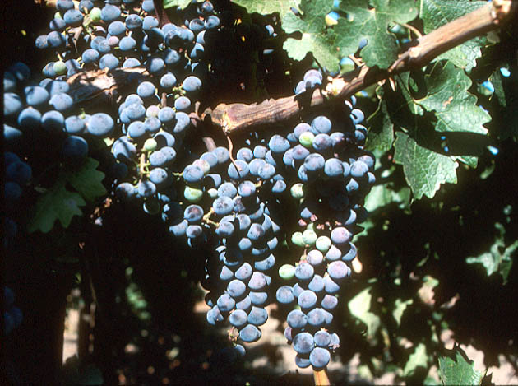
Field Trials in California with Grape Root Stocks Engineered to Resist Fanleaf Virus
SOURCE: http://www.democratandchronicle.com/apps/pbcs.dll/article?AID=/20080806/BUSINESS/808060336/1001

Slide 26
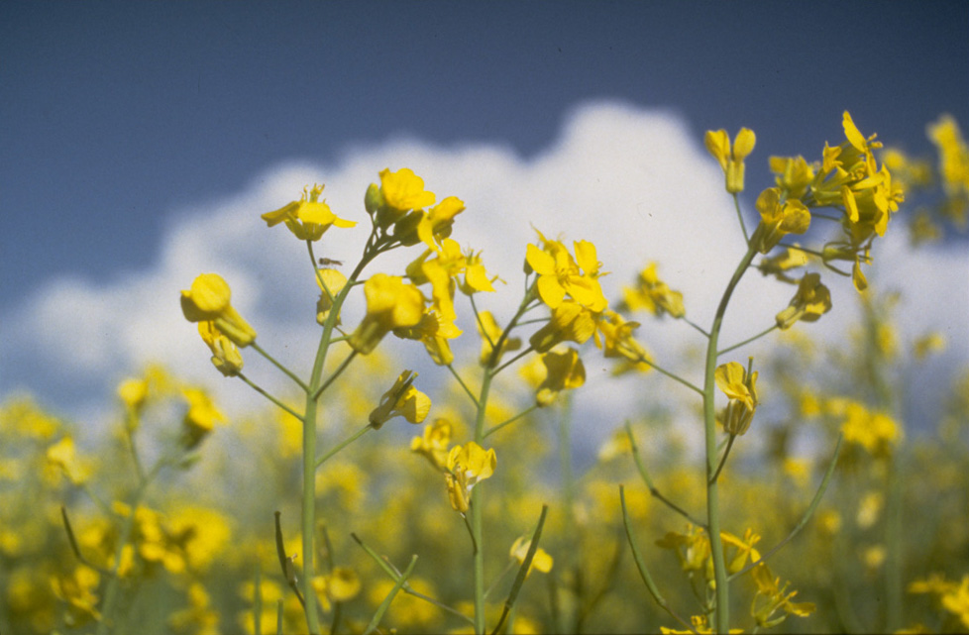
Davis company develops canola that uses 50% less nitrogen fertilizer
SOURCE: http://archives.foodsafety.ksu.edu/agnet/2007/4-2007/agnet_april_10.htm#story0

Slide 27
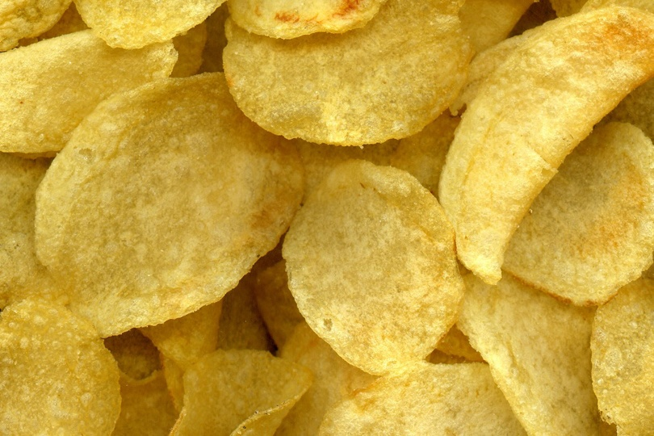
Engineering potato to reduce levels of acrylamide, a potential carcinogen and known neurotoxin
SOURCE: Wu, L., Bhaskar, P.B., Busse, J.S., Zhang, R., Bethke, P.C. and and Jiang, J. 2011. Developing Cold-Chipping Potato Varieties by Silencing the Vacuolar Invertase Gene. Crop Science 51: 981-990.
Notes:
27
June 17, 2011

Slide 28
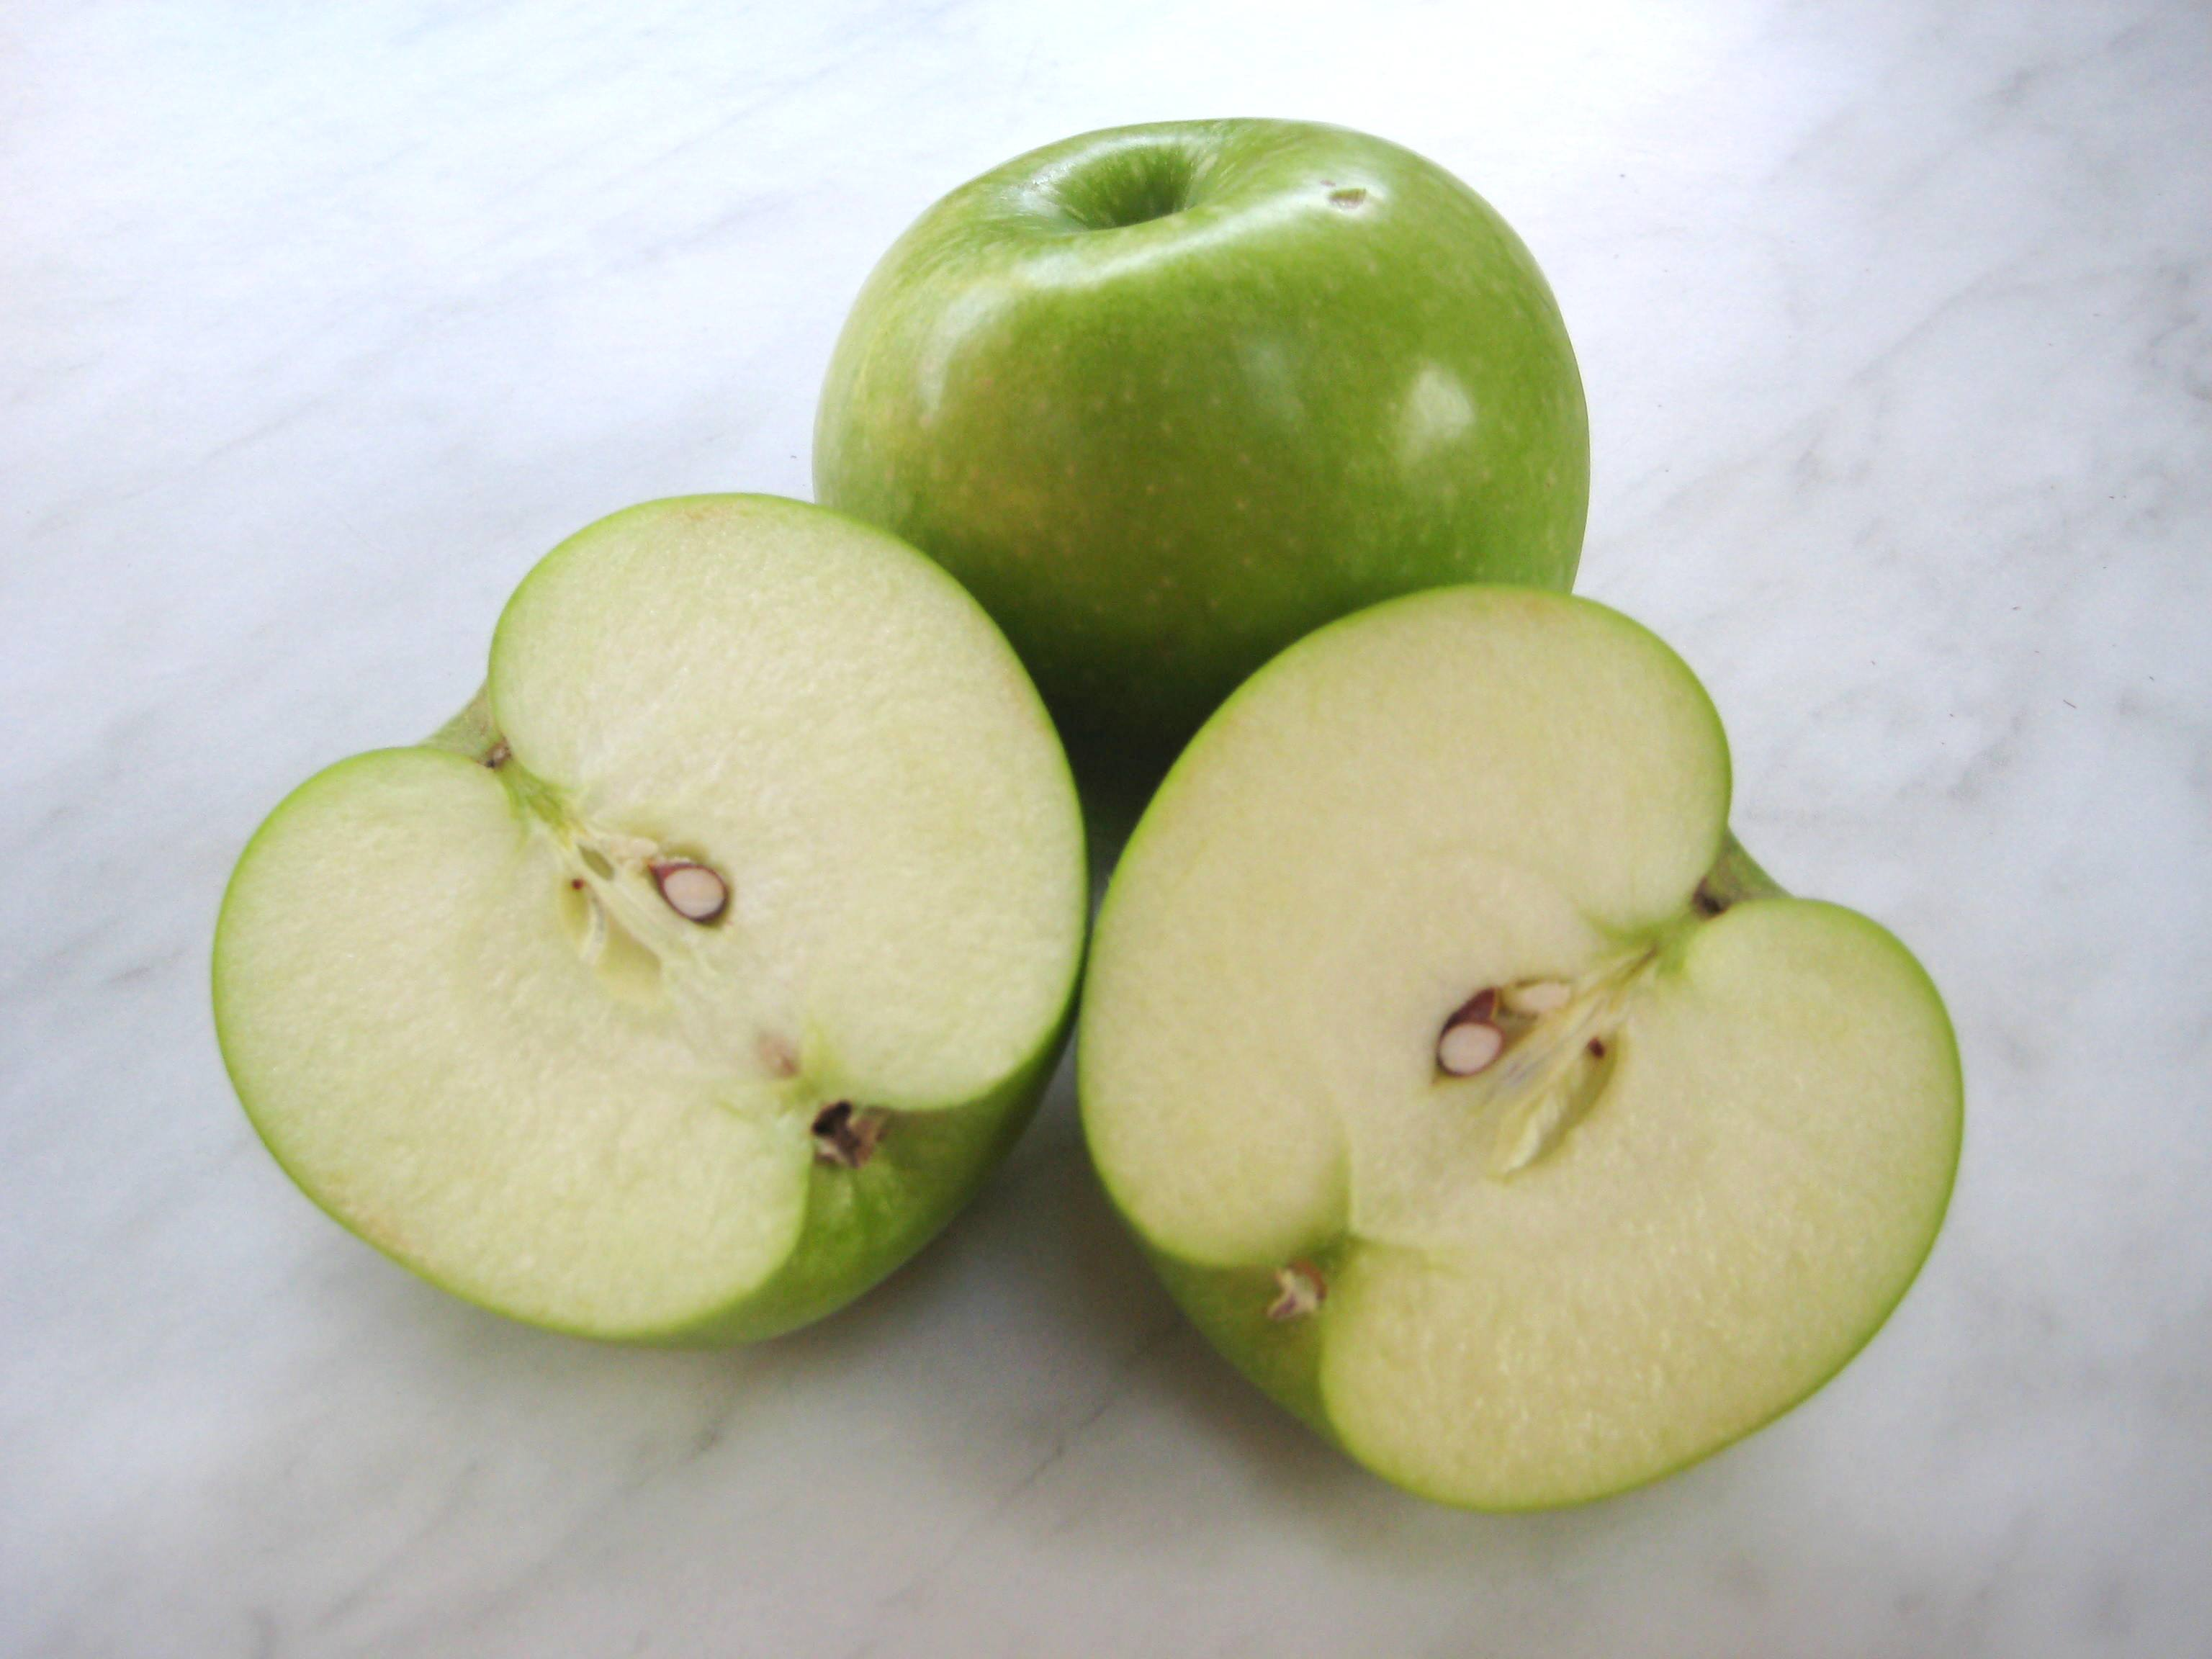
Non-browning GE apple, marketed in U.S. by Okanagan Specialty Fruits, will be labeled as genetically engineered
SOURCE:” Stop Genetically Engineered Apples!”, Organic Consumers Association, 3/24/11.
http://www.organicconsumers.org/bytes/ob269.htm#SEC3
Notes:
28
April 22, 2011

Slide 29
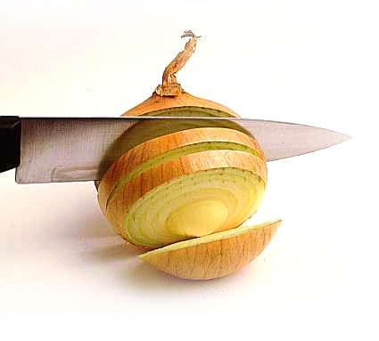
Tear-free onion developed by turning off tear-inducing enzyme
SOURCE: “Scientists create 'no tears' onions”, Herald and Weekly Times, 2/1/08
http://www.checkbiotech.org/green_News_Genetics.aspx?Name=genetics&infoId=16834

Slide 30
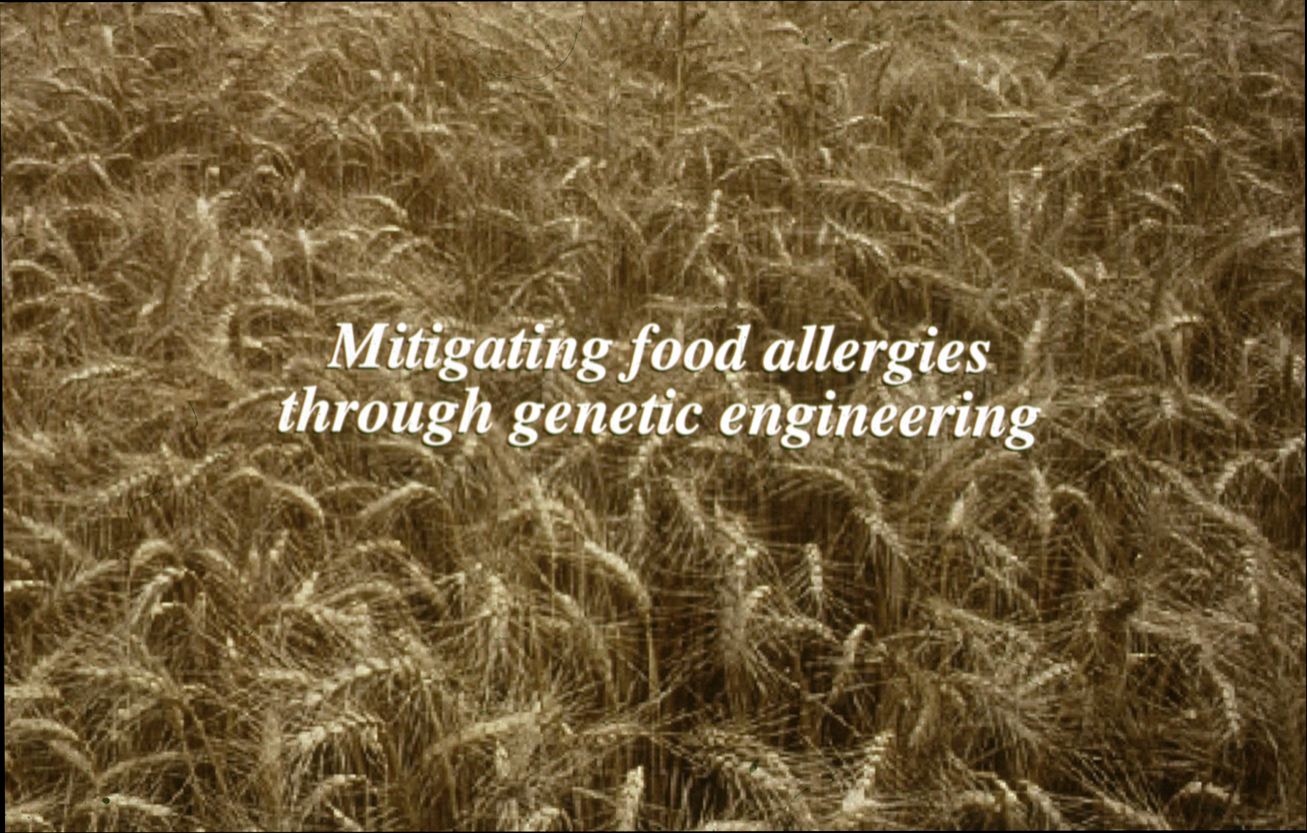
Mitigating food allergies, like peanut, soy and wheat

Slide 31
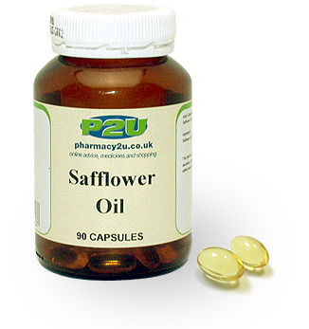
Safflower Oil Enhanced with
Omega-3 and Omega-6 Fatty Acids
SOURCE: Arcadia Biosciences

Slide 32
What is the U.S. regulatory process governing engineered plants and foods?

Slide 33
U.S. Regulatory Agencies
USDA
FDA
EPA
Field testing
Permits
Notifications
Determination of
non-regulated status
Food safety
Feed safety
Pesticidal plants
tolerance exemption
registrations
Herbicide registration
Plant pest?
Danger to people?
Risk to environment?

Slide 34
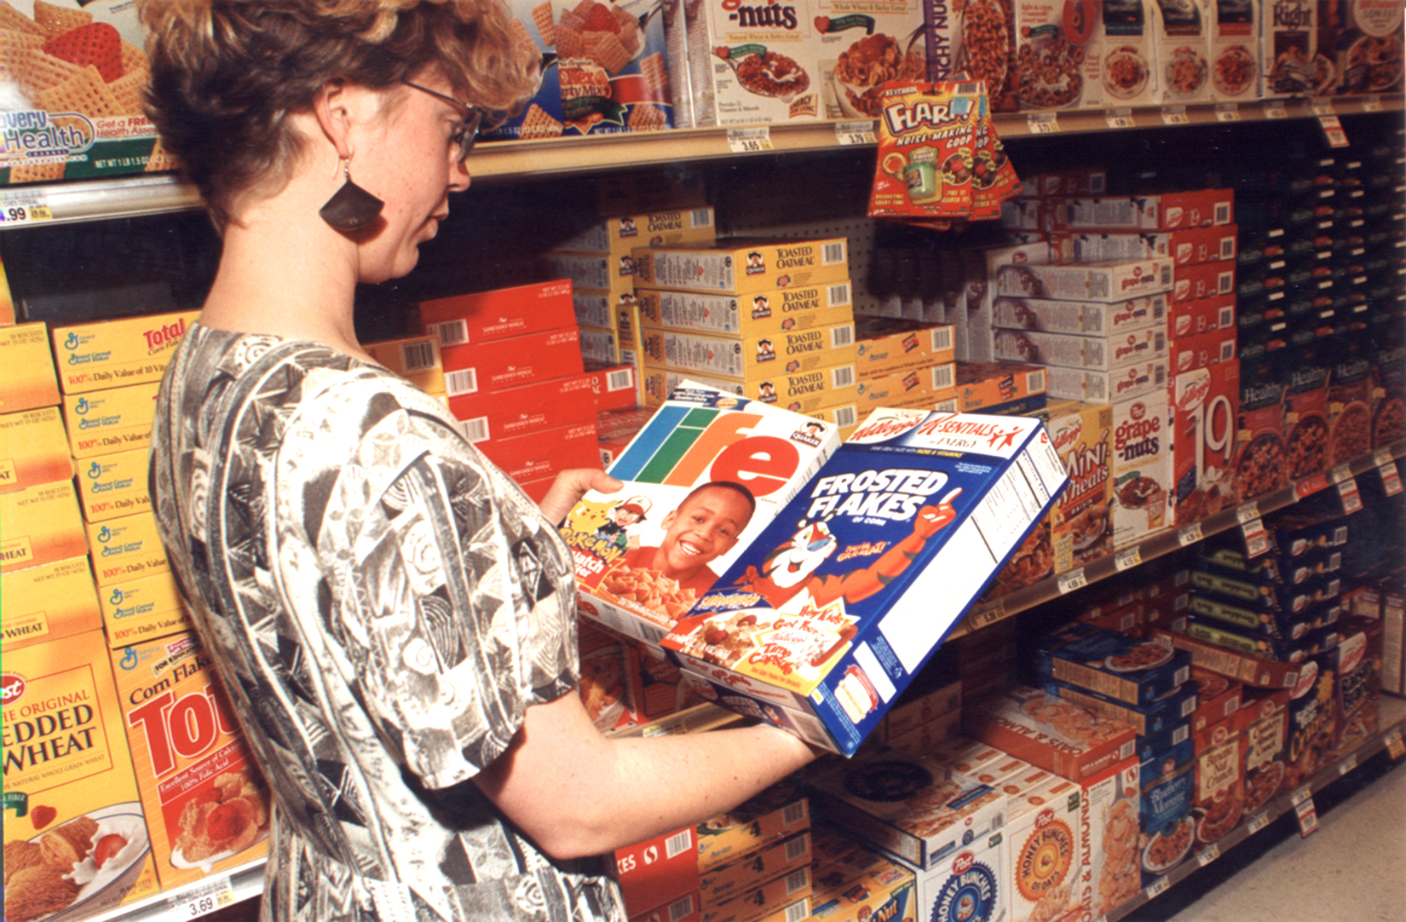
How Do Consumers Feel about GE Food?

Slide 35
Over last few months what food or ingredients did you avoid or eat less of?
2001 2003 2006 2010
Sugars 31% 65% 50% 51%
Fats/cholesterol 41% 39% 33% 32%
Animal products 28% 35% 28% 18%
Other 9% 9% 11% 14%
Snacks/Fast food N/A 9% 16% 16%
Salt/spices 11% 8% 12% 20%
Caffeine 4% 4% N/A N/A
Soda 4% 3% N/A N/A
Genetically engineered 0% 0% 0% 0%
Jan. April July Apr.
SOURCE: IFIC, April 2010.
http://www.foodinsight.org/Resources/Detail.aspx?topic=2010_Consumer_Perceptions_of_Food_Technology_Survey
Notes:
6/8/10

Slide 36
What, if anything are you concerned about when it comes to food safety?
Jan. Apr. July Apr.
2001 2003 2006 2010
Packaging 27% 15% 15% 5%
Food Handling/Preparation 23% 41% 35% 33%
Other 19% 9% 4% 4%
Disease/Contamination 16% 28% 36% 38%
Chemicals/Pesticides in Food 10% 7% 16% 10%
Altered/Engineered Food 2% 1% 3% 2%
--
Nothing 9% 5% -- --
SOURCE: IFIC, April 2010.
http://www.foodinsight.org/Resources/Detail.aspx?topic=2010_Consumer_Perceptions_of_Food_Technology_Survey
Notes:
6/8/10

Slide 37
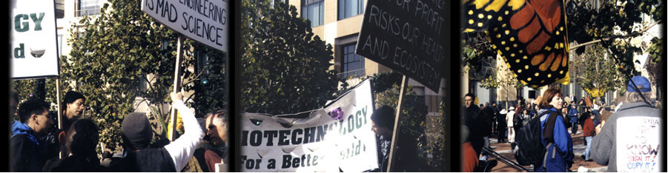
What Are Some Food Safety Issues?

Slide 38
What are some of the food safety issues?
Changes in nutritional content
No peer-reviewed food safety tests
Creation of allergens or activation of toxins
Labeling
Pharma crops contaminating food supply
Gene flow from food to intestinal bacteria increasing antibiotic resistance

Slide 39
What are some of the food safety issues?
Changes in nutritional content
No peer-reviewed food safety tests
Creation of allergens or activation of toxins
Labeling
Pharma crops contaminating food supply
Gene flow from food to intestinal bacteria increasing antibiotic resistance

Slide 40
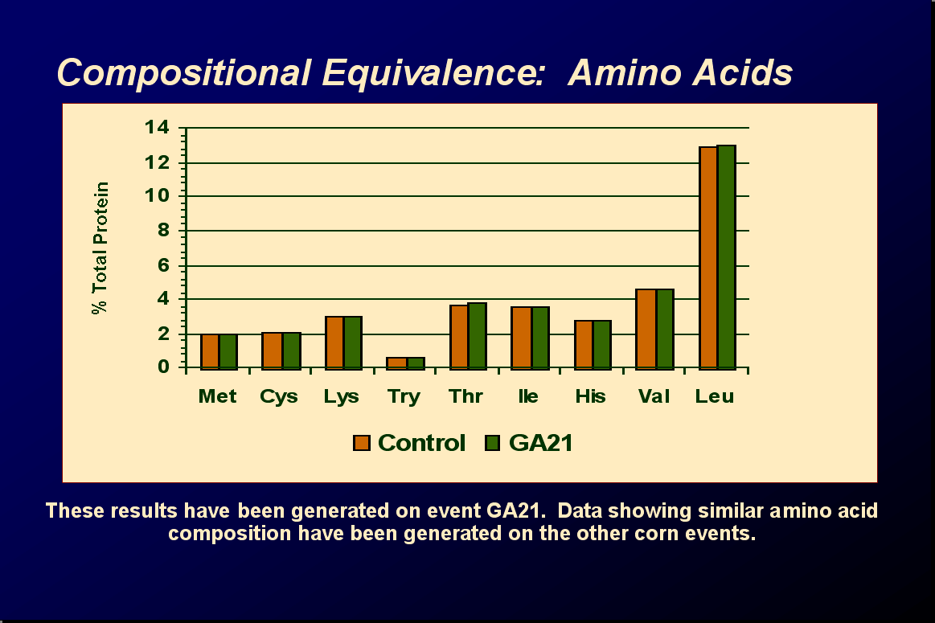
Substantial

Slide 41

Can engineer crops with purposeful
nutritional alterations
Engineering tomato to increase health-promoting compounds
SOURCE: Butelli, E., Titta, L., Giorgio, M., Mock, H., Matros, A., Peterek, S., Schijlen, E.G.W.M., Hall, R.D., Bovy, A.G., Luo, J. and Martin, C. 2008. Enrichment of tomato fruit with health-promoting anthocyanins by expression of select transcription factors. Nature Biotechnology, online first (doi:10.1038/nbt.1506)

Slide 42
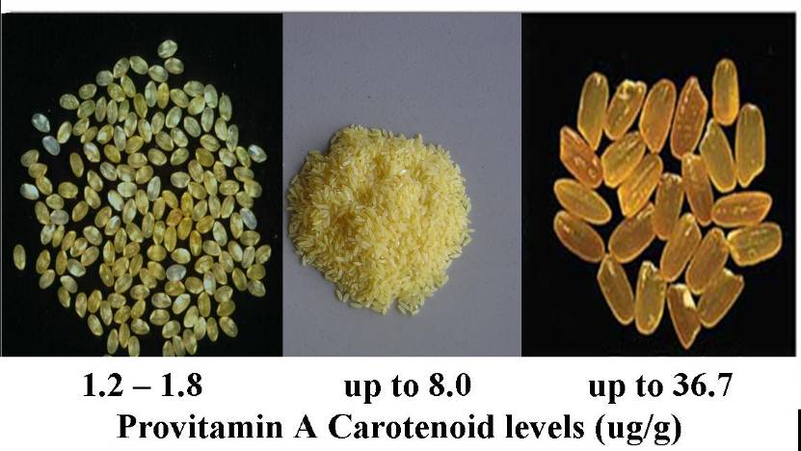
Golden Rice engineered to contain bioavailable pro-Vitamin A
Original GR (2000)
“Proof of Concept”
Golden Rice 1 (2004)
GR1
Golden Rice 2 (2005)
GR2
Normal portion of Golden Rice 2 provides
half of a child’s Vitamin A needs

Slide 43
What are some food safety issues?
Changes in nutritional content
Lack of peer-reviewed food safety tests
Creation of allergens or activation of toxins
Labeling
Pharma crops contaminating food supply
Gene flow from food to intestinal bacteria increasing antibiotic resistance

Slide 44
Need to test products of individual genes introduced
“It is difficult, if not impossible, to test food safety of whole foods and feeds with animal tests. Toxicity testing of individual components is much more sensitive than whole foods testing.”
“Nutritional and Safety Testing of Foods and Feeds Nutritionally Improved through Biotechnology” 2004. Comprehensive Reviews in Food Science and Food Safety, ILSI

Slide 45
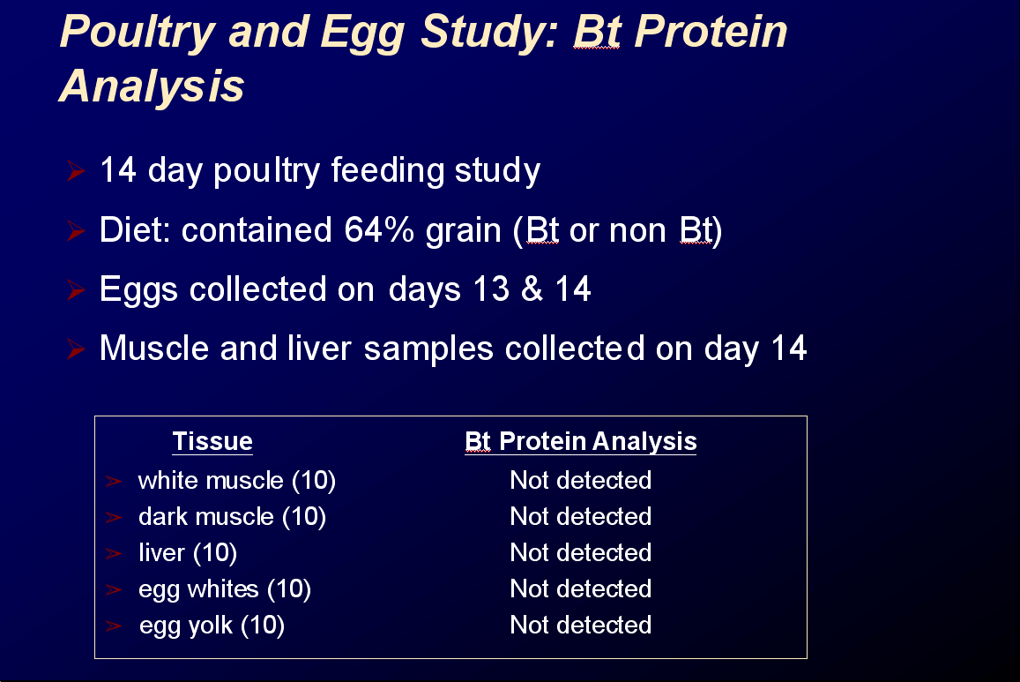
Example of type of animal safety tests conducted

Slide 46
What about the safety of the remaining edible portion of the food, aside from the product of the introduced gene?
Is it as safe as the conventional food?
This is the concept of
substantial equivalence
Modified food has essentially all characteristics of nonmodified food with respect to food and feed value
SOURCE: Safety of Genetically Engineered Foods: Aproaches to Assessing Unintended Health Effects 2004. Natl Acad Press

Slide 47
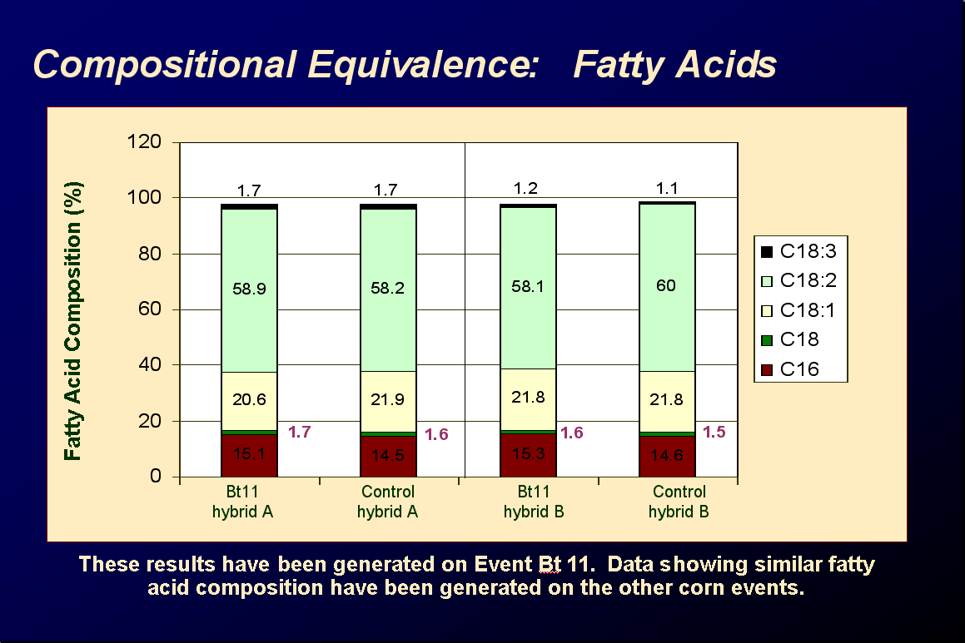
Substantial

Slide 48
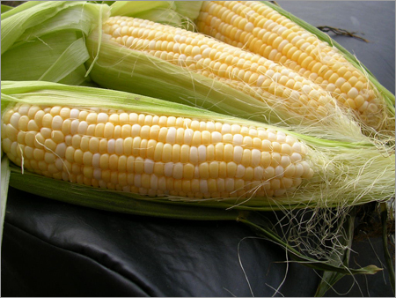
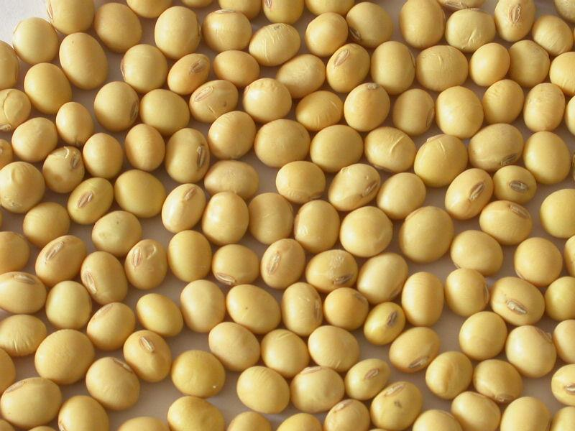
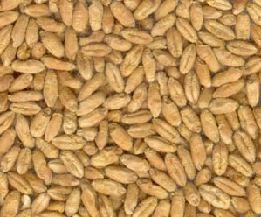
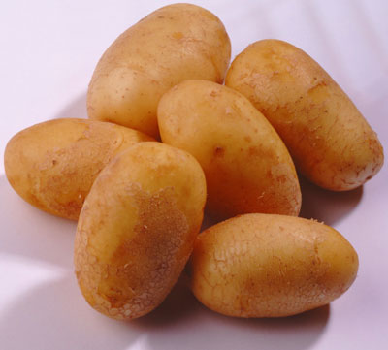
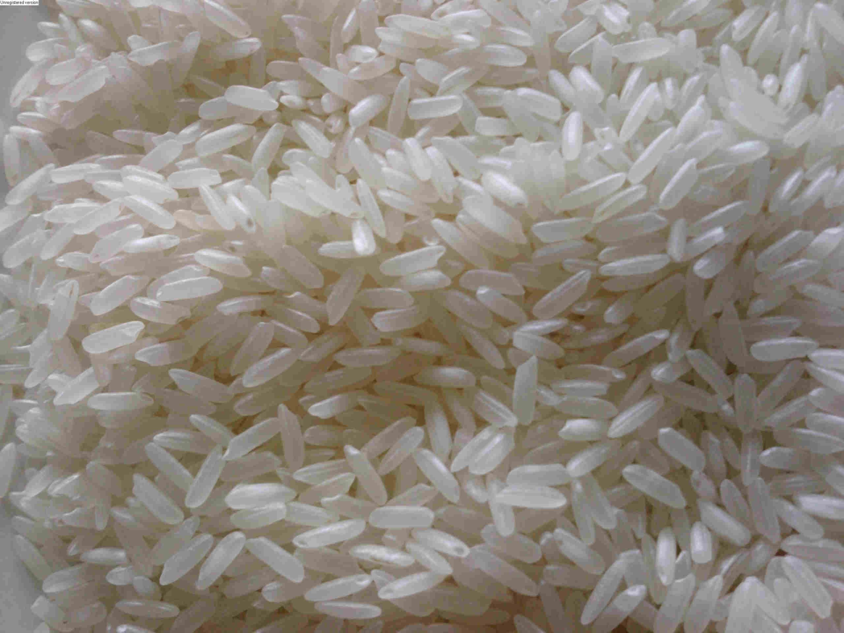
REVIEW STUDY FROM FRANCE
12 long-term (>90d to 2yr) and 12 multigenerational (2 to 5 generations) feeding trials in animals of GE feed
Conclusion: GE foods are nutritionally equivalent to non GE foods and can be safely consumed in food and feed
potato
rice
maize
soy
triticale
SOURCE: Snell C, Bernheim A, Berge J-P, Kuntz M, Pascal G, Paris A, Ricroch AE. 2012. Assessment of the health impact of GM plant diets in long-term and multigenerational animal feeding trials: A literature review. Food and Chemical Toxicology 50: 1134-1148.
Notes:
June 4, 2012

Slide 49
What are some food safety issues?
Changes in nutritional content
Lack of peer-reviewed food safety tests
Activation of toxins or creation of allergens
Labeling
Pharma crops contaminating food supply
Gene flow from food to intestinal bacteria increasing antibiotic resistance

Slide 50
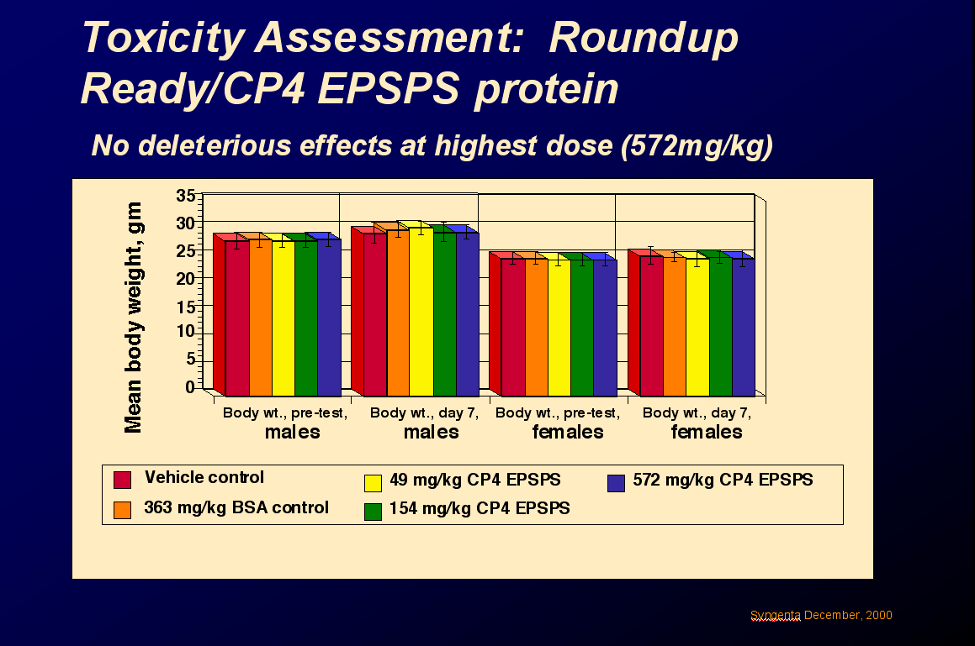

Slide 51

Inadvertent Creation of Allergens and Toxins
Is Possibility of Toxin Creation Limited to GE Foods?
No – naturally occurring toxins have happened with classical breeding, e.g., potato (glycoalkaloids) and celery (psoralens)

Slide 52

Use Engineering to Reduce Toxins: Fumonisin Reduction with Bt-maize
Fumonisin contamination caused by insect infestation led to outbreaks of lethal lung edema in pigs, brain tumors in horses
20- to 30-fold fumonisin reduction with Bt-maize
Modified from Drew L. Kershen
University of Oklahoma
SOURCE; Hammond, B. et al., (Feb. 2004), Lower fumonisin mycotoxin levels in the grain of Bt-corn grown in the United States in 2000-2002, J. Agric. Food Chem. 52: 1390-1397

Slide 53
What are some food safety issues?
Changes in nutritional content
Lack of peer-reviewed food safety tests
Creation of allergens or activation of toxins
Labeling
Pharma crops contaminating food supply
Gene flow from food to intestinal bacteria increasing antibiotic resistance

Slide 54
Why Doesn’t FDA Have a Labeling Policy for GM Foods?
Actually it does…
Foods produced through biotechnology are subject to same
labeling laws as all other foods and food ingredients
Govt-mandated label information relates to composition
or food attributes not agricultural or manufacturing practices
No label needed if food essentially equivalent in safety, composition and nutrition
GM food labeled if:
1. Different nutritional characteristics,
2. Genetic material from known allergenic source e.g., peanut, egg
3. Elevated levels of antinutritional or toxic cmpds

Slide 55

But other nations have specific mandatory labeling laws for GE, although they vary dramatically among countries, making international trade difficult
SOURCE: Marchant, G.E., Cardineau, G.A. and Redick, T.P. 2010. Thwarting Consumer Choice: The Case against Mandatory Labeling for Genetically Modified Foods. American Entreprise Institute, p. 71.
Notes:
August 14, 2012

Slide 56

In November 2012 California voted on a Proposition to require mandatory labeling of foods with GE ingredients.
What did that Proposition look like?

Slide 57
CA Labeling Proposition
Labeling Relating to Genetic Engineering
Any retail product that has been or may have been partially or wholly produced with genetic engineering must be labeled.
Any raw retail agricultural commodity must contain on the front of its package in clear and conspicuous words, “Genetically Engineered”.
Any processed foods, unless exempted, must have conspicuous language on package stating, “Partially Produced with Genetic Engineering” or “May be Partially Produced with Genetic Engineering”.
Labeling Relating to Using “Natural”
If food meets GE definitions above, or is processed, it may not be labeled for retail or in advertising that the food is “natural”, “naturally made”, “naturally grown”, “all natural” or any similar wording.

Slide 58
But There Were Quite a Few Exemptions to Labeling
Non-GE animals whether fed GE feed or injected with GE drugs.
Raw commodities grown without intentional use of GE seed.
Foods certified as “organic”.
Alcoholic beverages.
Processed food with no one ingredient >0.5% of weight of food.
Processed food for immediate consumption in restaurants.
Medical food.
Processed food labeled solely because it has one or more GE processing aids or enzymes.
Processed foods with one or more GE substances added during processing but removed or present in very low amounts.

Slide 59

After over $40M was spent convincing voters one way or the other, the proposition was defeated 51.4% to 48.6%
SOURCE: “California voters rebuff labels on GMO foods”, Capital Press, November 8, 2012
http://www.capitalpress.com/print/AP-CA-Prop-37-Food-labeling-110712
Notes:
December 4, 2012

Slide 60

End of Story?
Not in California, nor a number of other states, like Washington, Oregon, Vermont…
SOURCE: “GMO Food Fight: Round Two 2013”, Organic Bytes, Organic Consumers Association, January 3, 2013
http://www.organicconsumers.org/bytes/ob361.htm
Notes:
January 17, 2013

Slide 61

Putting a label on a whole food is relatively easy, but…

Slide 62

Processed foods are more difficult. For example, tomato sauce contains many varieties. Depending on type of label required, GE varieties would likely need to be tracked to assure correct content information.

Slide 63
If there is demand, might another solution be to allow the creation of a specialty market for labeled GE-free foods – for which people pay a premium price and for which farmers are paid premium prices to grow them?
But other consumers have the choice to buy GE foods.

Slide 64

Want to ask questions? Follow these easy steps in Biotech information section of http://ucbiotech.org
Notes:
64
February 16, 2012

Slide 65

Go to Issues and Responses section on drop-down menu from Biotechnology Information section. Chose category to see the issues or type your question in “search by phrase”. Hit search.
Notes:
65
February 16, 2012

Slide 66

Responses to the issue you raised will appear and you can click on the Response that best addresses your question.
Notes:
66
February 16, 2012

Slide 67

Response to the issue you raised will appear with links to the scientific literature. If that doesn’t answer your question, go back to the responses and choose another.
Notes:
67
February 16, 2012

Slide 68

Literature cited will appear with links when possible to the articles so that you can see them yourselves.
Notes:
68
February 16, 2012

Slide 69
Thank you for your attention

